Slide 1
VALID
START
COMP
0
1
8 bit
0
1
11
0
1
11
11
D
0
1
8’hFF
11
MIN[7:0]
8’h0
RESET
COMP
0
1
8 bit
0
1
11
0
1
11
11
D
MAX[7:0]
8’h0
RESET
0
1
Adder
11
0
1
D
SUM[13:0]
11
DATA[7:0]
14 bit
14’h0
CLK
RESET

Slide 2
VALID
START
COMP
0
1
8 bit
0
1
11
0
1
11
11
D
0
1
8’hFF
11
MIN[7:0]
8’h0
RESET
COMP
0
1
8 bit
0
1
11
0
1
11
11
D
MAX[7:0]
8’h0
RESET
0
1
Adder
11
0
1
D
SUM[13:0]
11
DATA[7:0]
14 bit
14’h0
CLK
RESET

Slide 3
VALID
START
COMP
0
1
8 bit
0
1
11
0
1
11
11
D
Q
0
1
8’hFF
11
MIN[7:0]
8’h0
RESET
COMP
0
1
8 bit
0
1
11
0
1
11
11
D
Q
MAX[7:0]
8’h0
RESET
0
1
Adder
11
0
1
D
Q
SUM[13:0]
11
DATA[7:0]
14 bit
14’h0
CLK
RESET

Slide 4
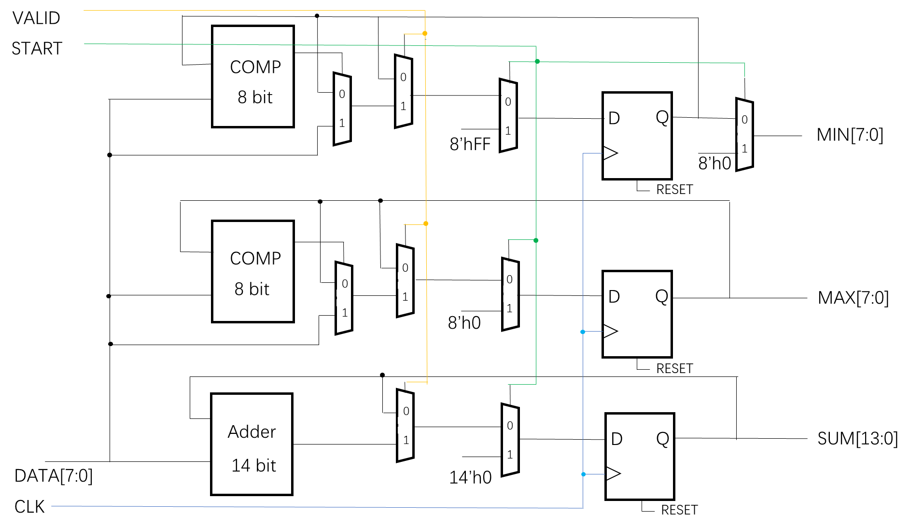
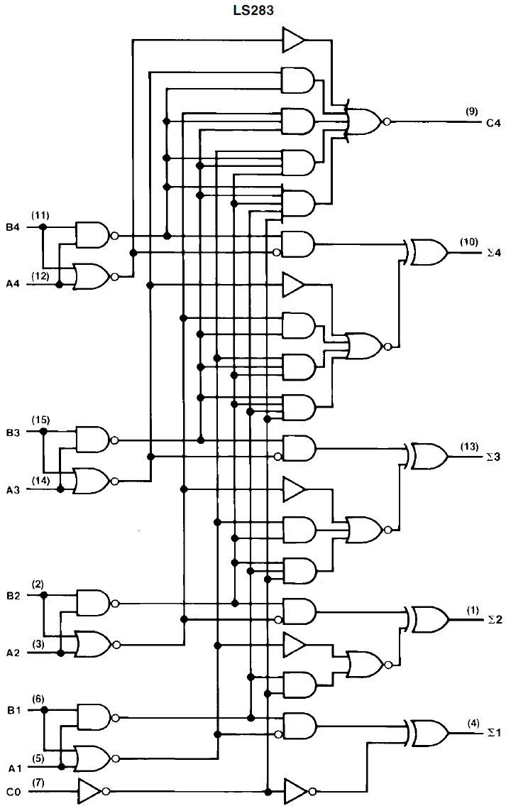
Main circuit frame
FCA4, Fast Carry Adder

Slide 5
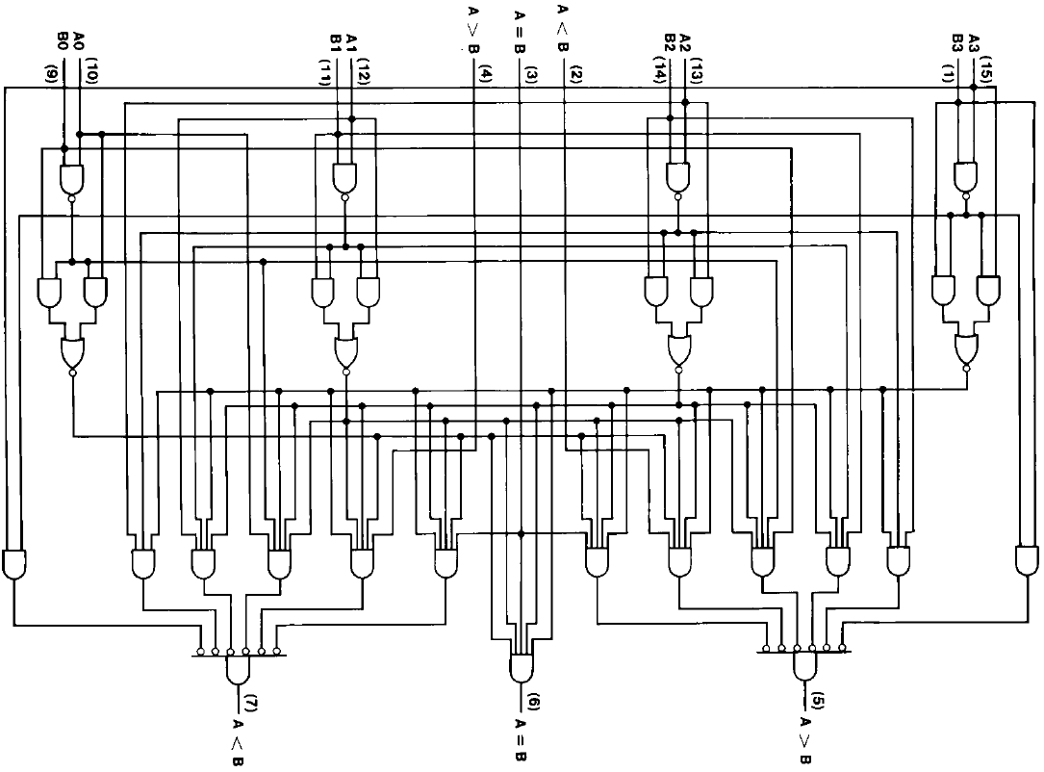
14 bit Adder：FCA4 × 3 + FA1 + HA1
8 bit Comparator: CAP4 × 2
D Pulse Register: D Latch Register × 2
8 bit Multiplexer: MUX2TO1 × 8
14 bit Multiplexer: MUX2TO1 × 14
Other circuitry structures are under the basic of Digital Electronic Technology.
4bit Comparator

