Slide 1
Chapter 4 First-Order Circuits
key points
1. Capatiors and Inductors
2. Equation and initial conditions of dynamic circuits
3. Zero-input response，Zero-state response and complete response

Slide 2

4.1 Dynamic element
4.1.1 Capacitors
1. Definition
A capacitor is a passive element designed to store energy in its electrical field.
Capacitor
A capacitor consists of two conducting plates separated by an insulator (or dielectric).
u
q-u
relationship
q

Slide 3
2. Linear capacitor
The amount of charge stored on the capacitor plate, represented by q, is proportional to the applied voltage u, then q ~ u curve is a line that goes through the origin.
q
α
C
O
u
+q
-q
Circuit symbol
＋
－
u
C is known as the capacitance of the capacitor.
The unit of capacitance is the farad (F).
Unit
Capacitor have values in the picofarad (pF) to microfarad(μF) range.

Slide 4
The current-voltage relationship for a capacitor
C
Differential expression of current-voltage relationship for a capacitor
i
＋
u
－
the associated reference direction
(1) The value of i depends on the change rate of u and has nothing to do with the value of u. A capacitor is a dynamic element;
(2) When the voltage across a capacitor is not changing with time (i.e., dc voltage), the current through the capacitor is zero. A capacitor is an open circuit to dc;
(3) In the actual circuit, the current through a capacitor is finite, and the voltage on the capacitor must be continuous and cannot change abruptly.

Slide 5
Integral expression
Thus:
The capacitor voltage depends on the past history of the capacitor current. Hence, the capacitor has memory property.
Note:
（1）When u and i adopt non-associated reference direction, a negative sign is added before the above formulas;
（2）u(t₀) is called the initial voltage value of capacitor，which reflects the energy storage condition at the initial time of capacitor, also known as the initial state.

Slide 6
3. The power and energy
Associate reference direction
Power
When the capacitor is charged， u>0，d u/d t >0，so i>0, q , p>0, capacitor absorbe power.
When the capacitance is discharged，u>0，d u/d t <0，so i<0, q , p<0, capacitor deliver power.
Thus:
The ideal capacitor does not dissipate energy. It taks power from the circuit when storing energy in its field and returns previously stored energy when delivering power to the circuit.
Therefore, capacitor is a passive component and an energy storage component, which does not consume energy.

Slide 7

The energy stored in the capacitor
if
We note that ,because the capacitor was uncharged at t =-∞.
The change of energy stored by capacitor from t₀ to t ：
Energy storage by capacitors is only dependent on voltage, and the voltage of a capacitor cannot change abruptly.

Slide 8
4.1.2 Inductors
Ψ(t)＝N Φ(t)
Inductance coil
The metal wire is wound on a frame to form a practical inductor. When the current flows through the coil, it will produce magnetic flux.
i (t)
+
u (t)
-
1. Definition
Ψ
Inductors
An inductor is a passive element designed to store energy in its magnetic field.
i
Wb-A
relationship

Slide 9
2. Linear inductor
At any time, the current i flowing through the inductor is proportional to its flux Ψ. The characteristic of Ψ~ i relationship of a linear inductor is a straight line passing through the origin.
Ψ
α
i
L
O
i
Circuit symbol
+
u (t)
-
L is the inductance of the inductor.
The unit of inductance is the henry (H).( or μH, mH)
Unit

Slide 10
Voltage-current relationship of inductor
i
L
Differential expression
+
u (t)
-
associate reference direction
(1) The voltage value of inductor is only dependent on the change rate of i, and has nothing to do with the value of i. inductor is a dynamic element;
(2) The voltage across an inductor is zero when the current is constant. Thus, the inductor acts like a short circuit to dc;
(3)In the actual circuit, the voltage value of inductor is finite. The current flowing through an inductor cannot change abtuptly, and it must be a continuous function of time.

Slide 11
Integral expression
Thus:
The inductor current depends on the past history of the inductor voltage. Hence, the inductor has memory property.
Note:
(1) When u and i use the non-associate direction, the above differential and integral expressions should be preceded by a minus sign;
(2) In the above formula, i(t₀) is called the initial current value of the inductor, which reflects the energy storage state at the initial time, also known as the initial state.

Slide 12
3. The power and energy
associate reference direction
Power
When the current increases, i >0, d i/d t>0, so u>0, p>0, inductor absorbed power.
When the current decreases, i>0, d i/d t<0, so u<0, p<0, inductor deliver power.
Thus:
In a period of time, the inductor can absorb the energy from the external supply and convert it into magnetic energy for storage. In another period of time, it releases the energy back to the circuit. Therefore, the inductor is a passive component and an energy storage component, which does not consume energy.

Slide 13
Energy storage of inductors
if
The energy changes from t₀ to t：
Thus:
(1)The energy of the inductor is only related to the current value at that time, and the inductor current cannot change abruptly, which reflects the energy cannot change abruptly;
(2) The energy stored in the inductor must be greater than or equal to zero.

Slide 14
Comparison of capacitors and inductor
Capacitor
Inductor
voltage u
charge q
current i
flux Ψ
Variable
Equation
Conclusion:
(1) The form of the equation is similar；
(2) If u-i, q- , C-L and i-u, are interchanged, the equation of inductor can be obtained from the equation of capacitor ；
(3) C and L are called dual elements.

Slide 15
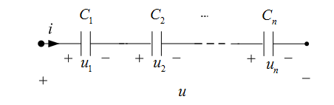
4.1.3 Series and parallel capacitors and inductors
1. Capacitors
Capacitors in series combine
......

Slide 16
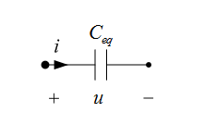

Slide 17
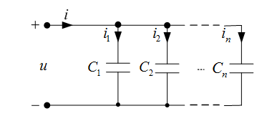
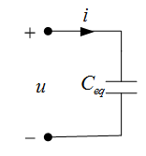
Capacitors in parallel combine

Slide 18
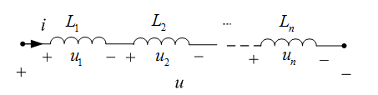
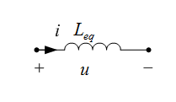
2. Inductors
Inductors in series combine

Slide 19
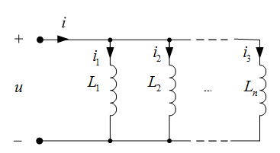
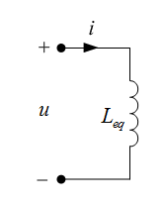
Inductors in parallel combine

Slide 20
4.2 equation and initial conditions of dynamic circuit
1. Dynamic Circuit
The circuit with dynamic element capacitance and inductance is called dynamic circuit.
When the dynamic circuit state changes, it needs to go through a change process to reach a new stable state. This change process is called the transient process of the circuit.
Switching
A change in the structure or state of a circuit
Branch access or disconnection
Change of circuit parameters
Causes of the transient process
There are energy storage elements in the circuit, the energy changes when the circuit changes, and the energy storage and release need a certain time to complete

Slide 21
2. Equations of dynamic circuit
Applying KVL and VCR
i
(t >0)
R
+
u_{s}（t）
u_{C}
C
–
the current as the variable：

Slide 22

Applying KVL and VCR
i
(t >0)
R
+
u_{s}（t）
u_{L}
L
–
inductor voltage is variable：
First-order circuit
active
resistor
circuit
Dynamic
element

Slide 23
i
(t >0)
＋
+
R
u_{S}（t）
u_{L}
L
u_{C}
－
－
＋
–
C
Second-order circuit
current as variable：

Slide 24
Conclusion：
（1）The circuit equations describing dynamic circuits are differential equations;
（2）The order of dynamic circuit equation is equal to
the number of dynamic elements in the circuit.
There is only one dynamic element, and the expression describing the circuit is a first-order linear differential equation.
First-order circuit
Second-order circuit
There are two dynamic elements, and the expression describing the circuit is a second- order linear differential equation.

Slide 25
3. Initial condition
(1) t = 0+ and t = 0-
Suppose that at t = 0, the circuit switches.
f(t)
0- : the time just before t=0
t
0-
0+
0
0+ : the time just after t=0
The initial conditions are the values of u, i and their derivatives when t = 0+.

Slide 26
(2) Initial condition for C
i
+
u_{c}
-
C
0
When t = 0+
i(ξ) is finite,
u_{C} (0+) = u_{C} (0-)
q =C u_{C}
q (0+) = q (0-)
Conclusion
At the moment of circuit changing, if the current of the capacitor was limited, the capacitor voltage (or charge) remains constant before and after the circuit switching.

Slide 27
(3) Initial condition for L
+
i
_{L}
u
L
-
0
When t = 0+
u is finite,
i_{L}(0+)= i_{L}(0-)
ψ_{L} (0+)= ψ_{L} (0-)
Conclusion
At the moment of circuit changing, if the voltage of inductor is finite, the current (or flux linkage) of inductor remains constant before and after the circuit changing.

Slide 28
(4) Switch Law
At the moment of circuit switching, if the current of the capacitor was limited, the capacitor voltage (or charge) remains constant before and after the circuit switching.
q (0₊) = q (0-)
u_{C} (0+) = u_{C} (0-)
ψ_{L} (0+)= ψ_{L} (0-)
At the moment of circuit switching, if the voltage of inductor is finite, the current (or flux linkage) of inductor remains constant before and after the circuit switching.
i_{L}(0+)= i_{L}(0-)
Note:
（1）The conditions of Switch Law are that capacitor
current and inductor voltage are finite value.
（2）Switch law reflects that energy cannot change abruply.

Slide 29
(5) initial values
(1) Find u_{C}(0-) and i_{L}(0-) from the circuit at t= 0-.
Example 1
Find i_{C}(0+)
+
-
+
u_{C}
-
i
+
u_{C}
-
10k
+
-
10k
i_{C}
40k
40k
10V
10V
k
open circuit
u_{C}(0-)=8V
+
8V
₋
(2) According to Switch Law
+
-
i
10k
u_{C} (0+) = u_{C} (0-)=8V
10V
i_{C}
(3) Find i_{C}(0+) from the equivalent circuit when t=0+.
0+
the equivalent circuit
capacitor is replaced by a voltage source
i_{C}(0₋)=0 i_{C}(0₊)

Slide 30
Example 2
When t = 0, close the switch K. Find u_{L}(0+).
Solution:
Find
1Ω
4Ω
1Ω
4Ω
+
u_{L}
-
K
L
i_{L}
short circuit
10V
i_{L}
10V
the equivalent circuit at t=0+
1Ω
4Ω
×
+
u_{L}
-
2A
From Switch Law:
10V
i_{L}(0+)= i_{L}(0-) =2A
Inductor is replaced by current source

Slide 31
Steps to find initial values:
1. Firstly, find u_{C}(0-) and i_{L}(0-) ;
2. Secondly, find u_{C}(0+) and i_{L}(0+) by Switch Law;
3. Draw equivalent circuit at t=0+ .
a. This is a circuit after switching.
b. The capacitor (inductor) is replaced by a voltage source (current source).
4. The value of each variable at t =0+ can be obtained from the equivalent circuit at t=0+.

Slide 32
Example 3
Find i_{C}(0+) , u_{L}(0+)
Solution:
L
i_{L}
i_{C}
the equivalent circuit at t=0₋
I_{S}
+
u_{L}
–
+
R
C
u_{C}
I_{S}
K(t=0)
–
R
the equivalent circuit at t=0+
i_{L}(0+) = i_{L}(0-) = I_{S}
I_{S}
+
–
i_{C}
u_{C}(0+) = u_{C}(0-) = RI_{S}
u_{L}
+
R
R I_{S}
–
u_{L}(0+)= - RI_{S}

Slide 33
Example 4
Calculate the branch current and inductor voltage at the moment when switch K is closed.
Solution:
the equivalent circuit at t=0₋
2Ω
+
u_{L}
-
+
-
K
L
3Ω
2Ω
3Ω
+
-
48V
C
i_{L}
+
i_{L}
48V
2Ω
2Ω
u_{C}
－
the equivalent circuit at t=0₊
+
-
i
+
-
u_{L}
i_{C}
3Ω
12A
+
-
48V
24V
2Ω

Slide 34
Example 5
Find the current flowing through switch K
at the moment when it is closed.
L
C
Solution:
i_{L}
+
－
u_{C}
（1）Find 0-:
100Ω
100Ω
100Ω
+
200V
-
K
u_{C}(0+) = u_{C}(0-) = 100V
u_{L}
100V
（2）Find 0+ circuit:
+
－
+
－
i_{C}
1A
100Ω
100Ω
100Ω
+
200V
-

Slide 35
4.3 Zero-input response of first-order circuit
Zero-input response refers to the response caused by the initial energy storage of energy storage element (dynamic element) without external excitation.
Zero-input response
u_{C} (0-)=U₀
1.Zero-input response of RC circuit
K(t=0)
i
+
+
C
u_{C}
u_{R}
R
u_{R}= Ri
–
–
Characteristic
Equation:
Characteristic
Root:
RCp+1=0

Slide 36
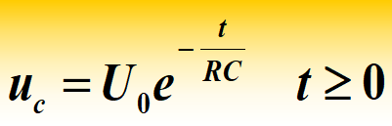
u_{C} (0+)=u_{C}(0-)=U₀
A=U₀
or

Slide 37
Conclusion：
（1） The voltage and current are the functions that decay with time according to the same exponential law;
U₀
u_{C}
i
continuous function
I₀
jump
0
0
t
t
（2） The response is linear with the initial state, and its decay rate is related to RC.
τ =RC. τ is called time constant of First-order circuit.
unit

Slide 38
τ = R C
The time constant τ reflects the transition time of the circuit.
The largerτ is, the longer the transition time is.
The smallerτ is, the shorter the transition time is.
u_{c}
physical meanings
U₀
τ is big
When the initial voltage is constant,
0
τ is small
t
C is larger（R is constant）,
initial energe w=Cu²/2 is larger
τ is large and
discharge time is longer
R is larger ( C is constant）,
discharge current i=u/R is smaller

Slide 39
t
0 τ 2τ 3τ 5τ
U₀ U₀ e ⁻¹ U₀ e ⁻² U₀ e ⁻³ U₀ e ⁻⁵
U₀ 0.368 U₀ 0.135 U₀ 0.05 U₀ 0.007 U₀
τ：The time required for the capacitor voltage to decay to 36.8% of original voltage.
It is considered that the transition process will be completed after 3τ－5τ.
The slope of the curve at time t₁ is :
u_{c}
I₀
0
t₁
t₂
τ＝ t₂－t₁
subtangent
t
τ

Slide 40
（3）Energy
The capacitor releases energy continuously and is absorbed by the resistor until it is completely consumed.
i
+
u_{C}
C
R
－
Assume u_{C}(0+)=U₀
Capacitor releases power：
Resistor absorbed power：

Slide 41
Example
The capacitor in the circuit is originally charged with a voltage of 24V. Find the capacitor voltage and the current of each branch after switch K is closed.
Solution:
i₁
K
This is a zero-input response problem of RC circuit,
+
2Ω
i₂
5F
u_{C}
3Ω
6Ω
－
i₃
equivalent circuit
Substitute
t >0
+
i₁
5F
u_{C}
4Ω
－

Slide 42
2.Zero-input response of the RL circuit
i
R₁
R
+
U_{S}
L
u_{L}
K(t=0)
–
Characteristic Equation: Lp+R=0
t >0
i
R
Characteristic Root:
+
L
u_{L}
–
Substitute initial value: i(0+)= I₀
A= i(0+)= I₀
We have:

Slide 43
Conclusion：
（1） The voltage and current are the functions that decay with time according to the same exponential law;
u_{L}
I₀
i_{L}
continuous function
t
jump
-RI₀
0
t
（2）The response has a linear relationship with the initial
state, and the attenuation speed is related to L/R.

Slide 44
τ = L/R is called time constant of RL circuit.
H
Wb
V·S
S
Ω
A·Ω
A·Ω
τ = L/R
The time constant τ reflects the transition time of the circuit.
The largerτ is, the longer the transition time is.
The smallerτ is, the shorter the transition time is.
Physical meanings
The initial value of current i(0) is constant：
τ is large and discharge time is longer.
L is larger, initial energy w=Li²/2 is larger;
R is smaller, p=Ri² is smaller, so
discharge process consumes little energy.

Slide 45
（3）Energy
i
R
The inductor releases energy continuously and is absorbed by the resistor until it is completely consumed
+
L
u_{L}
–
Assume i_{L}(0⁺)=I₀
Inductor releases energy：
Resistor absorbs energy：

Slide 46

Example 1
When t=0 , switch on K and find u_{v.} The range of voltmeter is 50V.
K(t=0)
Solution:
i_{L}
i_{L} (0+) = i_{L}(0-) = 1 A
+
R=10Ω
R_{V}
10kΩ
u_{V}
V
10V
L=4H
–
i_{L}
u_{V} (0⁺)=－ 10000V causes
damage.
R
V
10V
L

Slide 47
Example 2
When t=0 , the switch K changes from 1 to 2. Find the inductor voltage, current flowing through inductor and u_{12.}
Solution:
K(t=0)
2Ω
+
1
2
i_{L}
3Ω
24V
6Ω
+
–
4Ω
u_{L}
6H
4Ω
－
t >0
i
R
+
L
u_{L}
–

Slide 48
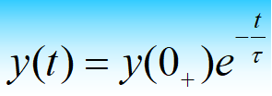
Summary
The zero input response of the first-order circuit is caused by the initial value of the energy storage element, and it is an exponential decay function that the initial value decays to zero.
RC circuit
u_{C} (0+) = u_{C} (0-)
RL circuit
i_{L}(0+)= i_{L}(0-)
2. Decay speed depends on the time constant τ.
RC circuit τ = RC , RL circuit τ = L/R
R is equivalent resistance of a terminal circuit connected to a dynamic element.
3. All responses in the same circuit have the same time constant.
4.Zero-input response of a first-order circuit is proportional to
the initial value.

Slide 49
4.4 Zero-state response of first-order circuit
Zero state response refers to the response of the circuit generated only by external excitation in the zero initial state (the initial energy storage of dynamic components is zero).
Zero-state response
1.Zero-state response of RC circuit
K(t=0)
i
R
+
u_{R}
–
+
U_{S}
u_{C}
C
–
Non-homogeneous linear differential equation.
u_{C} (0-)=0
Solution is：
Special solution
General solution

Slide 50
Special solution
（force component，steady-state component）
Special solution
General solution
（free coomponent，transient component）
General solution
Solution:
The constant A is determined by the initial condition u_{C} (0+)=0.
u_{C} (0+)=A+U_{S}= 0
A= － U_{S}

Slide 51
（1） Voltage and current are functions that change with time according to the same exponential law;
The capacitor voltage consists of two parts:
steady-state component
(forced component)
+
transient component
u_{c}
u_{c}''
U_{S}
i
jump
t
0
u_{C}'
0
t
-U_{S}
Continuous function

Slide 52
（2）The speed of the response is determined by the time
constant τ＝RC.
When τ is large, charging is slow; when τ is small, charging is fast.
（3）The response is linear to the excitation；
R
（4）Energy.
C
+
Energy storage：
U_{S}
-
The energy provided by a source：
The energy consumed by a resistor:
Half of the energy provided by the source is consumed in the resistor, and half of it is converted into electric field, and the energy is stored in the capacitor.

Slide 53
Example:
When t=0, switch K is closed. Given u_{C} (0 -) = 0, calculate (1) capacitor voltage and current; (2) charging time t when u_{C}＝80V .
Solution:
K
i
(1) This is a RC zero-state response problem
+
+
10μF
100V
u_{C}
-
500Ω
－
（2）Assume that u_{C}＝80V after t₁ seconds:

Slide 54
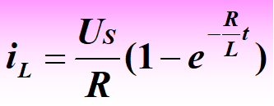
2. Zero-state response of RL circuit
K(t=0)
i_{L}
When i_{L}(0-)=0，the equation is ：
R
+
u_{R}
–
+
U_{S}
u_{L}
L
–
i_{L}
t
0
u_{L}
U_{S}
0
t

Slide 55
Example 1
When t=0, Switch K is opened. Find i_{L} and u_{L} after t>0.
Solution:
R
80Ω
This is a RL zero-state response problem：
10A
+
u_{L}
2H
200Ω
300Ω
K
i_{L}
–
t>0
10A
+
u_{L}
R_{eq}
2H
i_{L}
–

Slide 56
Example 2
When t=0 ,Switch K is opened. Find i_{L,} u_{L} and terminal voltage of current source afte t>0.
Solution:
5Ω
10Ω
This is a RL zero-state response problem：
2A
10Ω
+
+
u
K
2H
u_{L}
i_{L}
–
–
t>0
R_{eq}
+
+
u_{L}
U_{S}
2H
－
i_{L}
–

Slide 57
4.5 Complete-response of first-order Circuit
The response of a first-order circuit with non-zero initial state under external excitation is called complete response.
Complete Response
1. Complete Response
K(t=0)
i
R
Taking RC circuit as an example, the differential equation of the circuit is:
+
u_{R}
–
+
U_{S}
u_{C}
C
–
τ=RC
Solution is u_{C}(t) = u_{C}' + u_{C}"
Assuming initial value is A
Steady-state solution :
u_{C}'' =U_{S}
u_{C} (0－)=U₀
Transient solution：
u_{C} (0⁺)=A+U_{S}=U₀
∴ A=U₀ - U_{S}

Slide 58
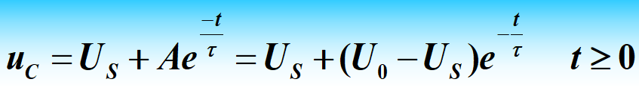


Forced component
(Steady-state solution)
Free component
(Transient solution)
2. Two decomposing ways of total response
（1）Emphasize the two working states of the circuit
u_{c}
Steady-state solution
Total response
Forced component
(Steady-state solution)
Free component
(Transient solution)
U_{S}
u_{C}'
=
U₀
u_{c}
Total solution
+
t
0
u_{C}"
U₀
-U_{S}
Transient solution
Clear physical concept

Slide 59
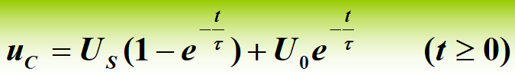
(2) Focus on causality--It is convenient for superposition calculation.
Zero-state response
Zero-input response
Total response=Zero-state response+Zero-input response
K(t=0)
i
K(t=0)
K(t=0)
R
i
i
R
R
+
–
+
+
+
u_{R}
+
–
+
–
u_{R}
=
u_{R}
+
U_{S}
u_{C}
U_{S}
u_{C}
u_{C}
C
C
C
–
–
–
u_{C} (0－)=U₀
u_{C} (0－)=0
u_{C} (0－)=U₀

Slide 60
Zero-input response
Zero-state response
u_{c}
Total response
U_{S}
U₀
Zero-state response
t
0
Zero-input response

Slide 61
Example 1
When t=0,Switch K is opened. Find i_{L} and u_{L} after t>0.
Solution:
8Ω
4Ω
This is an RL circuit complete response problem：
i_{L}
K(t=0)
+
+
u_{L}
0.6H
24V
–
－
Zero-input response：
Zero-state response：
Total response：

Slide 62
8Ω
4Ω
i_{L}
K(t=0)
+
+
u_{L}
0.6H
24V
–
－
find Steady-state component：
Total response：
Substitute initial value,we have:
6＝2＋A
A=4
Total response：

Slide 63
Example 2
When t=0, Switch K is closed. Find i_{C,} u_{C} and terminal voltage of current source after t>0.
Solution:
This is an RC circuit Total response problem：
1Ω
1Ω
1Ω
Steady-state component：
+
1A
+
+
10V
u_{C}
u
–
－
－
Total response：
A=－10

Slide 64

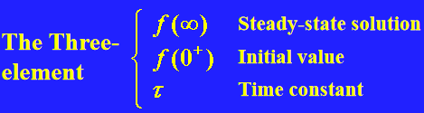
3. Three-element method for first-order circuit
The mathematical model of a first-order circuit
is a first-order differential equation：
The general form of the solution is:
Excitation is DC：
t = 0+
Applying t→∞ Steady-state circuit
Applying 0+ equalation circuit
τ_{C}=RC, τ_{L}=L/C
The analysis of the first-order circuit problem is transformed into the problem of solving the three elements of the circuit.

Slide 65
Example 1
When t=0, switch is closed. Find u_{C}(t) after switching circuit.
1A
2Ω
+
-
1Ω
3F
u_{C}
u_{c}
(V)
2
Solution:
0.667
0
t

Slide 66
Example 2
When t=0 , switch is closed. Find i_{L,} i₁ and i₂ after t>0.
Solution:
The three-element is：
i₁
5Ω
5Ω
i₂
i_{L}
+
+
0.5H
20V
10V
–
–

Slide 67
The three elements are：
5Ω
5Ω
i₁
i₂
+
+
20V
10V
–
2A
–
0＋ equivalent circuit

Slide 68
Example 3
When t=0, switch from 1→2. Find u_{C}(t) after switching circuit.
Solution:
i₁
4Ω
2
+
1
u_{C}
2A
4Ω
1Ω
The three elements are：
－
－
2i₁
8V
0.1F
+
－
+
i₁
4Ω
+
4Ω
u
2i₁
－
+
－

Slide 69
Example 4
When t=0 switch is closed. Find i(t) after switching circuit.
Solution:
The Three-element is：
1H
5Ω
i
+
2Ω
10V
S
–
0.25F

Slide 70
4.6 Step Response of First-Order Circuit
Unit Step Response
The zero-state response of the circuit to the unit step function is called the unit step response.
1. Singularity function
1. Unit Step
function
2. Delay unit step function
Step function starting at time τ:ε(t-τ)
3. Delay step function：Aε(t-τ)。

Slide 71
2. Function of step function
u_{C}(0₋)=0
1. Represent the state of the switch
2. Unit step function is used to "start" any function f(t).
f（t）ε(t)：start a function by ε(t).
3. Represent a staircase wave.

Slide 72
Example：In the circuit shown in Figure (a), the circuit has reached a stable state when the switch S is closed at 1. When t = 0, the switch turns from 1 to 2, and when t = τ =RC, it turns from 2 to 1. Find the u_{C}(t) when t≥0.
Solution 1：
When 0≤t< τ,circuit is shown in Figure(b).
Figure(a)
When t > τ,circuit is shown in Figure(c)
Figure(b)
Figure(c)

Slide 73
Solution 2:
The excitation is divided into the superposition
of two step sources.
The voltage of capacitor can be regarded as two zero-state
equations, but the starting time is different，so we have:

Slide 74
4.7 Impulse response of first-order circuit
Unit Impulse Response
The zero-state response of the circuit to the unit impulse function is called the unit impulse response.
1. Impulse function
1. Unit Impulse function
2. Delay Impulse function
Unit Impulse function δ(t)
Impulse intensity is 1
Delay Impulse function δ(t-τ₁)
Delay Impulse functionkδ(t-τ₂)
Impulse intensity is k

Slide 75
2. The nature of the impulse function
1.Integration of unit impulse functon δ(t)to time is equal to unit step function ε(t):
Conversely, the first derivative of the step function ε(t)to time is equal to the impulse function δ(t):
2.For any function f(t) that is continuous at t = 0,
there will be:
Thus:

Slide 76
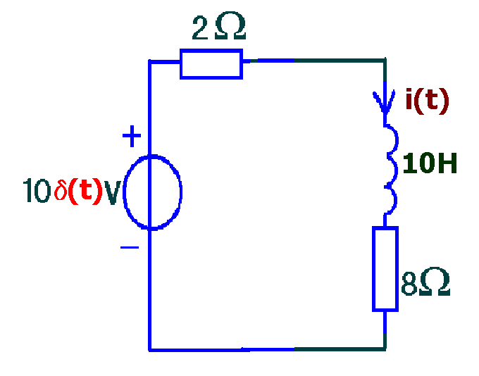
step response
impulse response
Example 1: Circuit is shown in
figure，Find i (t).
Solution：When excitation is ε(t).
When excitation is 10δ(t).

Slide 77
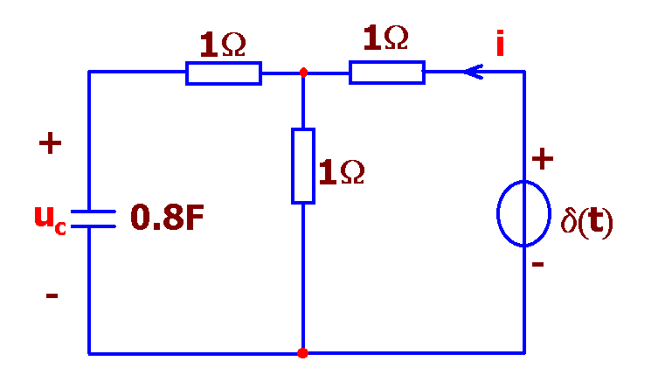
Example 2：Find Impulse response i.
Solution：
1、Find Step response S(t)
2、Find Impulse response h(t)

Slide 78
Homework： 4-21，22，26，30，31， 34，35，39，43，44

