Slide 1
Chapter 5
Sinusoidal Steady-State Analysis
key points：
1.Phasor
2.The phasor form of circuit law
3.Impedance, admittance
4.Application of phasor method
5.Power analysis
6.Resonant and mutual inductance

Slide 2
5.1 Basic conception of sinusoidal circuit
1. Sinusoid
i
T
A sinusoidal current is expressed as：
waveform：
O
t
i(t)=I_{m}cos(ωt+ψ)
ψ/ω
T (period) and f (frequency) :
T ：A periodic signal repeats a certain
pattern in a time interval of T.
unit：s, second
unit：Hertz(Hz)
f ：the number of periods appear
with in an interval of one second.

Slide 3
Sinusoidal Current Circuit
Circuits driven by sinusoidal current or voltage sources are called Sinusoidal Current Circuit or ac circuit.

Slide 4

2. Three elements of sinusoid
i(t)=I_{m}cos(ω t+ψ)
(1) (amplitude) I_{m}
maximum value
(2) (angular frequency)ω
The speed of phase change reflects the speed of sine change。
Unit： rad/s
i
(3) (initial phase angle) ψ
T
The starting point of timing reflecting sinusoidal quantity is usually expressed by angle。
Im
O
2π
t
ωt
ψ/ω
ψ

Slide 5
i
|ψ |≤π
0
t
ψ =0
ψ =π
ψ =－π/2

Slide 6
Example:
Sinusoidal current waveform is shown in figure,ω＝10³rad/s，
（1）Writing expression of i(t)；
（2）Find the time t₁ when the maximum
occurs.
i
100
50
t
Solution:
0
t₁

Slide 7
3. phase difference
u(t)=U_{m}cos(ω t+ψ _{u}), i(t)=I_{m}cos(ω t+ψ _{i})
phase difference is ：ϕ = (ω t+ψ _{u})- (ω t+ψ _{i})= ψ _{u}-ψ _{i}
is equal to difference of initial phase
|ϕ | ≤π (180°)
• ϕ >0， u leads to i by ϕ , or i lags u by ϕ.
(u reachs minima earlier)；
u, i
u
i
O
ω t
ϕ
• ϕ <0， i leads to u by ϕ ，or u lags i by ϕ ,
i reachs minima earlier.

Slide 8
Special phase relation：
ϕ =±π (±180º ) ，out of phase：
u, i
ϕ ＝ 0， in phase：
u
u, i
u
ω t
0
i
i
0
ω t
u, i
u
i
0
ω t
φ= π/2：
u leads to i by π/2, not u lags i by 3π/2；
i lags u by π/2, not i leads to u by 3π/2.

Slide 9
Example:
Find phase difference of two sinusoid.
When two sinusoids are compared in phase, they should satisfy the same frequency, same function and same sign, and they should be compared in the main value range.

Slide 10
4. Effective value of Periodic current and voltage
Effective value of Periodic current and voltage
DC I
AC i
R
R
Physical Meaning
Current effective value is defined
Effective values are also called root-meen-square.

Slide 11
Also, voltage effective value can be defined：
Effective value of sinusoidal ccurrent and voltage
i(t)=I_{m}cos(ω t+Ψ )

Slide 12
Similarly, the voltage relationship is：
When U=220V，U_{m}≈311V；U=380V，U_{m}≈537V。
（1）effective value—— rated value of equipment nameplate, voltage grade of power grid，Voltage and current indicated by AC measuring instrument；
maximum value——the insulation level and voltage withstand value
Notes：
（2）Symbols of instantaneous value, maximum value and effective value of voltage and current。

Slide 13
5.2 Phasors
1. Example
i
L
+
R
The circuit equation is a differential equation:
u
C
_
+

Slide 14

u, i
i₁
i₂
i₁+i₂ →i₃
i₁
i₃
i₂
$ω$：
I：
$φ$：
ω
ω
ω
0
ω t
I₁
I₂
I₃
Ψ ₁
Ψ ₂
Ψ ₃
The sum of sinusoidal quantities with the same frequency can still get the sinusoidal quantity with the same frequency.the initial phase and the effective value (or the maximum value)
Sinusoidal quantity
complex

Slide 15
2. Complex number and operation
Expression of complex number A
A=a+jb
is imaginary unit)
Im
Im
A
A
b
b
|A|
θ
0
a
Re
0
a
Re

Slide 16
The relationship of two expression：
Im
A
b
|A|
Rectangular form
Polar form
θ
0
a
Re
or
Graphical approach
Operaton of complex number
Im
(1)Addition and Subtraction——
(performed in rectangular form)
A₂
If A₁=a₁+jb₁， A₂=a₂+jb₂
A₁
0
Re
So A₁±A₂=(a₁±a₂)+j(b₁±b₂)

Slide 17
(2) Multiplication and Division——(performed in polar form)
If A₁=|A₁| θ ₁ ，A₂=|A₂| θ ₂
So:

Slide 18
Example:
Solution:
Im
A• e^{jθ}
(3) twiddle factor :
θ
Complex number：
e^{jθ} =cosθ +jsinθ =1∠θ
A
0
Re
A• e^{jθ} A rotates one Angle θ counterclockwise，magnitude is constant.

Slide 19
Im
0
Re
So +j, –j, -1 can be called twiddle factor.

Slide 20
3. The phasor representation of a sine
A complex function:
Take the real part of A(t):
A(t) can also be written as
complex constant
A(t)：I、 Ψ 、ω ，Complex constant: Ι , Ψ

Slide 21
is corresponding phasor of i(t) .
Magnitudeof phasor: the effective value of the sine.
The magnitude Angle of phasor: the initial phase of a sine.
The corresponding relationship
between sinusoidal voltage and phasor can also be established:
Example 1
已知
Solution：
Express i, u by phasor.

Slide 22
Example 2
Writing instantaneous representation of current.
Solution:
Phasor diagram
Such a graphical representation of phasors
is known as a phasor diagram.
θ
Ψ

Slide 23

4. Application of phasor method
(1) The addition or subtraction of sinusoids at the same frequency
phasor relation can be obtained：
i₁ ± i₂ = i₃

Slide 24
Example:
Using phasor diagram:
Im
Im
Re
Re

Slide 25
(2)Differential and integral of sinusoids
differential:
integral:

Slide 26
Example:
i(t)
R
+
u(t)
L
-
C
Calculate with phasor:

Slide 27
Note:
① sinusoids
phasor
time domain
frequency domain
sinusoids waveform
phasor diagram
② Only applicable to linear circuits whose excitation is
sinusoid at same frequency。
ω₁
N
linear
N
linear
ω
nolinear
ω₂
Not Applicable
③ Analying sinusoidal steady-state circuit。

Slide 28
5.3 Phasor formof circuital law
1.Phasor form of resistor elements VCR
i(t)
Time domain form：
When
+
u_{R}(t)
R
so
-
UR
Ψu
Phasor form：
+
R
Phase relation：
effective value relation
-
U_{R}=RI
Ψ_{u}=Ψ_{i}
phase relation
phasor model

Slide 29

Waveform diagram and phasor diagram：
same phase
p_{R}
URI
u_{R}
i
Ψ_{u}=Ψ_{i}
O
ω t
Instantaneous
power：
Instantaneous power with 2ω alternating. Indicates that the resistor always absorbs power

Slide 30
2. Phasor form of inductor elements VCR
Time domain form：
When
i(t)
so
+
u_{L}(t)
L
-
Phasor form：
+
jω L
Phase relation：
-
effective value relation： U=ω L I
Phase model
phase relation：Ψ_{u}=Ψ_{i} +90°

Slide 31
Waveform diagram and phasor diagram：
Voltage leads to current by 90⁰
p_{L}
u_{L}
i
Ψ_{i}
O
2π
ω t
Power：

Slide 32
3. Phasor form of phasor form VCR
Time domain：
when
i_{C}(t)
so
+
u(t)
C
-
Phasor form：
+
-
Phase form：
effective value relation： I_{C}=ω CU
Phasor model
phase relation：Ψ_{i}=Ψ_{u}+90°

Slide 33
Waveform diagram and phasor diagram：
Current leads to voltage by 90⁰
i_{C}
p_{C}
u
2π
ω t
Ψ_{u}
O
Power：

Slide 34

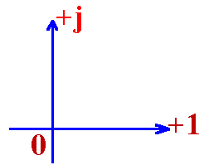
VCR
Element | Time domain | Frequency domain | Effective value relation | Phase relation | Phasor diagram
R
C
L
CCCS

Slide 35
4. Phasor form of Kirchhoff’s Laws
The addition and subtraction of sinusoids at the same frequency can be calculated using the corresponding phasor form.Therefore, in sinusoidal current circuit, KCL and KVL can be expressed in the form of corresponding phasors:
All sinusoidal currents flowing into a node still satisfy KCL when expressed in phasor;The sinusoidal voltages of all branches in any circuit can still satisfy KVL when expressed in phasor.

Slide 36
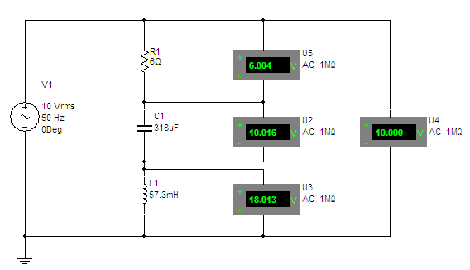
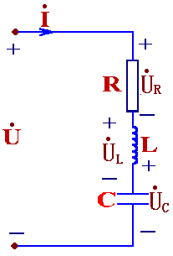
Example:
When U_{R}=6V,U_{L}=18V, U_{C}=10V. Find U=？
Solution:
Assume
（reference phasor）

Slide 37
5.4 Impedance 、 Admittance and Phasor model
1. Impedance
In conditions of sinusoidal steady-state:
+
source-free
linear
+
Z
-
-
Ohm's law
in phasors
Impedance:
Magnitude
Unit：Ω
Impedance angle

Slide 38
When there is a single element in the source-free network:
+
+
R
C
-
-
+
L
-
Z could be real and imaginary.

Slide 39
Inductive impedance:
X_{L}=ω L=2πfL，is called inductive reactance，
unit is Ω (Ohm)
Physical significance of inductive reactance：
(1) The ability to limit current；
(2) The inductive impedance is proportional to the frequency；
X_{L}
dc
short-circuit
open-circuit
ω
Phasor expression:
Inductive admittance

Slide 40
Capacitor impedance：
X_{C}=1/ω C， is called capacitor impedance，
Unit is Ω(Ohm)
The frequency is inversely proportional to the capacitor impedance,
ω →0， |X_{C}|→∞ dc open-circuit
ω →∞ ，|X_{C}|→0 high frequency short-circuit
|X_{C}|
ω
Phasor expression:
capacitor admittance

Slide 41
2. RLC series circuit
i
R
jω L
R
L
+
+
-
+
-
+
+
u_{R}
-
+
u_{L}
-
+
+
u
C
u_{C}
-
-
-
-
Accorrding to KVL：

Slide 42
Z— complex impedance；
R—resistance(real part)；X—(imaginary part)；
|Z|— magnitude of complex impedance；
ϕ_{z} —impedance angle
convertion relation：
or
R=|Z|cosϕ_{z}
X=|Z|sinϕ_{z}
impedance triangle:
|Z|
X
ϕ_{z}
R

Slide 43
According to R、L、C series circuit,we have：
（1）Z=R+j(ωL-1/ωC)=|Z|∠ϕ_{z} is complex,
so is called complex impedance.
（2）ωL > 1/ωC ，X>0， ϕ _{z}>0，circuit is inductive，
voltage leads current；
Phasor diagram：the current as the reference vector，
Triangle U_{R} 、U_{X} 、U
is called voltage triangle:
U_{X}
ϕ_{z}
R
jω L’
+
+
-
+
-
equivalent circui
-

Slide 44
ωL<1/ωC， X<0， ϕ_{z} <0，circuit is capacitive，
voltage lags coltage；
ϕ_{z}
U_{X}
R
+
-
+
+
equivalent circuit
-
-
ωL=1/ωC ，X=0， ϕ _{z}=0，circuit is resistive，
voltage is same das current.
+
+
equivalent circuit
R
-
-

Slide 45
Example:
R=15Ω, L=0.3mH, C=0.2μF,
i
R
L
+
+
u_{R}
-
+
u_{L}
-
+
u
C
u_{C}
Find i, u_{R} , u_{L} , u_{C} .
-
-
jω L
R
Solution:
Phasor model is：
+
-
+
+
-
+
-
-

Slide 46
Thus:
-3.4°
ϕ
Note:
U_{L}=8.42>U=5，The partial voltage is greater than the total voltage.
phasor diagram

Slide 47
3. Admittance
In conditions of sinusoidal steady-state:
+
source-free
linear
+
Y
-
-
Admittance:
magnitude
Unit：S
admittance angle

Slide 48
For the same two-terminal network:
When there is a single element in the source-free network:
+
+
R
C
-
-
+
L
-
Y could be real and imaginary.

Slide 49
4. RLC parallel circuit
i
+
i_{L}
i_{L}
i_{C}
+
u
R
L
C
R
jω L
-
-
According to KCL：

Slide 50
Y— complex admittance；G—conductance(real part)；
B—susceptance(imaginary)；
|Y|—magnitude of complex admittance；ϕ _{y}—admittance angle
convertion relation：
G=|Y|cosϕ _{y}
B=|Y|sinϕ _{y}
or
Admittance triangle:
|Y|
B
ϕ _{y}
G

Slide 51
According to R、L、C parallel circuit,we have ：
（1）Y=G+j(ωC-1/ωL)=|Y|∠ϕ_{y} ；
（2）ωC > 1/ωL ，B>0， ϕ_{y}>0
Phasor diagram：the voltage as the reference vectorr，
Triangle I_{R} 、I_{B}、I is called current triangle.
ϕ_{y}
I_{B}
In RLC parallel circuit, the partial current is greater than the total current.

Slide 52
equivalent circuit
+
R
-
ωC<1/ωL ，B<0， ϕ_{y}<0，circuit is inductive，
current lags voltage；
ϕ_{y}

Slide 53
+
equivalent circuit
R
jω L’
-
ωC=1/ωL ，B=0， ϕ _{y} =0，circuit is resistive，
current is same as voltage.
+
equivalent circuit
R
-

Slide 54
5. Equivalent conversion of complex impedance
and complex admittance
R
Z
jX
Y
G
jB
Note
In gernal G≠1/R B≠1/X。If Z is inductive，X>0，so B<0，still is inductive

Slide 55
If it converse from Y to Z，we have：
R
Y
G
jB
Z
jX

Slide 56
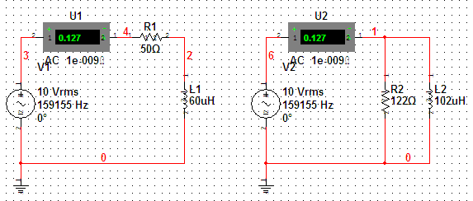
Exampel:
Find equivalent parallel circuit when ω＝10⁶rad/s.
50Ω
Solution
The series circuit RL impedance is：
0.06mH
R’
L’

Slide 57
5.5 Phasor analysis of sinusoidal
steady-state circuits
Comparison of resistor circuit and sinusoidal current circuit：
sinusoidal circuit:
Resistor circuit:
Element constraint condition or
Element constraint condition
or

Slide 58
Conclusion:
1. The phasor method is introduced to transform the problem of solving the differential equation of sinusoidal steady-state circuit into the problem of solving the complex algebraic equation。
2. By introducing the phasor model of the circuit, it is not necessary to write the time domain differential equation, but directly write the algebraic equation in the form of phasor.
3.After introducing impedance, all network theorems and methods can be applied to AC, and DC (f = 0) is a special case.

Slide 59
Example:1:
Find:Each branch current.
i₂
R₁
R₁
i₁
i₃
C
+
R₂
+
R₂
u
Z₁
Z₂
_
L
_
Solution:
Draw the phasor model of the circuit:

Slide 60
R₁
+
R₂
Z₁
Z₂
_

Slide 61
Example 2
Write the loop current equation and
node voltage equation of the circuit。
_
_
+
+
R₂
R₂
L
R₁
C
R₁
R₃
R₃
R₄
R₄
Solution:
Loop method:

Slide 62
_
+
R₂
R₁
R₃
R₄
Node method:

Slide 63
Example 3.
Z₂
Find:
Z₁
Z₃
Z
Solution:
Method 1：
source transformation
Z₂
Z₁//Z₃
+
Z
-

Slide 64
Method 2：Thevenin equivalent transformation
Z₂
Find open-circuit voltage：
Z₁
Z₃
Find equivalent impedance：
Z_{eq}
+
Z
-

Slide 65
Example 4
Find Thevenin equivalent circuit.
_
＋
50Ω
+
+
50Ω
100Ω
j300Ω
j300Ω
+
+
_
_
_
_
Solution:
Find short-circuit：
example 5-13

Slide 66

Example 5
Find
applying superposition theorem.
Z₁
Z₂
+
Z₃
-
Solution:
works alone( open-circuit)
works alone( short-circuit)

Slide 67
Example 6
The balanced bridgeZ₁=R₁ , Z₂=R₂ , Z₃=R₃+jωL₃。
Find：Z_{x}=R_{x}+jωL_{x}。
Solution:
Balanced condition：Z₁ Z₃= Z₂ Z_{x ,} We have:
Z₁
Z₂
|Z₁|∠ϕ₁ •|Z₃|∠ϕ₃ = |Z₂|∠ϕ₂ •|Z_{x}|∠ϕ_{x}
|Z₁| |Z₃| = |Z₂| |Z_{x}|
Z_{x}
Z₃
ϕ₁ +ϕ₃ = ϕ₂ +ϕ_{x}
∼
R₁(R₃+jωL₃)=R₂(R_{x}+j ωL_{x})
∴ R_{x}=R₁R₃ /R₂ , L_{x}=L₃ R₁/R₂

Slide 68
Example 7
Z=10+j50Ω , Z₁=400+j1000Ω。
Z
The phase difference is 90°of and ,calculate β
+
_
Z₁
Solution:
So current leads to voltage by 90°.

Slide 69
R₁
Example 8
U=115V , U₁=55.4V ,
U₂=80V , R₁=32Ω , f=50Hz
Find： R₂ and L_{2 .}
_
+
+
+
R₂
Method 1:
phasor diagram.
_
L₂
_
θ
θ₂
example 5-14

Slide 70
Method 2:
R₁
_
+
+
+
R₂
_
L₂
_
The rest of the steps are the same as Method 1.

Slide 71
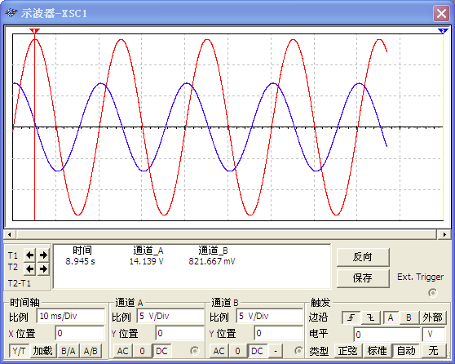
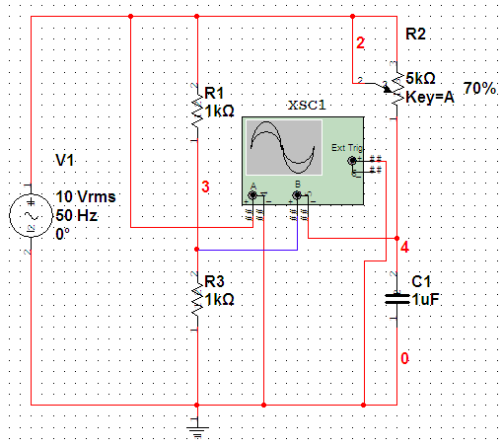
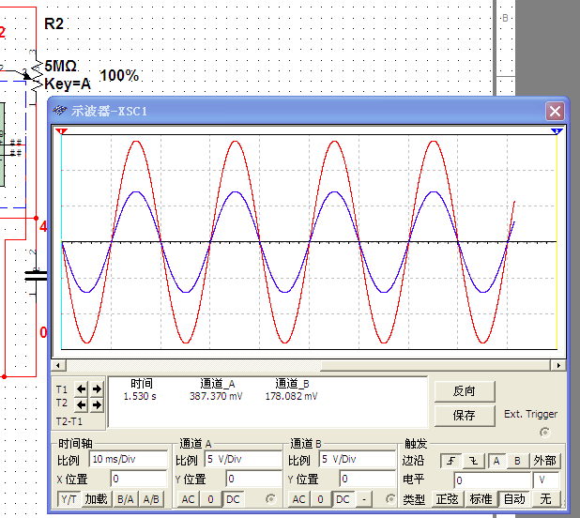
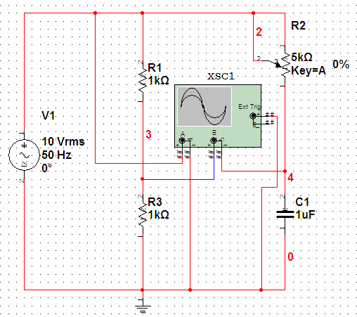
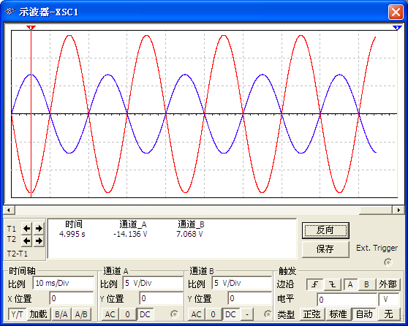


Example 9
When R₂ from 0→∞，
how to change?
+
b
+
R₁
R₂
b
-
a
b
_
+
º
º
+
R₁
-
-
Solution:
a
Applying phasor diagram
When R₂=0，θ =180°；
When R₂ →∞，θ =0°。
From phasor diagram,when R₂ changes, does not change,the phase changes.
is Phase-shifting Angle
The range is

Slide 72
Example 10
Find: I_{1、}X_{C、}X_{L、}R_{2.}
R₁
+
_
jX_{C}
+
jX_{L}
R₂
_
Solution:
Applying phasoe diagram:

Slide 73

5.6 Power of the sinusoidal steady-state circuit
The power absorbed by a source-free one terminal network
i
+
source-free
u
_
φ is phase difference of u and i
1. instantaneous power
Decomposition method 1；
Decomposition method 2

Slide 74
Decomposition method 1：
p
UIcosϕ is
Constant component
u
i
0
ω t
UIcos (2ω t －ϕ) is Sinusoidal component
• p Sometimes it's positive, sometimes it's negative ；
• p>0, Circuit absorbs power；
• p<0，Circuit releases power；

Slide 75
Decomposition method 2：
UIcosϕ (1-cos2ω t)
is irreversible compent
ω t
0
UIsinϕ sin2ω t
is reversible compent

Slide 76
2.P(average power)
Unit：W（Watt）
ϕ =ψ_{u}-ψ_{i}：power factor angle。For source-free network，ϕ is impedance angle of equivalent impedance.
cos ϕ ：power factor

Slide 77
cosϕ
1, pure resistor
0， pure reactor
Generally , 0≤⏐cosϕ⏐≤1
X>0, ϕ >0 , Inductive
X<0, ϕ <0 , Capacitive
Example:
cosϕ =0.5 (Inductive)， so ϕ =60º (voltage leads to current by 60º)
Average power is actually the power consumed by the resistor, also called as active power.Represents the actual power consumed by the circuit, it is not only related to the equivalent value of voltage and current , and associated with cosϕ .

Slide 78
3. Q (reactive power)
Unit：var
Q>0，Network absorbs reactive power；
Q<0，Network releases reactive power.
Q reflects the changing power between the network and the external circuit.It is determined by the properties of energy storage element L and C
4. S(apparent power)
Unit:

Slide 79
Average power、Reactive power and Apparent power：
Average power: P=UIcosϕ Unit：W
Reactive power: Q=UIsinϕ Unit：var
Apparent power: S=UI Unit：VA
S
Q
ϕ
power triangle
P

Slide 80
Power calculation for arbitrary impedance：
i
P_{Z} =UIcosϕ =I²|Z|cosϕ =I²R
+
Q_{Z} =UIsinϕ =I²|Z|sinϕ =I²X
＝I²(X_{L}＋X_{C})=Q_{L}＋Q_{C}
u
Z
-
absorbs reactive power
supplies reactive power
S
similar triangle
Z
Q
X
j
j
P
R

Slide 81
Reactive compensation of inductor and capacitor
i
R
p_{L}
L
+
+
u_{L}
-
i
+
u
C
u_{C}
0
u_{L}
ω t
-
-
When L releases power, C absorbs power, then the power exchanged with the external circuit is p_{L}+p_{C}.
p_{C}
i
u_{C}
0
ω t

Slide 82
Physical meaning of reactive power:
Reflects the rate of energy exchange between the source and the load.
Example:

Slide 83
5. Increase of power factor
Problems caused by low power factor:
(1) The equipment is not fully utilized, the current is up to the rating,
but the power capacity is still there;
P=UIcosϕ=Scosϕ
S
75kVA
Load
cosϕ =1, P=S=75kW
cosϕ =0.7, P=0.7S=52.5kW
asynchronous motor no-load cosϕ =0.2~0.3
full load cosϕ =0.7~0.85
fluorescent lamp cosϕ =0.45~0.6

Slide 84
(2) When the same active power is output, the current in the circuit is high.
I=P/(Ucosϕ)
High loss of circuit.
+
i
ϕ₁
ϕ₂
u
Z
-
Solution:（1）High voltage transmission;
（2）Improve equipment;
（3）Parallel capacitance, improve power factor.

Slide 85
Analysis:
+
ϕ₁
ϕ₂
R
C
L
_
Conclusion：
After parallel capacitance, the voltage and current of the original load is unchanged, and the absorbed active power and reactive power do not change. that is, the working state of the load does not change.But the power factor of the circuit is increased.

Slide 86

Calculate parallel capacitance：
ϕ₁
ϕ₂
Substitude
Different compensation capacity
lack
complete——not use.
over——power factor changes from high to low.

Slide 87
Power triangle can be used to calculate parallel capacitance：
Q_{C}
Q_{L}
Q
ϕ₁
ϕ₂
P
After the parallel capacitor, the source to the load of active( UI_{L} cosϕ₁=UI cosϕ₂) is constant , but the reactive power to the load transfer(UIsinϕ₂<UI_{L}sinϕ₁ )reduced, to reduce this part of the reactive power is "produced" by capacitor to compensate, make the inductive load to absorb reactive power is constant, and the power factor is improved.

Slide 88
Example
f=50Hz, U=220V, P=10kW, cosϕ₁=0.6，When the power factor is 0.9, find the capacitor C in parallel . What is the total current of the circuit before and after the parallel?
Solution：
+
R
C
_
L
Before capacitor inparallel：
After capacitor inparallel：

Slide 89
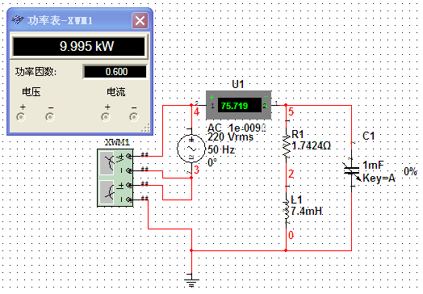
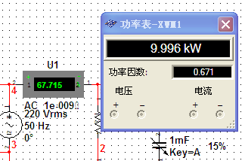
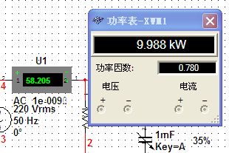
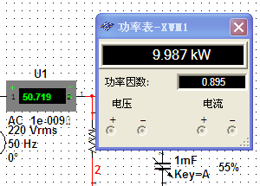
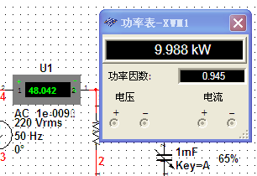
To increase the power factor from 0.9 to 0.95, how much more parallel capacitance should be added, and what is the total current in the circuit?
Solution:
Obviously, the total current decreases with the increase of the power factor, but the capacitance required for the further increase of the power factor is large, while the decrease of the total current is not obvious.Therefore, the power factor is generally raised to 0.9.

Slide 90
Example
The transformer capacity of an industrial user is S9-200kVA，P=50000kwh，Q=59000kvarh，the electric price is ¥ 0.6 /kwh. Find:(1)power factor(cosφ) and interest rate adjustment electricity charge?(2)After capacitance compensation, cosφ=0.95, what is the interest rate adjustment electricity charge?
Solution:
(1) cosφ=0.65, Adjust the electricity bill against the interest rate, the adjustment percentage is +15%. So the interest rate adjustment electricity charge=50000×0.6×15%=4500.
(2) cosφ=0.95, Adjust the electricity bill against the interest rate, the adjustment percentage is -0.75%. So the interest rate adjustment electricity charge=50000×0.6×(-0.75%)=-225.

Slide 91
6.Complex power
+
load
Definition：
Unit:
_
The complex power can also be expressed as：

Slide 92
Conclusion:
（1） is complex, not the phasor,it doesn't correspond to any sine；
（2） :The real part is average power, the imaginary part is
reactive power, and the magnitude is apparent power.
（3）The complex power satisfies the conservation law:
in steady-state sinusoidal, the sum of the complex powers
absorbed by all branches of any circuit is zero
Complex power conservation does not equate to apparent power conservation

Slide 93

Example:
+
10∠0º A
10Ω
Find the complex power of each branch.
5Ω
_
j25Ω
Solution:
-j15Ω
¯
S_{release}
S_{1 absorb}
¯
S_{2 absorb}
¯

Slide 94
7.Maximum power transmission
active network
load
equivalent circuit
Z_{i}
+
Z_{L}
-
Z_{i}= R_{i} + jX_{i}， Z_{L}= R_{L} + jX_{L}
Active power:

Slide 95
The condition of maximum power P_{max} obtained by load
(1) Z_{L}= R_{L} + jX_{L} can be changed at will.
(a) If R_{L}is constant，X_{L} is changed.
Obviously，When X_{i} + X_{L}=0，also X_{L} =-X_{i}，P is maximum
(b) Then if R_{L} is changed，P_{max} is:
When R_{L}= R_{i} ，P is maximum.
Combined with (a)、(b)，
the condition of maximum power P_{max} obtained by load
R_{L}= R_{i}
best matching
Z_{L}= Z_{i}*
X_{L} =-X_{i}

Slide 96

(2) If in Z_{L}= R_{L} + jX_{L}, Only X_{L} changes are allowed.
The conditions for obtaining maximum power are :
X_{i} + X_{L}=0，also X_{L} =-X_{i}
Maximum power:
(3) If Z_{L}= R_{L} is pure resistor.
Current in the circuit is：
Power of load is：
Magnitude matching
The conditions for obtaining maximum power:
Example 5-19

Slide 97
Example:
Find Z_{L} and the maximum power when Z_{L} obtains the maximum power？
－j30Ω
Z_{i}
-j30Ω
30Ω
Z_{L}
+
Z_{L}
4∠90º A
-
Solution:
When

Slide 98
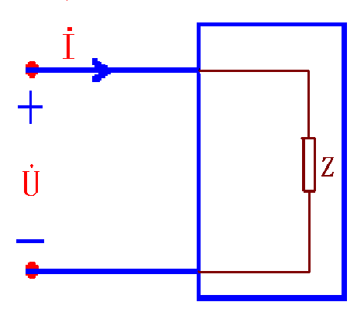
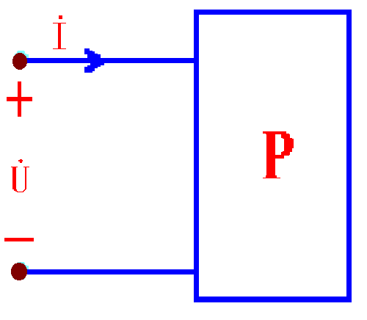
5.7 Resonant Circuit
Resonance is a condition in an RCL circuit in whitch the capacitive and inductive reactances are equal in magnitude,thereby resulting in a purely resistive impedance.
Classification:
Resonant conditions:
1、series resonance
2、parallel resonance
3、Series parallel resonance
4、 coupling resonance
}
X = X_{L} - X_{C}
=0
}
or:
B= B_{C} - B_{L}
=0
Z=R+jX or Y=G+jB

Slide 99
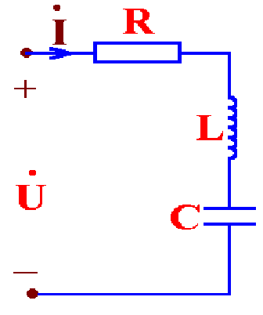
1. Series Resonance
1、Resonant conditions and resonant frequency:
Resonant conditions：
Resonant frequency：
L₁
L
C
or
AM radio
Resonance generation method：
1）Given signal source, change circuit parameters;
2）Circuit given, change signal source frequency.

Slide 100
Resonance parameters
1、Resonant impedance：the input impedance Z₀ of the resonant circuit Series resonance circuit: Z₀=R
2、Characteristic impedance：inductive reactance or capacitive reactance at resonant ρ.
Series resonance circuit:
3、Quality factor:

Slide 101
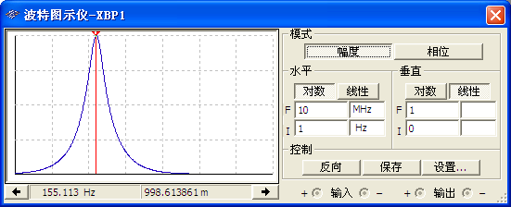
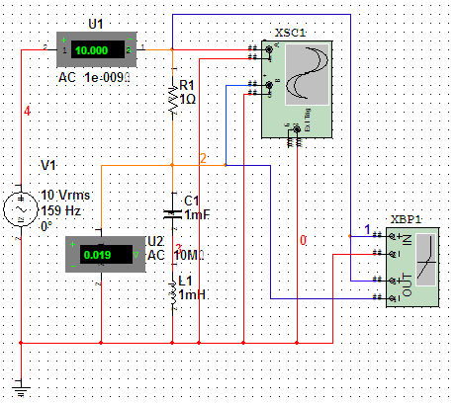
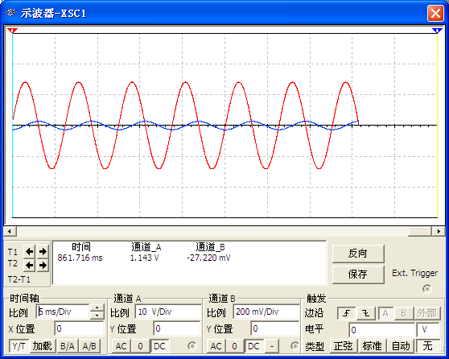
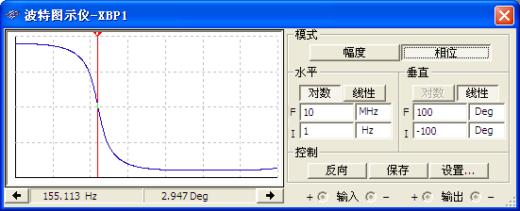
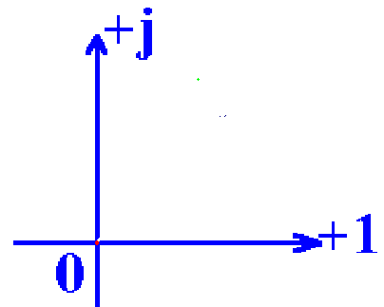
3、Series resonance characteristic
1）Minimum impedance：Z₀=R
2) ϕ_{u}-ϕ_{i} = 0
3) cos ϕ=1
4) Maximum current：
I_{m}=U/R
5) Overvoltage occurs at terminals L and C: U_{L}=U_{C}=QU
6) Phasor diagram
İ
（phase of the current is the same as the voltage）

Slide 102
4、Selectivity
The selectivity of an RCL circuit is the ability of the circuit to respond
to a certain frequency and discriminate against all other frequencies.
Example：
The circuit parameters of a receiver are:
R
+
L=250μH, R=20Ω,
U₁=U₂= U₃ =10μV,
u₁
_
+
L
u₂
_
f₀=820 kHz.
+
C
u₃
C=150pF
_

Slide 103
Radio 1
Radio 2
Radio 3
f (kHz)
820
640
1026
ω L（Ω）
1290
1000
1612
1/ωC
（Ω）
-1290
-1660
-1034
X
0
- 660
577
I=U/|Z| (μA)
I₀=0.5
I₁=0.015
I₂=0.017
I(f )
∴Get radio program at 820kHz.
0
640
820
1200
f (kHz)
Thinking：Is selectivity related to Q?

Slide 104
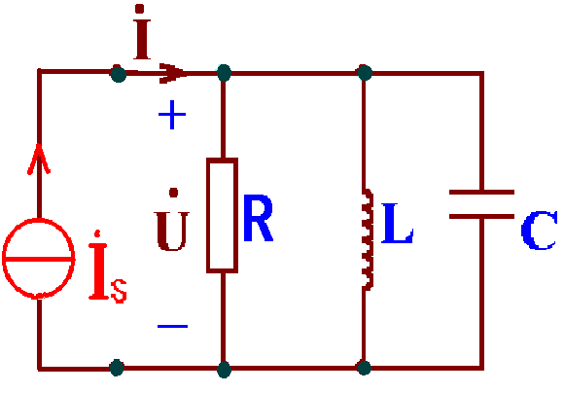
2. Parallel Resonance
1、Resonant conditions and resonant frequency:
Circuit model (a)：
Resonant conditions:
( a)
Resonant impedance：
Resonant frequency:
or
Characteristic impedance：

Slide 105
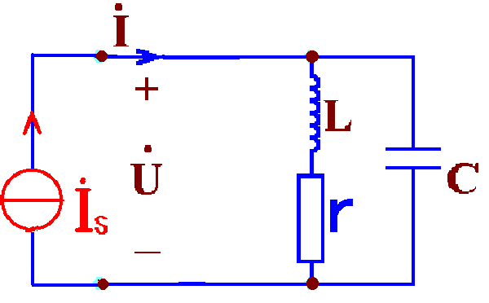
Circuit model (b)：
( b)
Resonant conditions:
Resonant impedanc
Resonant frequency:
Characteristic impedance：
ω₀L＞＞r. ω₀ is high, ω varies around ω₀, so
or

Slide 106
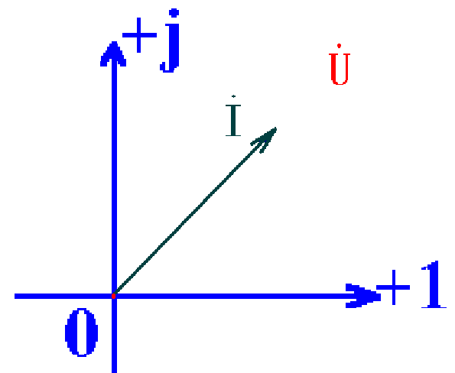
2、Parallel resonance characteristic
1）Minimum admittance：
2) ϕ_{u}-ϕ_{i} = 0
3) cosϕ =1
4) Maximum voltage：
U = I_{s} Z₀
5) Overcurrent occurs in L and C:
I_{L} ≈ I_{C}=Q I_{s}
6) Phasor diagram
（phase of the current is the same as the voltage）

Slide 107
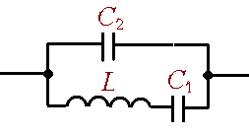
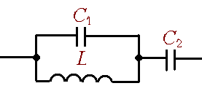
* Series 、 parallel resonance
Find circuit resonant frequency:
ω_{parallel}
ω_{series}
ω_{parallel}
ω_{series}
Series resonance：Z=0 ( short-circuit ）
Parallel resonance：Z=∞ ( open-circuit ）

Slide 108
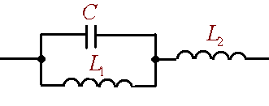
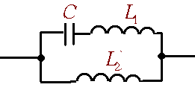
Find circuit resonant frequency:
Example：
Series resonance：Z=0 ( short-circuit ）
Parallel resonance：Z=∞ ( open-circuit ）
ω_{parallel}
ω_{series}
ω_{series}
ω_{parallel}

Slide 109
*Application：Filter Circuit
Excitation u_{s}(t), contains two frequencies component ω₁、ω₂ (ω₁<ω₂)：
Request response u_{o}(t) containing only frequency voltage ω₂.
+
u_{s}(t)
u_{o}(t)
How to achieve?
_
L₁
(1)
+
+
u_{s}(t)
C₂
R
u_{o}(t)
ω₁ signal is disconnected
_
_

Slide 110
ω₂ Signal is connected
L₁
L₃
(2)
+
+
u_{s}(t)
C₂
R
u_{o}(t)
_
_
Parallel resonance, open-circuit
Series resonance, short-circuit
The signal ω₂ is applied directly to the load.

Slide 111
5.8 Coupling Inductor
Coupling inductance element is multi-terminal element, in the real circuit, such as the middle coil, the oscillation coil in radio and television, the transformer used in the rectifier source and so on are coupling inductance element.
Φ₁₁
1. Mutual Inductance
Φ ₂₁
N₁
N₂
i₁
+
u₁₁
–
+
u₂₁
–
When the current i₁ flowing into in coil 1, magnetic flux is generated in coil 1,meanwhile, a part of the magnetic flux through the adjacent coil 2, this part is called mutual inductance flux.There is a magnetic coupling between the two coils.

Slide 112
Ψ ： magnetic linkage，ψ =Nφ
When there is no ferromagnetic material around the coil (hollow coil)，Ψ is proportional to the i. When only one coil:
, L₁ is self-inductance coefficient. Unit: H
When there is a current in both coils, the flux of each coil is the algebraic sum of the self-flux and the cross-flux:
M₁₂, M₂₁ is called coefficient of mutual induction. Unit: H
Note
(1) M is related to the shape, geometric position and space medium of the coil, independent of the current in the coil, and proportional to N₁，N₂, satisfying M₁₂=M₂₁
(2) L is always positive, proportional to N squared, M is positive or negative.

Slide 113
2. Coupling Coefficient
The coupling coefficient K is used to represent the tightness degree of magnetic coupling between two coils.
When k=1， is called complete coupled;
Leakage flux Φ _{s1} =Φ_{s2}=0
Φ₁₁= Φ_{21 ，}Φ₂₂ =Φ₁₂
Generally：
The coupling coefficient K is related to the structure of the coil, the mutual geometrical position and the magnetic medium in space.

Slide 114
3. The relationship between voltage and current on coupled inductors
When i₁ is a time-varying current,the flux will also vary over time, resulting a voltage is induced .
when the direction of i₁、u₁₁、u₂₁ and Φ conforms to the right-hand rule,according to The law of electromagnetic induction and Lenz's law：
self-inductance voltage
mutual inductance voltage
When two coils are supplied with current, the voltages at both terminals of each coil contain self-inductance voltage and mutual inductance voltage:

Slide 115
In a sinusoidal AC circuit, the equation of iphasor form is:

Slide 116
4. Dotted Terminal of a mutual inductance coil
For self-inductance voltage, u and i are passive reference configuration，u、i and Φ conforms to the right screw rule, its expression is:
i₁
u11
For self-inductance voltage, as the voltage and current are on the same coil, the mathematical description can be easily written as long as the reference direction is determined, without considering the winding direction.
For mutual inductance, the current is on the other coil, so the winding of the two coils must be known in order to determine its sign.

Slide 117
Dot convention
When two currents flow in or out of the corresponding terminals of two coils at the same time, if the magnetic flux generated strengthens each other, the corresponding terminals are called the dotted terminal of the two mutual inductors coil.
Φ₁₁
Φ _{s}
Φ ₀
N₁
N₂
N₃
i₁
*
i₂
i₃
*
•
•
△
△
+
u₁₁
–
+
u₂₁
–
+
u₃₁
–
Note：The dotted terminal of the coil must be identified in pairs.

Slide 118
(1) if a current enters the dotted terminal of one coil,the reference polarity of the mutual voltage in the sencond coil is positive at the dotted terminal of the second coil.
Example:
i
Φ
•
*
1
2
1
Δ
*
*
2
3
*
1'
2'
2'
•
Δ
1'
3'
(2) If a current leaves the dotted terminal of one coil,the reference polarity of the mutal voltage in the second coil is positive at the dot convention of the second coil.

Slide 119
The property of mutual inductance coils are determined by the dot convention and the reference directions of u and i.
M
*
*
i₁
+
u₂₁
–
M
*
*
i₁
–
u₂₁
+
1、When the coupling is in the same direction, the symbol of mutual inductance voltage is the same as that of self-inductance voltage, and the symbol of reverse coupling is different from self-inductance voltage;
2. When the induced inductance current flows into the coil from the marked end of the dotted terminal, the "+" polarity of the mutual inductance voltage is placed at the marked end of the dotted trminal, and vice versa.
Methods:
Notes:
一、当为同向耦合时，则互感电压在KVL方程中与自感电压同号，反向耦合时与自感电压异号；
二、如果施感电流的流入端与其产生的互感电压的正极性所在的端子是同名端的话，互感电压为正，否则为负。

Slide 120
Example:
Write u-i relationship in circuit.
i₁
i₂
i₁
M
i₂
M
+
*
*
+
+
*
+
u₁
L₁
L₂
u₂
u₁
L₁
L₂
u₂
_
_
_
_
*
i₁
M
i₂
i₁
i₂
M
+
*
+
+
*
_
u₁
L₁
L₂
u₂
u₁
L₁
_
L₂
u₂
*
_
_
*
+

Slide 121
5.8.2 Calculation of a circuit with coupled inductance
1. series of coupled inductors
i
R₁
M
L₂
R₂
L₁
+
*
–
*
（1） series-aiding connection
u₁
+
u₂
–
+
u
–
i
+
R
u
L
–
Decoupling equivalent circuit

Slide 122
i
（2） series-opposing connection
+
i
R₁
M
L₂
R₂
R
L₁
+
*
–
*
u
u₁
+
u₂
–
L
+
u
–
–
A common method for measuring mutual inductance coefficient:

Slide 123
2. Parallel connection of coupled inductors
i
M
+
i₁
i₂
（1） In parallel on the same side
*
*
u
L₁
L₂
–
i = i₁ +i₂
u, i relationship：
equivalent inductance:

Slide 124
i
M
（2） Opposite sides parallel
+
i₁
i₂
*
u
L₁
L₂
*
–
i = i₁ +i₂
u, i relationship：
equivalent inductance:

Slide 125
3.The T-type equivalence of the coupled inductance
（1） T-type decoupling equivalence that dotted terminal is common terminal
jω M
1
2
1
2
*
*
jω(L₁-M)
jω(L₂-M)
jωL₁
jωL₂
jωM
3
3

Slide 126
（2） T-type decoupling equivalence that dot convention is common terminal
jω M
1
2
1
2
*
jω(L₁＋M)
jωL₁
jωL₂
jω(L₂＋M)
*
－jωM
3
3
The T-type decoupling equivalent circuit is
independent of the current reference direction.

Slide 127
i₁
M
i₂
i
M
i₁
i₂
+
*
*
+
+
*
*
u₁
L₁
L₂
u
L₁
L₂
u₂
–
–
–
jωM
jω(L₁－M)
jω(L₂－M)
jω(L₁－M)
jω(L₂－M)
jωM

Slide 128
4. Controlled source equivalent circuit
i₁
M
i₂
+
+
+
*
*
+
L₂
jω L₁
jω L₂
u₁
L₁
u₂
+
+
–
–
–
–
–
–

Slide 129
Example:
Find equivalent inductance L_{ab.}
Solution:
M=4H
M=3H
a
a
2H
5H
6H
4H
6H
b
0.5H
2H
3H
b
M=1H
a
2H
9H
7H
a
1H
2H
-3H
L_{ab}=5H
L_{ab}=6H
3H
b
b
0.5H
3H
4H

Slide 130
5. Calculation of a circuit with coupled inductance
(1) Under sinusoidal steady-state, the phasor analysis method is
applied to the calculation of circuits with mutual inductance.
(2) Mutual inductance coil has self-inductance voltage and mutual
inductance voltage.
(3) branch circuit, loop circuit or mutual inductance elimination to
calculate.
Example 5-23
Example 5-24

Slide 131
Example 2
Find the open circuit voltage.
M₁₂
R₁
L₁
L₂
•
•
Solution 1
Δ
*
+
+
L₃
M₃₁
M₂₃
Δ
*
_
_

Slide 132
Solution 2
Make the decoupling equivalent circuit:
M₁₂
L₁–M₁₂
L₂–M₁₂
L₁
L₂
Δ
•
•
*
Δ
*
L₃+M₁₂
M₁₃
M₂₃
M₁₃
L₃
M₂₃
Δ
*
Δ
*
L₁–M₁₂ +M₂₃ –M₁₃
L₂–M₁₂–M₂₃ +M₁₃
L₁–M₁₂ +M₂₃
L₂–M₁₂ –M₂₃
Δ
L₃+M₁₂–M₂₃ –M₁₃
L₃+M₁₂ –M₂₃
M₁₃
Δ

Slide 133
L₁–M₁₂ +M₂₃ –M₁₃
L₂–M₁₂–M₂₃ +M₁₃
R₁
+
+
L₃+M₁₂–M₂₃ –M₁₃
–
_

Slide 134
5.9 Hollow transformer and ideal transformer
A transformer is composed of two coils with mutual inductance. One coil is connected to the source and the other coil is connected to the load. A transformer is a device that uses mutual inductance to transmit energy or signals from one circuit to another circuit.
When the core of the transformer coil is a non-ferromagnetic material, it is called a hollow transformer.
1. Hollow transformer circuit
jω M
R₁
R₂
+
*
*
jω L₁
jω L₂
Z=R+jX
–
Primary side loop
Secondary side loop

Slide 135
2. Analytical method
jω M
R₁
R₂
+
*
*
（1） Equation method analysis
jω L₁
jω L₂
Z=R+jX
–
Loop equation:
Z₁₁=R₁+jω L₁， Z₂₂=(R₂+R)+j(ω L₂+X)

Slide 136
（2） Equivalent circuit analysis
Z₁₁
+
+
Z₂₂
–
–
primary side equivalent circuit
side equivalent circuit

Slide 137
Z₁₁
+
–
The input impedance of the secondary side to the primary side.
primary side equivalent circuit
+
Z₂₂
The input impedance of the primary side to the secondary side.
–
secondary side equivalent circuit
（3） Decoupling equivalent analysis
The circuit with mutual inductance is equivalent to the circuit without mutual inductance, and then analyzed.

Slide 138
Example1
L₁=3.6H , L₂=0.06H , M=0.465H , R₁=20Ω , R₂=0.08Ω ,
jω M
R_{L}=42Ω , ω =314rad/s,
R₁
R₂
+
*
*
jω L₁
jω L₂
Find
–
R_{L}
Solution1
Z₁₁
+
Applying primary side equivalent circuit
–

Slide 139
Solution 2
Applying secondary side equivalent circuit
+
Z₂₂
–

Slide 140
Ideal transformer
1.Three idealized conditions
（1）non-loss
The coil wire has no resistance and the permeability of the ferromagnetic material as the core is infinite.
（2）complete coupled
（3）parameters are infinite
But

Slide 141
i
Φ
2.Main properties of ideal transformer
1
2
1'
2'
（1）voltage transformation
N₁
N₂
n:1
+
*
*
+
u₁
u₂
_
_
Ideal transformer model
If
n:1
+
*
+
u₁
u₂
_
_
*

Slide 142
i₁
n:1
i₂
（2）current transformation
M
+
*
*
+
u₁
L₁
L₂
u₂
_
_
0
Ideal transformer model
idealized condition：
i₁、i₂If one of i₁、i₂ flows in from the same end and the other flows out from the same end, then:

Slide 143
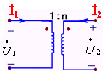
Note:
Conclusion:
1、Voltage relationship
2、Current relationship
1、Voltage and current are independent;
2、 The primary and secondary voltages satisfy the algebraic relation：
Note：The voltage direction is the same as the same side.
3、The primary current and the secondary current
satisfy the algebraic relation:
Note： The current direction is the same as the same side.
4、The circuit equation is different if the same side and reference direction are different.

Slide 144
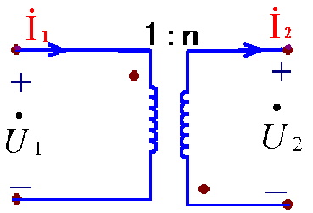
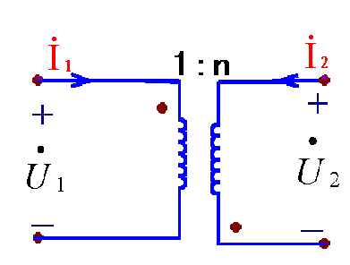
Write the following ideal transformer v-a relationship.
Example:
（1）
（2）

Slide 145
（3）Impedance transformation
n : 1
+
+
+
*
*
Z
n²Z
–
–
–
Note
The impedance transformation property of an ideal transformer only changes the magnitude of the impedance, not the property of the impedance.

Slide 146
（4）Power
i₁
n : 1
i₂
+
+
*
*
u₁
u₂
–
–
Conclusion：
（a）Ideal transformers neither store energy nor consume energy, and only transmit signals and energy in the circuit.
（b）The characteristic equation of an ideal transformer is algebraic, so it is a memoryless multiterminal element.

Slide 147
Example 1
Power resistance R_{S}=2kΩ，load resistor R_{L}=20Ω。When the power of RL is maximum, find the ratio n of the ideal transformer .
R_{S}
n : 1
R_{S}
+
*
*
+
u_{S}
R_{L}
u_{S}
n²R_{L}
–
–
When n²R_{L}=R_{S},
Applying changing impedance property
20n²=2000
∴ n²=100， n=10 .

Slide 148
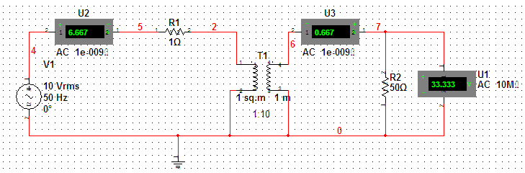
Example 2
Find
1Ω
1 : 10
+
+
*
*
+
50Ω
–
–
–
Method 1：Writing equation

Slide 149
Method 2：Impedance transformation
1Ω
+
+
–
–
Method 3：Thevenin's equivalent
Find

Slide 150
Find R_{eq}：
1Ω
1 : 10
*
*
R_{eq}=10²×1=100Ω
R_{eq}
Thevenin's equivalent circuit：
100Ω
+
+
50Ω
–
–

Slide 151
Example 3
Find the power absorbed by resistor R.
1Ω
Solution:
Applying Loop method
1Ω
n : 1
3
+
+
*
*
+
1Ω
1
R=1Ω
2
–
–
–

Slide 152
Homework：
5-39，42，43，48，49，54，59，63，66，69，75，76，83

