Slide 1
Chapter6
Three-phase Circuits
Key points
1.Basic Concepts
2.Analysis of the balanced
three-phase circuit
3.The concept of unbalanced three-phase circuits
4.Power in three-phase circuits

Slide 2
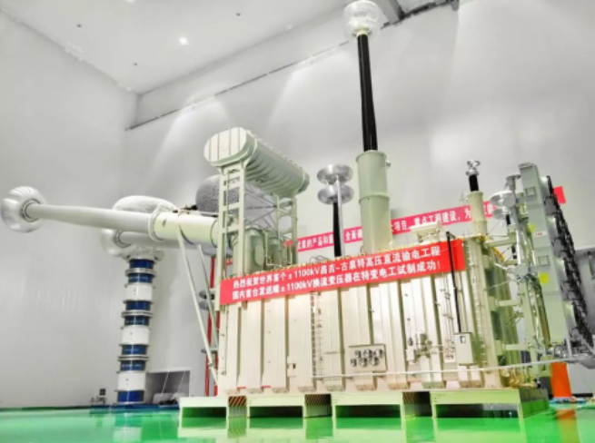
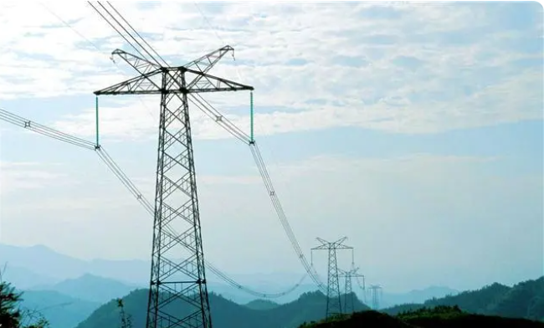
The sole owner of UHV transmission core technology!
In 2019, China's major power grid operators have energized their largest and strongest transmission line to date - 1.1 million volt DC power transmission. The transmission capacity of the newly built UHVDC line can reach 12 kMW. This can meet the electricity demand of 50 million Chinese households, and the transmission capacity is 50% higher than most of the 800 kV UHVDC transmission lines built by the State Grid in the past decade.

Slide 3
6.1 Three-phase circuit
1.Three-phase source
Usually generated by the three phase ac generator, three-phase winding in the spatial difference of 120 °, when the rotor rotates at uniform angular velocity ω, voltage is produced in the three-phase winding, forming a balanced three-phase source.
A
Y
N
Z
º
I
ω
º
S
C
B
X
A three-phase generator

Slide 4
（1）Expression of instantaneous value
A
A
A
A
A
A
A
A
A
A
A
A
A
•
•
•
•
•
u_{A}=Ucosωt
•
•
•
•
•
•
•
•
Y
Y
Y
Y
Y
Y
Y
Y
Y
Y
Y
Y
Y
Z
Z
Z
Z
Z
Z
Z
Z
Z
Z
Z
Z
Z
•
S
•
S
+
S
•
+
S
•
•
S
•
u_{B}=Ucos(ωt-120˚)
•
•
+
S
•
S
S
S
+
S
•
•
S
•
•
+
•
S
•
•
S
•
•
•
•
•
u_{C}=Ucos(ωt-240˚)
=Ucos(ωt+120˚)
ω
ω
ω
ω
ω
ω
ω
ω
ω
ω
ω
ω
ω
+
+
•
+
•
+
+
+
+
+
N
•
+
N
N
•
+
N
+
N
+
+
•
+
+
+
+
+
+
N
N
+
N
+
N
N
N
N
C
N
C
C
C
C
C
C
C
C
C
C
C
C
B
B
B
B
B
B
B
B
B
B
B
B
B
+
+
+
+
+
+
+
+
+
+
+
+
（2）Waveform
+
X
X
X
X
X
X
X
X
X
X
X
X
X
u_{A}
u_{B}
u_{C}
phase A
0
phase B
ωt
phase C

Slide 5
（3） Expression of phasor
120°
120°
120°
（4） Characteristics of balanced three-phase source

Slide 6
2. The connection of three-phase source
（1）Star connection(Wye connection)
Connect the end X, Y and Z of the three windings together,
and lead out the beginning A,B and C
A
A
–
+
+
X
A
–
Y
Y
–
+
B
X
–
N
–
Z
+
B
–
+
+
B
Z
C
C
C
N
The points of X, Y, and Z connected together are called the neutral points of Y connected balanced three-phase source, denoted by N.

Slide 7
（2）Triangle connection(Δ connection)
The three windings are connected
sequentially at the beginning and the end.
A
A
Z
A
+
–
+
Z
–
+
–
–
X
C
X
B
B
+
–
B
+
Y
+
C
–
Y
C
Balanced three-phase source with Δ connection has no neutral.

Slide 8
A
A
+
A
Z
A
–
+
–
Y
X
–
N
+
–
–
Z
C
X
+
B
B
+
B
–
B
C
Y
+
C
C
(1) Terminal line：The line that comes out of A, B, and C.
(2) Neutral line：The line derived from the neutral point N.
(3) three-phase three-wire system
three-phase four-wire system
(4) Line voltage：Voltage between terminal lines.
(5) Phase voltage：line-to-neutral voltage
(6) Line currents：Currents flowing throughthe lines.
(7) Phase currents：Currents flowing out of the sources.

Slide 9
3. Three-phase load and connection
The load of a three-phase circuit consists of three parts,
each of which is called a single-phase load.
A'
A'
Z_{CA}
Z_{A}
Z_{AB}
N'
Z_{C}
B'
Z_{BC}
B'
Z_{B}
C'
C'
Star connection
Triangle connection
When
is called balanced three-phase load

Slide 10
A'
A'
Z_{A}
Z_{CA}
N'
Z_{AB}
B'
B'
Z_{B}
Z_{BC}
Z_{C}
C'
C'
Phase voltage：Voltage on load each phase
Line voltage：Voltage between load terminals.
Line current：The current flowing through the end line.
Phase current：Current flowing the load in each phase

Slide 11
4. Three-phase circuit
The three-phase circuit is a system composed of balanced three-phase power supply and three-phase load.
Y
Source
Y
Load
△
Y
Source
△
Load
△
When the source and load of a three-phase circuit are balanced, it is called a balanced three-phase circuit.

Slide 12
Z
–
+
A
three-phase four-wire system
Z
–
+
N
B
N’
–
+
Z
Y
Y
C
–
+
A
Z
–
+
Y
△
B
Z
Z
–
+
C

Slide 13
6.2 Calculation of balanced three-phase circuits
1. Y connection
A
A
+
–
Y
X
–
N
–
Z
+
B
+
B
C
C

Slide 14
The relationship between phase voltage and
line voltage is obtained by using phasor diagram:
30º
30º
30º
Generally expressed as:
Line voltage balanced
(equal in magnitude,
phase difference 120º)

Slide 15
Conclusion:
Y connection of balanced three-phase souce
(1) Phase voltage is balanced，so line voltage is balanced.
(2) The magnitude of the line voltage is equal to √3 times
the phase voltage.
(3) Line voltage leads phase voltage by 30º.

Slide 16
2. Δ connection
Z
A
A
–
+
+
–
C
X
–
B
Y
+
B
C
The line voltage is equal to the corresponding phase voltage.
The relationship between line-voltage and phase-voltage also applies to balanced star and triangular loads.

Slide 17
3.The relationship between phase current and line current
A'
Z
N'
Z
B'
Z
C'
Conclusion
In star connection, the line current is equal to the phase current.

Slide 18
A'
Z
Z
B'
Z
C'
Conclution:
Z/3
Balanced circuit of Δ connection
A'
(1)The magnitude of the line current is equal to √3 times the phase current.
(2)Phase of line current lags
phase current 30º
Z/3
B'
N’
Z/3
C'

Slide 19
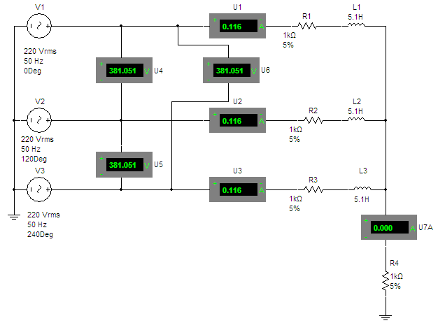
1. Y–Y connection(Three-phase three-wire system）
A
a
+
Z
_
N
n
_
_
Z
c
B
Z
b
C
+
+

Slide 20
Take N points as reference points, write node equations for N point
A
a
+
Z
_
N
n
_
_
Z
c
B
Z
b
C
+
+

Slide 21

Because of the equipotential of N and n points, it can be short-circuited, and the current is zero.
A
a
+
A
a
Z
+
_
N
n
Z
_
_
Z
c
–
B
Z
b
C
+
+
N
n
phase A
calculating circuit
Load side phase voltage：
balanced voltage

Slide 22
calculating
current：
balanced current
Conclusion：
1.U_{nN}=0，source neutral and load neutral are equipotential.
2.In the balanced case, the voltage and current of each phase are balanced, and the equivalent circuit of one phase (A phase) can be used for calculation.
3. Y connection：

Slide 23
2. Y–Δ connection
A
a
+
_
Z
Z
N
_
_
Z
c
b
C
+
B
+
Solution 1
The voltage on the load is equal to line voltage :

Slide 24
Calculate phase current：
Line current：
30º
30º
30º
ϕ
30º

Slide 25

Conclusion:
(1) Phase voltage and line voltage on the load are same and balanced.
(2) Line current and phase current are balanced.The magnitude of the line current is equal to √3 times the phase current.
Solution 2：
Z/3
A
a
+
Z
Z
_
N
_
_
n
c
b
C
+
B
Z
+

Slide 26
A
a
+
Z/3
–
N
n
Solution 3：
Applying a single-phase equivalent circuit for calculating phase current.
A
a
+
Z
–
B
b

Slide 27
3. Calculation of balanced three-phase circuit with Δ connected source
A
A
+
–
+
–
+
–
–
N
–
N
B
+
–
+
+
B
C
C
Replacing the Δ connected source with Y connected source, then calculate applying Y–Y， Y– Δ connection.

Slide 28
Example:
A
Z_{l}
a
_
+
Z
Z
+
_
_
Z
C
+
B
Z_{l}
c
b
Z_{l}
A
a
+
Z_{l}
Z/3
–
N
n

Slide 29
General calculation method for balanced three-phase circuits:
(1) Convert all three-phase souces and loads
into Y - Y connected circuit；
(2) Connect each load to the source neutral；
(3) Draw a single-phase circuit , find the voltage
and current of single-phase:
The voltage in single-phase circuit is the phase voltage at Y connection.
The current in single-phase circuit is a line current.
(4) Find the current and voltage of the original
circuit,according to Δ connection、Y connection.
(5) Find the voltage and current of the other two phases.

Slide 30
Example 1
Balanced three-phase source line voltage
is 380V，Z=3+j4Ω， Z_{l} =6.4+j4.8Ω.
Z_{l}
A
Find phase voltage 、line voltage and crrent of load Z.
Z
Z
Solution:
Z_{l}
Z
B
Draw single-phase diagram
Z_{l}
C
A
Z_{l}
Z
–
+
a
A
Z_{l}
+
Z_{l}
B
Z
N
–
+
Z
–
C
Z_{l}
Z
–
+
N
n

Slide 31
A
a
+
Z_{l}
Z
–
N
n

Slide 32
Example 2
In balanced three-phae circuit，line voltage of source is 380V，|Z₁|=10Ω，cosϕ₁ =0.6(inductive)， Z₂= –j50Ω， Z_{N}=1+ j2Ω. Find：line current、phase current，draw phasor diagram.
Solution:
Draw a single-phase diagram.
_
+
A
N
_
+
B
Z₂
_
+
C
Z₁
+
N'
Z_{N}
Z₁
_

Slide 33
+
Z₁
_
According to symmetry, line current and phase current
of B and C phases can be obtained:

Slide 34
Thus we can draw a phasor diagram：
Three - phase current for the first load:
30º
–18.4º
Three - phase current for the second load:
–53.1º

Slide 35
6.3 Calculation of unbalanced three-phase circuit
unbalanced source
Unbalanced
unbalanced load
Analysis object
balanced source unbalanced load
Methods
Complex AC circuit analysis method
Neutral displacement

Slide 36
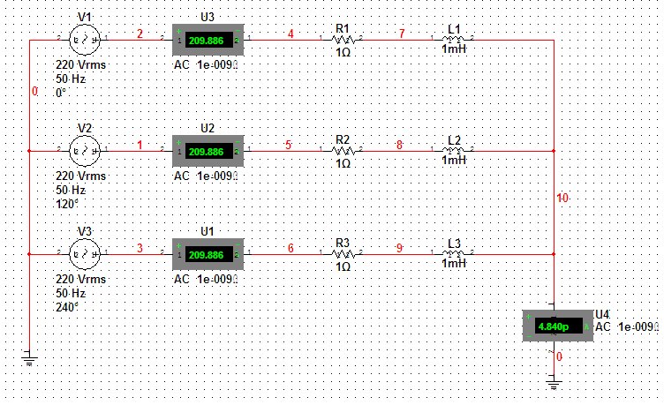
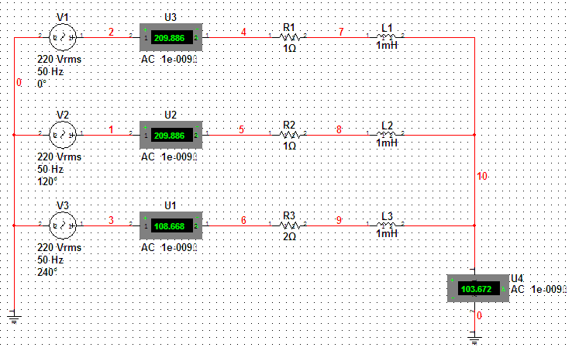
+
A
Z_{a}
_
Z_{N}
N
N'
_
_
Z_{b}
B
Z_{c}
+
+
C
Three-phase load Z_{a}、Z_{b}、 Z_{c} are unequal.
phase voltage：

Slide 37
Phasor diagram
N'
N
Neutral
displacement.
The load neutral does not coincide with the source neutral.
In the case of balanced souce, the unbalance of load end can be judged according to the neutral displacement. When the neutral displacement is large, the phase voltage of load will be seriously unbalanced and the load working state will be abnormal.

Slide 38
Example 1
Lighting circuit:
(1) In general,Three-phase four-wire system，
the neutral impedance is approximately zero.
A
N
N'
C
B
(2) If three-phase three-wire system,
We sssume phase A is open-circuit.
A
N'
The bulb is not operating at rated voltage.
C
B

Slide 39
(3) Phase A is short-circuit
A
N'
Exceeding the rated voltage of the bulb, it may burn out.
C
B
Find short-circuit current：
The short-circuit current is 3 times the normal current.

Slide 40
In circuit,source is balanced,When the switch S is closed,reading of ammeter is 5A.
Example 2
A₁
S
Z
Fnd:The reading of each ammeter after switch S isopened
A₂
Z
Z
A₃
Solution:
When switch S is opened, the current in ammeter A₂ is the same as that when the load is balanced.The current in A₁ and A₃ is equivalent to the phase current when the load is balanced.
Reading of ammeter A₂=5A
Reading ammeter A₁、A₃ =

Slide 41
6.4 Power of three-phase cicuit
1. Power of balanced three-phase circuit
（1）Average power
P_{p}=U_{p}I_{p}cosϕ
A’
Z
Three-phase total： P=3P_{p}=3U_{p}I_{p}cosϕ
B’
Z
Y connection:
C’
Z

Slide 42
A’
△ connection:
Z
Z
B’
Z
C’
Note:
(1) ϕ is Phase Angle of phase ccurrent and phase voltage(impedance Angle)，it's not the phase difference between line voltage and line current.
(2) cosϕ is power factor of each phase，three-phase power factor in balanced three-phase system:
cosϕ _{A}= cosϕ _{B} = cosϕ _{C} = cosϕ .

Slide 43
（2） Reactive power
Q=Q_{A}+Q_{B}+Q_{C}= 3Q_{p}
（3） Apparent power
Power factor can be defined：cosϕ =P/S

Slide 44
（4）Instantaneous power of balanced three-phase loads
Assume:
So:

Slide 45
2. Measurement of three-phase power
(1) Three meters
*
A
W
three-phase
load
Three-phase
four-wire system
*
*
B
W
*
*
C
W
*
N
If load is balanced，just take a meter and multiply the reading by 3.

Slide 46
(2) Two meters：
*
Three-phase
load
A
W₁
*
Three-phase
three-wire
system
*
B
W₂
*
C
If the reading of W₁ is P₁ , the reading of W₂ is P₂ ，so total three-phase power is:
P=P₁+P₂

Slide 47
*
Three-phase
load
A
A
Three-phase
load
*
W₁
*
B
W₂
B
*
W₁
*
*
C
C
*
W₂
*
*
Three-phase
load
A
W₁
*
B
C
*
W₂
*
If the reading of W₁ is P₁ , the reading of W₂ is P₂ ，so total three-phase power is：
P=P₁+P₂

Slide 48
Prove：
Assume that the load is a Y connection.
i_{A}
A
p=u_{AN} i_{A} + u_{BN} i_{B}+ u_{CN} i_{C}
i_{A} + i_{B}+ i_{C}=0 i_{C}= –(i_{A} + i_{B})
N
i_{C}
p= (u_{AN} – u_{CN})i_{A} + (u_{BN} – u_{CN}) i_{B}
= u_{AC}i_{A} +u_{BC} i_{B}
C
B
i_{B}
P=U_{AC}I_{A}cosϕ ₁ + U_{BC}I_{B}cosϕ ₂ ＝
W₁
W₂
ϕ ₁ : phase difference between u_{AC} and i_{A ;}
ϕ ₂ : phase difference between u_{BC} and i_{B}.
So the algebraic sum of the readings of the two power meters is the total three-phase power. Because the △ connection can be changed to Y connection, the conclusion is still valid.

Slide 49
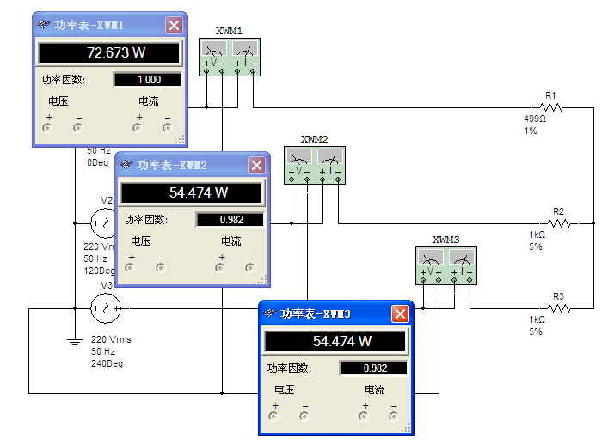
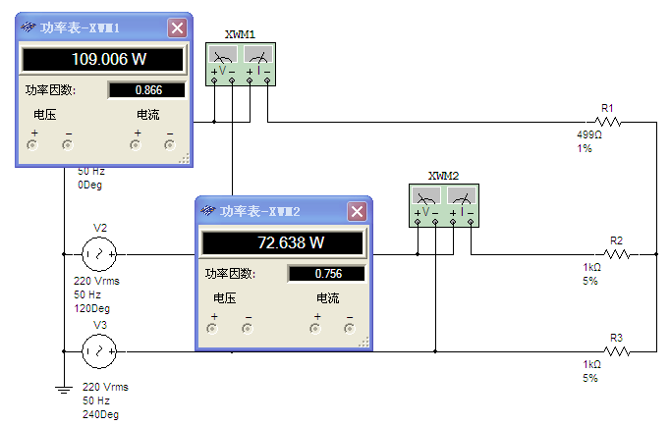
Note:
1. Only in three - phase three - wire system, two meters can be used.
2. The algebraic sum of the two meter readings is the total three-phase power.
3. When wiring according to the correct polarity, one of the two meters may have a negative reading. The pointer of the power meter is reversed and its current coil polarity is reversed. The pointer points to a positive number, but at this time the reading should be recorded as negative.
4. There are three ways to measure three-phase power by two-meter method. Note the same end of the power meter.
5. When load is balanced：

Slide 50
Example 1
U_{l} =380V，Z₁=30+j40Ω， P=1700W, cosϕ=0.8(inductive).
Find：
(1) The total power generated by the line current and the source;
(2) Measure the load power of the motor using two meters, find two meter reading.
Solution:
A
(1)
B
D
C
motor
Z₁

Slide 51
load of the motor：
Total current ：
P_{total}
_{tatal}

Slide 52
*
A
W₁
(2) two meters method
*
*
D
B
W₂
*
C
motor
Z₁
Reading of W₁: P₁
P₁=U_{AC}I_{A2}cosϕ ₁ = 380×3.23cos(– 30°+ 36.9° )
=1218.5W
Reading of W₂: P₂
P₂=U_{BC}I_{B2}cosϕ ₂= 380×3.23cos( 30°+ 36.9° )= 481.6W=P-P₁

Slide 53
The circuit shown in the figure,If the reading of the power meter in the diagram is 5000W，find the reactive power absorbed by this load.
Example 2
Solution:
*
Three-phase
load
A
W₁
Reading of W₁ is P₁：
B
*
P₁=U_{BC}I_{A}cosϕ ₁
ϕ _{1 :} phase difference between U_{BC} and I_{A}
C
From phasor diagram：
The reactive power absorbed by the load is:
ϕ₁
ϕ

Slide 54
Assume that the system balance, line voltage is 13.8 kV transformer substation, each the impedance of the transmission line is 0.6 + j4.8 Ω, some time, the load power of 3.6 MW and MVar 3.6, assuming that the voltage of the power station is kept within ±5.8% of the normal value of the substation to be practical, is there a problem with the line voltage and if so, what should be done??
Example 3
Solution:
power
station
transformer
substation
Assume
So
0.6+j4.8Ω
A
a
We can obtain：
+
+
1.2
MW
1.2
MVar
-
-
n
N
（single-phase equivalent circuit）

Slide 55
0.6+j4.8Ω
A
a
Thus:
+
+
1.2
MW
1.2
MVar
-
-
n
N
（single-phase equivalent circuit）
Solution：Add a capacitor bank to the substation to provide reactive power
then

Slide 56
Homework： 6-26，28，29，30，34，38

