Slide 1
Data Wrangling with Baltimore City 911 Report Data
XYZ

Slide 2
Overview of Dataset
This dataset has 292761 instances/entries (rows) of victims based crime.
There are 16 columns.
Few mention the time of the incident, few describe the location it took place in. And few others describe the incident that took place.
Few interesting/unique observations:
Columns Crime_Code and Description are highly correlated, crime_code represents the type of crime that took place and description explains it. All the rows with same description have same crime code.
The value of column Total Incidents is always 1
The column location1 is NIL for all the rows.

Slide 3
Analysis of Columns
Total Incidents is Numerical, Post contains real values and Longitude and Latitude contains real and continuous values.
Total incidents is the only numerical value, and it is constant through the data. So, min, max, mean and median of Total_incidents is 1. And the standard deviation is 0.
Crime Code, Description, Inside/Outside, Weapon, District, vri_name1 are discrete type of attributes as they have a finite set of values.
Inside/Outside is a symbolic variables which describes weather the crime took place inside or outside the house.

Slide 4
Analysis of Columns
We have 2 temporal column which mention about the time the crime took place in. Those are Crime_date and Crime_time.
And they are few spatial categories which describe the location of crime like Latitude and Longitude.
8 columns have 0% NIL values. So, for every row they have a proper value.
1 of the column has 100% NIL values, so it is of no use having that column. Other than this 2 other columns have above 50% NIL rate indicating that more have half of their entries have no value.
This data is collected over 30 years and 10 districts, and having 81 crime codes( 81 different kinds of crime).

Slide 5
Crime rate over time

Slide 6
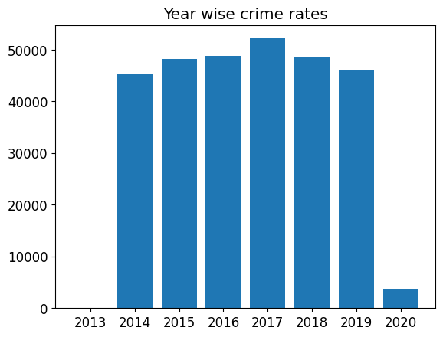
The year wise crimes have been ignored before 2013 because data is very less for years from that.
Other than that the crime rates have been pretty standard over the years, initially they were gradually increasing. Reached peak on 2017 and now it’s gradually reducing.
2020 crimes are so low because we have data only for 1.5 months.

Slide 7
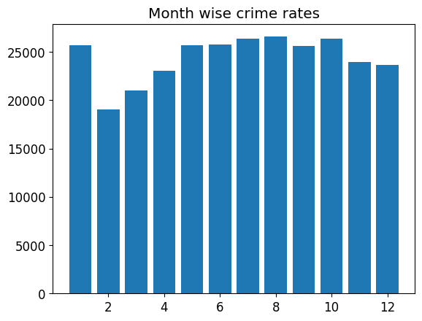
If we see the trend for monthly crime rates, it is clear that Jan has very high crime rate.
Immediately after that the crimes rate go down by a lot in feb, it again slowly increases and reaches it’s global peak in around August

Slide 8
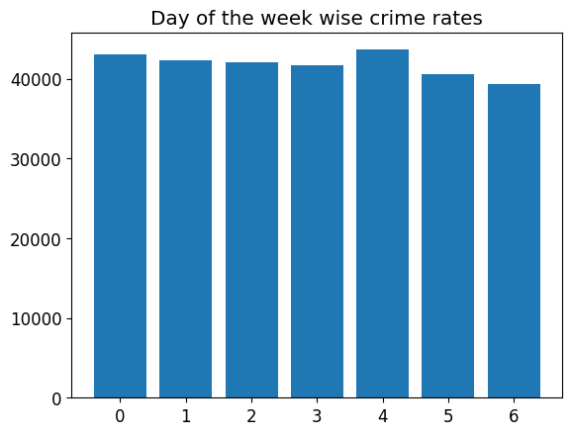
Coming to days of week all days seem to have pretty even crime distrubution.

Slide 9
Plot for Crime Type

Slide 10
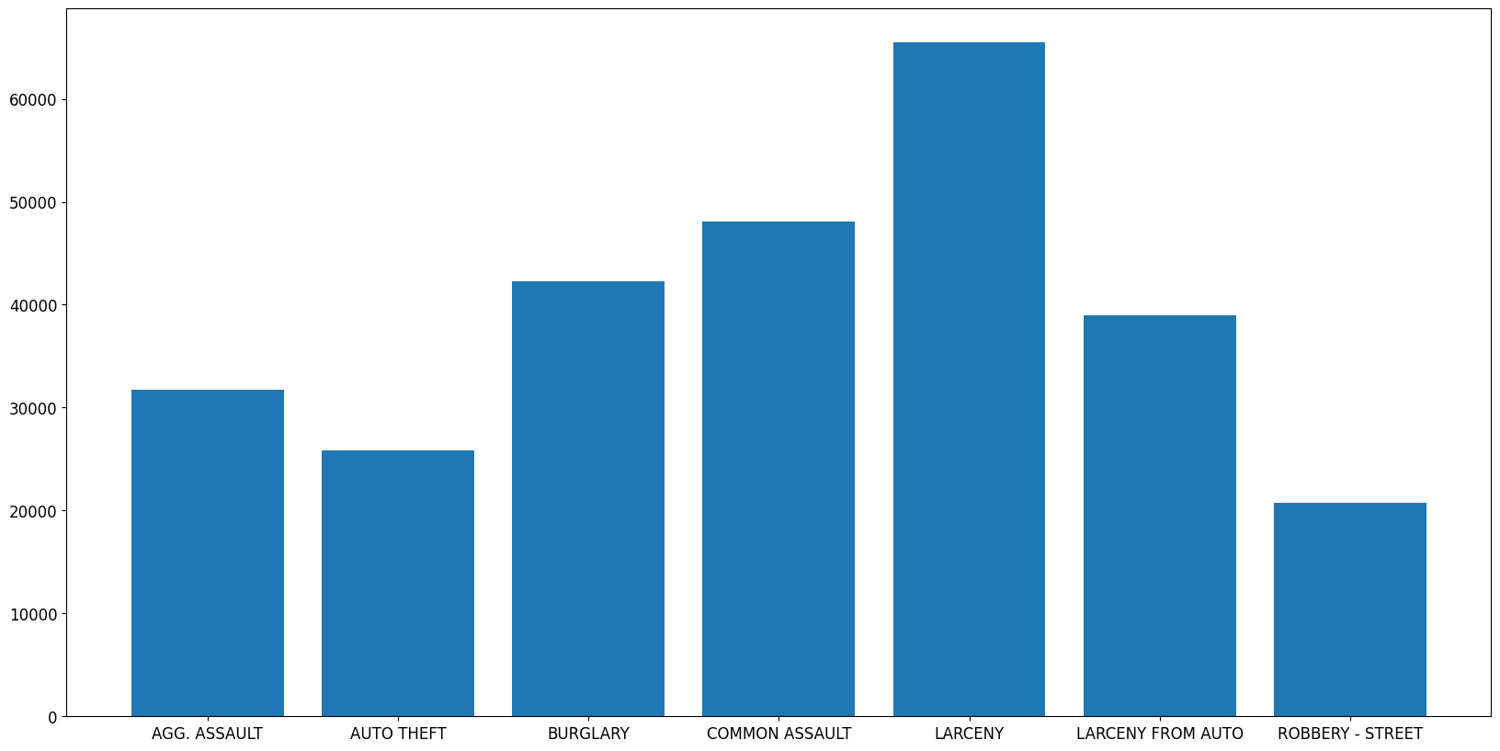
I have considered the description as the column for crime type. As it gives us the prefect analysis for crime types. There are 14 crime types and we decided them into 7-7, this plot has crime types with highest occurance.

Slide 11
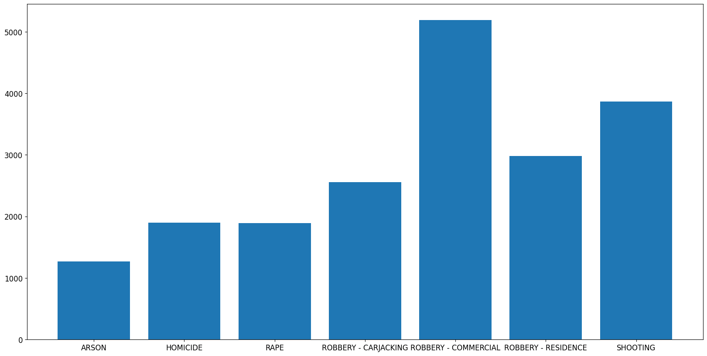
As you can see, compared to the last plot, the crime occurrence for these crime types is comparatively low. And Arson is the least occured crime out of everything.

Slide 12
Variation of Crime types by time

Slide 13
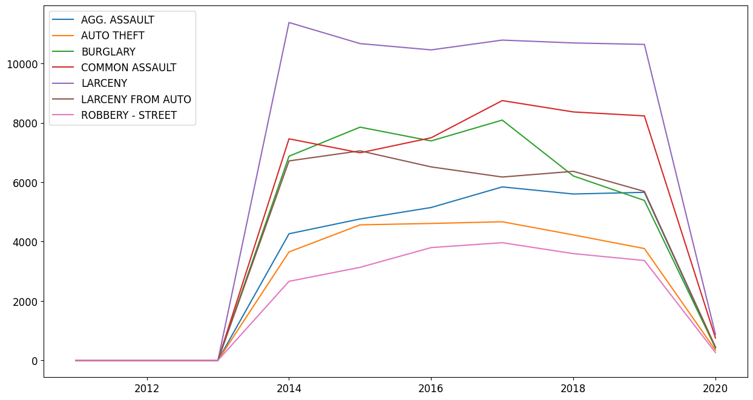
Plot 1 for variation of Crime types over years

Slide 14
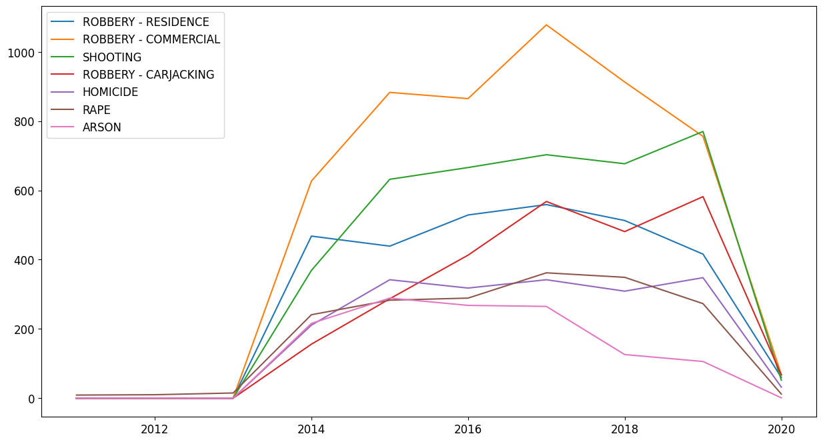
Plot 2 for variation of Crime types over years

Slide 15
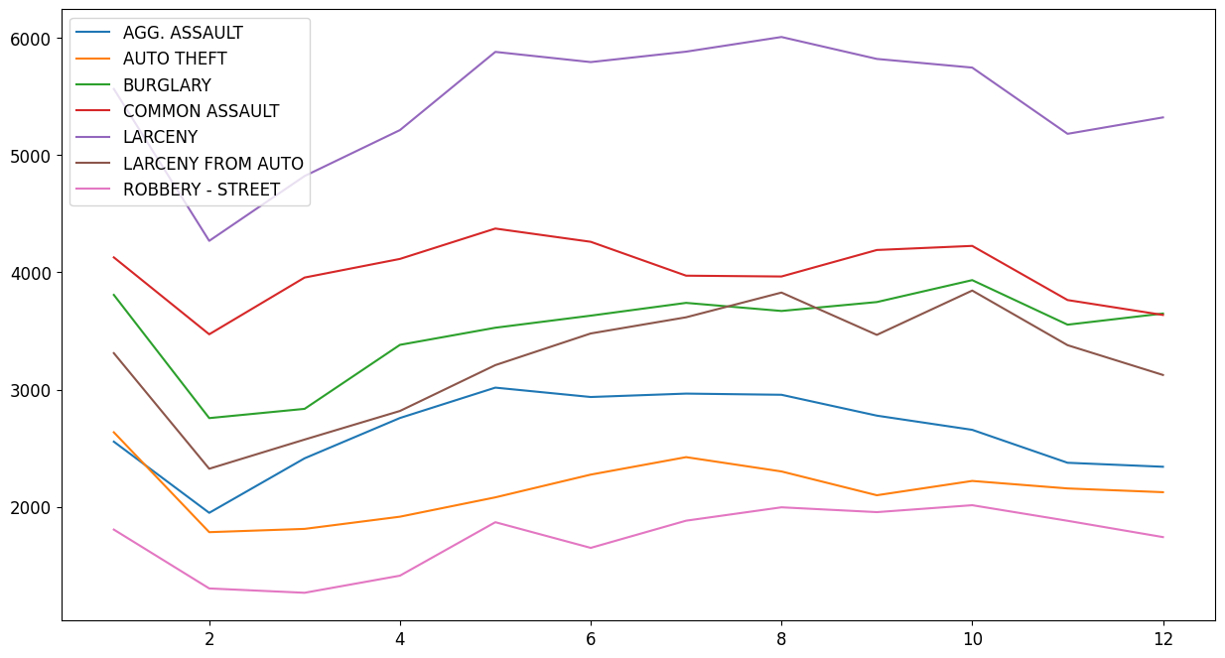
Plot 1 for variation of Crime types over several months

Slide 16
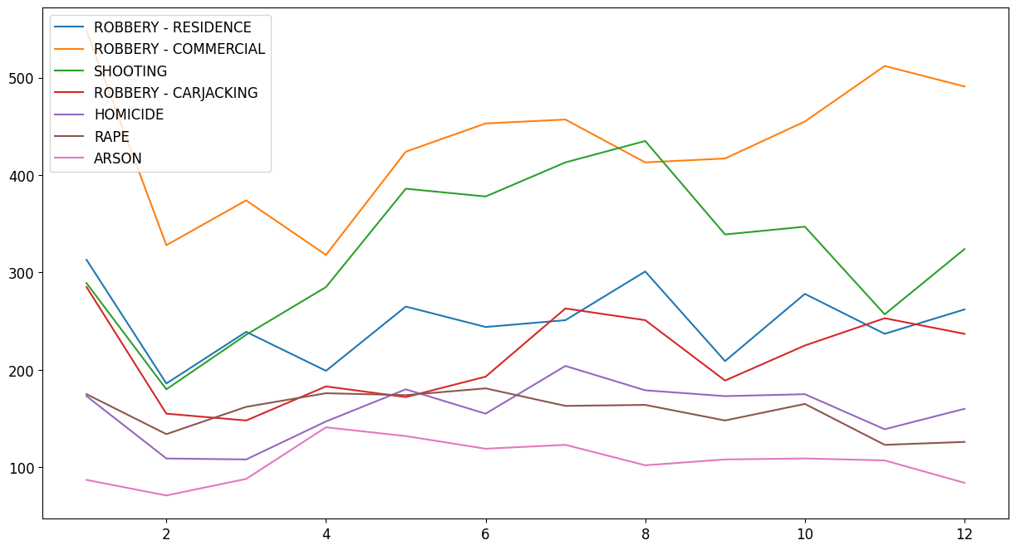
Plot 2 for variation of Crime types over several months

Slide 17
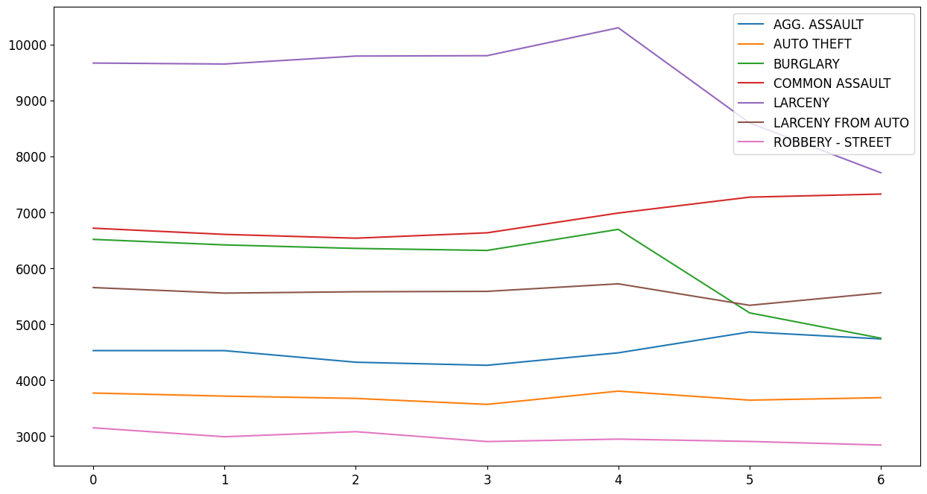
Plot 1 for variation of Crime types over different days of the week

Slide 18
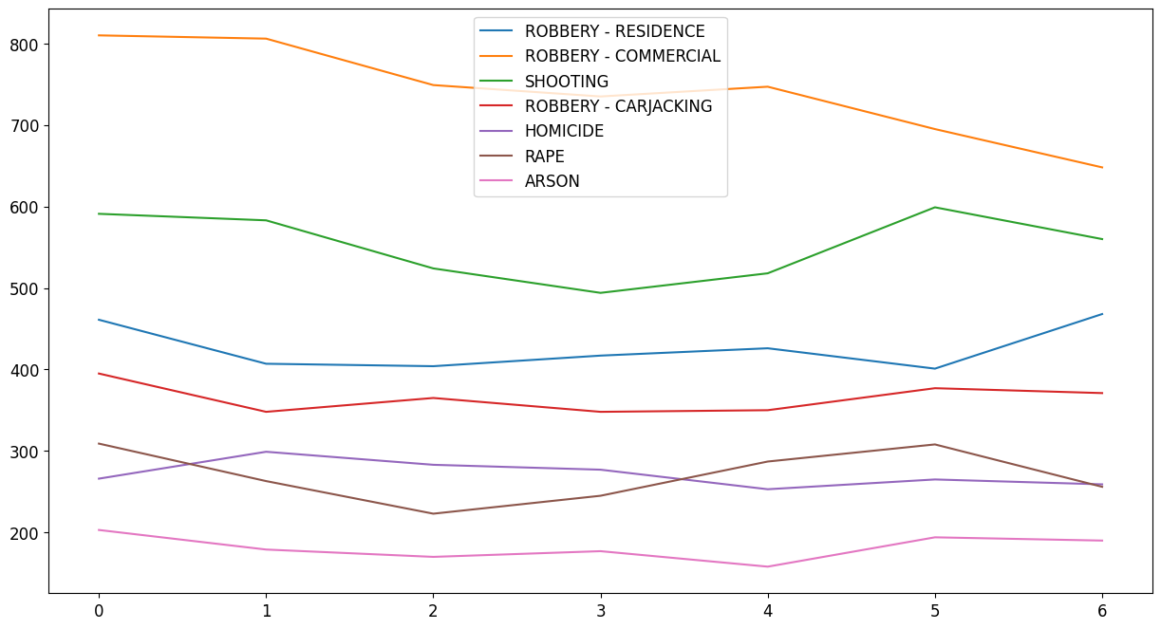
Plot 2 for variation of Crime types over different days of the week

Slide 19
Crime based on weapons used

Slide 20
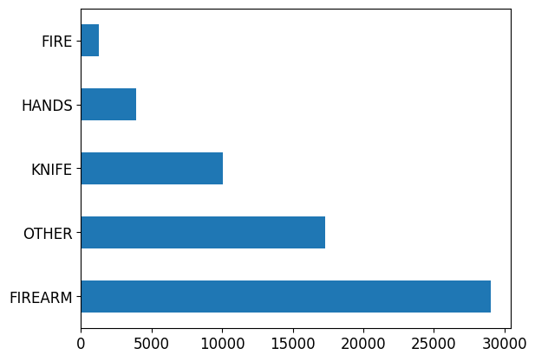
As we can see most, of the crime are done by using the firearm weapon.

