Slide 1
Application of risk parity model and machine learning model
in asset allocation
華敏學 R08725051
Youtube影片：https://youtu.be/ukgFZsasA1Q

Slide 2
+
01
BACKGROUND
CONTENTS
02
RISK PARITY
03
IMPROVMENT
+

Slide 3
PART ONE
BACKGROUND

Slide 4
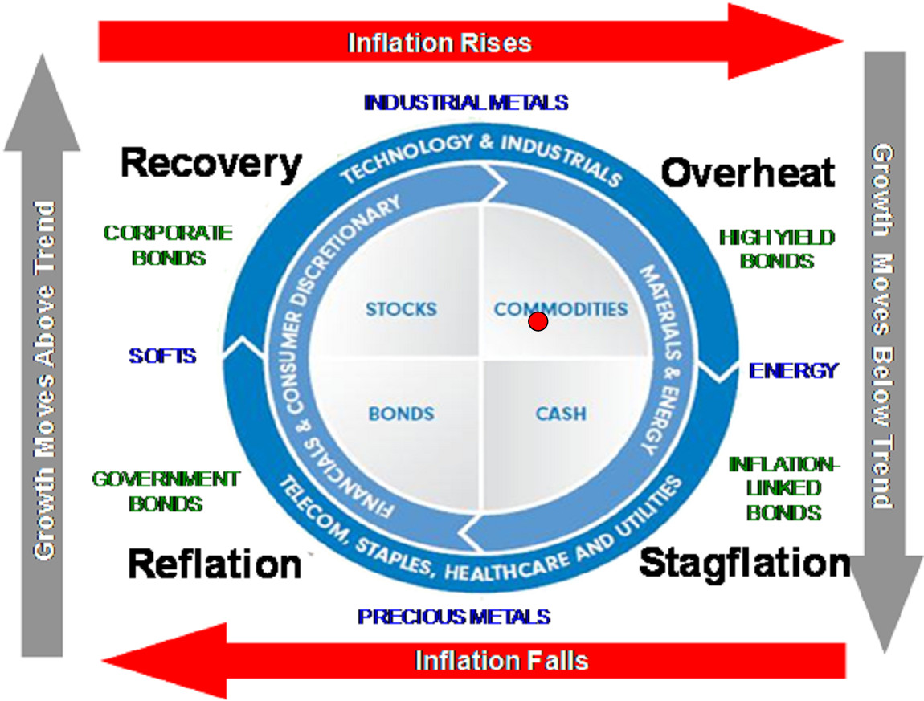
Diversification of investment risk has always been the core research problem of portfolio construction.In recent years, affected by the impact of the external market, the volatility of the financial market has increased and fluctuated violently, and the price of financial assets has fallen to different degrees.
In this market environment, all kinds of investment funds are faced with greater investment risks. If the risks of fund portfolio cannot be controlled within a reasonable range, they will eventually be liquidated.
Instead of putting all your eggs in one basket, fund managers focus on allocating funds across asset classes

Slide 5
PART TWO
RISK PARITY

Slide 6
Risk Parity Model
The risk parity strategy aims at simultaneously considering the risk of individual assets in the portfolio and the synergic risk among assets, so as to make the risk of each asset.
The risk contribution is the same to achieve the purpose of optimizing the portfolio risk.
Portfolio Returns
Rf
β
α
(Rm - Rf)

Slide 7
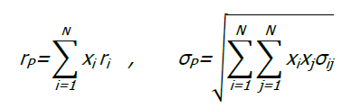




Ri and Xi respectively represent the return and weight of assets, and the return and standard deviation of the portfolio can be expressed as:
The marginal risk contribution of assets can be expressed as:
After knowing the marginal risk contribution and multiplying by the corresponding weight, we can get the total risk contribution:
Risk parity requires the risk contribution of each risk factor in the portfolio to be equal:

Slide 8
PART THREE
IMPROVMENT

Slide 9
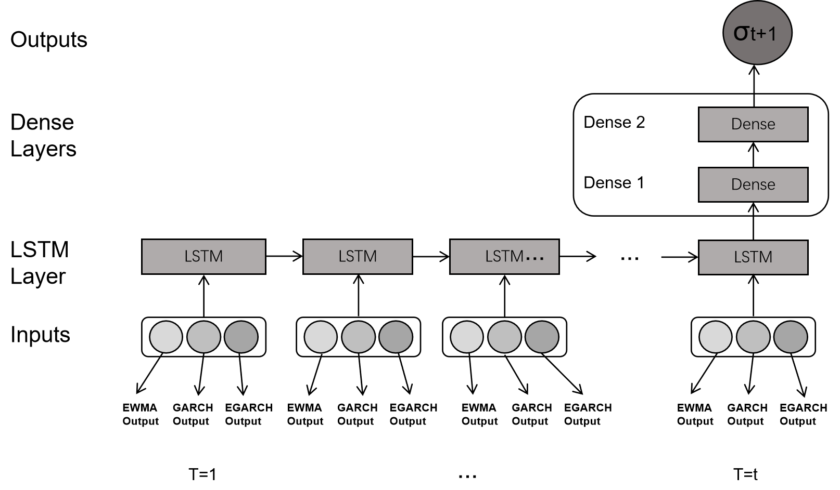
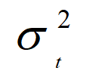
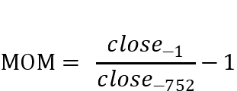
The measurement of volatility is calculated by the garch model + LSTM model
The index data is D_J，Nada，GG，SP500 and PX_LAST five index data, the volatility rate data is used to use the volatility rate of the five indexes that are predicted by the egarch, garch, LSTM and garzen LSTM.
 | My | EWMA | GARCH | EGARCH
MSE | 0.0000075 | 0.0000161 | 0.0000102 | 0.0000100
MAE | 0.0019246 | 0.0029154 | 0.0019944 | 0.0020566

Slide 10
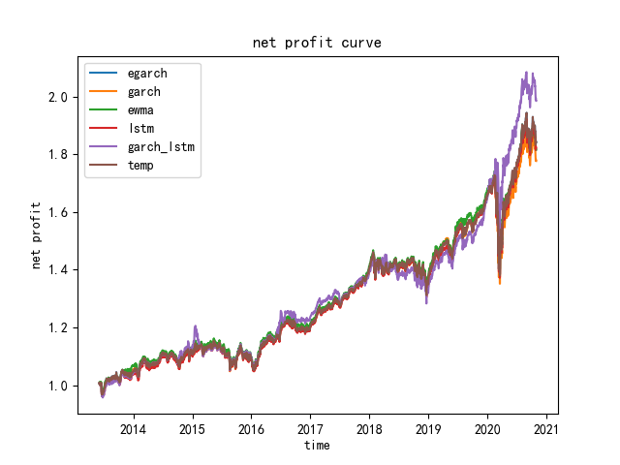
 | Cumulative Return | Annualized Return | Annualized Volatility | Sharp Rate | Maxdown
EGARCH | 84.28% | 8.60% | 10.52% | 0.82 | 20.10%
GARCH | 77.69% | 8.07% | 10.83% | 0.74 | 21.54%
EWMA | 81.57% | 8.38 | 10.19% | 0.82 | 19.76%
GARCH-LSTM | 98.55% | 9.70% | 10.43% | 0.93 | 15.22%

Slide 11
THANK YOU!

