Slide 1
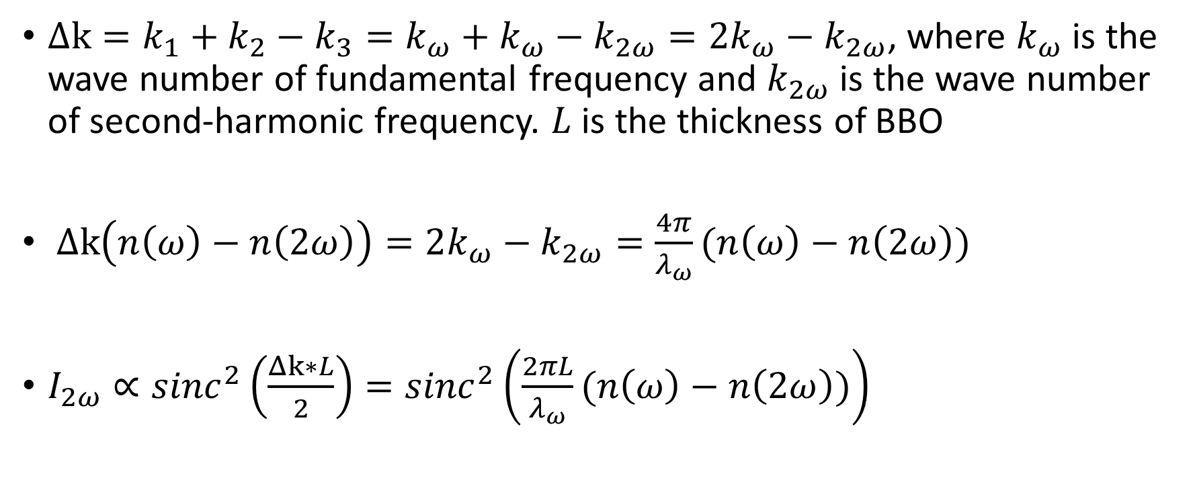
Intensity as a function of refractive index
$Δk=k_{1}+k_{2}−k_{3}=k_{ω}+k_{ω}−k_{2ω}=2k_{ω}−k_{2ω}$, where $k_{ω}$ is the wave number of fundamental frequency and $k_{2ω}$ is the wave number of second-harmonic frequency. $L$ is the thickness of BBO
$Δk\left(n\left(ω\right)−n\left(2ω\right)\right)=2k_{ω}−k_{2ω}=\frac{4π}{λ_{ω}}(n\left(ω\right)−n\left(2ω\right))$
$I_{2ω}∝{sinc}^{2}\left(\frac{Δk∗L}{2}\right)={sinc}^{2}\left(\frac{2πL}{λ_{ω}}(n\left(ω\right)−n\left(2ω\right))\right)$

Slide 2


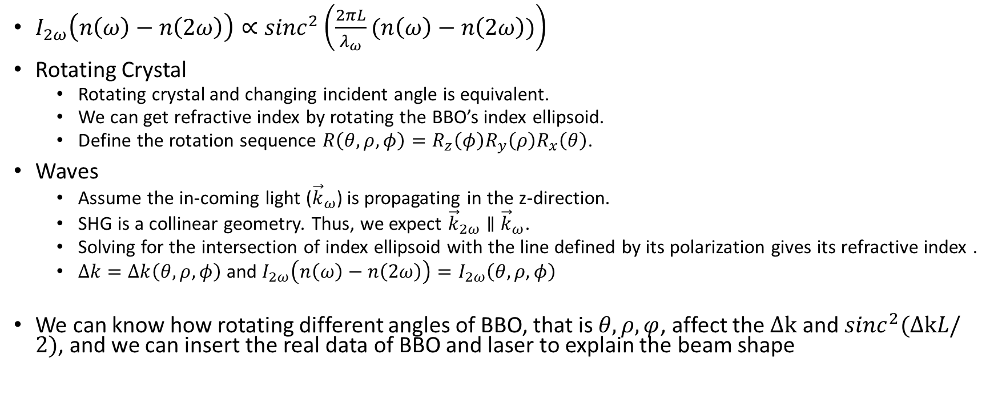



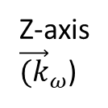

The relation of BBO angles and intensity
Z-axis
${\vec{(k}}_{ω}$)
$$φ$$
$I_{2ω}\left(n\left(ω\right)−n\left(2ω\right)\right)∝{sinc}^{2}\left(\frac{2πL}{λ_{ω}}(n\left(ω\right)−n\left(2ω\right))\right)$
Rotating Crystal
Rotating crystal and changing incident angle is equivalent.
We can get refractive index by rotating the BBO’s index ellipsoid.
Define the rotation sequence $R\left(θ,ρ,φ\right)=R_{z}\left(φ\right){R_{y}\left(ρ\right)R}_{x}\left(θ\right)$.
Waves
Assume the in-coming light (${\vec{k}}_{ω}$) is propagating in the z-direction.
SHG is a collinear geometry. Thus, we expect ${\vec{k}}_{2ω}∥$ ${\vec{k}}_{ω}$.
Solving for the intersection of index ellipsoid with the line defined by its polarization gives its refractive index .
$Δk=Δk\left(θ,ρ,φ\right)$ and $I_{2ω}\left(n\left(ω\right)−n\left(2ω\right)\right)=I_{2ω}\left(θ,ρ,φ\right)$
We can know how rotating different angles of BBO, that is $θ,ρ,φ$, affect the $Δk$ and ${sinc}^{2}(ΔkL/2)$, and we can insert the real data of BBO and laser to explain the beam shape
$$θ$$
$$ρ$$
X-axis
Y-axis

Slide 3
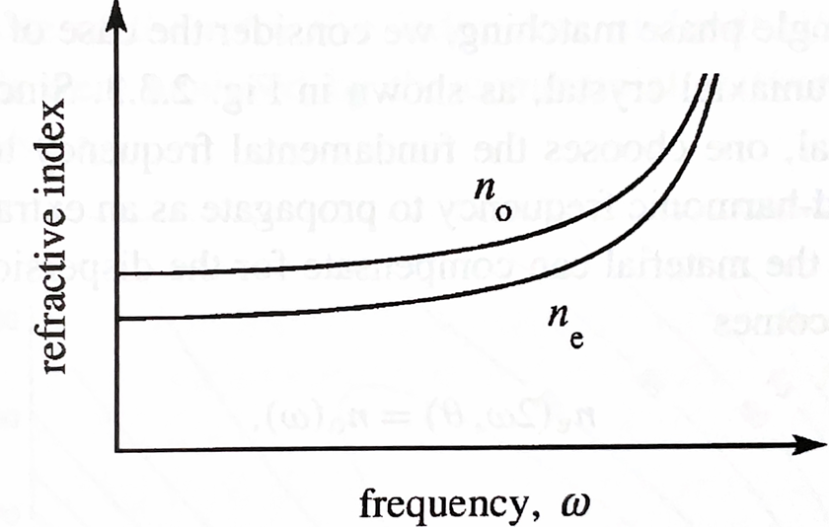
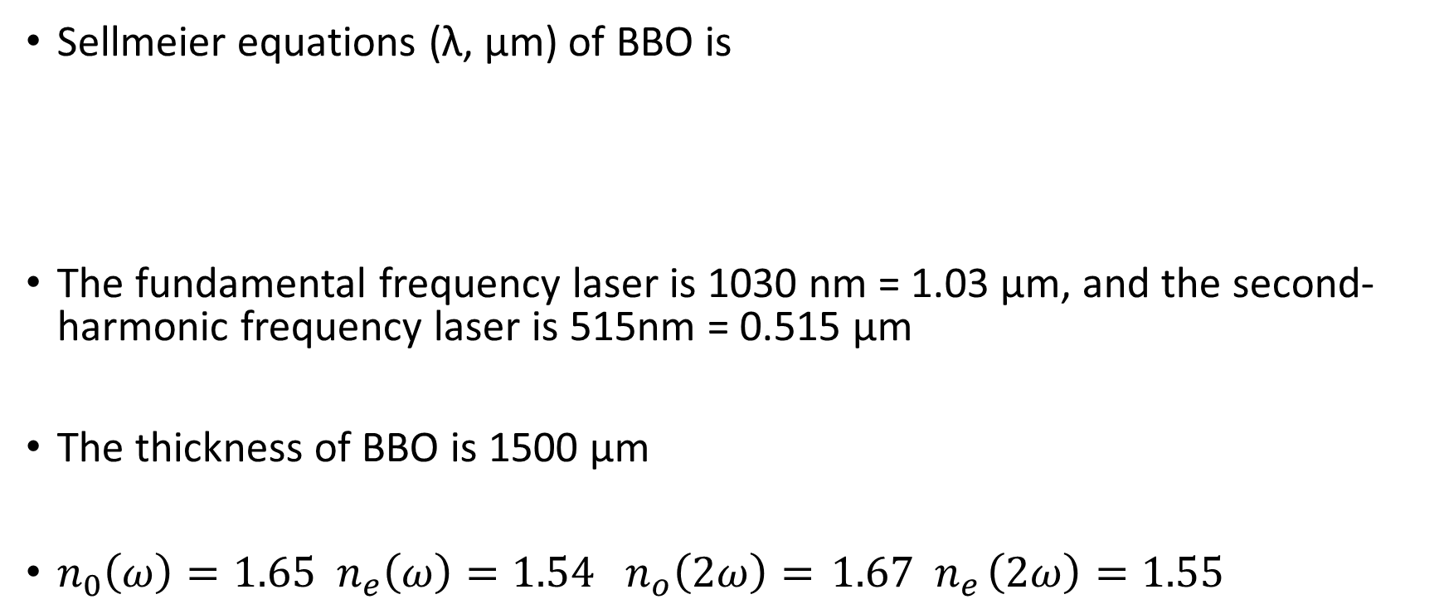
The parameter of BBO and laser
Sellmeier equations (λ, μm) of BBO is
The fundamental frequency laser is 1030 nm = 1.03 μm, and the second-harmonic frequency laser is 515nm = 0.515 μm
The thickness of BBO is 1500 μm
$n_{0}\left(ω\right)=1.65 { n}_{e}\left(ω\right)=1.54 n_{o}\left(2ω\right)={ 1.67 n}_{e}\left(2ω\right)=1.55$

Slide 4
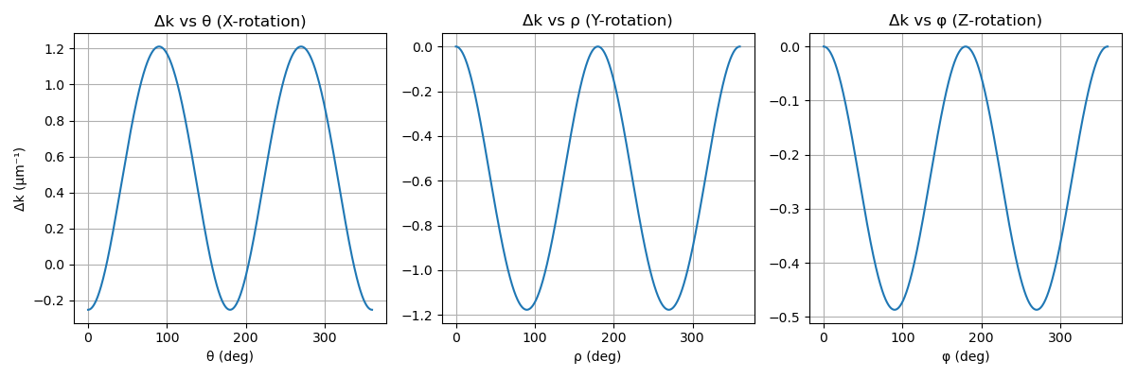
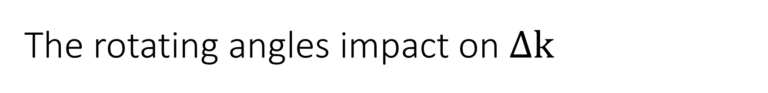
The rotating angles impact on $Δk$

Slide 5
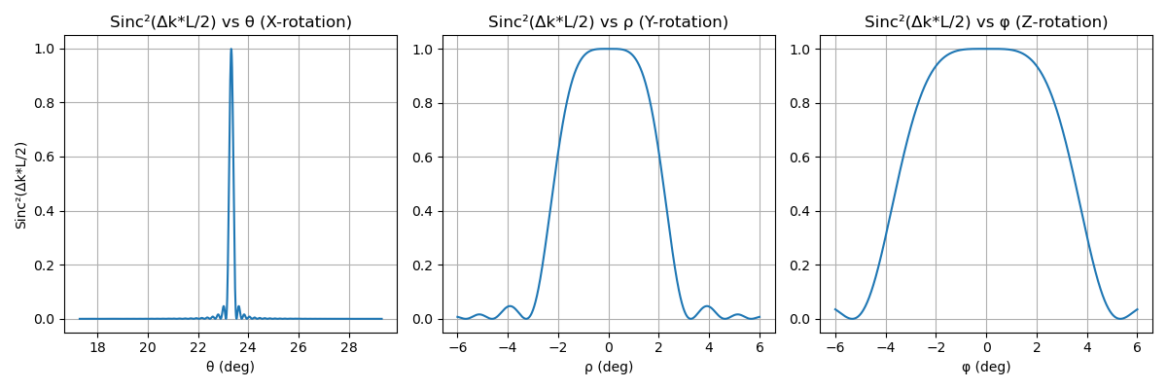








The rotating angles impact on intensity
The red line represents half intensity for comparing their impact
The green line represents the first zero intensity beside center
$$−2.18°$$
$$2.18°$$
$$−5.35°$$
$$−3.55°$$
$$3.55°$$
$$5.35°$$
$$−3.27°$$
$$3.27°$$

Slide 6
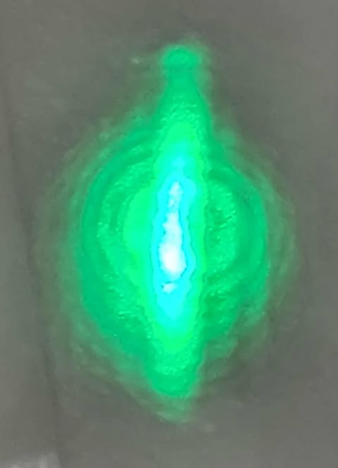
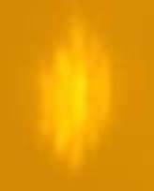
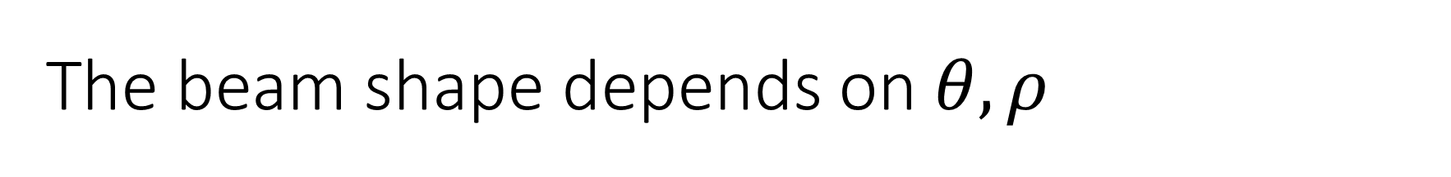


The beam shape depends on$θ,ρ$
$$ρ$$
$$θ$$
(picture through goggle)

Slide 7
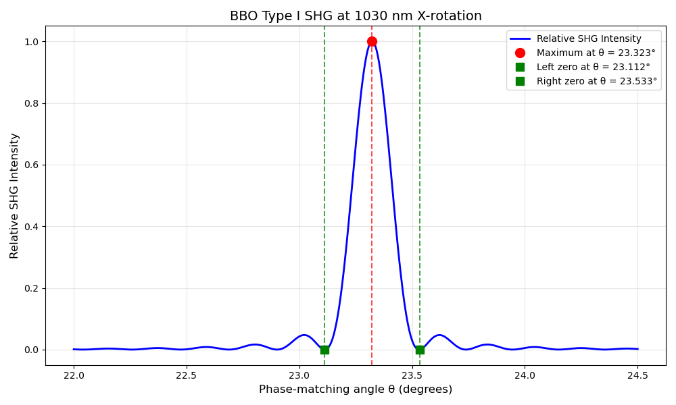

The beam shape depends on$θ,ρ$
0.421$°$

Slide 8
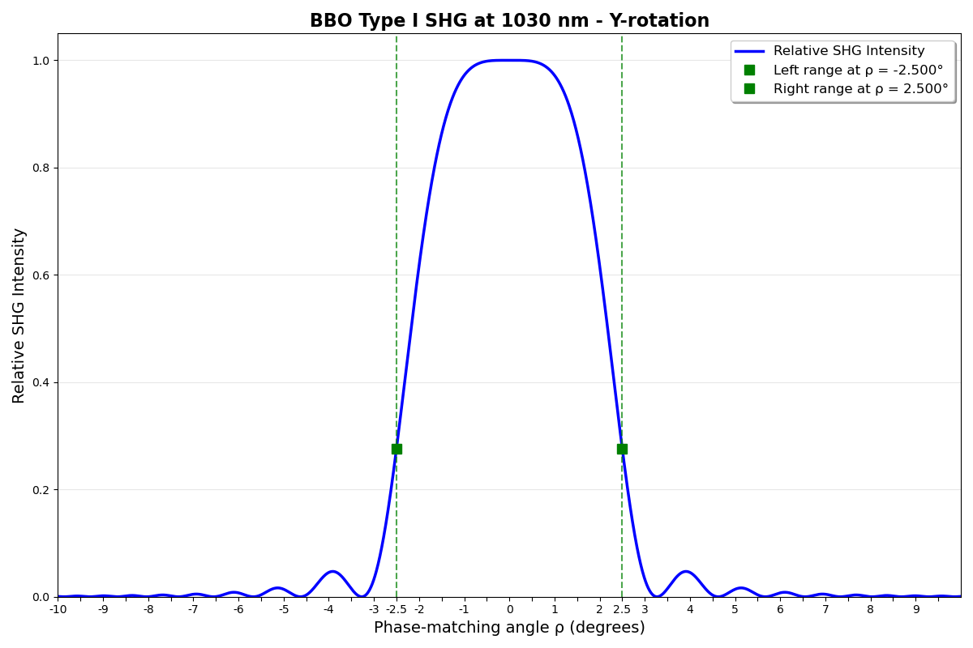

The beam shape depends on$θ,ρ$
5$°$

Slide 9
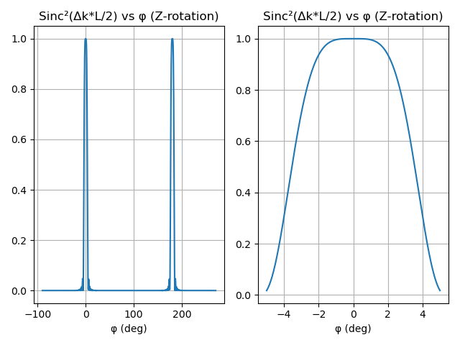
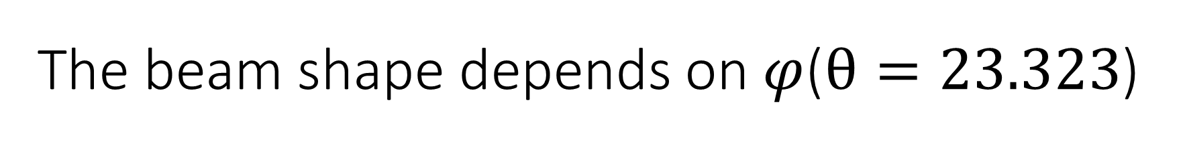
The beam shape depends on$φ$($θ=23.323$)

Slide 10
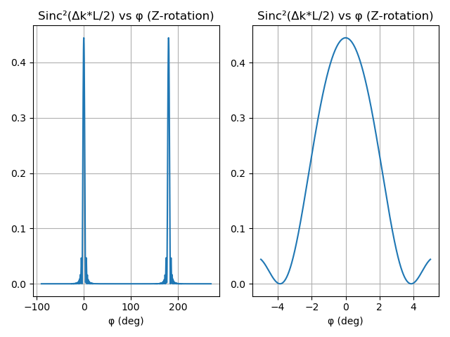
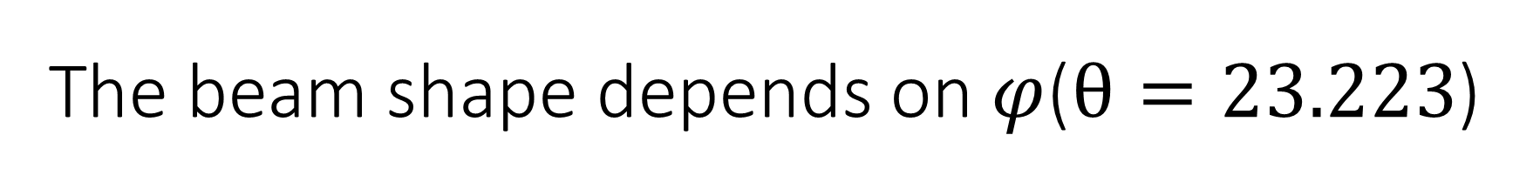
The beam shape depends on$φ$($θ=23.223$)

Slide 11
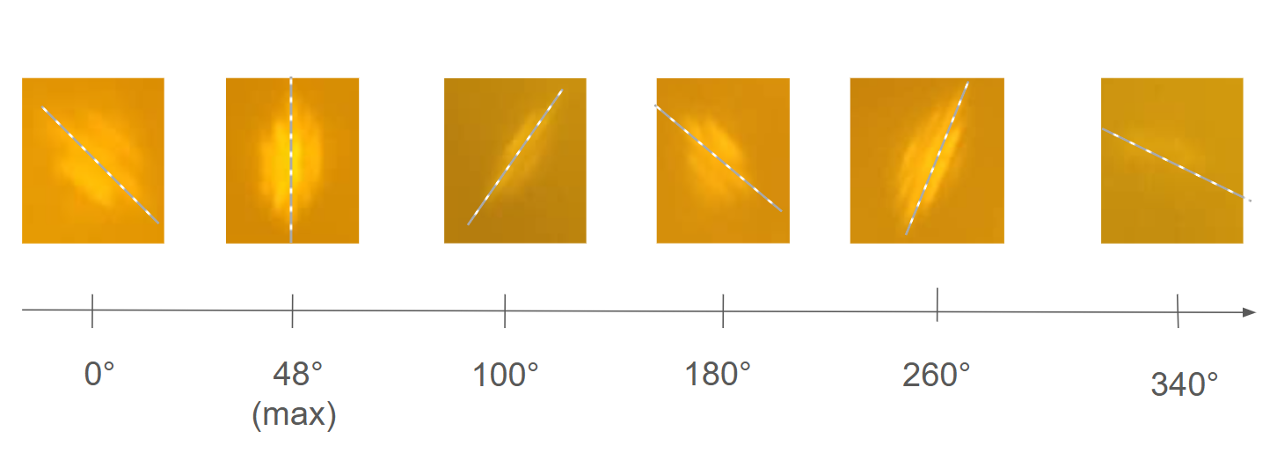
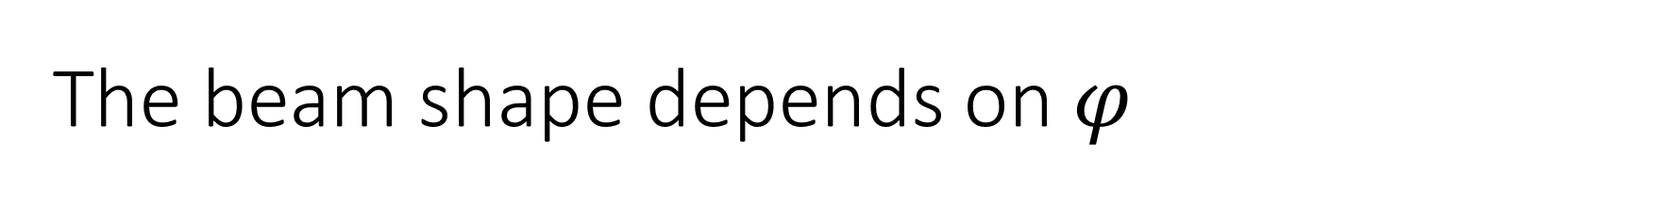
The beam shape depends on$φ$

Slide 12
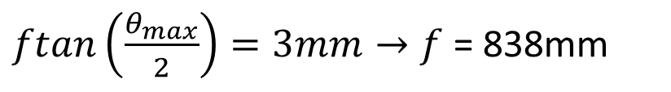


Make the light appear in central bright fringe
The range of angle in the central bright fringe is $θ_{max}=0.421°$
The input beam diameter is 6mm
Is it possible to find a lens which focus length(f) reach our goal?
$$0.421°$$
$ftan\left(\frac{θ_{max}}{2}\right)=3mm→f$ = 838mm
f
It’s not feasible!!
6mm

