Slide 1
Hotel Pickup Similar-Day Selection
Pareto multi-objective optimization for the second-stage selection
Why change?
Recommended decision flow
The business has two objectives that can conflict:
KNN
Pareto
Business rule
1 Maximize Pickup
→
→
2 Keep Block Size close to Today
15 similar-day
candidates
Remove dominated
candidates
Select final
similar day
Key idea: this is a multi-objective optimization problem, so we should first identify the Pareto-optimal candidates rather than force the two objectives into one score.

Slide 2
1. Why This Is a Multi-Objective Optimization Problem
Objective A
Objective B
The conflict
Maximize Pickup
Minimize Block Size Gap vs. Today
A higher-Pickup day may have a larger Block Size gap, and vice versa.
Therefore, there is no single “best” candidate unless the business defines how to trade off the two objectives.
Why Pareto?
It removes candidates that are worse on both objectives, while keeping the meaningful trade-offs. No arbitrary 70/30 weighting is required upfront.

Slide 3
2. Pareto Logic: Remove Dominated Candidates
Higher Pickup is better; smaller Block Size Gap is better
Pickup ↑
Dominance example
B has both higher Pickup and a smaller Block Size Gap than D. Therefore, D is dominated by B and can be removed.
C 35% / 10%
B 28% / 5%
Pareto frontier
D 25% / 12%
A, B and C each represent a different trade-off. None is better than another on both objectives, so all remain Pareto-optimal.
A 20% / 2%
E 18% / 15%
Block Size Gap →

Slide 4
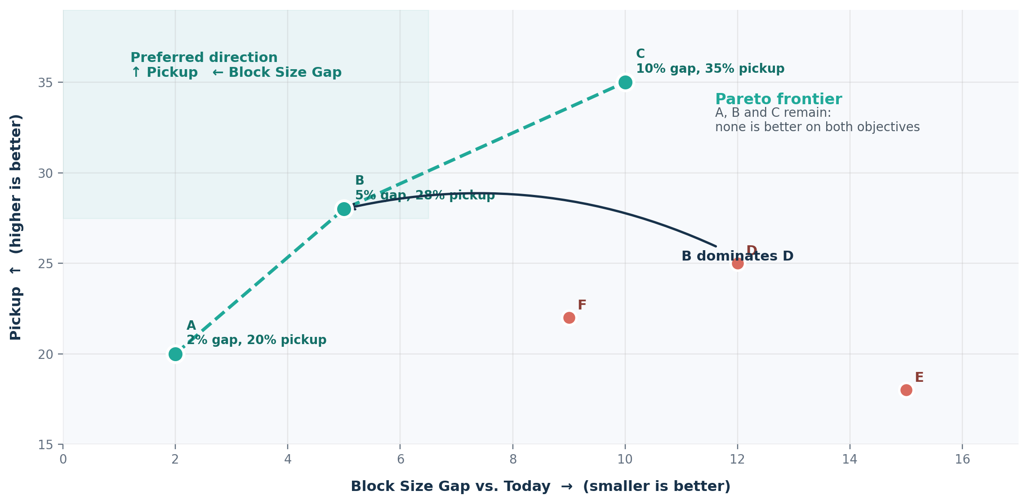
3. Pareto Frontier: Keep Only Meaningful Trade-offs
A candidate is removed only when another candidate is better on both Pickup and Block Size Gap.
Pareto-optimal
A, B and C stay because each offers a different trade-off.
Dominated
D is removed because B has both higher Pickup and a smaller Block Size Gap.
Key takeaway
Pareto reduces the candidate set without forcing an arbitrary weight between the two objectives.
4

Slide 5
4. How Many Similar Days Can Remain?
The number is not fixed — it depends on the dominance relationships among the 15 candidates
Case A | 1 remains
Case B | Several remain
Case C | All 15 remain
Example
A: 32% pickup / 3% gap
B: 25% / 6% C: 20% / 12%
Example
A: 20% / 2% B: 28% / 5%
C: 35% / 10% D: 25% / 12%
Example
A: 20% / 2% B: 25% / 4%
C: 30% / 7% D: 35% / 10%
A dominates B and C → only A remains.
B dominates D; A, B and C remain as trade-offs.
If this pattern continues across all 15, all 15 remain.
Pareto does not guarantee one final day. It guarantees that clearly inferior choices are removed first.

Slide 6
5. Pareto vs. Current Z-score Screening
Dimension
Current Z-score Screening
Pareto Multi-Objective Optimization
Purpose
Standardizes a metric relative to mean and standard deviation
Directly handles the two business objectives
Business interpretation
“How many standard deviations from the mean?”
“Higher Pickup, smaller Block Size Gap”
Dependence on candidates
Mean / SD can shift with outliers or with the 15-day composition
No mean or SD required; based on dominance
Trade-off handling
Z-score alone does not resolve the conflict; thresholds or weights are still needed
Keeps non-dominated trade-offs without weights upfront
Recommended role
Useful for standardization or anomaly screening
Better fit for second-stage multi-objective candidate selection
Recommended flow: KNN → 15 Candidates → Pareto Filtering → Business Constraint → Final Pick

