Slide 1


Hong Kong Airport
Tax Refund Project
PROJECT SHARING
July 2026

Slide 2
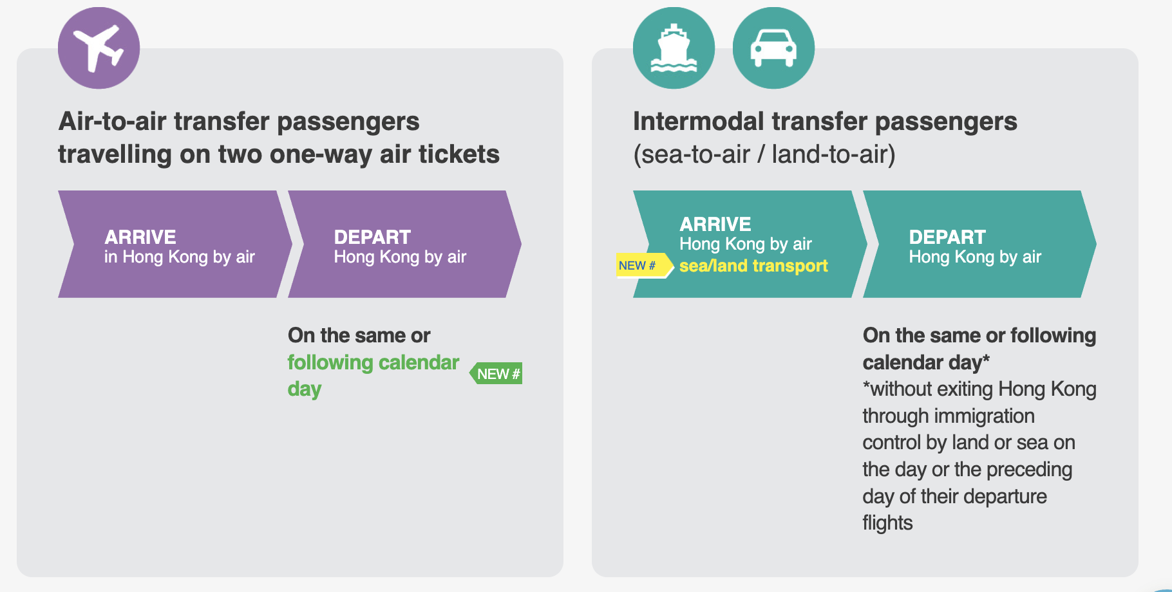
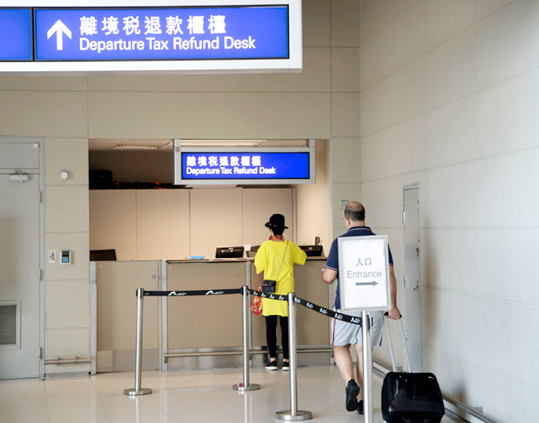

Air Passenger Departure Tax Refund
Business scope: main eligible and non-eligible APDT refund cases before AI document processing.
APDT baseline
Main eligible situations
Tax is paid with eligible air tickets
Refund outcome depends on trip path and proof documents
Required documents
AI models help read trip proofs, tickets, receipts, forms, dates, and scenario evidence for eligibility decisions.
2

Slide 3

Document Processing Workflow
Upload
→
PaddleOCR
pass
1
2
→
→
4A
Validate
Confidence
check
Image / PDF
Small-model first pass text
field rules
JSON output
→
Not Pass
QwenVL2.5
still fail
→
Human review
3
4
Fallback for hard layouts
and missing fields
Route easy documents through OCR first; reserve QwenVL2.5 capacity for ambiguous cases.
3

Slide 4
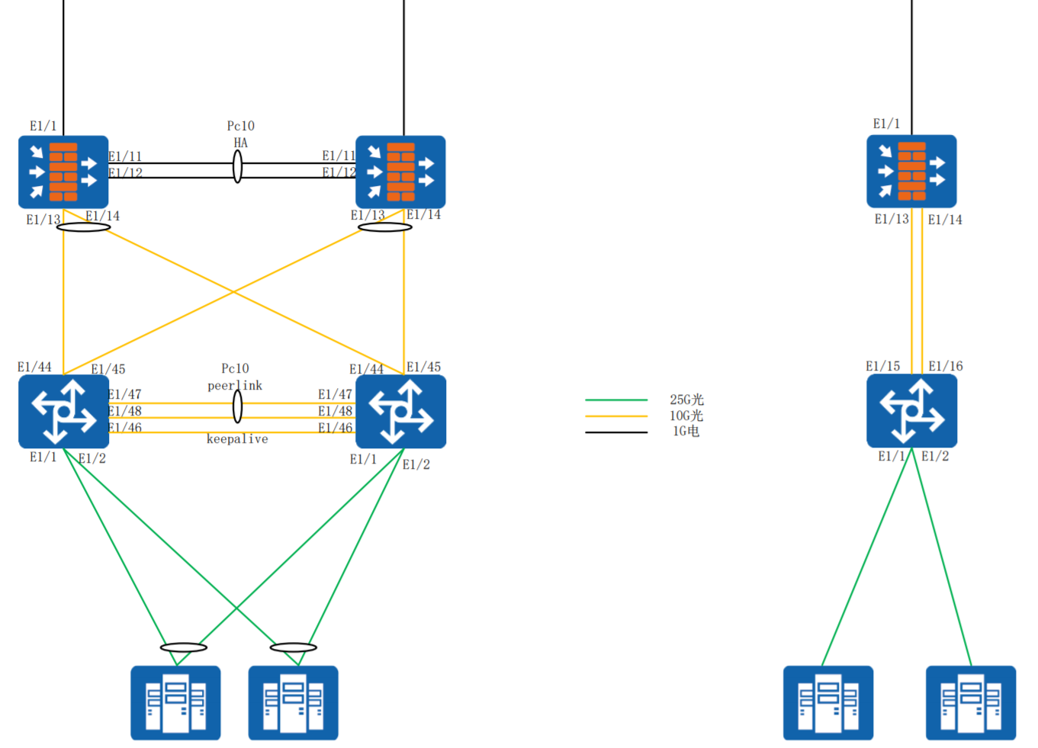
PROD
SQCC
AI Infrastructure
168.106.0.0/16
172.16.0.0/12
168.106.0.0/16
172.16.0.0/12
168.106.22.30
42.200.32.39
GPU Infrastructure
DIA 100M
DIA 100M
3 × AI Servers, each equipped with 8 × Huawei Ascend 910B GPUs
Production: 2 servers (16 GPUs)
Testing / UAT: 1 server (8 GPUs)
103.107.91.34/29
GW:103.107.91.33
E1/1
103.239.177.226/29
GW:103.239.177.225
Network Architecture
Dedicated leased line connection to airport servers
Production and Test environments are physically isolated
Availability & Security
On-premises inference with all models hosted locally
Dedicated Firewall
172.16.10.146/29 172.16.10.147/29
GW:172.16.10.145 GW:172.16.10.145
172.16.10.146/29 -172.16.10.147/29
GW:172.16.10.145
HK8-301-C19
HK8-301-C18
HK8-301-C20
3

Slide 5
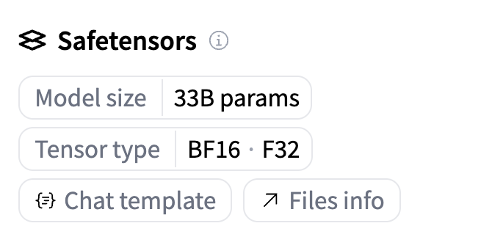
LLM Concurrency Calculation (Why 2 AI servers)
Capacity is constrained by KV cache memory, not only by total card count.
2 × 8
2 × 4
10K
512 GB
910B cards in production
Cards allocated to QwenVL2.5
Configured context window
Total VRAM
Model Weights (Qwen2.5-VL-32B)
KV cache
32B × 2 (FP16) x 2 (2 server) = 128 GB
2 (K + V) × 64 layers × 8 KV heads × 128 head dim × 2 bytes(FP16) = 256K/token
~8
256K/token * 10K token= 2.5 GB/request
VRAM (KV cache) = 512 GB * 0.8 (buffer) – 126 GB = 281.6GB Max Concurrency = 281.6/2.5 = 112 request
Shorter contexts can support higher batch concurrency; 128K should be treated as worst-case sizing.
7

