Slide 1
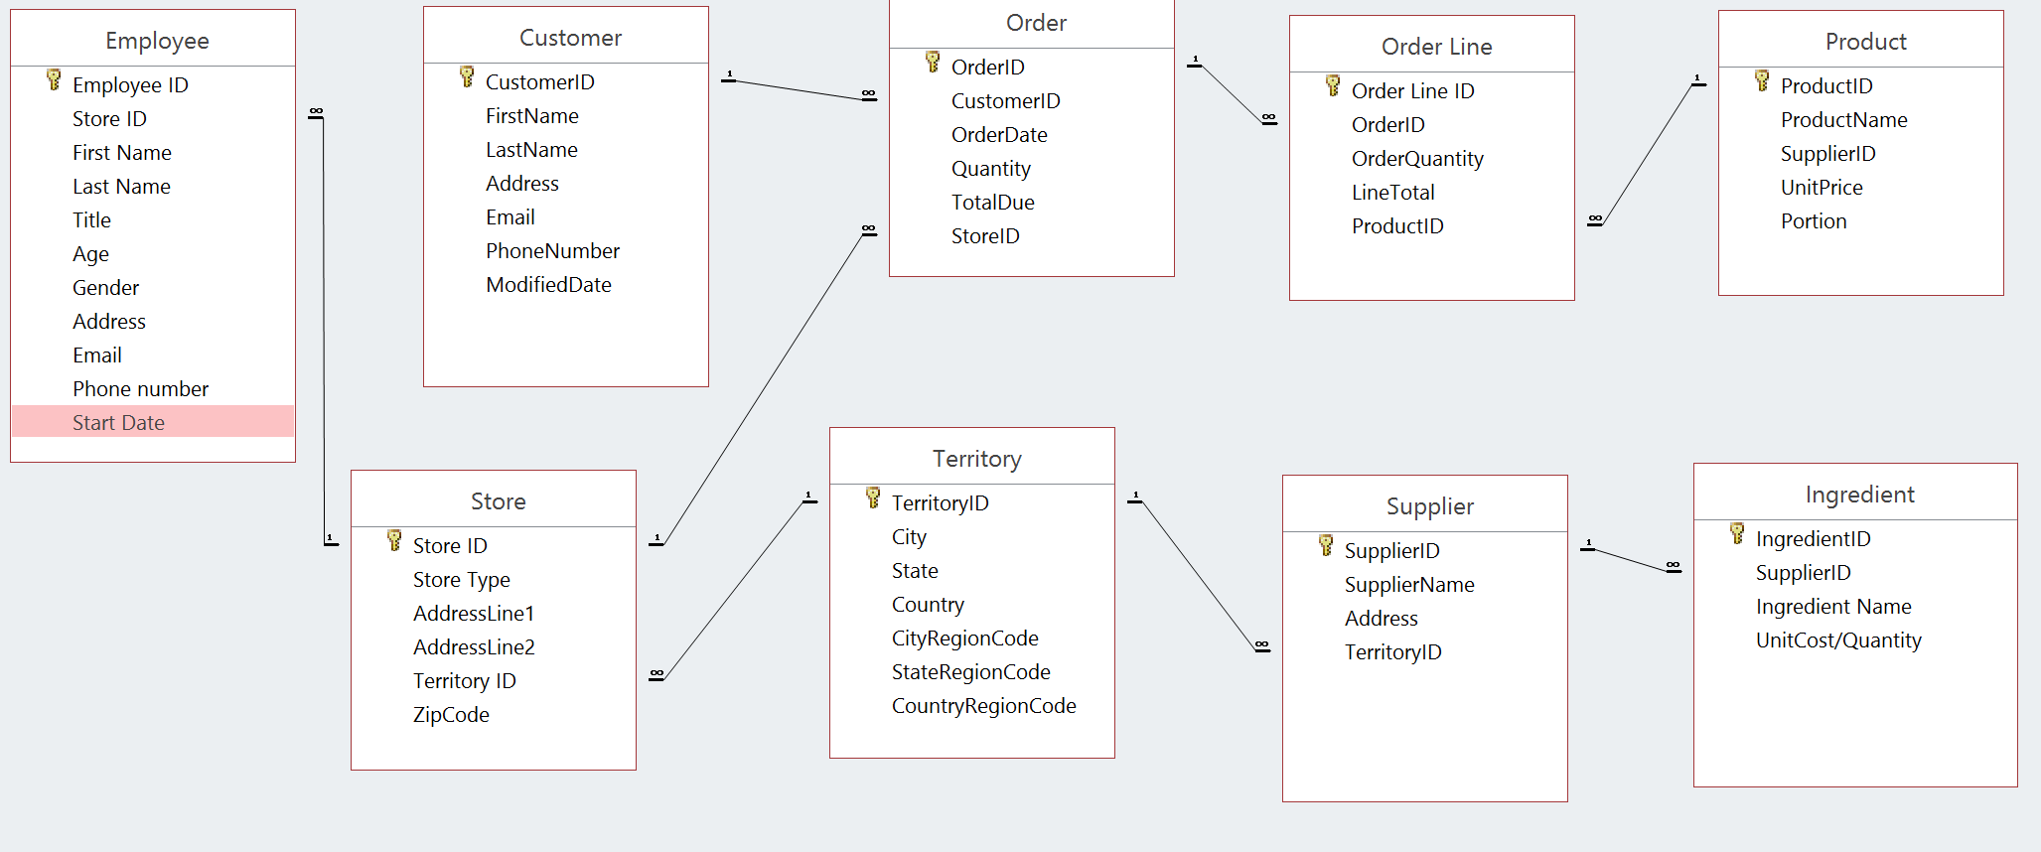
teamChipotle_dbdesign.pptx

Slide 2
Company Background
Chipotle Mexican Grill, Inc. (Chipotle), together with its subsidiaries, operates Chipotle Mexican Grill restaurants. The Company's Chipotle Mexican Grill restaurants serve a menu of burritos, tacos, burrito bowls (a burrito without the tortilla) and salads. As of December 31, 2016, the Company managed its operations and restaurants based on 11 regions, 29 of its restaurants were located outside of the United States, with 17 in Canada, six in the United Kingdom, five in France and one in Frankfurt, Germany. The field team are the employees who work closely with but not directly within specific restaurants. The field support system includes apprentice team leaders (step up from restaurateurs), team leaders or area managers, team directors and regional directors. Because Chipotle doesn't franchise, all restaurants are corporately owned. https://www.reuters.com/finance/stocks/company-profile/CMG.N
The team members are Huateng Zhang, Lingxiao Lyu, and Zirui Jiao.
Assumptions:
A store has many employees while an employee can only work for one store
A supplier can provide multiple types of ingredients while one type of ingredients can only be provided by one supplier
A customer can put several orders while one order can only be put by one customer.

