Slide 1
PROJECT PRESENTATION
,,SECURITY ANALYSIS OF ARTIFICIAL INTELLIGENCE MODELS IN THE CONTEXT OF ADVERSARIAL ATTACKS AND A COMPARISON OF IBM ADVERSARIAL ROBUSTNESS TOOLBOX (ART) AND FOOLBOX’’

Slide 2
Adversarial Attacks
01
minimal changes to input data
02
lead to incorrect model classification
03
difficult to detect

Slide 3
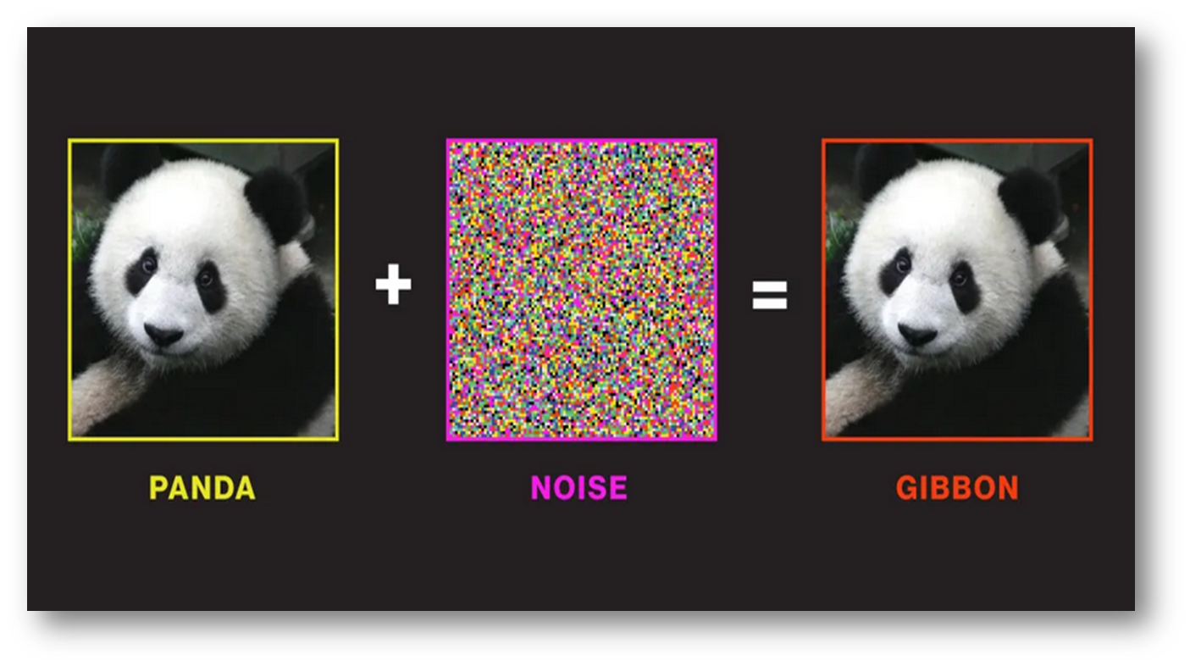
EXAMPLE OF AN ADVERSARIAL ATTACK

Slide 4
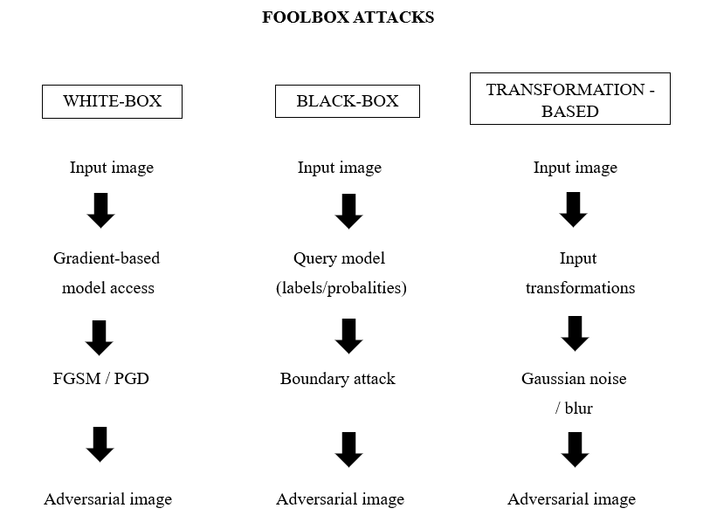
FOOLBOX – TYPES OF ADVERSARIAL ATTACKS

Slide 5
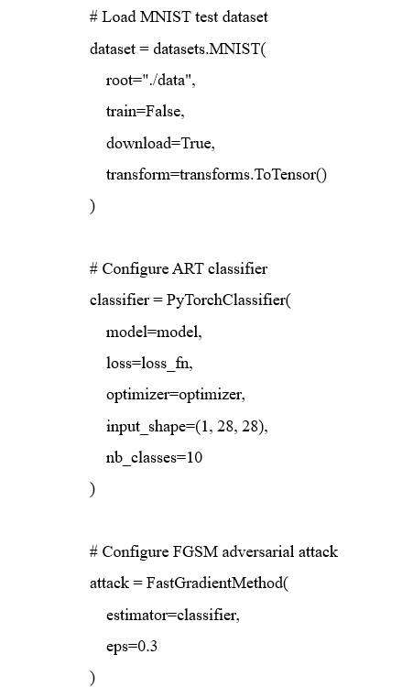

MNIST Model Implementation – Test Data Preparation and ART Classifier Configuration

Slide 6
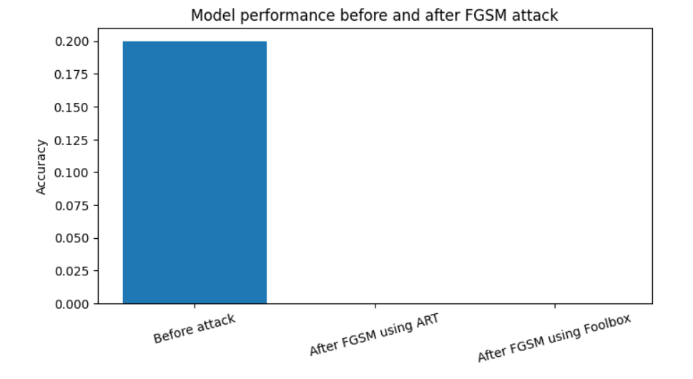

RESULTS – MODEL ACCURACY BEFORE AND AFTER THE FGSM ATTACK

Slide 7
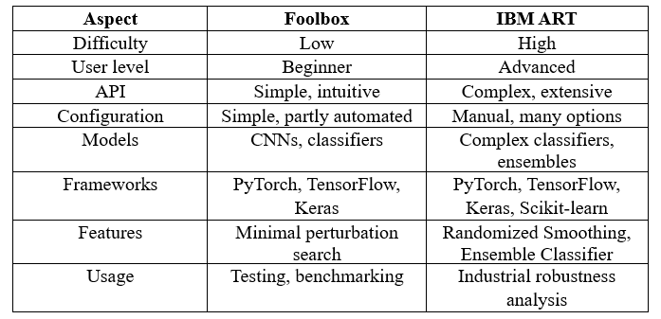

TOOL COMPARISON: FOOLBOX VS ART

Slide 8
REFERENCES
becyber.pl. Adversarial Attacks on AI – What They Are and How to Protect Against Them. https://becyber.pl/ataki-adwersarialne-na-ai-co-to-jest-i-jak-sie-chronic/
Option E
MIT Technology Review. How We Might Protect Ourselves from Malicious AI. (2019). https://www.technologyreview.com/2019/05/19/135299/how-we-might-protect-ourselves-from-malicious-ai/
Option D
Madry, A., Makelov, A., Schmidt, L., Tsipras, D., & Vladu, A. Towards Deep Learning Models Resistant to Adversarial Attacks. (2018). https://arxiv.org/abs/
1706.06083
Option C
Option B
Foolbox Documentation.
Adversarial Attacks.
https://foolbox.
readthedocs.io/
en/stable/modules/attacks.html
Option A
gov.pl. Threats to AI-Based Systems. https://www.gov.pl/web/baza-wiedzy/zagrozenia-dla-systemow-wykorzystujacych-ai

Slide 9
THANK YOU FOR YOUR ATTENTION

