Slide 1
Dossier ‘A’
Top Bottom : Top depends on bottom
Project A
Project B
Dossier ‘D’
Dossier ‘E’
Dossier ‘C’
Project C
Project D
Project E
Dossier ‘G’
Project F
Project G

Slide 2
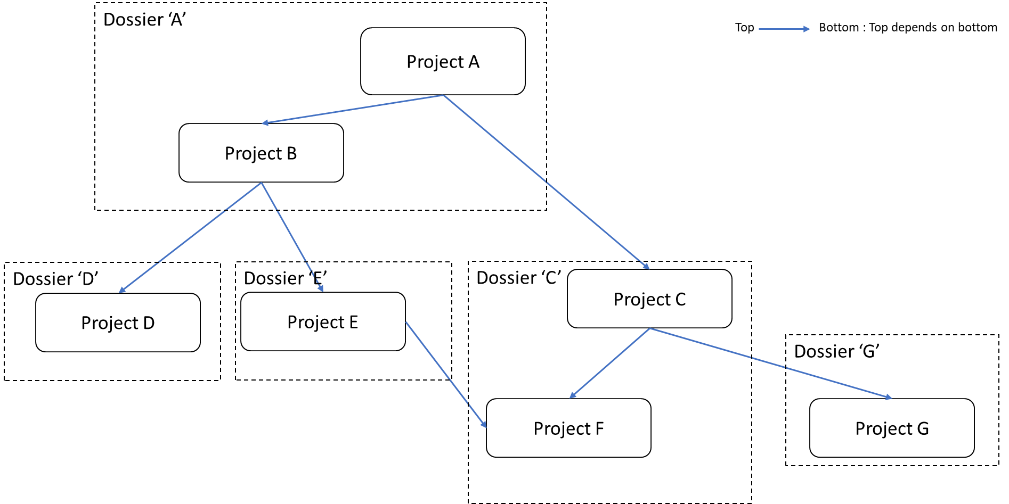
📁 A
├─📁 B
└─📄kiss.yaml
📁 D
└─📄kiss.yaml
📁 E
└─📄kiss.yaml
📁 C
├─📁 F
└─📄kiss.yaml
📁 G
└─📄kiss.yaml

Slide 3
Binary project (elf, .exe)
name: name of the project
- 1er caractère : lettre ASCII (maj/min) ou _
- caractères suivants : lettres, chiffres ou _
version: SemVer version
description: description of the project
path: path of the project, (optional, kiss.yaml directory if not set)
sources: list of source
- relative to my_bin:path directory
- absolute (Warning if build on absolute path)
- * -> n’importe quelle suite de caractères sauf séparateur
- ** -> tous les fichiers et dossiers récursivement
- ? -> un seul caractère ( src? -> src0, src1, srcA, etc…)
dependencies: list of dependencies
name : name of the dependency
path : path of the dependency, (optional, name if not set)
git : git address of the repo to clone
branch : branch to clone (optional)
📁 my_bin
└─📄kiss.yaml
bin:
- name: my_bin
version: 0.1.0
description: This is project my_bin
sources:
- src\main.cpp
dependencies:
- name: dep_b
- name: dep_c
path: ../C
- name: dep_git
git : git@...
branch : dev

Slide 4
Static library project (.a, .lib)
name: name of the project
- 1er caractère : lettre ASCII (maj/min) ou _
- caractères suivants : lettres, chiffres ou _
version: SemVer version
description: description of the project
path: path of the project, (optional, kiss.yaml directory if not set)
sources: list of source
- relative to B:path directory
- absolute (Warning if build on absolute path)
- * -> n’importe quelle suite de caractères sauf séparateur
- ** -> tous les fichiers et dossiers récursivement
- ? -> un seul caractère ( src? -> src0, src1, srcA, etc…)
interface_directories: list of interface directories
- relative to my_lib:path directory
- absolute (Warning if build on absolute path)
dependencies: list of dependencies
name : name of the dependency
path : path of the dependency, (optional, name if not set)
git : git address of the repo to clone
branch : branch to clone (optional)
📁 my_lib
└─📄kiss.yaml
lib:
- name: my_lib
version: 0.1.0
description: This is project my_lib
sources:
- src\lib.cpp
interface_directories:
- interface\my_lib
dependencies:
- name: dep_b
- name: dep_c
path: ../C
- name: dep_git
git : git@...
branch : dev

Slide 5
Dynamic library project (.so, .dll)
name: name of the project
- 1er caractère : lettre ASCII (maj/min) ou _
- caractères suivants : lettres, chiffres ou _
version: SemVer version
description: description of the project
path: path of the project, (optional, kiss.yaml directory if not set)
sources: list of source
- relative to B:path directory
- absolute (Warning if build on absolute path)
- * -> n’importe quelle suite de caractères sauf séparateur
- ** -> tous les fichiers et dossiers récursivement
- ? -> un seul caractère ( src? -> src0, src1, srcA, etc…)
interface_directories: list of interface directories
- relative to my_lib:path directory
- absolute (Warning if build on absolute path)
dependencies: list of dependencies
name : name of the dependency
path : path of the dependency, (optional, name if not set)
git : git address of the repo to clone
branch : branch to clone (optional)
📁 my_dyn
└─📄kiss.yaml
dyn:
- name: my_dyn
version: 0.1.0
description: This is project my_dyn
sources:
- src\dyn.cpp
interface_directories:
- interface\my_dyn
dependencies:
- name: dep_b
- name: dep_c
path: ../C
- name: dep_git
git : git@...
branch : dev

Slide 6
Workspace
📁 my_workspace
└─📄kiss.yaml
name: name of the workspace
- 1er caractère : lettre ASCII (maj/min) ou _
- caractères suivants : lettres, chiffres ou _
version: SemVer version
description: description of the project
path: path of the workspace, (optional, kiss.yaml directory if not set)
projects: list of project to include in the workspace
- relative to my_workspace:path directory
- absolute (Warning if build on absolute path)
default: name of the default project
workspace:
- name: my_workspace
version: 0.1.0
description: This is project my_workspace
path: my_workspace/path
projects:
- name: dep_c
path: ../C
- name: dep_d
path: ../d
default: dep_c

Slide 7
Create new project
In current directory
$ kiss new bin my_bin --description ‘this is my_bin’
$ kiss new lib my_lib --description ‘this is my_lib’
$ kiss new dyn my_dyn --description ‘this is my_dyn’
$ kiss new workspace my_workspace --description ‘this is my_workspace’
In given directory
$ kiss –d ../dir new bin my_bin --description ‘this is my_bin’
$ kiss –d ../dir new lib my_lib --description ‘this is my_lib’
$ kiss –d ../dir new dyn my_dyn --description ‘this is my_dyn’
$ kiss –d ../dir new workspace my_workspace --description ‘this is my_workspace’

Slide 8
Yaml class struct
📄kiss.yaml
YamlFile
load_yaml() : load the file in a editable yaml dictionnary
save_yaml() : save the yaml dictionnary in file
load_yaml_projects_in_directory() : load all yaml file in a directory and return a list of all YamlProject
file: /a/b/c/kiss.yaml
yaml: dict of yaml obj
load_yaml() -> yaml
save_yaml()
load_yaml_projects_in_directory()

Slide 9
Yaml class struct
YamlProject
type: [bin, lib, dyn]
file : /a/b/c/kiss.yaml
directory : yaml:path of the project, default is file parent
name : yaml:name of the project
description : yaml:description of the project
version : yaml:version of the project
dependencies : yaml:dependencies of the project

