Slide 1
Model design and Gal
Introduction to Lithospheric Geodynamic Modelling

Slide 2
Contents
Gale
  Physics
  Some numerical implementations
    Particle-in-cell
    Non-linear iterations
Model design
  Things to plan
    Model size, boundary / initial conditions, material properties
  Simple “colliding plates” lithosphere scale model
Gale input file, running Gale

Slide 3
Gale
https://geodynamics.org/cig/software/gale
Finite element code for long-term tectonic models
Solves the equations for conservation of heat, mass and momentum
  Thermo-mechanical code
    Density related to temperature
    Body forces (gravity) related to density
  Flow driven by body forces and/or boundary conditions

Slide 4
Gale
Gale uses FEM – From user's point of view, the concepts of grid and boundary/initial conditions apply like in finite differences
    “Grid” → “Mesh”
    Elements between grid points
In Gale, different material and field variables are defined using two different meshes
    Velocity mesh (incl. strain rate)
    Pressure mesh
  Again, not so relevant from user's point of view
The mesh is deformable

Slide 5
Gale – particle-in-cell method
Flow implies advection ...
  … of heat
  … of material
Heat advection solved within the heat equation
Material advection
  Not relevant if the whole model consists of one material that has homogeneous inherent density, viscosity and other material parameters
  … which often is not the case
inherent & effective material properties

Slide 6
Gale – material advection
Material properties in Gale
  Diffusivity (heat eq.)
  Density (stokes eq.)
  Rheological parameters – viscosity, cohesion, internal angle of friction, … (stokes eq.)
  Constants that describe how these are affected by pressure and/or temperature
(simplified) lithology of the model

Slide 7
Gale – material advection
Particle-in-cell method, marker-in-cell method, tracer method (“swarm” in Gale)
Large number of particles “injected” into the whole model domain
  Each carries information about its material and thus about its material parameters
Velocity field solution from stokes equation
  Flow velocity known at grid points
  Interpolated to calculate velocity of each particle
  Once moved, material information from particle is interpolated to mesh for use in heat/stokes equation

Slide 8
Solver methods
Conservation laws are discretized into a set of linear equations
  Can be solved directly or iteratively
  At least once per time step
Further iterations needed for non-linear rheologies
  Solving stokes equation gives new velocity field → new strain rate values → new effective viscosity values → solution of the stokes equation changes
Convergence and tolerance

Slide 9
Model design
Choose
  Model geometry
    Size and shape, locations of boundaries
    Internal structure: initial material boundaries, immobile regions, etc.
  Physical material parameters
  Initial condition (temperature, velocity)
  Boundary conditions (temperature, velocity)
  Resolution, run time

Slide 10
Model design – model geometry
Model geometry
  Size and shape, locations of boundaries
    Scale of the problem (intrusion, crust, lithosphere, upper mantle)
  Internal structure: initial material boundaries, immobile regions, etc.
    Resolution of the model: Smallest interesting feature vs element size (distance between grid points)
    Complexity (models are replicas of nature)

Slide 11
Model design
Choose
  Physical material parameters
    Literature; de facto standards
    Often need simplification (cf geometry)
    Does the model software support them? (e.g. plasticity, temperature dependent rheology or diffusivity)

Slide 12
Model design
Choose
  Boundary conditions (temperature, velocity)
    “Active” vs “passive”
      A driving force of the model (e.g. basal heating, horizontal tectonic movement, …) – u described, T > T_{ini} described or dT/dx > 0 described
      Boundaries necessary only to keep model size finite, effect on processes inside model domain as small as possible. Described du/dx or dT/dx = 0
    Ensure compatibility with each other

Slide 13
Model design
Choose
  Initial condition (temperature, velocity)
    Make sure they are compatible with boundary conditions (e.g. T > T_{ini} implies active heating)
    Stability / steady-state

Slide 14
Model design
Choose
  Resolution, run time
    How good resolution is needed to observe the wanted features?
    How long does the model have to run (model time), 1000 yrs, 1 Myrs, 100 Myrs?
    How good computer you have got
    How long (wall clock time) you are prepared to wait for the results

Slide 15
Example model: Colliding plates
Two colliding plates
  Old cratonic lithosphere (“craton”) colliding with younger plate (“tecton”) at rate 1 cm/a
  Craton older, cooler and thus stronger than the tecton
  What kind of large-scale structures form in the crust?
Simplifications:
  Plate boundary straight, subducting parts of plates not considered, no suture
  Lithology: Crusts of tecton and craton (visco-plastic) and the lithospheric mantle (viscous)
  Model domain: Large parts of mantle not regarded
  Thermal processes not regarded

Slide 16
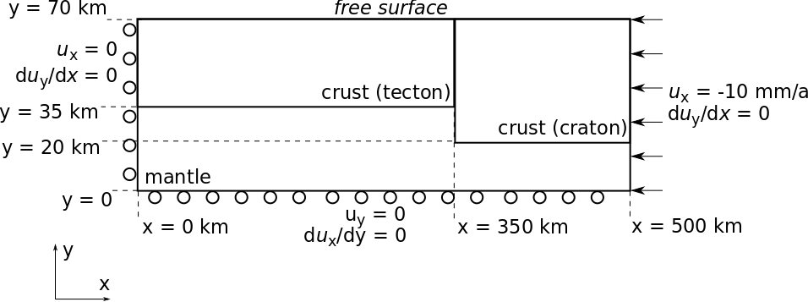
Example model: Colliding plates

Slide 17
Example model: Colliding plates
Material properties
  Density: 2800 kg/m³ for crust, 3200 kg/m³ for mantle
  Rheology
    Linearly viscous mantle, η = 10²³
    Brittle-viscous crust:
      Tecton η = 10²⁵, C = 20 MPa, ϕ = 15º → 1.5º
      Craton η = 10²⁶, C = 30 MPa, ϕ = 30º → 20º

