Slide 1
Heat transfer – Analytical solutions
Introduction to Lithospheric Geodynamic Modelling

Slide 2
Contents & aims
Solving the heat transfer equation
    Simple one-dimensional cases
    Basic behaviour of the geotherm in steady-state
    Demonstrate the mathematical basis of boundary conditions
Plotting solutions with Python
    Get to know python scripts
    Varying the parameters
    Understand how the solutions react to changes in physical parameters

Slide 3
Heat transfer equation
How do material properties affect the lithospheric geotherm?
Analytical solutions → to get an idea how the geotherm should look like before we even consider running any numerical models

Slide 4
Heat transfer equation simplified
Assume no advection (u_{z} = 0)
Assume no internal heat production (H = 0)
Assume constant heat conductivity (dk/dz = 0)

Slide 5
Heat transfer equation really simplified
Assume steady-state (dT/dt = 0)

Slide 6
Steady-state geotherm

Slide 7


Steady-state geotherm
Equation of a straight line
T
Heat conductivity k affects the
steepness of the geotherm
What are the values of the constants?
z
Low k
High k

Slide 8
Steady-state geotherm
T
Surface, z = 0 km
T = 20ºC
Lower crust, z = 30 km
T = 600ºC
z
–> T can be evaluated at any depth z once k is chosen

Slide 9
Steady-state geotherm
Heat transfer equation has an analytical solution ...
T
Surface, z = 0 km
T = 20ºC
NB! No k here
… given the two boundary conditions
at
Lower crust, z = 30 km
T = 600ºC
at
z

Slide 10
Steady-state geotherm with radiogenic heating
T
… integrate twice …
Surface, z = 0 km
T = 20ºC
Not a straight line
… apply same boundary conditions …
Lower crust, z = 30 km
T = 600ºC
z

Slide 11
Mid-lesson wrap-up & play time
Steady-state geotherm does not depend on density or heat capacity
Form is dictated by heat conductivity and internal heat production only (in absence of advection…)
  Geotherm with A=0 – linear, straight line
  Geotherm with A>0 – curved, parabolic
Two boundary conditions are needed (for two integration constants)

Slide 12
Heat equation, analytical solutions in python
Download the course package (ZIP) at https://github.com/HUGG/NGWM2016-modelling-course.git
Extract it in your home folder
Change to folder NGWM2016-modelling-course / Lessons / 03-Analytical-solutions-heat-transfer /scripts
Run plot_steady_state_heat_eq_with_A.py (double click or run at command prompt)
Right click > Choose “Edit with IDLE”
Change values of k and H and re-run
  What happens with small / large values of A?
  What happens with small / large values of k?

Slide 13
About boundary conditions
We defined boundary conditions as a constant temperature at given depth
  This is known as Dirichlet boundary condition
Instead of temperature, we can also define heat flow, the derivative of T, at either (or both) boundary
  This is known as von Neumann boundary condition

Slide 14
Heat flow boundary condition
The heat transfer equation has an alytical solution
T
… given the two boundary conditions
Surface, z = 0 km
T = 20ºC
at
at
Low q
What happens to the geotherm if …
A is increased/decreased?
q_{b} is increased/decreased?
–> plot_steady_state_heat_eq_vonNeumann.py
High q
z

Slide 15
Steady-state heat equation, internal boundary conditions
Despite the name, boundary conditions need not to be applied at the boundary.
Consider the general solution to the steady-state heat equation.
where
with boundary conditions

Slide 16
Steady-state heat equation, internal boundary conditions
where
with boundary conditions
For example, we can use measured values of heat flow and temperature at surface (z₁ = 0; z₂ = 0)

Slide 17
Steady-state heat equation, internal boundary conditions
Open script plot_steady_state_heat_eq_innerbnd.py.
By default this uses boundary conditions T=20 at surface (z=0) and q=15mW/m² at the bottom of the crust (z=40 km). These can be varied to different values at different depths.
Using the script, find out the approximate value for internal heat generation within the crust, if we know that
  T=0 at surface (measured)
  q=60mW/m² at surface (measured)
  T~600 at the bottom of the crust (40 km) (estimate / literature)

Slide 18
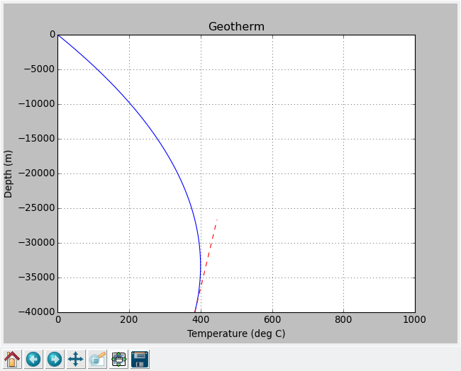
Steady-state heat equation, internal boundary conditions
  T=0 at surface
  q=60mW/m² at surface
  A unchanged (1.8µW/m³)
  Do we need to increase or decrease the value of A?

Slide 19
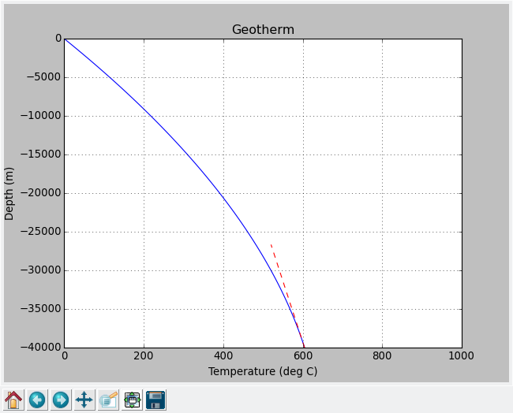
Steady-state heat equation, internal boundary conditions
To keep the surface heat flow at 60mW/m² and to increase the value of bottom heat flow, heat generation value needs to be decreased

Slide 20
Complications that were not considered
Heat conductivity is not constant throughout the crust (lithological variation and T dependence)
Heat production is not constant throughout the crust (and is very low in mantle)
T
T
Low k
e.g. granite
A > 0
High k,
e.g. basalt
Geotherm can be defined piecewise
… or we could use numerical models
Med k,
intermediate composition
A ~ 0
z
z

Slide 21
Non-steady-state heat equation
Need two integrations in respect to z, one integration in respect to t
  Three boundary condition values needed
  Boundary condition in time = initial condition

Slide 22
Non-steady-state heat equation
Need two integrations in respect to z, one integration in respect to t
  Not that easy …
Let's have a look at a semi-infinite half-space case
  Only one (spatial) boundary condition and one (temporal) initial condition

Slide 23
Heat equation in semi-infinite half-space
Initial condition
T₁
T
T₀
T
T₁
T₀
T
z
z
z
time
Boundary condition(s)

Slide 24
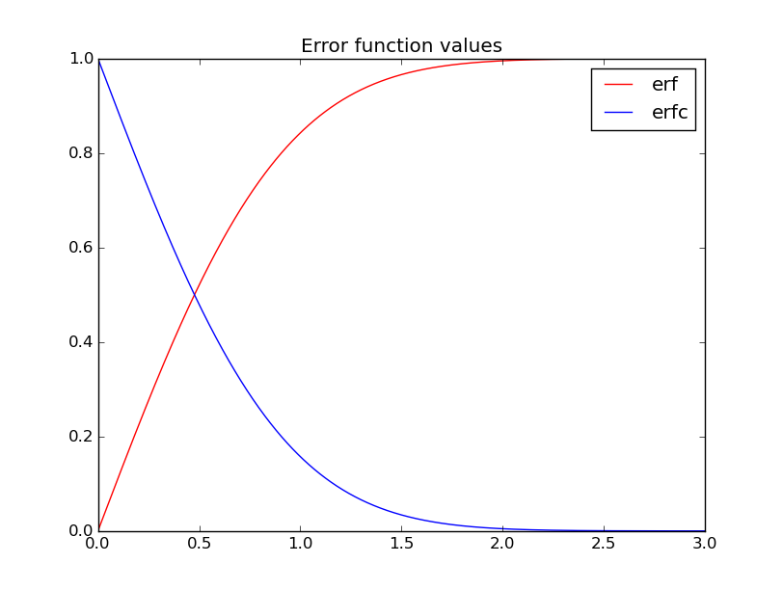
Heat equation in semi-infinite half-space
Solution:
More about transient heat equations
later today…
Characteristic thermal diffusion distance
–> how far the heat diffuses in time t
erfc = 1 - erf

Slide 25
Heat equation in semi-infinite half-space
Solution:
T₁
T₀
T
More about transient heat equations
later today…
Characteristic thermal diffusion distance
–> how far the heat diffuses in time t
“Back of the envelope” calculations:
E.g. is thermal conduction important process in crustal scale in a
numerical model that runs for 100 kyrs?
z

Slide 26
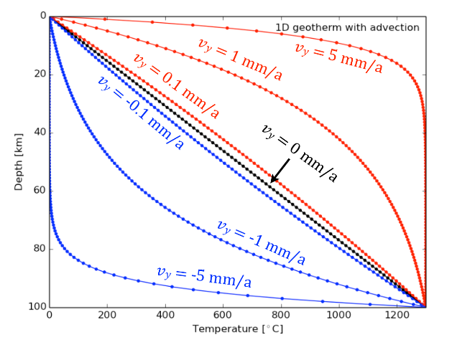
Steady-state heat equation with advection

Slide 27
Steady-state heat equation with advection

Slide 28
Steady-state heat equation with advection
–> plot_steady_state_heat_eq_advection.py

Slide 29
Steady-state heat equation with advection
plot_steady_state_heat_eq_advection.py
Default case: u_{z} = 5 mm/a (sedimentation)
If sedimentation rate decreases to 2 mm/a, does heat conductivity need to be
a) increased or
b) decreased
to maintain the same geotherm?

Slide 30
Peclet number
Non-dimensional number describing the relevance of diffusive and advective heat (or mass) transfer processes
–> plot_steady_state_heat_eq_advection.py
- What's the effect of u_{z} if k has a really high value?

