Slide 1
Finite differences method
Introduction to Lithospheric Geodynamic Modelling

Slide 2
Contents
How to transform partial differential equations to something computers understand
Finite differences method (FDM)
    Application to the heat equation
    Comparison with analytical results
    Boundary and initial conditions in FDM
    Stability and accuracy of solutions

Slide 3
Motivation
Analytical solutions to heat diffusion and material flow
    Give good insight into the processes in question
    Are exact and provable to be correct
    Need to be re-derived when boundary/initial conditions change or new terms are added
    Do not exist at all in some (many) cases
Numerical methods
    Computer algorithms to solve partial differential equations of many kind
    Almost exactly opposite pros/cons

Slide 4
Finite differences method (FDM)
Based on idea of approximating derivatives of functions with finite differences that can be evaluated with a computer
    This approximation is done only at discrete locations (grid points) → accuracy
    Relatively easy to implement
Other methods used in geodynamics, e.g. finite element or finite volume methods (FEM, FVM)
    Used to solve same PDEs but use different mathematical background
    Concepts of discretization, initial conditions and boundary conditions apply

Slide 5


Finite differences method (FDM)
What is FDM?
Basic idea:
&
–>
&
–>

Slide 6
Finite differences method (FDM)
How to apply FDM to the heat diffusion equation?
Basic idea:
… where x₂–x₁ is small (or small enough)

Slide 7
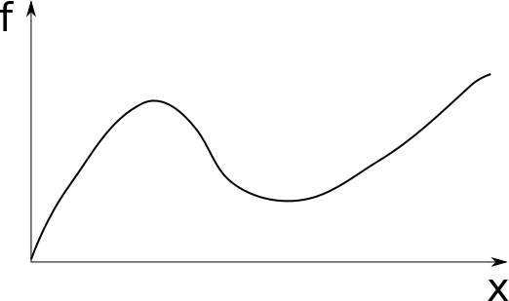
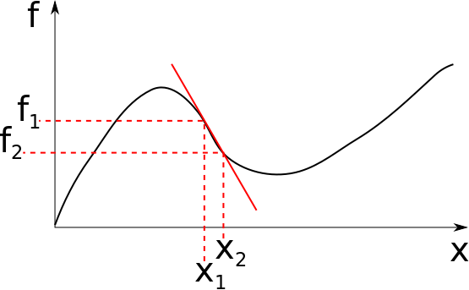
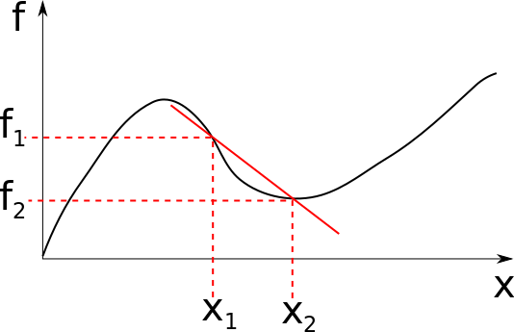
Finite differences method (FDM)

Slide 8
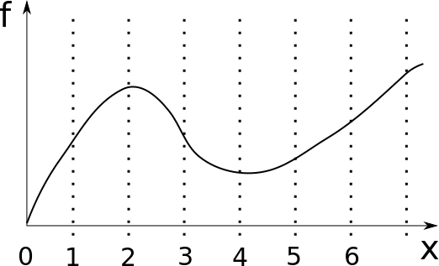
Grid
Grid number: 0, 1, 2, 3, …
Grid location: x₀, x₁, x₂, ...

Slide 9
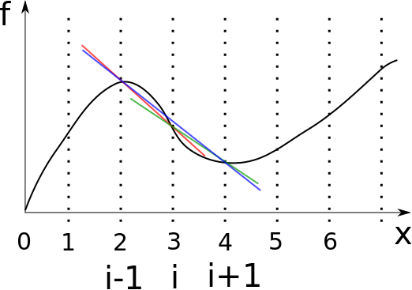
Forward, backward and central differences
Forward:
Backward:
Central:

Slide 10
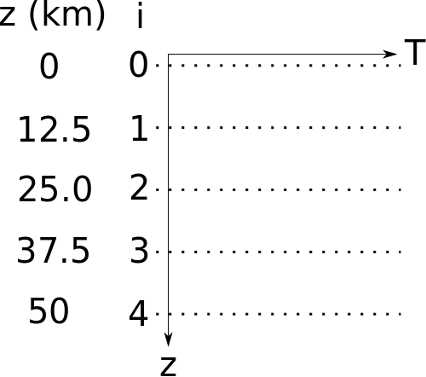
Example 1: FDM for heat flow
discretization
rearrange
choose grid
- num of grid points
- boundary locations

Slide 11

Example 1: FDM for heat flow
??
…

Slide 12
Example 1: FDM for heat flow
…
–> Solvable when T_{surf} is known and
heat flow q is constant and known
–> heat_flow.py

Slide 13
Example 1: FDM for heat flow
Open Lessons / 05-Finite-differences / scriptsheat_flow.py in IDLE
Modify the script at line 42, change the line from
    T[i] = ????
and make it use the formula on previous slide to calculate value T_{i}
Run (F5) to see if results are what you would expect

Slide 14
Example 2: Steady state heat eq with radiogenic heating

Slide 15
Example 2: Steady state heat eq with radiogenic heating
rewrite:
rearrange:

Slide 16
Example 2: Steady state heat eq with radiogenic heating
→ Point i = 1 cannot be calculated
→ Can we just assign T₁ a value like we did for T₀?
No? Why not?
Yes? How?
→ geotherm_with_A.py
“ghost point”

Slide 17
Example 2: Steady state heat eq with radiogenic heating
→ geotherm_with_A.py
Fill in lines with “????”: use equation below to calculate temperature for grid point 1 and for grid points >1
The temperature value at the ghost point has already been calculated. Make sure you understand the logic behind it, and then use it to calculate the temperature value at grid point 1.
“ghost point”

Slide 18
Example 2: Steady state heat eq with radiogenic heating
We have an analytical solution for this problem (Lesson 03 → plot_steady_state_heat_eq_innerbnd.py)
How accurate is our numerical solution?
(geotherm_with_A_compared.py)
    Vary the number of grid points ( = grid resolution)

Slide 19
Example 2b: Steady state heat eq with varying radiogenic heating
What if A=A(z)?
geotherm_with_A_variable.py

Slide 20
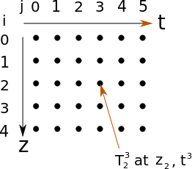
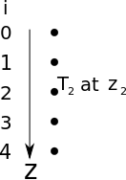
Example 3: Transient heat equation

Slide 21
Example 3: Transient heat equation

Slide 22
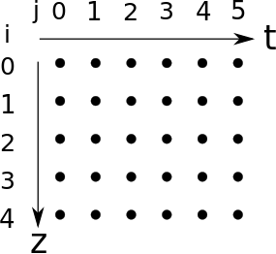
Example 3: Transient heat equation

Slide 23
Example 3: Transient heat equation
Boundary conditions
Initial conditions
–> heat_transient.py
- implement boundary conditions
- implement calculation of the inner
grid points

Slide 24
Example 3: Transient heat equation
–> heat_transient.py
- implement boundary conditions
- implement calculation of the inner
grid points
Cooling of oceanic lithosphere:
T₁
T
T₀
T
T₀
T₁
T
T1 = 1300ºC, cools instantly to
T1 = 0ºC at the surface (sea floor)
T_{surf} = 0ºC
T_{bott} = 1300ºC
z
z
z

Slide 25
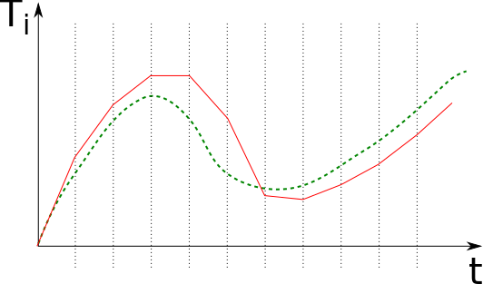
Stability of heat diffusion in FDM
–> heat_transient.py
- increase time step size, e.g.
dt = 1.0 * 112500000000000.0
dt = 1.2 * 112500000000000.0
dt = 2.0 * 112500000000000.0
- What happens? Why?

Slide 26
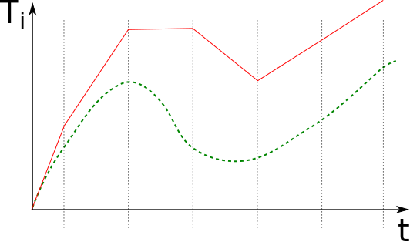
Stability of heat diffusion in FDM
–> heat_transient.py
- increase time step size, e.g.
dt = 1.0 * 112500000000000.0
dt = 1.2 * 112500000000000.0
dt = 2.0 * 112500000000000.0
- What happens? Why?

Slide 27
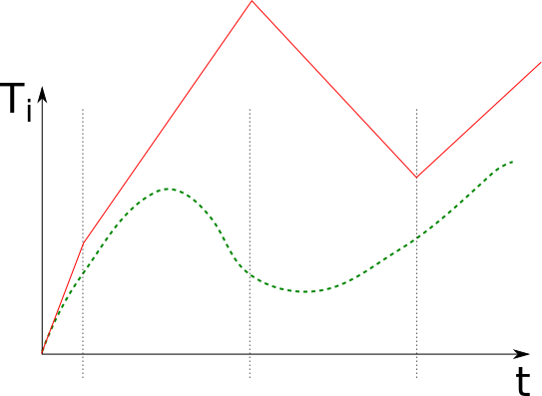
Stability of heat diffusion in FDM
–> heat_transient.py
- increase time step size, e.g.
dt = 1.0 * 112500000000000.0
dt = 1.2 * 112500000000000.0
dt = 2.0 * 112500000000000.0
- What happens? Why?

Slide 28
Stability of heat diffusion in FDM
The numerical scheme only allows heat to diffuse one grid space to the
next grid point
… but the sum of temperatures in surrounding grid points is multiplied by dt
→ too large dt can make T₁ > T₂ even if originally T₁ < T₂ → heat diffuses
“upstream” – should not be possible!
von Neumann stability analysis →

Slide 29
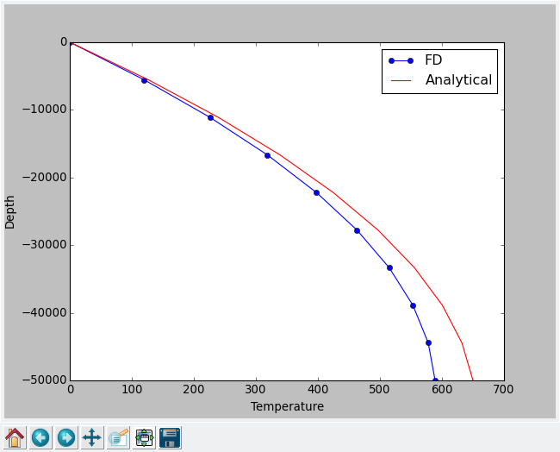
Stability of heat diffusion in FDM
von Neumann stability analysis →

Slide 30
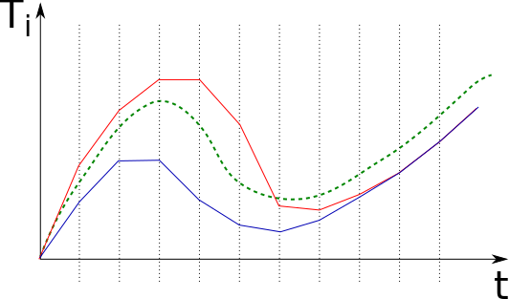
Time stepping schemes in finite differences
Forward Euler
Backward Euler
Explicit
Implicit
Overshoots
Undershoots
Stability criterion
Always stable

Slide 31
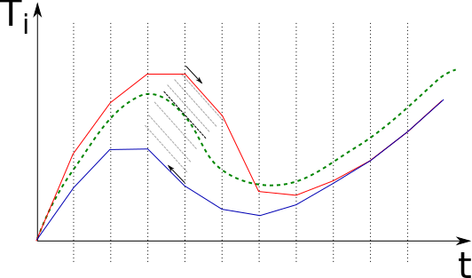
Time stepping schemes in finite differences
Forward Euler
Backward Euler
Explicit
Implicit
Overshoots
Undershoots
Stability criterion
Always stable
Averaging schemes,
e.g. Crank-Nicolson

Slide 32
Heat equation, implicit (backward Euler) time stepping scheme
??
…
→ System of linear equations (n unknowns, n equations, n = number of grid points)

Slide 33
Why use FDM (or any numerical method)
1D → 2D/3D
    Analytical solutions very complicated
    Numerical solutions longer to type but still only +, -, *, and /

Slide 34
Why use FDM (or any numerical method)
Complex geometries, e.g. spatially varying material parameters or deformed model boundaries
    Longer, no more or only slightly more complex
A bit more complexity involved in non-linear cases
    e.g. k=k(T)
      Iterative solutions
    Still virtually always superior to analytical approach

Slide 35
Why NOT use FDM (or any numerical method)
In complex (read: typical) model set-ups accuracy is hard to estimate
    Resolution tests
      Error in FD of heat equation is proportional to Δt and Δx²
      (“first order accurate in time”, “second order accurate in space”)
    Benchmarks

Slide 37
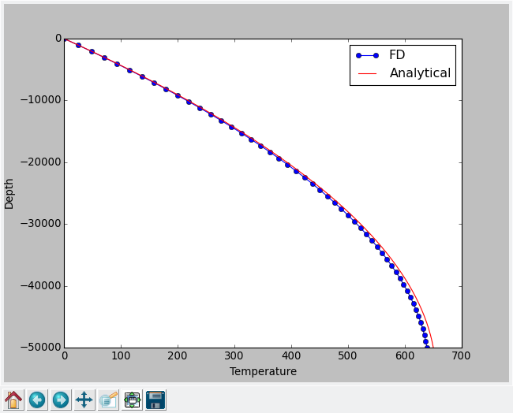

Slide 38
