Slide 1
Portfolio Valuation
By Hugo Browning and Jakob Thompson from the Quant Finance Team at PWC

Slide 2
Objectives of Approach
Goal: To determine the value of the portfolio as of 31 December 2020
Methodology Overview:
Conduct quantitative analysis of the historical repayment data
Compute expected repayment percentages
Forecast future cash flows
Discount cash flows to present value
Compare portfolio value with client estimate
Audit Threshold: A value of CHF 500,000 or less is deemed to be acceptable due to size of the given dataset

Slide 3


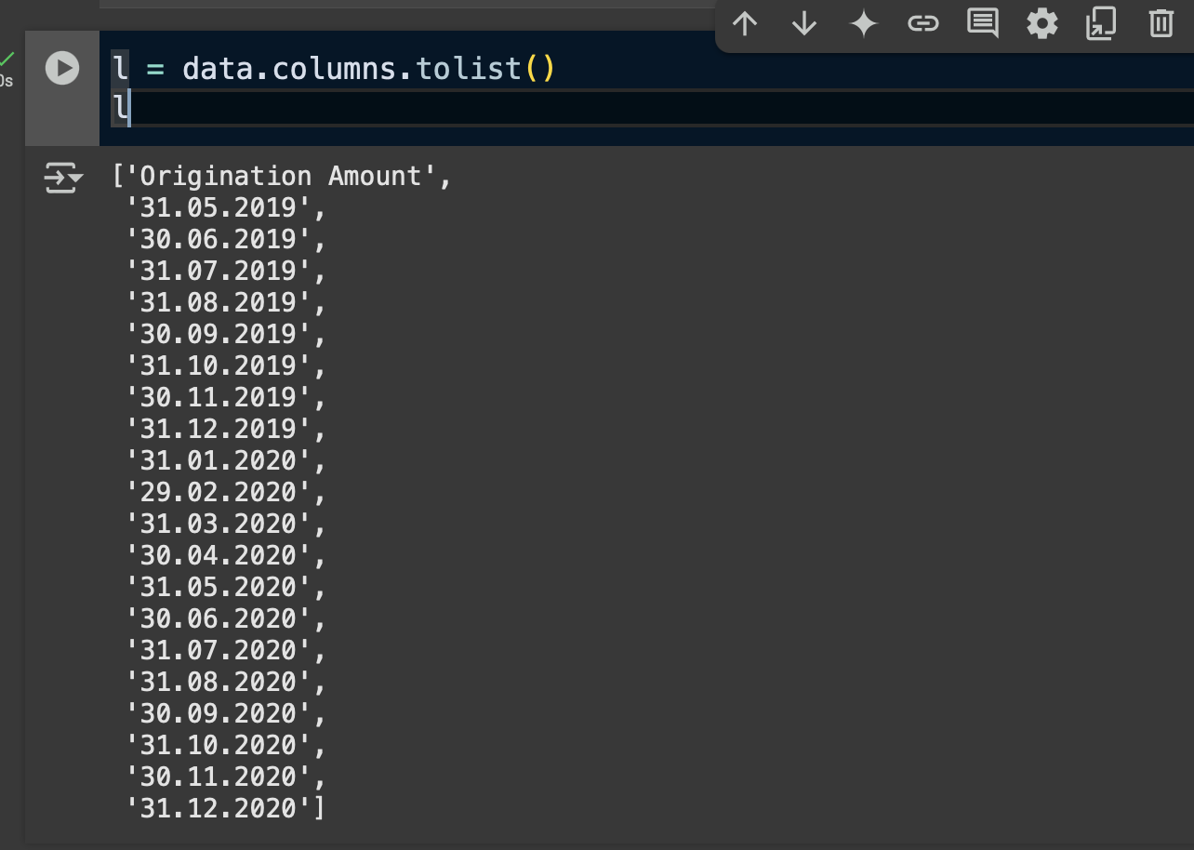

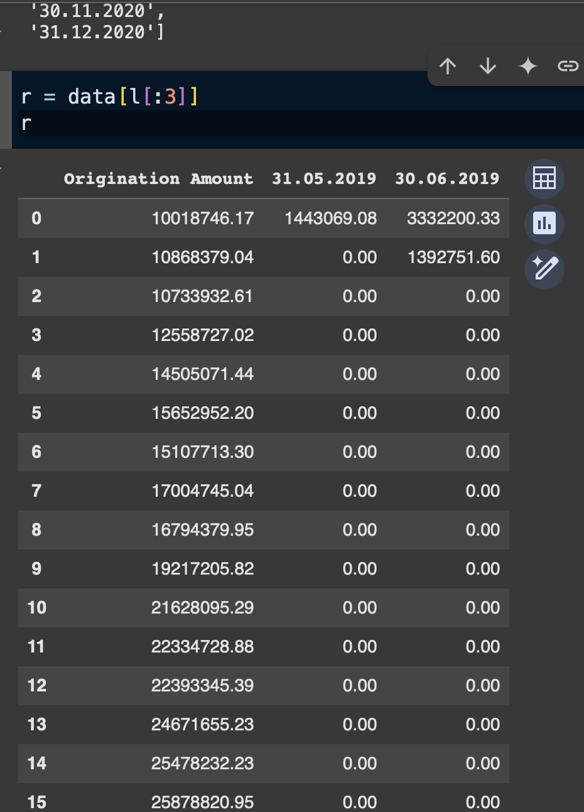
DATA OVERVIEW
FIG 1
Dataset:
Includes loan origination amounts and monthly repayments (June 2019 – Dec 2020)
Structure:
Columns = Monthly Repayments (Fig 1)
Rows = Loan Vintages (Origination months)
FIG 2

Slide 4
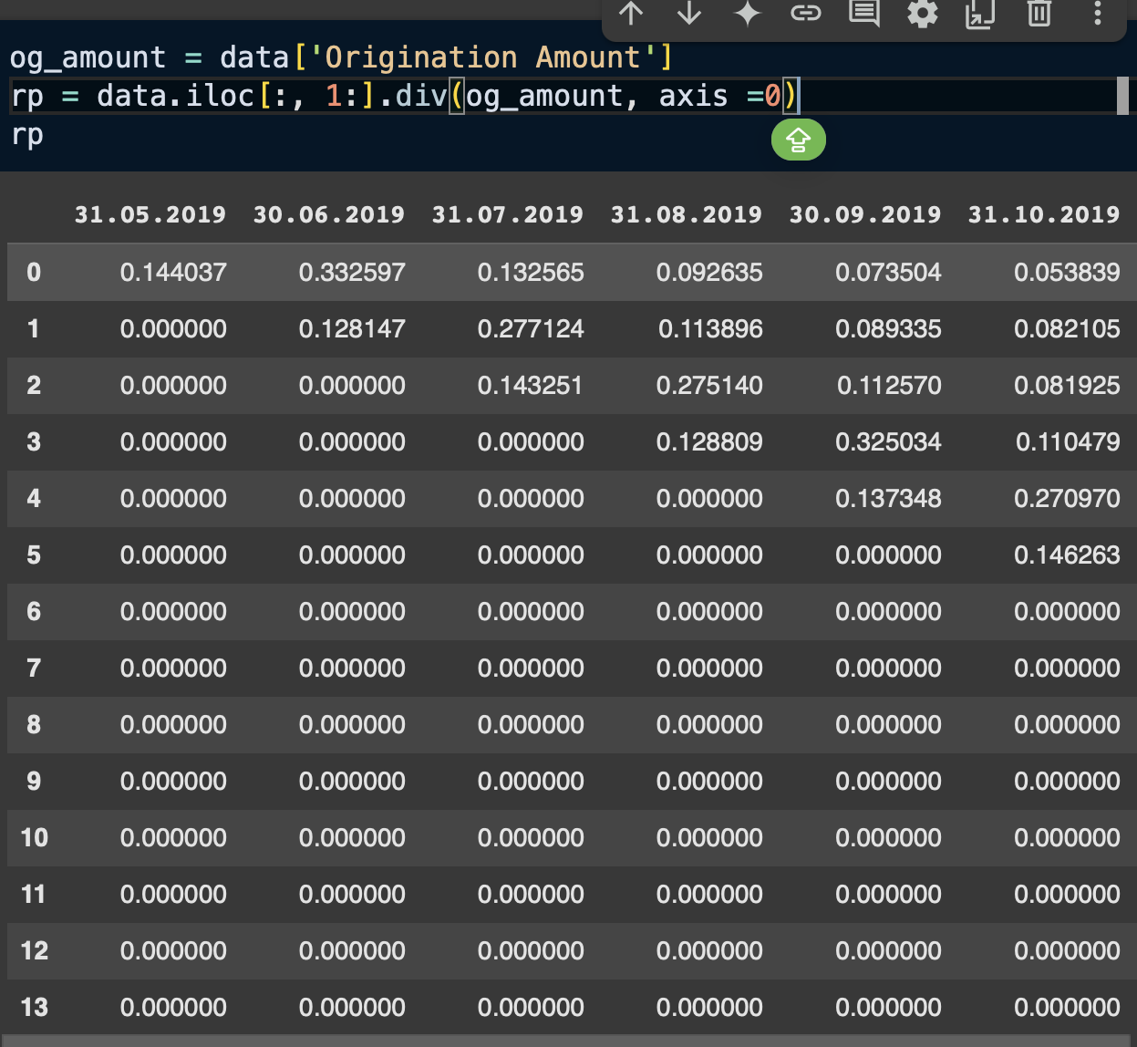
Historical Repayment %
FIG 3
We have the repayment % for each month (fig 3), these are demonstrated in decimal ranging from 0 to 1.
Formula:
RP_{i} = RP amount in month i / origination amount for the vintage

Slide 5
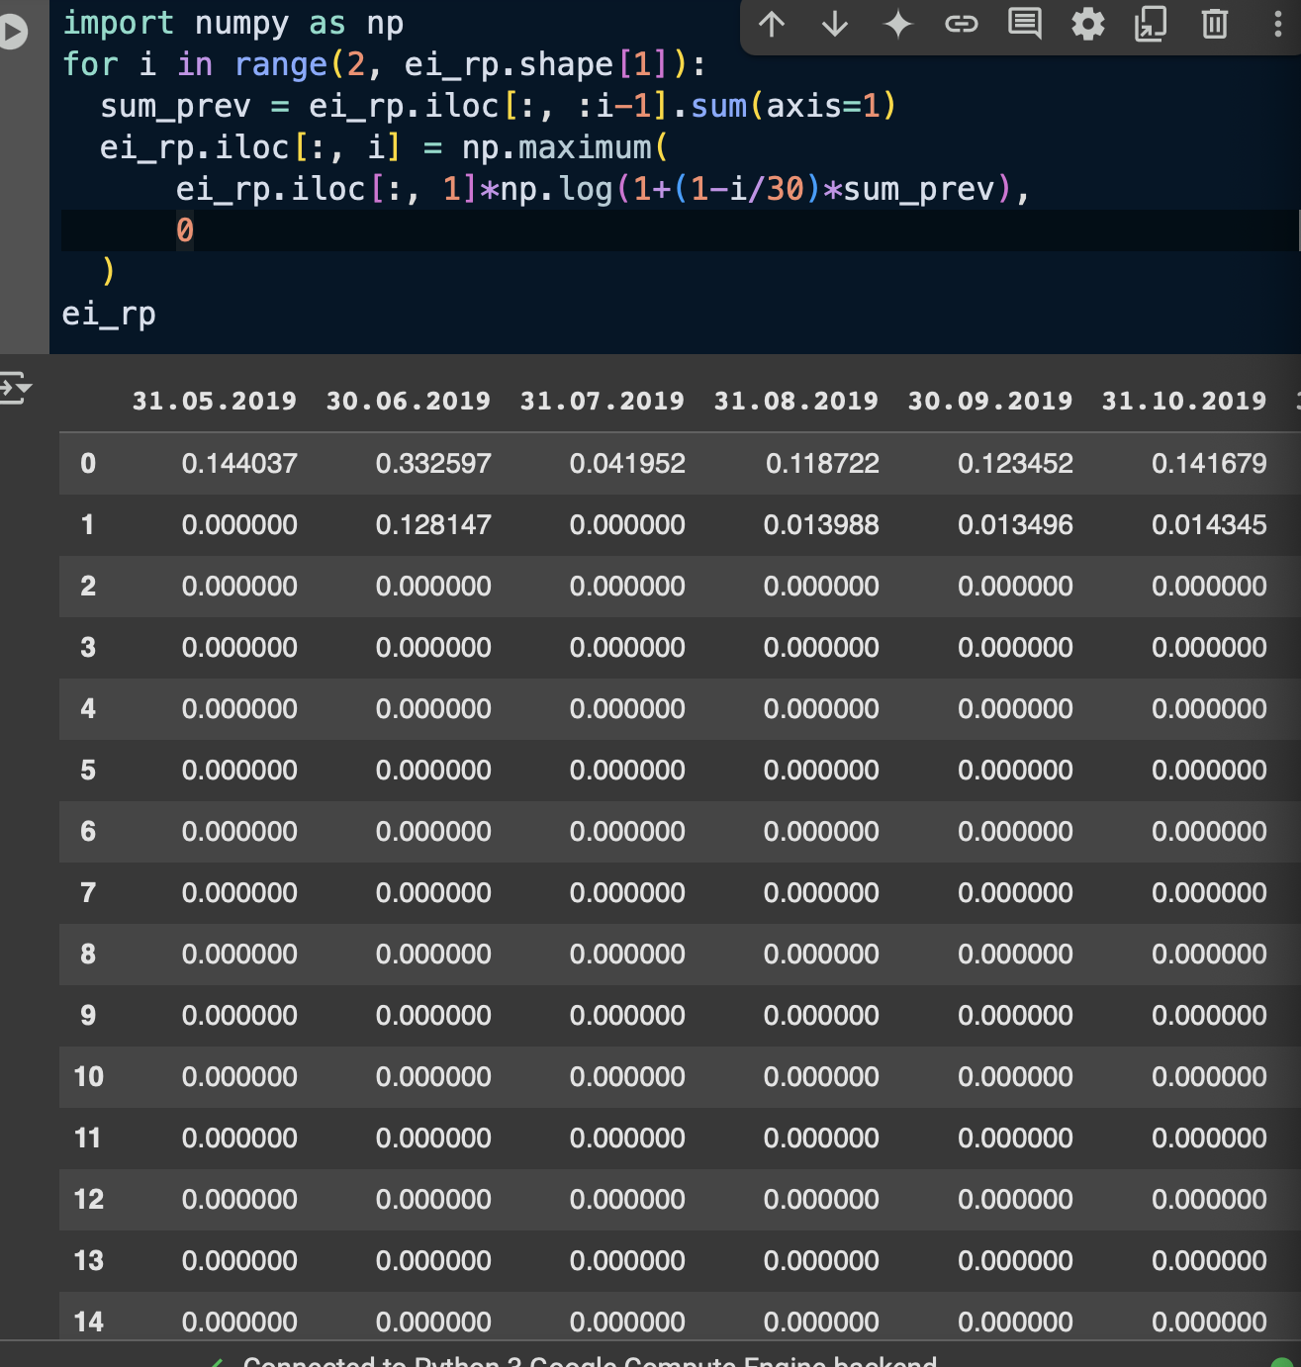

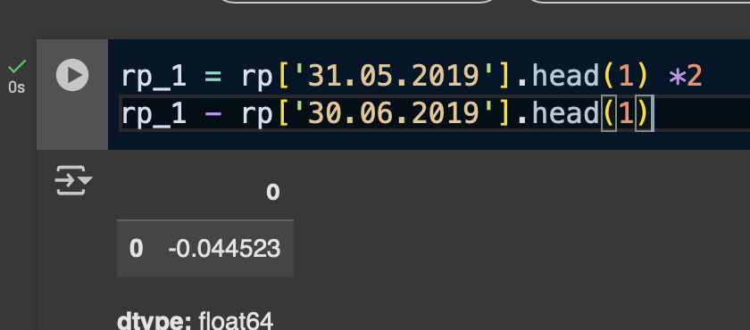

Expected Repayment %
Fig 4
The computed formula (fig 4) for the forecast horizon (fig 5) given by the PWC quant finance team.
As a result, we get the % scores in decimal from the 3rd to the 30th month as indicated by ‘3 $≤i ≤30′$.
The audit company assumed that the historical repayment % as of June 2019 would be twice as big as of July 2019. This assumption was slightly off, as July 2019 was below the assumed repayment % as of June 2019 (2P₂ = 1P₁) with an absolute difference of 0.0445 (to 4 dp).
Fig 5
FIG 6

Slide 6
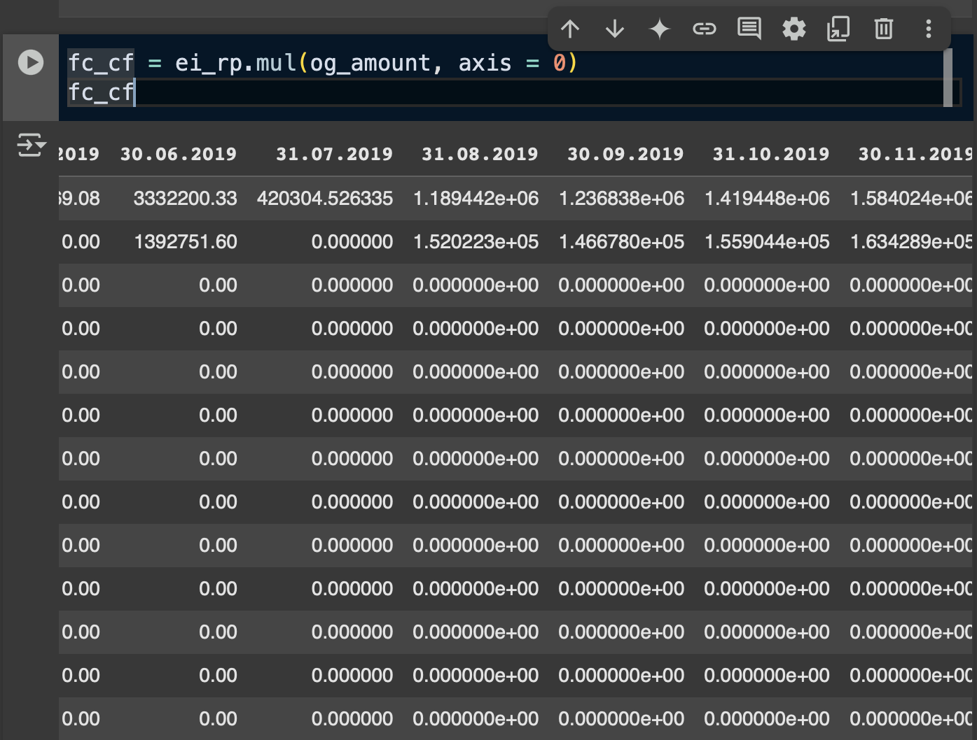
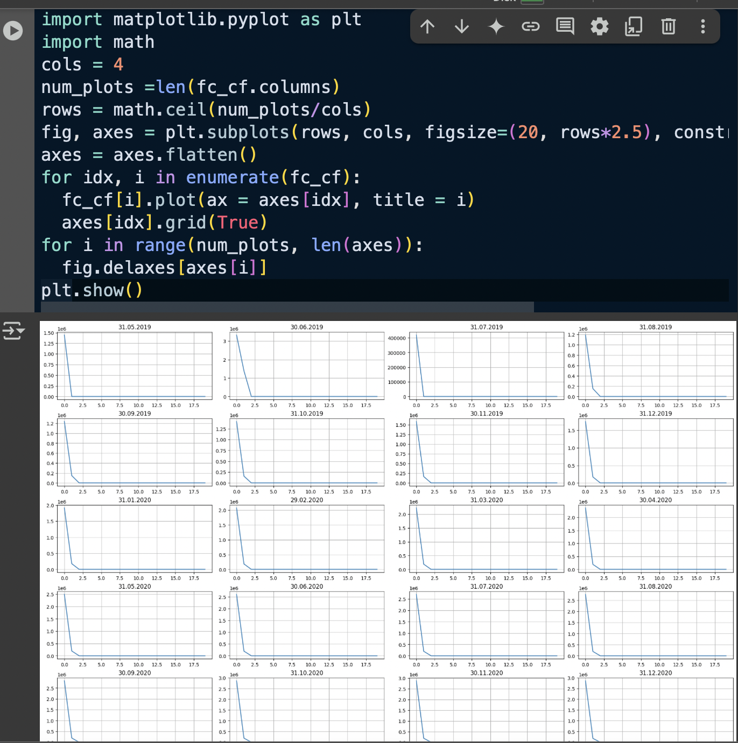
Forecasted Cash Flow:
FIG 7
The forecasted cash flow of the given months (fig 7) indicate very low scores for each originated month.
The computed plots of graphs, evidently shows (fig 8) that there is a very similar and almost exact correlation (negative) displayed
Thus indicating a predictable downward trend over time
FIG 8

Slide 7
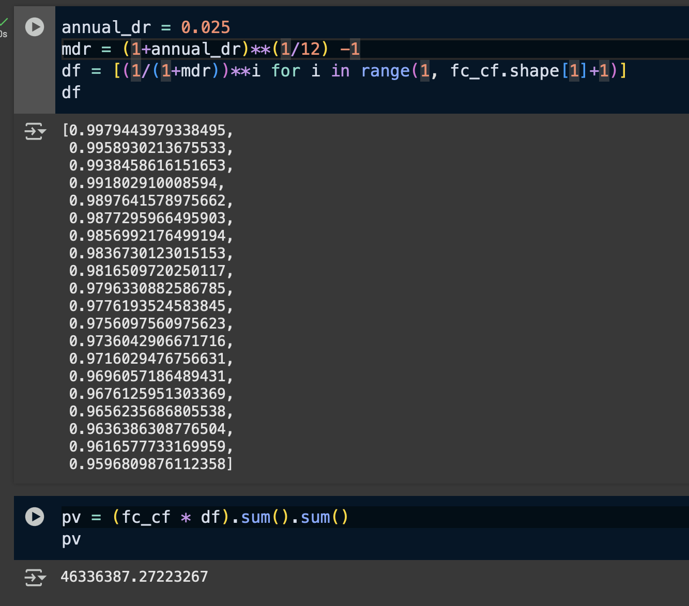
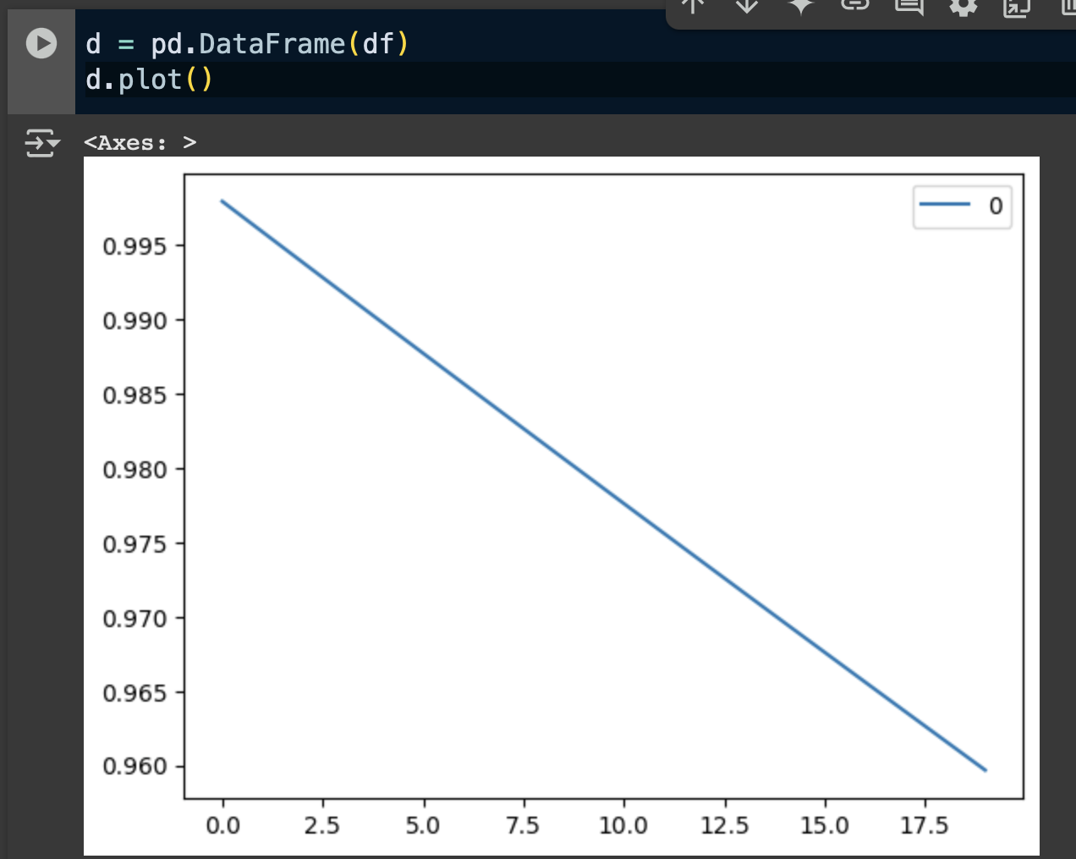

Discount Cash Flows and Portfolio Value:
Fig 9
FIG 11
With a given annual discount rate of 25% (set at 0.025), we receive a monthly discount rate (fig 9) in the given list (set as ‘df’), calculated with the formula (fig 10)
There is a gradual decline (fig 11), indicating a consistent but slow reduction in value over time.
The present value (set as pv) is at CHP 46,336,387.27 (at 2 dp). This is less than the client’s estimated present value of CHF 84,993,122.67
FIG 10

Slide 8
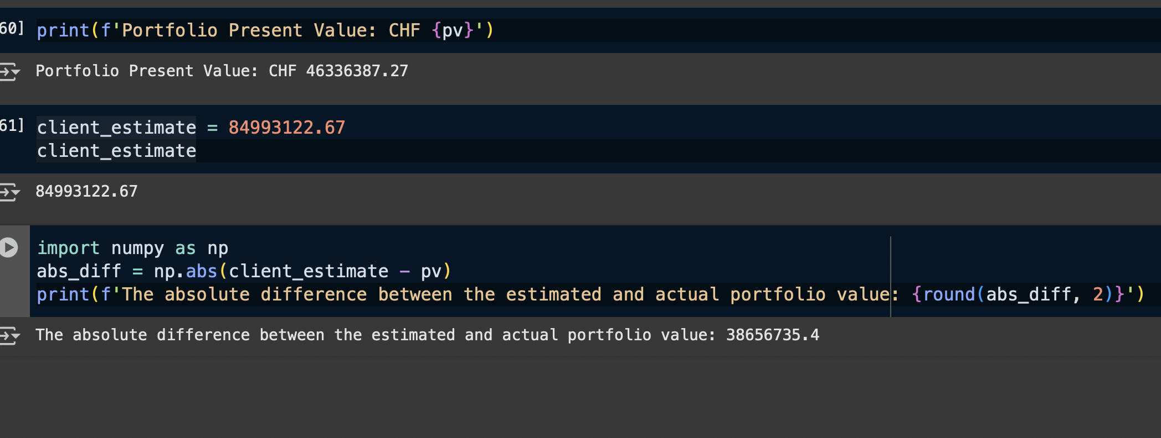
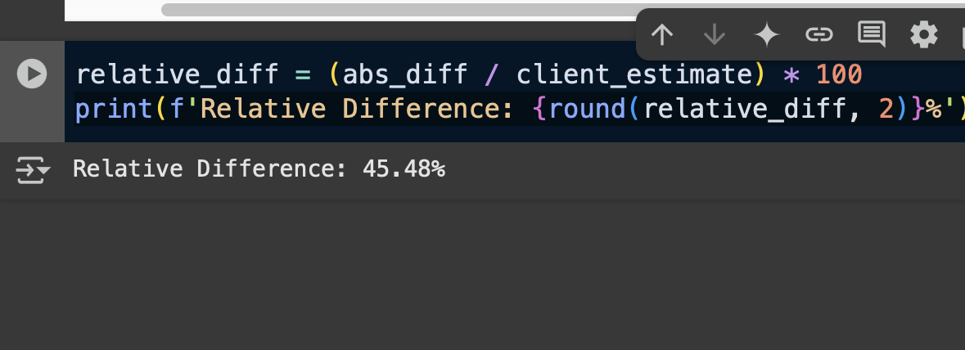
Summary of Client’s Portfolio Estimation:
FIG 12
The absolute difference between the client’s estimated present value (CHF 84,993,122.67) and the actual present value (CHF 46,336,387.27) is significant (fig 12), with an absolute difference of CHF 38,656,736.4.
It can be assumed that the audit company overestimated (fig 13) by about 45.48%, calculated by the relative difference.
z
FIG 13

