Slide 1
HUMA 5630 | Digital Humanities
Final Project: Text Analysis on the Lyrics of Pop Music in 2020s
Group 5: DENG, Junwei (21015955)

Slide 2
Section 1: Project Introducton
- why to analyze music lyrics in the field of humanities
- music lyrics reflect the social, cultural, and historical contexts
- music lyrics can evoke emotional responses
- why to analyze music lyrics with digital approaches
- more data and more efficient data processing
- broader vision on the lyrics
- more accessible with visualization and online publishing to audience
- why pop music
- more universal audience
Section2: Research Questions
- what are 2020s pop songs “talking” about
- how do 2020s pop songs sound (emotionally), with consideration of COVID-19

Slide 3
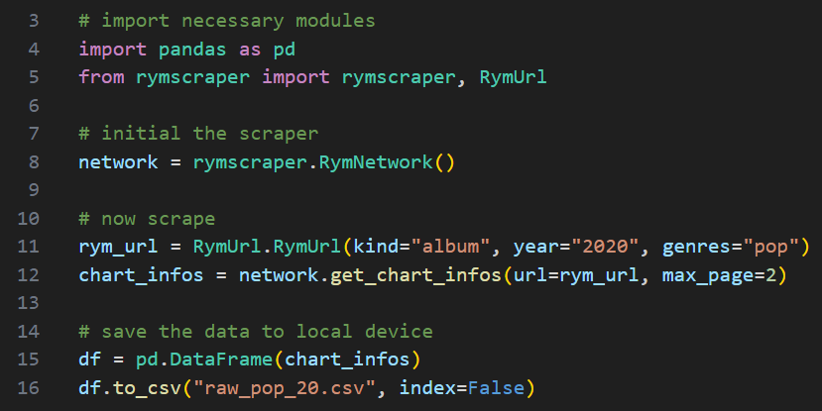
Section 3: Workflow
- Section 3.1: Data Acquiring and Processing
- Step 1: acquire metadata of pop music publications in 2020s
- scrape charts from rateyourmusic.com with rymscraper (from github)
- charts sort music by rating score in descending order
- 2 pages of chart contents (80 entries) for each year were scraped

Slide 4
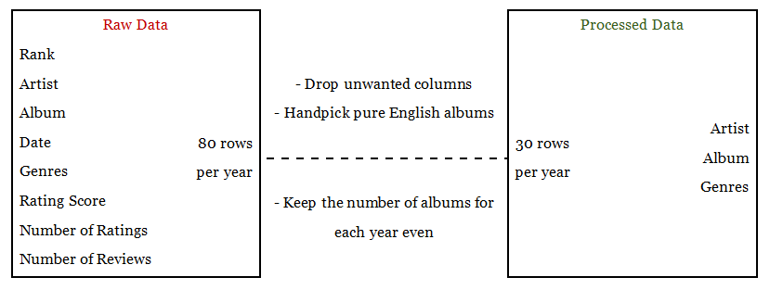
Section 3: Workflow
- Section 3.1: Data Acquiring and Processing
- Step 1: acquire metadata of pop music publications in 2020s
- scrape charts from rateyourmusic.com with rymscraper (from github)
- charts sort music by rating score in descending order
- 2 pages of chart contents (80 entries) for each year were scraped
- data structure

Slide 5
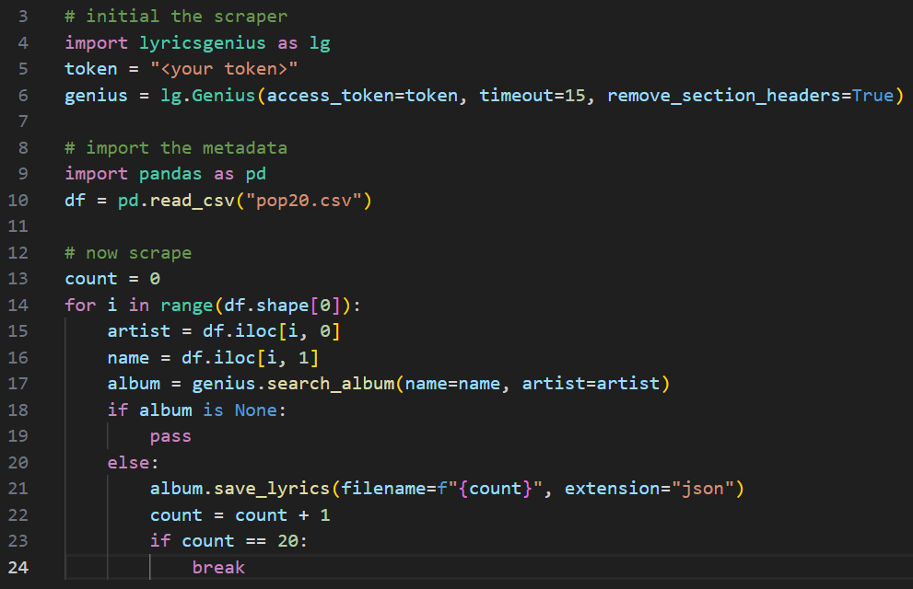
Section 3: Workflow
- Section 3.1: Data Acquiring and Processing
- Step 2: acquire lyrics on the basis of the processed metadata
- scrape lyrics from genius.com with lyricsgenius (from github)
notes:
- for each album, a json file will be returned, which contains extremely detailed information, of course including the lyrics
- I scraped the lyrics separately for each year
- as you can see, some of the albums are not included in genius.com, so I decide to terminate the scraping loop once the number of json files hits 20

Slide 6
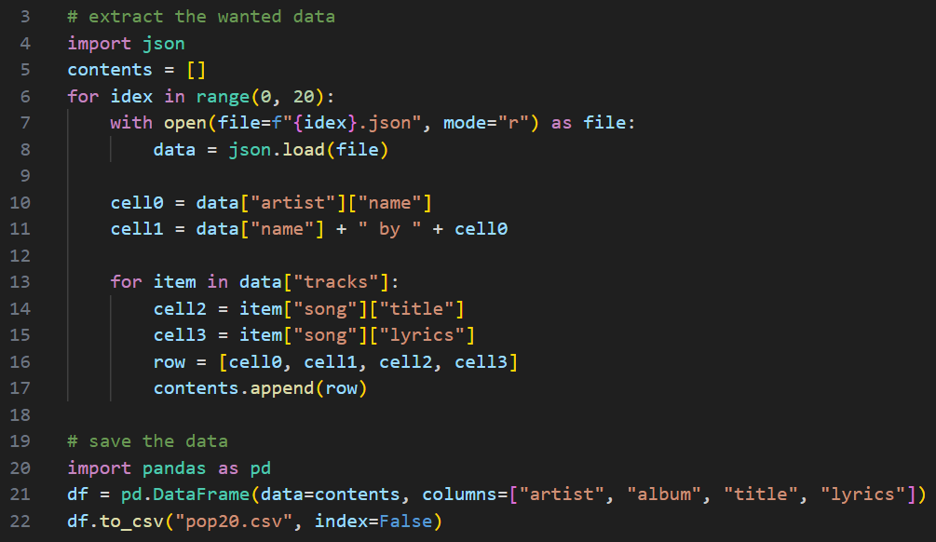
Section 3: Workflow
- Section 3.1: Data Acquiring and Processing
- Step 2: acquire lyrics on the basis of the processed metadata
- scrape lyrics from genius.com with lyricsgenius (from github)
- extract wanted contents form the json files
notes:
- for some of the tracks, the lyrics are missing, mainly because these tracks are interludes (pure melody)
- I took 2 approaches to deal with the missing values: drop and replace with “ ”
- NA-dropped data: 1209 rows
- NA-replaced data: 1354 rows
- the column “period” was added later

Slide 7
Section 3: Workflow
- Section 3.2: Data Analysis and Visualization
- Part 1: topic modeling (with NA-dropped data)
- Step 1: pre-process the lyrics with nltk
- dice all the lyrics into words
- construct a list of stopwords and remove all of them from the data
- detect the part-of-speech of all the remaining words and pick out all the nouns
- Step 2: implement the topic modeling with gensim
- construct the dictionary and corpus for topic modeling with the nouns
- try differnt number of topics and calculate the corresponding coherence score
- settle on a proper number of topics
- Step 3: interpret the topics with openai

Slide 8
Section 3: Workflow
- Section 3.2: Data Analysis and Visualization
- Part 2.1: sentiment analysis (with NA-dropped data)
- Note: lyrics of 20 pop albums released during 2017~2019 are included as baseline
- Step 1: detect the sentiment of each track with textblob (polarity & subjectivity)
- polarity: range from -1 (negative) to 1 (positive)
- subjectivity: range from 0 (telling fact) to 1 (telling opinion)
- Step 2: tell the gender of the artists with openai (female, male and neutral)
- Step 3: plot the sentiment with seaborn (strip-plot & scatter-plot)
- polarity against the periods with differrnt artist genders
- subjectivity against the periods with different artist genders
- sentiment map of the periods

Slide 9
Section 3: Workflow
- Section 3.2: Data Analysis and Visualization
- Part 2.2: sentiment analysis (with NA-replaced data)
- Note: lyrics of 20 pop albums released during 2017~2019 are included as baseline
- Step 1: handpick 20 albums which I am intersted in
- Step 2: plot the sentiment of these 20 albums with seaborn (heatmap)
- polarity against individual tracks
- subjectivity against individual tracks
- note: polarity and subjectivity for “ ” are both 0

Slide 10
Section 3: Workflow
- Section 3.2: Data Analysis and Visualization
- Part 3 (by-product): word embedding (on the genres)
- Step 1: get a list of music genres defined by rateyourmusic.com from github
- the list contains 1772 items
- rym defines a very detailed system of music genres and pop is only a major one
- other major music genres includes country, hip hop, jazz, punk ...
- there are many subgenres under the umbrella of the major genres
- note: it is a 2021 version list and contents may have been updated
- note: I tried to scrape the latest one but I failed and my IP is blocked now :\
- Step 2: add a new binary column to tell if the genre is included in my data
- Step 3: get the embeddings of the genres with openai
- Step 4: export 2 tsv files (embeddings & metadata)
- Step 5: visualize on projector.tensorflow.org

Slide 11
Section 3: Workflow
- Section 3.2: Data Analysis and Visualization
- Part 3 (by-product): word embedding (on the genres)
- embeddings express the strings of music genres in the form of vector
- for each string of genre, openai returns a vector with around 1500 dimensions
- projector.tensorflow.org is an online embedding visualization platform
- it provides different algorithms to reduce the embedding dimension to 2 or 3 for plotting
- with visualizing the embeddings, we can intuitively observe the relations among the genres in the respect of their connotations

Slide 12
Section 4: Project Demonstration (with findings)
- I created a webpage with streamlit to showcase this project
- the last segment of DH workflow (data publishing)
Section 5: Further Enhancement
- more data
- more direct project description
- interactive plots
- aesthetic

Slide 13
Thanks for listening!

