Slide 1


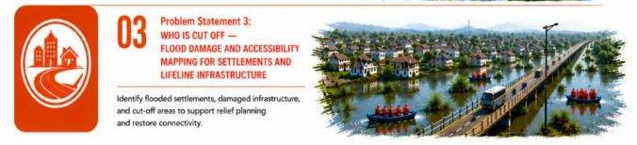
PROJECT TITLE
GeoReach
Flood Accessibility Intelligence for Assam
SELECTED THEME
Problem Statement 3: Who Is Cut Off
Flood Damage & Accessibility Mapping for Settlements and Lifeline Infrastructure
Team GeoReach is solving Problem Statement 3 for the IEEE EO Hackathon — Assam Floods 2026.
TEAM NAME
Team Name
Live dashboard: [add your deployed link / QR here]

Slide 2
Basic Information
Summary
Study Area
Method
Floods cut off villages before anyone confirms it
GeoReach ranks who is isolated, how badly, and how many people are affected
Built to drive real dispatch decisions, not just visualization
Dhemaji, Lakhimpur, Majuli — north bank of the Brahmaputra
Densest char (river-island) and low-lying settlement belt in Assam
Thinnest rural road network — first to submerge each monsoon
Extract flood extent from Sentinel-1 SAR (high scenario)
Estimate flood depth per road segment using SRTM elevation (HAND-style terrain analysis)
Overlay flood extent on the OSM road graph to flag blocked roads & bridges
Classify 80 settlements into 4 tiers: Critically Isolated / Isolated / Partially Accessible / Accessible, based on remaining passable routes
Rank settlements by population stranded to generate a prioritized reach-first list
Serve results through an interactive live dashboard (GeoReach)
Data
Sentinel-1 SAR — flood extent · Source: Copernicus Dataspace
SRTM DEM — terrain / flood depth · Source: USGS
OpenStreetMap — road network, hospitals, village locations · Source: Geofabrik/OSM
Population layer — settlement population for priority ranking · Source: [WorldPop / Census — confirm]

Slide 3
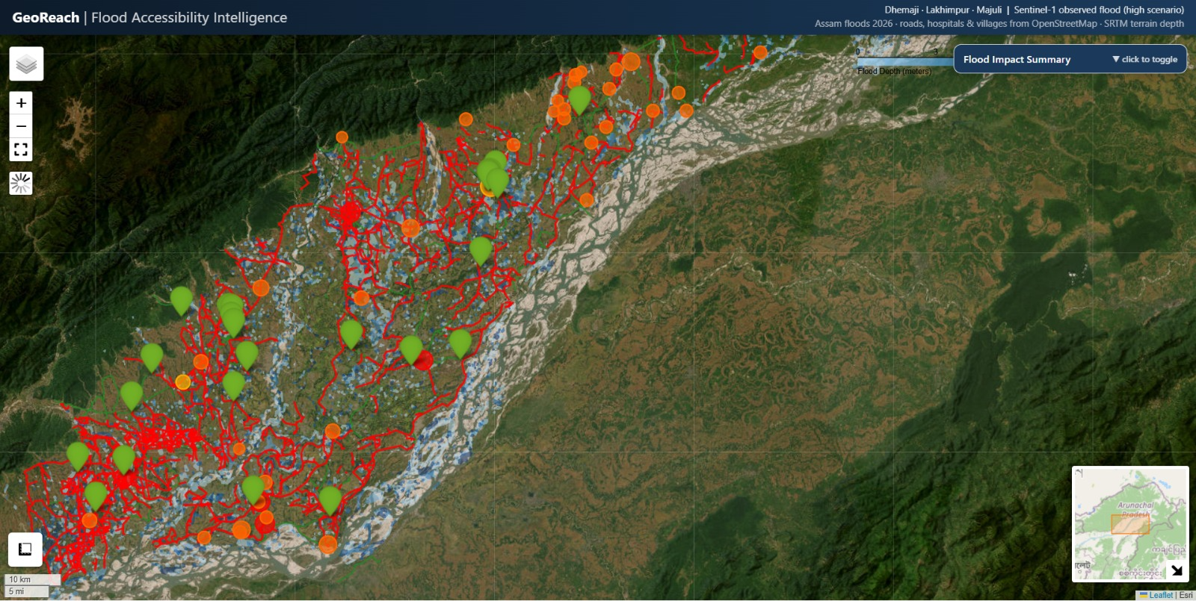
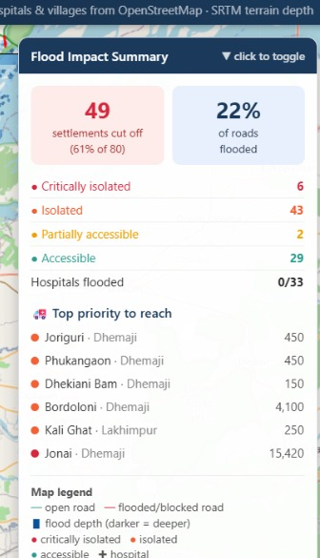
Results
Maps
Charts & Statistics
80 settlements analyzed
49 cut off (61%)
6 Critically Isolated · 43 Isolated
2 Partially Accessible · 29 Accessible
22% of roads flooded
0/33 hospitals flooded
Top priority: Jonai (15,420) · Bordoloni (4,100)
Red = flooded/blocked road · Green = open road
Blue shading = flood depth (darker = deeper)
Markers: red = isolated · orange = partial · green = accessible
"49 villages cut off, ranked by who to reach first — every hospital in the region stays reachable."

