Slide 1
A proposed mzIdentML extension for Glycopeptides
Joshua Klein
Joseph Zaia

Slide 2

What is mzIdentML?
mzIdentML is a data model specification and XML format created by the Proteomics Standards Initiative (PSI) for reporting peptide and protein identifications from (tandem) mass spectrometry.
mzIdentML tracks:
The input mass spectrometry data files, protein databases and parameters of the identification process.
The name, version, and publisher of the software used, and combinations of software.
The features of each peptide or protein identification, including confidence score and false discovery rate estimate.
The relationship between spectra and raw data files, spectra and peptides, peptides and protein (groups) and proteins within protein groups.
Supports both known and unknown peptide modifications, as well as cross-linked peptides.
The contact persons and owners of the analysis described by the document.

Slide 3
How Does This Differ From The Glycopeptide MS Guidelines?
The reporting guidelines are generated in part by the researcher combining information with a overarching view of the study, while mzIdentML is only intended to track what goes into a search engine and what comes out.
The reporting guidelines form may be partially written in free text to be read by another human, while an mzIdentML file is intended to be populated almost entirely by software, to be consumed by other software.
Ideally, we could populate the guidelines file from the mzIdentML file.

Slide 4
How Does mzIdentML Affect Our Work Today?
mzIdentML is used by mass spectrometry result archives including PRIDE and MassIVE to connect identifications with spectra, supporting validation and reanalysis of published results.
These also make it possible to automatically generate annotated spectra to satisfy common journal requirements using archive-provided tools.
mzIdentML can also be used to communicate identifications between software. One example of this is using one tool for identification and another tool for quantification or spectral library construction.

Slide 5


Example From Proteomics
Identification
Peptides Identified
mzID
MSGF+
Quantification
RAW
Raw Mass Spectra
RAW
RAW
Annotated Spectra and DOI
Peptides Quantified
Annotate and Reference
PNG
PDF
CSV
PNG
PNG

Slide 6
What were the glycopeptides searched for?
What kind of glycopeptide search was performed?
Which glycans were considered?
How did each glycopeptide spectrum match evaluate/score?

Slide 7
Representing Modified Peptides
<Peptide id="PEPTIDE_53221">
<PeptideSequence>DQCIVDDITYNVNDTFHKR</PeptideSequence>
<Modification monoisotopicMassDelta="57.021464" location="3">
<cvParam accession="UNIMOD:4" cvRef="UNIMOD" name="Carbamidomethyl" value=""/>
</Modification>
</Peptide>
mzIdentML can represent modified peptides by referencing external databases of modifications.
The Unimod database contains over 700 glycan compositions imported from GlyConnect covering a mixture of N- and O-linked glycans.
When a modification doesn’t have an entry in a database, an unknown modification with a known mass may be specified, but the name is largely user-defined and uncontrolled.
mzIdentML does not have a canonical method for representing glycans not found in Unimod, or any database in general.
mzIdentML has no way of expressing aggregated modifications of known total but unknown distributed localization, as is commonly found on multiply glycosylated peptides.

Slide 8
Proposal For Glycopeptides
<Peptide id="PEPTIDE_65658">
<PeptideSequence>NQALNLSLAYSFVTPLTSMVVTKPDDQEQSQVAEKPMEGESR</PeptideSequence>
<Modification monoisotopicMassDelta="2222.78300487" location="5">
<cvParam accession="MS:XXXXX1" cvRef="PSI-MS" name="glycosylation modification"/>
<cvParam accession="MS:XXXXX5" cvRef="PSI-MS" name="N-glycan" value=""/>
<cvParam accession="GNO:G00912UN" cvRef="GNO" name="G00912UN" value=""/>
<!-- AND/OR -->
<cvParam accession="MS:XXXXX2" cvRef="PSI-MS" name="monosaccharide count" value="Hex:5"/>
<cvParam accession="MS:XXXXX2" cvRef="PSI-MS" name="monosaccharide count" value="HexNAc:4"/>
<cvParam accession="MS:XXXXX2" cvRef="PSI-MS" name="monosaccharide count" value="Neu5Ac:2"/>
<cvParam accession="MS:XXXX14" cvRef="PSI-MS" name="glycan composition" value=""/>
</Modification>
</Peptide>
Denote how the software treated the glycan (site and motifs)
Reference glycan by accession
Define glycan by composition
Glycosylation modifications can be specified as either a reference to the GNOme controlled vocabulary or by composition, using the known monosaccharides Hex, HexNAc, dHex, Fuc, NeuAc, NeuGc, and Pen plus substituents Sulfate and Phosphate. Monosaccharides not on this list may be specified but must include a mass value.

Slide 9
Aggregate of Glycans On Single Peptide
<Peptide id="PEPTIDE_139">
<PeptideSequence>SNNSIAIPTNF</PeptideSequence>
<Modification monoisotopicMassDelta="3261.12040604" location="2">
<cvParam accession="MS:XXXXX1" cvRef="PSI-MS" name="glycosylation modification"/>
<cvParam accession="MS:XXXXX5" cvRef="PSI-MS" name="N-glycan" value=""/>
<cvParam accession="MS:XXXXX2" cvRef="PSI-MS" name="monosaccharide count" value="Hex:15"/>
<cvParam accession="MS:XXXXX2" cvRef="PSI-MS" name="monosaccharide count" value="HexNAc:4"/>
<cvParam accession="MS:XXXX15" cvRef="PSI-MS" name="glycan aggregate" value=""/>
</Modification>
<Modification monoisotopicMassDelta="0" location="10">
<cvParam accession="MS:XXXXX1" cvRef="PSI-MS" name="glycosylation modification"/>
<cvParam accession="MS:XXXXX5" cvRef="PSI-MS" name="N-glycan" value=""/>
<cvParam accession="MS:XXXXX2" cvRef="PSI-MS" name="monosaccharide count" value="Hex:15"/>
<cvParam accession="MS:XXXXX2" cvRef="PSI-MS" name="monosaccharide count" value="HexNAc:4"/>
<cvParam accession="MS:XXXX15" cvRef="PSI-MS" name="glycan aggregate" value=""/>
</Modification>
</Peptide>
Define glycan by composition because this is not a feasible single glycan
Additional locations are specified and linked by composition

Slide 10
Tracking How A MS/MS Search Was Executed
An MS/MS Search Algorithm has many intrinsic and extrinsic parameters that need to be saved in order to reproduce the result. An mzIdentML document can track these parameters, though many do not have controlled vocabulary terms.
Mass accuracy thresholds for MS and MS/MS
Variable and Fixed Modification Rules used, and multiplicity permitted
Protein database, protease cleavage pattern, and external annotation sources
Intermediate score thresholds
Search strategy types (classic, multi-round, de novo, cross-linking, proteogenomic)
FDR or score thresholds applied, if any.

Slide 11
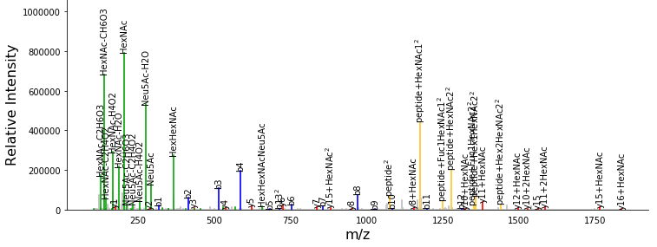
Multi-Part Identification under HCD
Glycopeptide = Peptide + $[1..n]$ “Localized Glycans”
Evidence for the Glycan
Oxonium Ions
Evidence for the Peptide
Peptide + Y Ions
Peptide b & y ions
Notes:
Glycopeptides are made up of a peptide and one or more glycans. When we identify one, we’re trying to identify each of those components from the experimental evidence. Most of that comes from the fragmentation pattern we observe, but not all fragments explain all parts. A method for encoding a peptide-component uncertainty and/or a glycan-component uncertainty, as well as a joint uncertainty may be used. How this is carried out is not consistent across the field. Vocabulary terms will be needed to express these techniques and to denote how search results were filtered.

Slide 12
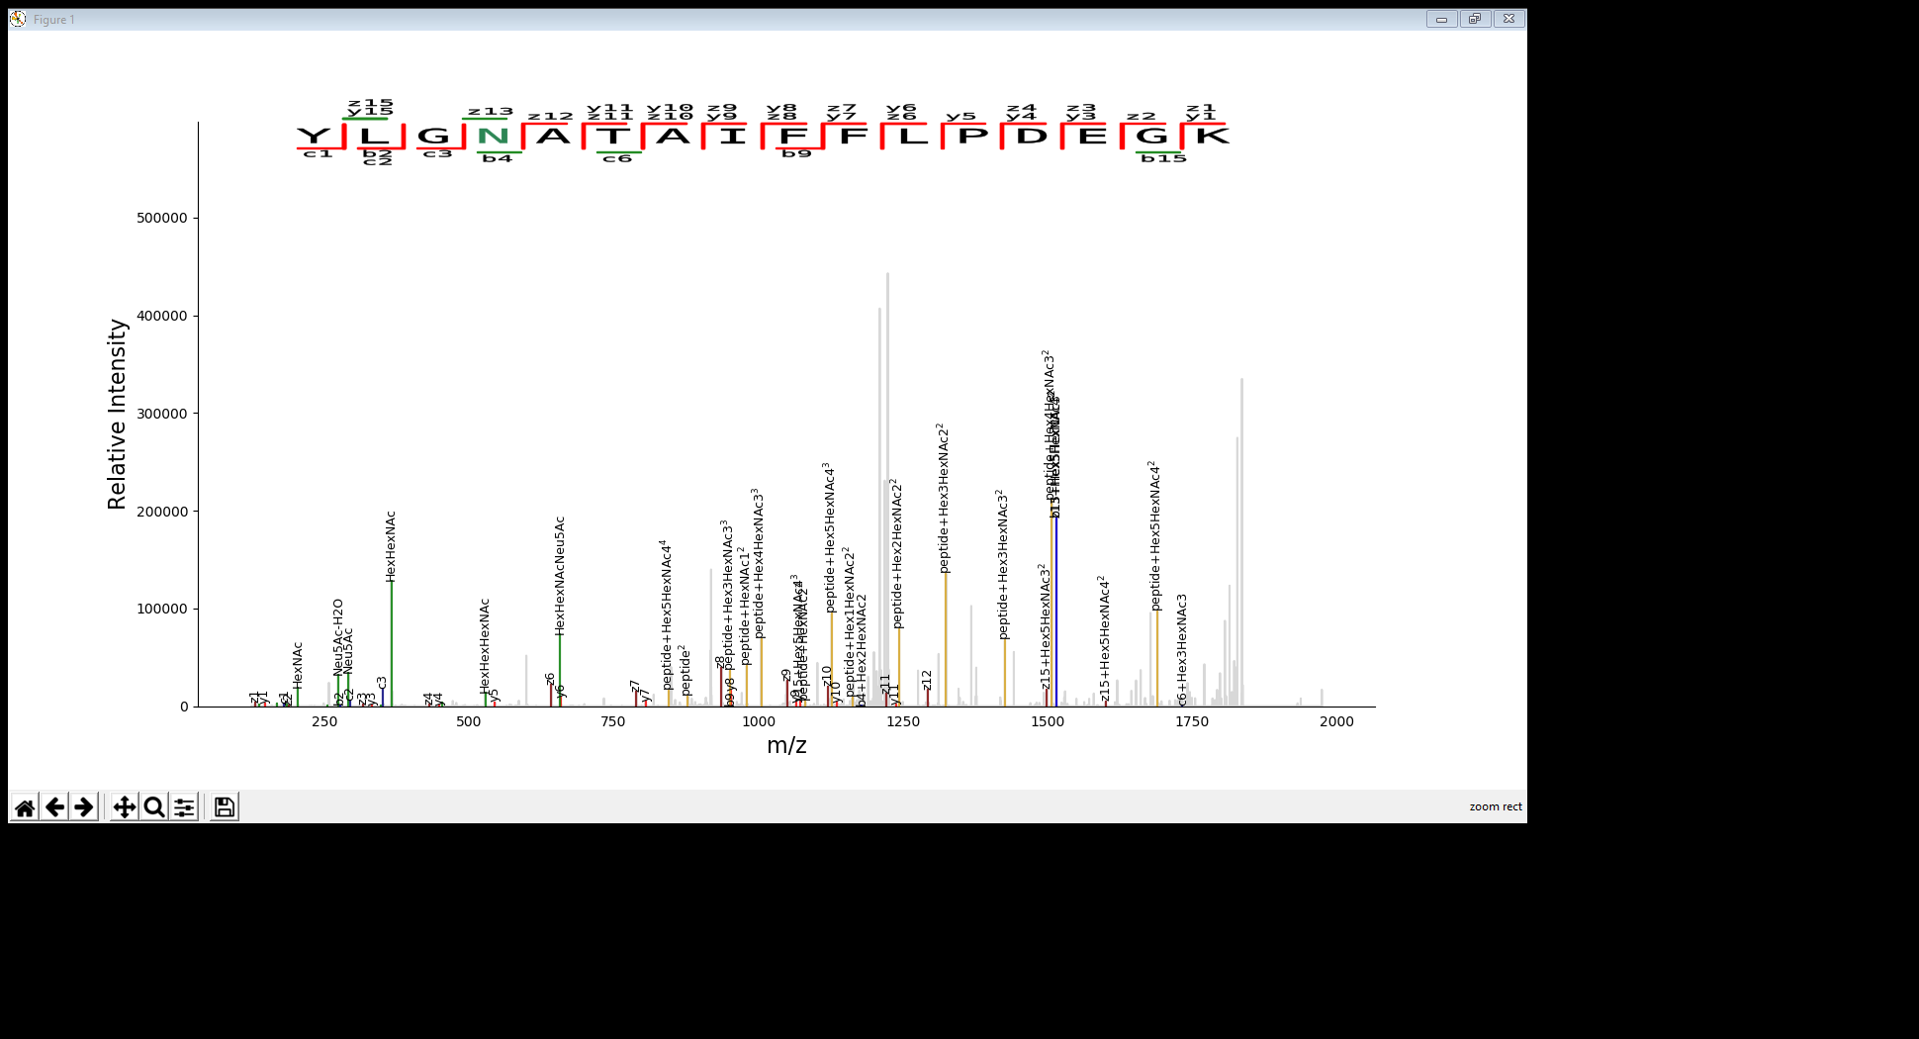
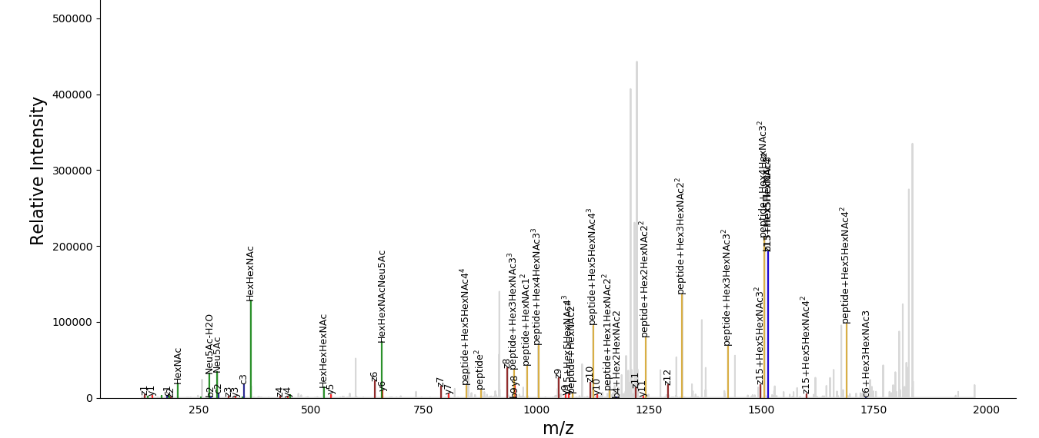
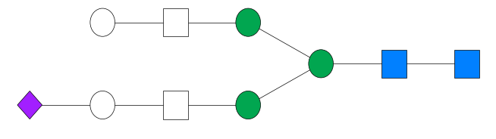
Multi-Part Identification under EThcD
Mixture of Peptide and Glycan Fragmentation in the same product ion
Notes:
Annotation becomes more difficult as we now mix glycan and peptide fragmentation processes in the same product ion, within the same spectrum. The standard does not provide a method for expressing this type of mixed fragmentation in the identification, or per-fragment annotation.

Slide 13
Glycopeptide Searches With Multiple Scores or Dissociation Modes
Several glycopeptide ID algorithms use multiple scores to filter glycopeptides pre- and post-FDR estimation. These scores should be clearly identified in the resulting mzIdentML, and how they were used to filter identifications should be expressed.
There are many ways in which a glycopeptide can fragment. While the name of a score may not change, its interpretation depends upon how the algorithm expected fragmentation to occur. This expectation should be expressed globally or on a per-spectrum basis for mixed mode datasets.

Slide 14
Encoding Glycopeptide Identifications With Single Score and FDR
<SpectrumIdentificationResult spectrumID="controllerType=0 controllerNumber=1 scan=23616"
spectraData_ref="SPECTRADATA_1" id="SPECTRUMIDENTIFICATIONRESULT_3">
<SpectrumIdentificationItem passThreshold="true" rank="1" chargeState="3" calculatedMassToCharge="1022.75662417"
peptide_ref="PEPTIDE_10" experimentalMassToCharge="1022.7564944" id="SPECTRUMIDENTIFICATIONITEM_3">
<PeptideEvidenceRef peptideEvidence_ref="PEPTIDEEVIDENCE_10"/>
<cvParam accession="MS:XXX10A" cvRef="PSI-MS" name="GlycReSoft:total score" value="94.9170107962"/>
<cvParam accession="MS:XXX111" cvRef="PSI-MS" name="glycan dissociating, peptide preserving" value=""/>
<cvParam accession="MS:XXX114" cvRef="PSI-MS" name="glycan eliminated, peptide dissociating" value=""/>
<cvParam accession="MS:XXX10D" cvRef="PSI-MS" name="GlycReSoft:glycopeptide q-value" value="0.00793650793651"/>
</SpectrumIdentificationItem>
</SpectrumIdentificationResult>
Reference to the glycopeptide being matched
The score which is used for sorting competing assignments
The expected dissociation processes for this spectrum
The single FDR estimate for this identification

Slide 15
Encoding Glycopeptide Identifications With Multiple Scores and Joint FDR
<SpectrumIdentificationResult spectrumID="controllerType=0 controllerNumber=1 scan=43836"
spectraData_ref="SPECTRADATA_1" id="SPECTRUMIDENTIFICATIONRESULT_1">
<SpectrumIdentificationItem passThreshold="true" rank="1" chargeState="4" calculatedMassToCharge="1067.44664714"
peptide_ref="PEPTIDE_53221" experimentalMassToCharge="1067.44664938" id="SPECTRUMIDENTIFICATIONITEM_1">
<PeptideEvidenceRef peptideEvidence_ref="PEPTIDEEVIDENCE_53221"/>
<cvParam accession="MS:XXX10A" cvRef="PSI-MS" name="GlycReSoft:total score" value="29.5103392825"/>
<cvParam accession="MS:XXX111" cvRef="PSI-MS" name="glycan dissociating, peptide preserving" value=""/>
<cvParam accession="MS:XXX114" cvRef="PSI-MS" name="glycan eliminated, peptide dissociating" value=""/>
<cvParam accession="MS:XXX10C" cvRef="PSI-MS" name="GlycReSoft:peptide score" value="20.017543431"/>
<cvParam accession="MS:XXX10B" cvRef="PSI-MS" name="GlycReSoft:glycan score" value="46.108036734"/>
<cvParam accession="MS:XXX10H" cvRef="PSI-MS" name="GlycReSoft:glycan coverage" value="0.899500714163"/>
<cvParam accession="MS:XXX10G" cvRef="PSI-MS" name="GlycReSoft:joint q-value" value="0.00120481927711"/>
<cvParam accession="MS:XXX10E" cvRef="PSI-MS" name="GlycReSoft:peptide q-value" value="0.00120481927711"/>
<cvParam accession="MS:XXX10F" cvRef="PSI-MS" name="GlycReSoft:glycan q-value" value="9.42146066205e-32"/>
<cvParam accession="MS:XXX10D" cvRef="PSI-MS" name="GlycReSoft:glycopeptide q-value" value="9.14279098921e-29"/>
</SpectrumIdentificationItem>
</SpectrumIdentificationResult>
The total score which is used for sorting competing assignments
The expected dissociation processes for this spectrum
Individual supporting scores that contribute to the total score
Multiple false discovery rate estimates may be listed, but the search parameters will specify which will be used to filter identifications.

Slide 16
Open Questions
Is the method of specifying an identification too verbose?
Dissociation modes may be inferred from the matched spectrum’s metadata, but the interpretation of each “activation method” CV term is vendor-specific. IE, “low energy collisional dissociation” with a “large” number of electron volts is comparable to HCD (Bruker TIMS-TOF)
Reporting three or more scores per spectrum makes the result more complicated, and without knowledge of the controlled vocabulary term tree, knowing which to trust is hard.
Should a database search engine have to output the complete list of glycans it considered? If yes, this may be 1-3,000 entries for glycan compositions, and 10-100,000+ for glycan structures.
Should they be treated just like any other variable modification?

Slide 17
Acknowledgements
Special thanks to:
Nathan Edwards (Georgetown University) for his early feedback on the draft and explanation about the structure of the GNOme ontology.
Andrew Jones (University of Liverpool, PSI) for guidance on starting this extension.

