Slide 1




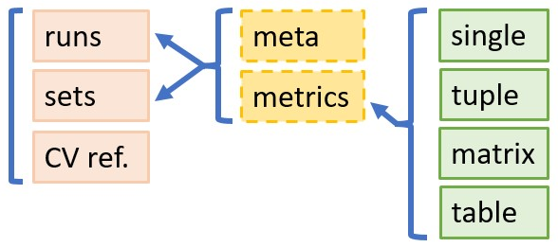
mzQC in a nutshell
Small and fast
Easy to grasp
Concise (focus on metric definitions)
Notes:
And that is, in a nutshell:
that mzqc is small and fast via a lightweight specification, in uncomplicated and almost ubiquitously supported JSON, and advanced control via ontologies
The schema is easy to grasp, we record metrics for runs and sets of runs, and the references to used vocabularies.
to each of runs and sets we also store helpful metadata, and at the core of each metric are the values which can take the form of a single, a tuple, a matrix, or a table
And finally mzqc is concise thanks to the focus on metric definitions in the CV

