Slide 1

qcML gets real
Disney 1940
Dave Tabb, Stellenbosch University
April 18, 2018

Slide 2
Our hypothesis
If biological MS quality control information could be structured in a flexible but defined format (qcML), that advance would facilitate interoperation and development of quality metric generators, databases and repositories, statistical frameworks, and decision-support systems.

Slide 3

Update: solidifying format
n-way metric
Defining sets of numbers: JSON
<content cvRef="PSI-QC-CV" accession="QC:3000008" value="4"> {'UO:0000191':[0.301236,0.13286,0.174576,0.391328]} </content>
Queueing additions for CV: qcML-dev
EuBIC Hackathon 2018: QC Dashboard
A fraction
https://github.com/HUPO-PSI/qcML-development

Slide 4
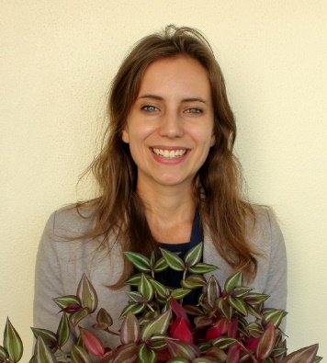


Update: youngsters to the fore!
Developing metrics for SWATH QC
Marina Pauw, Ph.D. candidate http://sun.ac.za
Defining metrics for MALDI-TOF profiling
Hugo López Fernández, Ph.D. http://sing.ei.uvigo.es
Demonstrating text for MIAPE-QC
Jinmeng Jia, Ph.D. candidate http://faculty.ecnu.edu.cn/

Slide 5
Plan of Attack
April 19th AM and PM
April 20th AM
Formalize suggested CV edits
Formulate new material for CV
Develop examples of CV terms
Review updated MIAPE-QC with demonstrator text
Envision repository implementations
Evaluating current implementations: Getting to 1.0!

Slide 6
From cv to CV!
Tackle Essentials
Dream of what is possible
Broaden pool of committers
Establish process for new software, new terms
Canonize set of essential metrics: MIAPE-QC
Determine integration plan with HUPO-PSI-MS
Spiking defined standards yields intensity ratios
Metabolomics dwarfs proteomics for potential analytes
RPLC-nESI is not universal! MALDI, GC, CE…

Slide 7
Seeking v1.0
Stepping toward MIAPE-QC
What metrics are essential and unambiguous?
Can we produce text that meets our criteria?
Is a manuscript the right way to communicate expectation?
Defining a role for repositories
Which sets are assayed?
Which metrics do we want?
Hand-crafting qcML examples
QuaMeter IDFree
OpenMS NIST metrics
Mass-UP MALDI metrics
iMonDB multi-file assessment

Slide 8
Closing thoughts
Software implementations are essential to demonstrating qcML value and impelling the CV to become a solid foundation.
The qcML conversation is now becoming applied rather than theoretical.
New partners inject energy and variety into our discussions.

