Slide 1
mzQuantML sketch of OpenMS alternative (version 0.1.2d)
cvList
ProteinList
PeptideList
seq., mod., external ref
QuantList
QuantLayer
QuantValue
CV : type of data / layer description
CV: transformation / aggregation function
AssayList
raw file, label, ident. file
StudyVariableList
discussion about optional studyVariableRef attr. in <QuantValue> (could „explain“ the aggregation further)
replicates, exp. cond.
FeatureList
mass trace
DataProcessingList

Slide 2
mzQuantML QuantList
Self-References from <QuantValue> to <QuantValue> enable description of:
„aggregation / transformation“ (CV term in <QuantValue>)
„type of data / layer description“ (CV term in <QuantLayer>)
If we had studyvariable_ref, there would be finer grained „parallel“ layers (red) corresponding to the experiment structure
layer „protein ratios “
aggregation:
„ratio“
„wildtype “
layer „mutant“
layer „protein values“
aggregation:
„condense proteins“ / „sum“
„wildtype “
layer „mutant samples“
layer „peptide values“
aggregation:
„condense peptides“ / “average“
layer „normalized values“
…
aggregation:
„normalization“
layer „raw values“

Slide 3
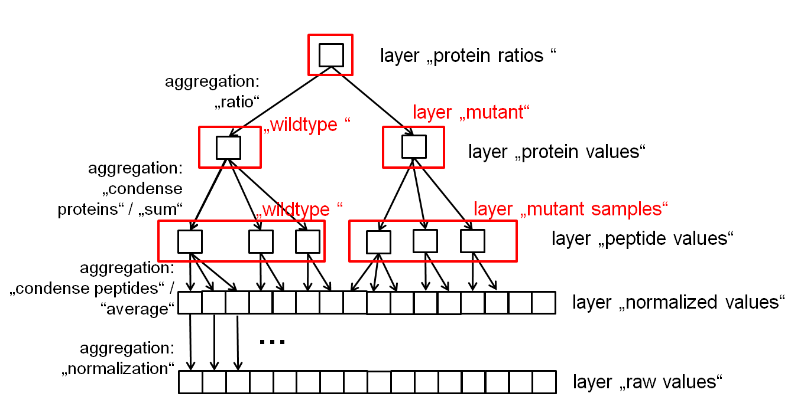
mzQuantML references to and from QuantList (proposal for next schema version)
Peptide
Protein
seq., mod., external ref
<QuantList> could be the central mandatory element of the schema; <FeatureList>, <PeptideList> and <ProteinList> could be optional!
QuantList
Feature

