Slide 1
Quant CVs (visualization of differences to psi-ms.obo version 3.7.3, released 2011-07-13) Martin Eisenacher, August ^{12th}, 2011

Slide 2
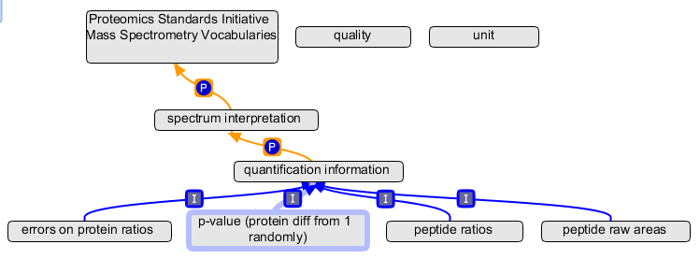
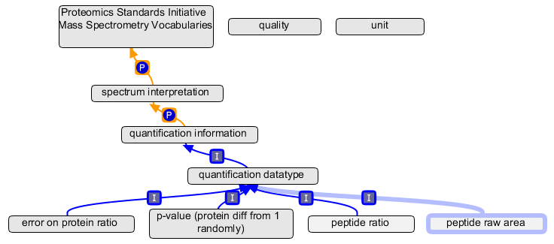
Change type A) (implies new term type A)
Current:
Some terms were inserted during the mzIdentML dvelopment below "quantification information".
Actually they were the result of a brainstorming process.
In the current obo they have been moved below "quantification datatype"
and lost their value (as values are now given in schema element content).
Some of them changed from plural to singular form.
Suggested change:
…

Slide 3
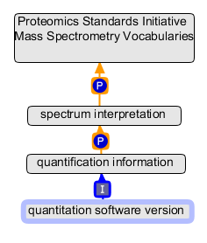
Change type B)
Current:
Term should now be obsolete, because part of the schema (as attribute)
Suggested change:

Slide 4
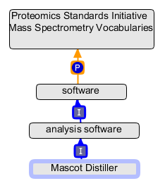
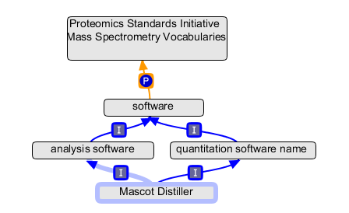
Change type C)
Current:
Some existing software names should be also in the "quantitation software name branch".
Suggested change:
…

Slide 5
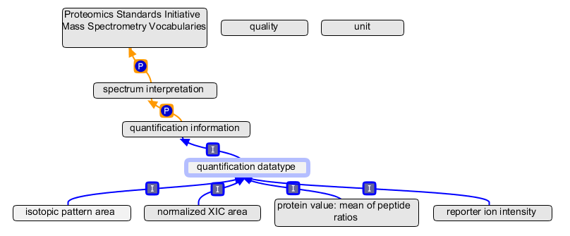
New terms type A) and K)
A) New branch for quantification datataypes
K) Further terms for quantification data types
…

Slide 6
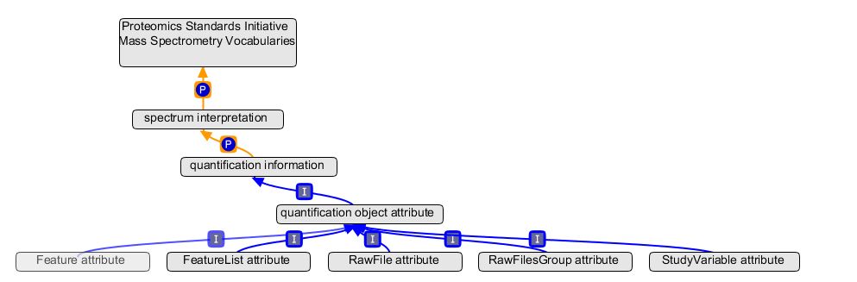
New term type B)
New branch containing quantification object details. This term is only introduced to group the following terms like "StudyVariable attribute", "RawFile attribute" etc.

Slide 7
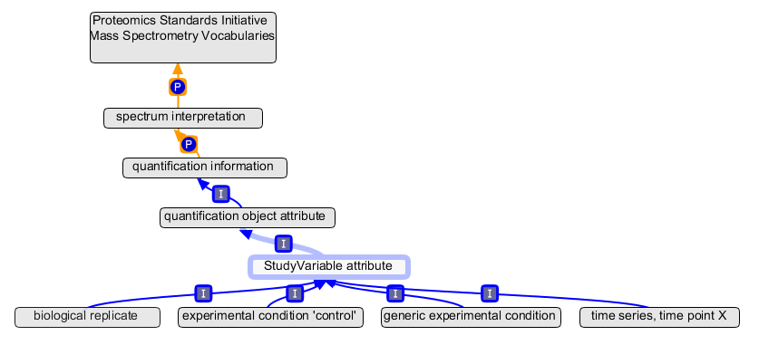
New term type C)
C) New branch for study variable descriptions, e.g. experimental conditions etc.

Slide 8
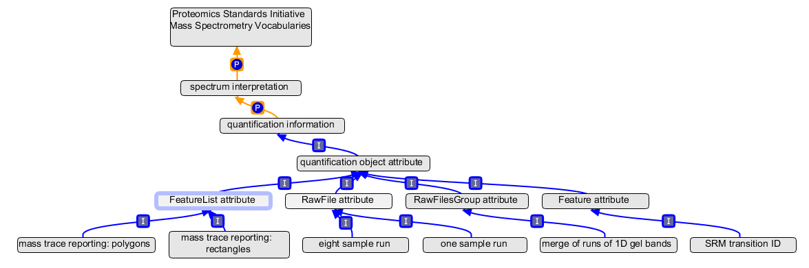
New terms type D), E), F), G)
D) New branch for raw file variable descriptions, e.g. "one sample run" etc.
E) New branch for RawFilesGroup descriptions
F) New branch for FeatureList descriptions
G) New branch for Feature descriptions
…
…

Slide 9
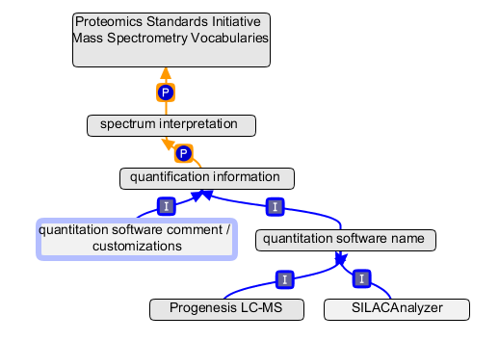
New terms type H), I)
H) Further quant. software names
I) New term for software comments / customizations

Slide 10
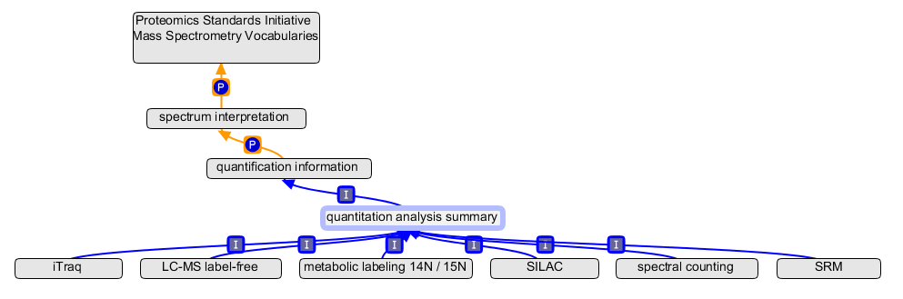
New terms type J)
J) New branch for describing the overall workflow, e.g. LC/MS label-free, SILAC

Slide 11
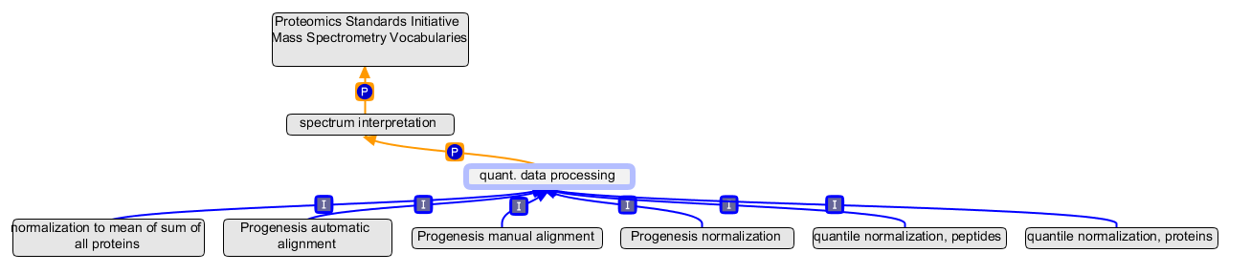
New terms type L)
L) New branch for describing quantification data processing

