Slide 1

Towards mzTab-M 2.1 - Evolving the HUPO-PSI standard format for reporting of small molecule mass spectrometry results
Nils Hoffmann
n.hoffmann@fz-juelich.de
HUPO-PSI mzTab-M Working Group
IBG-5, Forschungszentrum Jülich
Outstation Bielefeld University
Germany
July 22nd 2025 - CompMS Track - ISMB/ECCB 2025 – Liverpool, United Kingdom

Slide 2

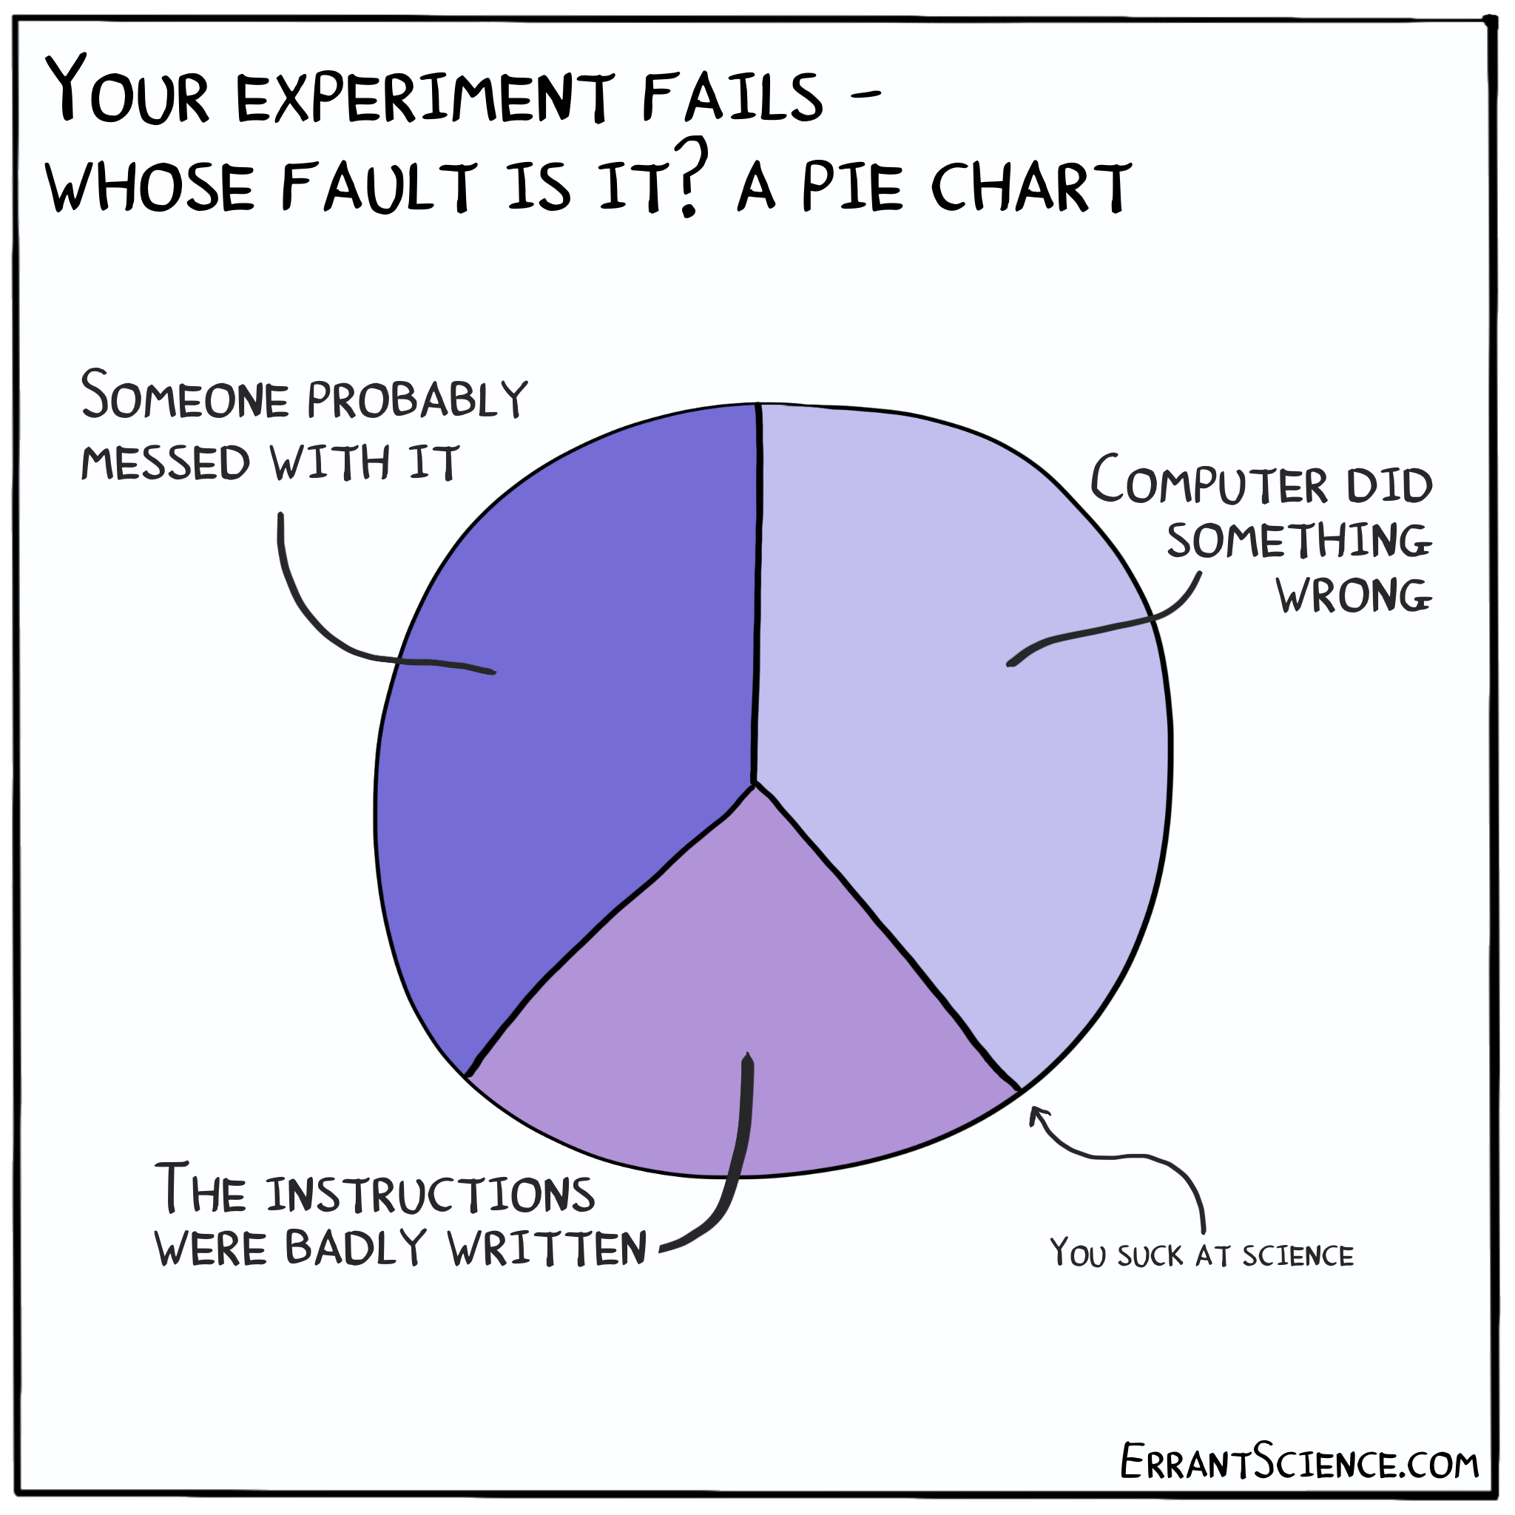
Interoperability & Reusability in Research
The I and R in FAIR¹
1: Best-practice guidelines
How to do things, decision guide for method selection (both experimental and computational)
First step to ensure high quality of results and data
2: Minimal reporting standards
Describe what was done and how
Help both analytical / experimental re-use, reproducibility and computational processing
3: Defined, well structured and validatable formats
Aid processing & interpretation (by humans and computers)
Enable large scale integration and combination of data, basis for machine learning applications
1
3
2
¹ Wilkinson, MD et al., Sci Data. 2016

Slide 3




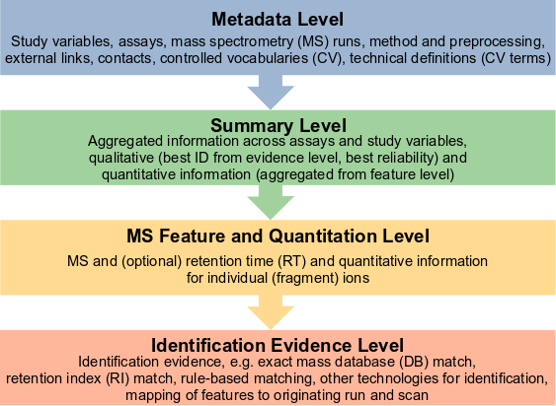






mzTab-M Data Format
PSI + MSI single file standard for small molecule mass spectrometry (MS) experiment results, qualitative & quantitative, tab-separated or JSON
Minimal reporting standards, but can adapt to your MS use-case, extensible schema, with optional elements (CCS, 2nd retention time…) and pluggable CV terms + semantic validation
Supports communication of level of confidence + ambiguity for identification based on evidence from MS or complementary information / diagnostic fragments
Reference implementations available
Supported by multiple tools for output & input
MTD mzTab-version 2.0.0-M MTD mzTab-ID ISAS-2018-1234
…
MTD publication[1] pubmed:29039908 | doi:10.1021/acs.analchem.7b03576
MTD cv[1]-label MS
MTD cv[1]-full_name PSI-MS controlled vocabulary
MTD cv[1]-version 4.0.18
…
MTD quantification_method [MS, MS:1001838, SRM quantitation analysis, ]
…
MTD instrument[1]-name [MS, MS:1002581, QTRAP 6500 , ]
CV definition
CV term usage
CV term usage
Hoffmann, N et al., Analytical Chemistry. 2019
Notes:
Click: mzTab-M is a common output format to report final quantitative results from analytical approaches using MS on small molecules, as well as the evidence trail in terms of features measured directly from MS and different types of approaches used to identify molecules. It was developed in a collaboration of the Proteomics Standards Initiative and the Metabolomics Society Data Standards Task Group and was originally published in 2019.
mzTab-M is a spreadsheet-friendly, column-based, tab-separated format and consists of four different sections or “levels”: Metadata, summary, ms feature and quantitation, and the identification evidence level.
Click: It defines minimal reporting requirements, but is extensible via user-defined elements, e.g. CCV, 2nd column retention times and CV terms.
Click: The metadata section captures
Click: controlled vocabularies, analytical and MS method details, study variables and assay information, as well as the software used for processing, and other background information.
Click: The format was specifically designed to support the communication of levels of confidence and ambiguity in the identification of small molecules and allows to report supporting evidence for identification to be linked to individual ion features from the evidence section.

Slide 4
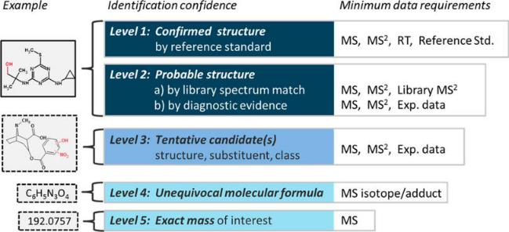
How To Report Identification Confidence?
Level 1: Identified Metabolite
Level 2: Putatively annotated compounds
Level 3: Putatively characterized compound classes
Level 4: Unknown compounds
Authentic reference std., orthogonal method
Physicochemical props and / or spectral similarity of compound
Physicochemical props and / or spectral similarity of class
Differentiation based on spectral or chromatographic data
MSI 4 level scheme ¹
Allows to report what is known about a molecule and how ambiguous the identifications are
Focus on distinction between unknowns, compound class, compounds and metabolites
High Resolution-MS extension ² (right)
Focus on MS molecular characteristics & structural evidence
Adds more differentiation to communicate confidence
Both: intentionally coarse, actual diagnostic evidence is not reported with confidence level!
¹ Sumner, LW et al., Metabolomics. 2007 ² Schymanski, EL et al., Environ Sci Technol. 2014

Slide 5
MZTAB-M 2.1 Data Format Update
M + S + F + E
Rebooted activities at HUPO-PSI Spring Meeting in Tübingen, Germany, 2025
Relaxed requirements for presence of summary table to support XCMS and other incremental tool workflows
JSON schema, adapted semantic validation for different use-cases (Metadata + Summary, Metadata + Features, untargeted, targeted, ...)
Serialized JSON Format as first-class alternative to TSV format
Explore more efficient binary representations
M + S
M + F

Slide 6
MZTAB-M 2.1 Data Format Update
M + S + F + E
Explore better integration / machine interpretability for mzQC and SDRF for metabolomics
Basis for AI method training
Combined hackathon / cross-walk for mzTab-M, SDRF, ISA-Tab and potentially other formats & tool developers, checking interoperability and interconversion at ELIXIR BioHackathon Europe, Nov. 3rd - 7th 2025, in-person or virtual participation
We need your use-cases and input!
M + S
M + F
https://biohackathon-europe.org/

Slide 7
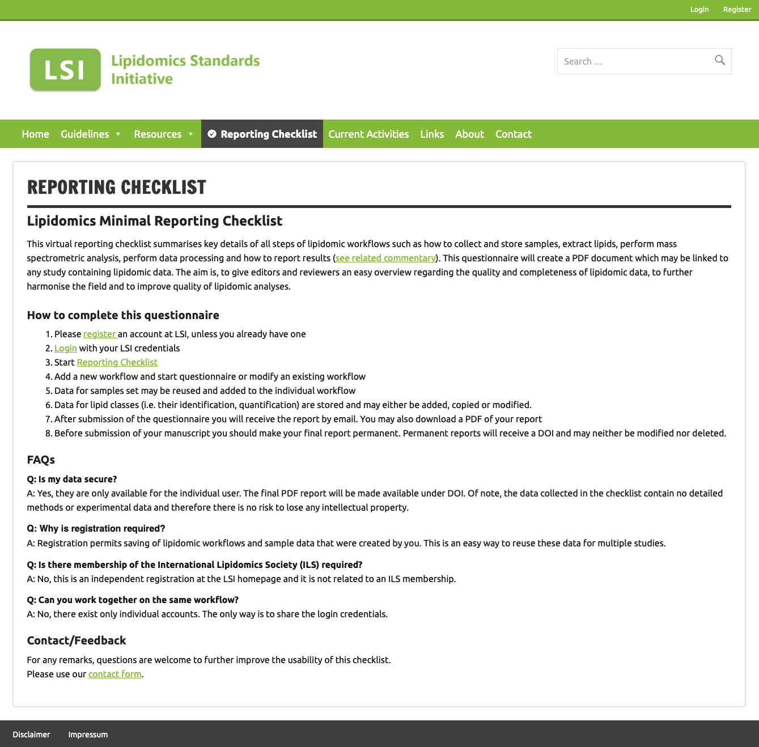


Future Integration of MZTAB-M 2.1
Small Molecule Mass Spectrometry Tools
Data Hub
Lipidomics Reporting Checklist¹
mzML &
mzQC
& other formats
Generate metadata from minimum information checklists
Common format for FAIR data sharing
Mapping to MetaboLights⁶ ISA format or Metabolomics Workbench mwTab⁷
Modularize mzTab-M to link to
SDRF² (sample metadata)
mzQC³ (QC info for runs)
mzSpecLib⁴ (library IDs)
USIs⁵ (Universal Spectrum Identifiers) linking to source spectra
¹ Kopczynski, D et al., J Lipid Res. 2024
² Dai, C et al., Nat Commun. 2021
³ Bielow, C et al., J Am Soc Mass Spectrom. 2024
⁴ Klein, J et al., Analytical Chemistry. 2024
⁵ Deutsch, EW et al., Nat Methods. 2021
⁶ Yurekten, O et al., Nucleic Acids Research. 2024
⁷ Powell, CD et al., MDPI Metabolites. 2021

Slide 8

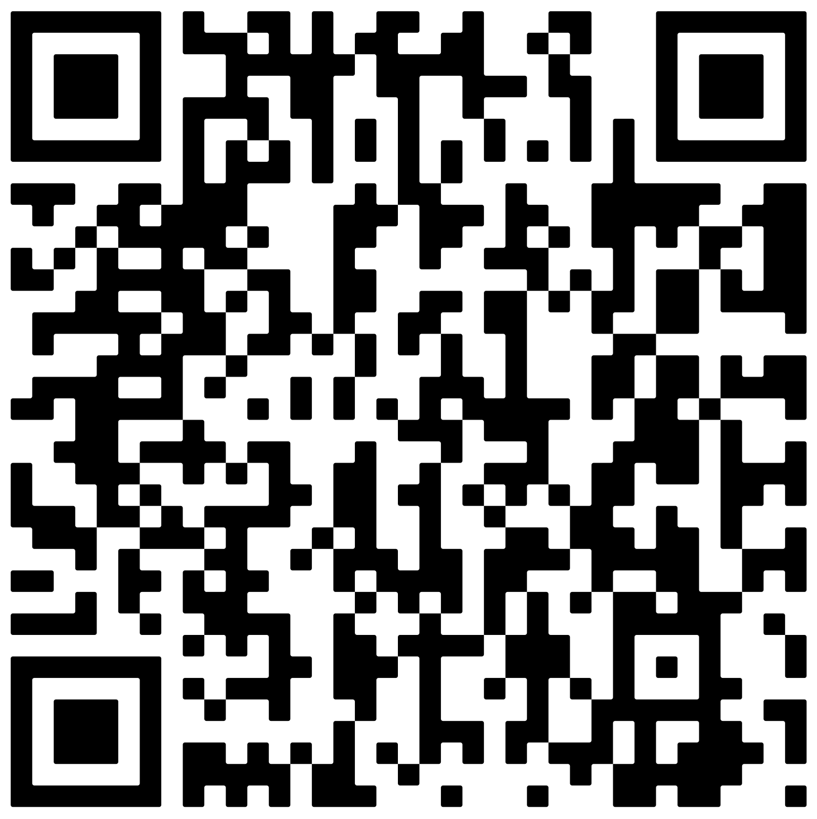





Thanks!
Contact:
Nils Hoffmann
n.hoffmann@fz-juelich.de
Data Science & Computational Mass Spectrometry IBG-5, Forschungszentrum Jülich GmbH Outstation Bielefeld University
HUPO-PSI Website
mzTab-M Mailing List
mzTab-M GitHub Repository
Acknowledgements:
HUPO-PSI mzTab-M 2.1 Working Group: Bo Burla, Yasin El Abiead, Joe Foster, Jürgen Hartler, Helge Hecht, Janik Kokot, Philippine Louail, Steffen Neumann, Kozo Nishida, Thomas Payne, Johannes Rainer, Juan Antonio Vizcaíno, Ralf Weber, Ozgur Yurekten
HUPO-PSI mzTab-M 2.0 - MetSoc Data Standards Task Group: Joel Rein, Timo Sachsenberg, Jürgen Hartler, Kenneth Haug, Gerhard Mayer, Oliver Alka, Saravanan Dayalan, Jake Pearce, Philippe Rocca-Serra, Da Qi, Martin Eisenacher, Yasset Perez-Riverol, Juan Antonio Vizcaíno, Reza Salek, Steffen Neumann, Andy Jones HUPO-PSI mzQC Working Group: Dave Tabb, Mathias Walzer, Wout Bittremieux, Julian Uszkoreit, Chris Bielow SDRF4Metabolomics: Yasset Perez-Riverol, Matthias Mattanovich
Funding:
LIFS – This work was supported by the German Network for Bioinformatics Infrastructure – de.NBI, funded by the German Federal Ministry of Education and Research (BMBF) – Grant FKZ 031L0108A,B,C until 12/2021
Funded via the Helmholtz Association and Forschungszentrum Jülich since 1/2022
PhD Position Available
Please check the HUPO-PSI website for current activities and further links!
Parts of this presentation use adapted slides from Juan Antonio Vizcaíno, Wout Bittremieux, David Tabb and other HUPO-PSI members.

