Slide 1
Version 1.0 Design - Proteomics
Complete vs Summary
Minor diffs at Meta Data level; Complete enforces assays and ms_run meta-data
Quant reported at assay and SV level in Complete; Summary allows quant at SV level only; only other difference is protein_coverage attribute enforced in Complete
Quant is optional at assay level in Summary files; so is search engine scores for every ms_run
No difference between Summary and Complete
Complete vs Summary
Only diff - Software optional in S;
Optional in S: protein_coverage; counts of PSMs, peptides; search engine scores per run
Peptide section should not be used (presume no support for peptide-level stats)
No difference between Summary and Complete
Proteomics Quant
Proteomics Ident
Metadata
Metadata
Protein
Protein
Peptide
PSM
PSM
Quant vs ID diffs: No use of peptide section; Protein section leaves out Abundance columns;

Slide 2
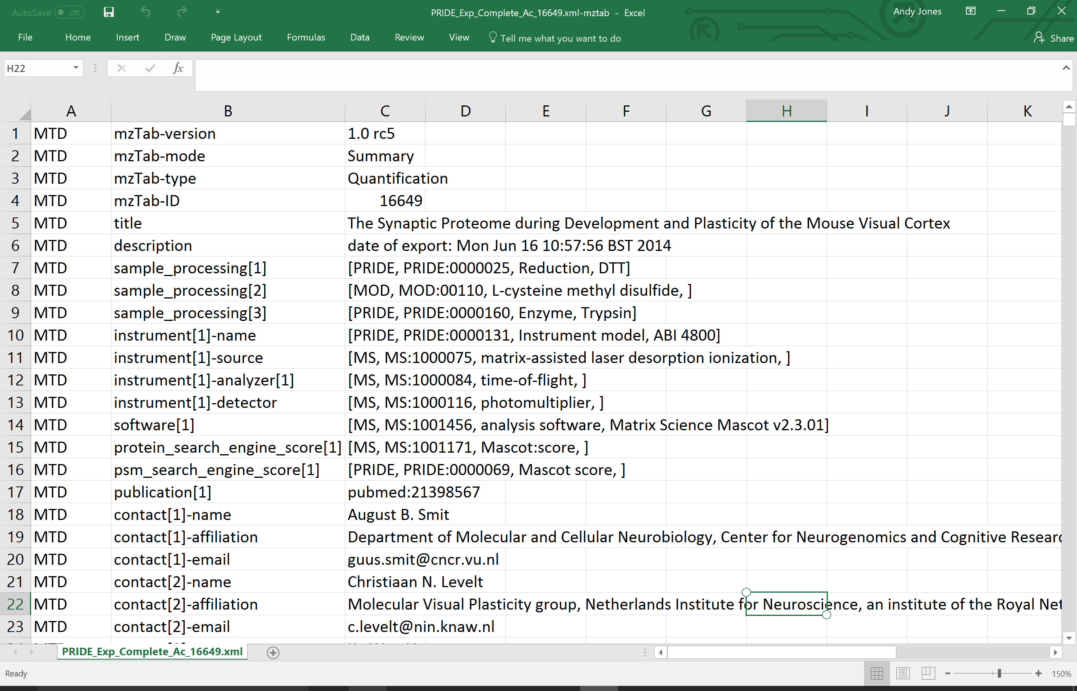
Proteomics metadata

Slide 3
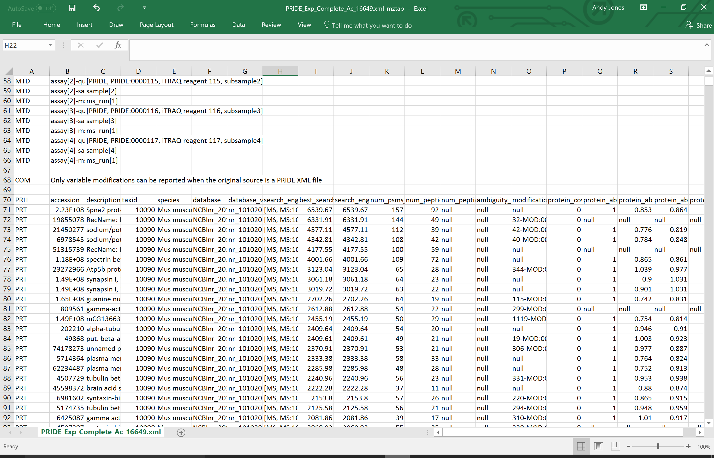
Proteomics protein table

Slide 4
Hard to locate proteomics files containing a peptide section – no current exporters appear fully functional?

Slide 5
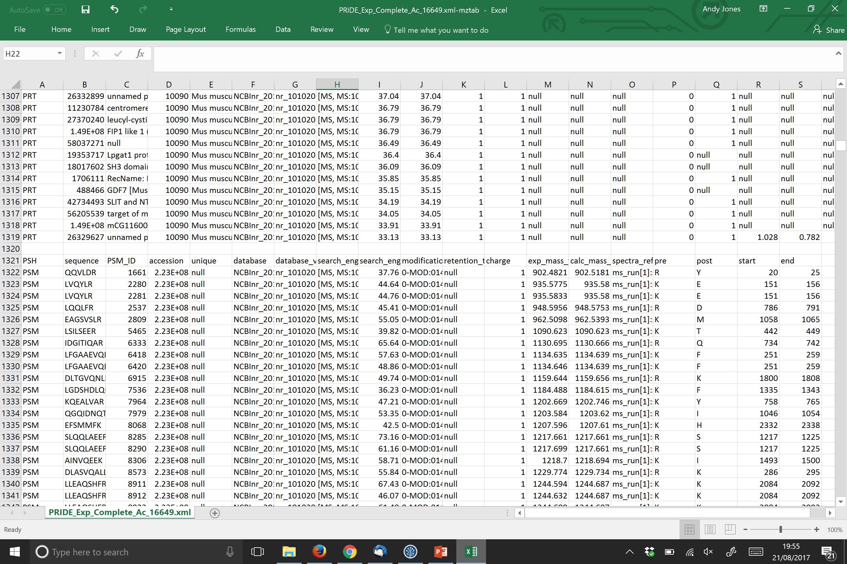
Proteomics PSM table

Slide 6
Proposed design change for proteomics in 1.1
Summary vs Complete distinction at present is rather pointless – seems fairly rare that studies will report quant only at SV-level but not at assay level
What would be the use of this data? Cannot be used for statistics?
Distinction between ID and Quant file is mostly just the use of the quant columns – why not just make them null?
If distinction between Complete and Summary is desirable, why not split into Protein table vs all three tables are per proposed design in metabolomics 1.1 (following slides)
Downsides of this approach:
Phospho-proteomics Summary file would not really work; but want to encourage most exporters to go for Complete files anyway, so long as reporting is not so onerous

Slide 7
Metabolomics v1.1 Design
Metabolomics Complete
Metabolomics Summary
Metadata
Metadata
“Final” quantified small molecules of interest e.g. including aggregation across adduct forms or different charge states etc
SML
SML
SMF
Features quantified in MS e.g. individual adduct form
Evidence stream for identification of molecule
No planned differences in the quality or quantity of metadata required
SME

Slide 8
Review examples file from GitHub via Excel (easier to visualise than here)

Slide 9
Proteomics v1.1 design-proposed
Proteomics Complete
Proteomics Summary
Metadata
Metadata
“Final” quantified small molecules of interest e.g. including aggregation across adduct forms or different charge states etc
Protein
Protein
In case of ID only files, abundance columns are nulled; force exporters to add layer aggregating PSMs into peptides (e.g. mzIdentML already has a peptide section anyway, so this is really the same work).
Peptide
*Additional notes: In an ideal world, we would have data at all three levels in a complete file. The linkage between layers in 1.0 is not explicitly specified. It is implied that PSMs reporting a given sequence and protein accession have been used to identify the given peptide or protein. This is okay, so long as the exporting tool doesn’t report PSMs not passing the threshold. In general, this could be an issue with mzTab files, since there is no concept of pass_threshold = true. If in mzTab 1.1, explicit links are added between layers then a peptide section could have zero references to the PSM section. This would pass validation (presumably?), but would it cause other problems downstream? This is no better in mzTab 1.0 anyway, since export software could still choose not to report PSMs or report PSMs inconsistent with peptide or protein list.
PSM
1.0 specs imply that PSMs are mandatory for quant, which will be a big pain for some quant software; I would vote to make PSM table optional, say with a Boolean flag in the metadata for PSM_reported = “true|false” (MORE DISCUSSION NEEDED*)

Slide 10
Experimental design modelling replicates
Assay is in effect measurements made from a sample of interest, using MS
Different (bio or tech) replicates are modelled as different assays
Technical replicates usually multiple ms_runs
Assay 1
Assay 2
Assay 3
ms_run 1
ms_run 2
ms_run 3
Sample 1
Sample 1
Sample 1
mzTab 1.0 specs:
Clear definitions of biological and technical replicates are difficult to provide as these are somewhat dependent upon the biological domain. However, we use the following general definitions in mzTab.
Biological replicates are where different samples have been analyzed by MS.
Technical replicates are where same samples are analyzed multiple times by (LC)-MS.

Slide 11
Experimental design label-free with no pre-fractionation (proteomics or metabolomics) – 3 tech reps, no bio reps, 2 conditions (SVs)
Study Variable 1
Study Variable 2
Assay 1
Assay 2
Assay 3
Assay 4
Assay 5
Assay 6
ms_run 1
ms_run 2
ms_run 3
ms_run 4
ms_run 5
ms_run 6
Sample 2
Samples are always optional and can have additional attributes
Sample 1
Sample 1
Sample 1
Sample 2
Sample 2

Slide 12
Experimental design label-free with no pre-fractionation (proteomics or metabolomics) – 3 bio reps, no tech reps, 2 SVs
Study Variable 1
Study Variable 2
Assay 1
Assay 2
Assay 3
Assay 4
Assay 5
Assay 6
ms_run 1
ms_run 2
ms_run 3
ms_run 4
ms_run 5
ms_run 6
Sample 1
Sample 2
Sample 3
Sample 4
Sample 5
Sample 6

Slide 13
Experimental design Duplex SILAC 2 tech reps
mzTab 1.0 is unclear on what SV quants should include in this case
Assay quants are supposed to encode ratios as “raw quant values”. At protein-level, this would imply ratio could/should be encoded as follows, but it is unclear:
A1 A2 A3 A4 SV1 SV2
Protein 1 1 2.7 1 2.8 1 2.75
Protein 2 1 3.1 1 3.4 1 3.25
SILAC and iTRAQ mzTab 1.0 files show actual abundance quant values for all assays, but this is not the true data from most software approaches (SILAC at least), often uses median peptide ratio, so it is not meaningful to put raw quants in via this mechanism
Study Variable 1
Study Variable 2
Assay 1
Assay 2
Assay 3
Assay 4
ms_run 1
ms_run 2
Sample 1
Sample 2

Slide 14
Question – encoding bio versus technical replicates?
Issue #30 on GitHub
Seems hard to encode at SV, assay or ms_run level
Assay and ms_run can be re-used within file for different designs
SV could say whether it contains bio and/or tech reps, but seems hard to flag which is which
Given this is complex – seems that enforcing if exporters wish to communicate a distinction between bio and tech reps, can be done via the multiplicity of connections to samples as on previous slides

Slide 15
Problems with supporting pre-fractionation
Problem
A row in the Peptide table has “retention_time” and then assay (and SV) quants.
Assay can only be linked to 1 ms_run
ms_run is supposed to be designed to allow for multiple fractions inside it
But – this looks like it was never implemented, since it can only have 1 location
Also, then impossible to say which fraction (or MS file) the Peptide came from
Same problem at PSM level
Same problem in SMF table
Same problem in SME table
Possible solutions
Peptide, PSM and SME currently have a spectra_ref column intended for referencing MS2 spectra (for MS2 peptide quants in that case)
Could overload the use of this to capture fraction ID as well
ms_run[1]-[1] where second field is fraction ID
ms_run[1]-[1]-location
ms_run[1]-[2]-location etc
Could add a column to each table for fraction ID, then come up with some way of encoding raw file locations etc in metadata?
More discussion here: https://github.com/HUPO-PSI/mzTab/issues/26

Slide 16
In case of pre-fractionation, what is ms_run?
mzTab 1.0 specs: “MS run – An MS run is effectively one run (or set of runs on pre-fractionated samples) on an MS instrument, and is referenced from assay in different contexts.”
Given we have concept of assay to capture complete set of measurements to be grouped together, do we need the concept of ms_run as a grouped set of MS instances?
Protein table has “num_psms_ms_run[1-n]” – unclear why this is not per assay, and just treat it like a label-free?
ms_run could thus default to being file location and other attributes?
However, even under this design, would still need to talk about fractions in the Peptide and SMF table… especially if fractionated samples have then been aligned -> can’t give a single ms_run value per row
MORE WORK NEEDED https://github.com/HUPO-PSI/mzTab/issues/26

Slide 17
Model suggestion from Timo:
PEH sequence ... cv_opt_global_ms_run
PEP VLPASLAANIPVK ... 1,8,15,23
PEP VLPASLAANIPVK ... 2,9,16,24
This could be supported via this route as a backwards compatible update as to how to encode fractions in practice without a schema change, perhaps with the following amendment, so that it is easy to locate the mapping between peptides and fractions
PEH sequence ... opt_ms_run[1]_cv_MS:100XXXX_fraction_IDs opt_ms_run[2]_cv_MS:100XXXX_fraction_IDs
PEP VLPASLAANIPVK ... 1,8,15,23 1,7,16,24
PEP VLPASLAANIPVK ... 2,9,16,24 2,9,24
This addition is not backwards compatible but extra meta-data can be added without really breaking anything, since no readers or writers can handle fractionated data in mzTab 1.1
MTD ms_run[1-n]-fraction[1-n]-location LOCATIONOFRAWFILE.raw

Slide 18
Aug 2017 meeting Main items (core)
Agree release plan
Do we want to keep mzTab fully coordinated development between proteomics and metabolomics or split in mzTab-P and mzTab-M
Fully separate formats or a shared core format, with extensions.
The shared core approach would have the benefit of developing something that could be potentially re-used for other communities e.g. glycomics, but again, this is extra work now to split it up
Agree design of Complete versus Summary
Assays and/or SVs mandatory?
What data to report about SVs?
Agree approach for handling pre-fractionation
Agree method to report bio versus tech replicates

Slide 19
Aug 2017 meeting Main items (proteomics)
Major decision on whether to keep the distinction between Id versus Quant
If decided to remove the distinction, then:
Proposal to have Summary be Protein table only; Complete be all three tables
Proposal to add explicit links from Protein to peptide (peptide_id) and from peptide to psm (psm_id)
Decide what to do about num_psms_ms_run[1-n] columns
Decision on how to report protein grouping info; and peptide mapping to multiple proteins
Various minor(ish) items about how to report databases, search engines etc flagged as comments on the spec doc
Note – most participants are metabolomics focussed, so at worst some of this work could be deferred if necessary. This will delay a coordinated release of mzTab 1.1 though
We could do a mzTab-M 1.1 release, stripped of proteomics details altogether?

Slide 20
Aug 2017 meeting Main items (metabolomics)
Review specification document – various minor-ish items to resolve
Need a working validator
Need implementations
Do we have all controlled vocabularies we need?

Slide 21
Proposed plan of action
I (Andy) have started work on splitting the spec doc into Core Metadata and proteomics/metabolomics specific
Propose to branch fully the mzTab 1.1-M document removing all references to proteomics part
While doing this re-design, we fully split into core with metabolomics extension parts
We can then proceed working only on this document
For proteomics, we can separate out the development of mzTab 1.1-P when the time is right and we have sufficient people to get this completed

Slide 22
Plan for Aug 2017 meeting
Priorities:
Agree strategy for 1.1 (split M vs P or M&P together)
Agree plan for completing spec doc, validator and software
Implementation in Metabolights / OpenMS / Progenesis / others?
Work through spec doc + example files (metabolomics only; propose to leave proteomics for now)
Agree plan for release of specs and writing a metabolomics manuscript

