Slide 1
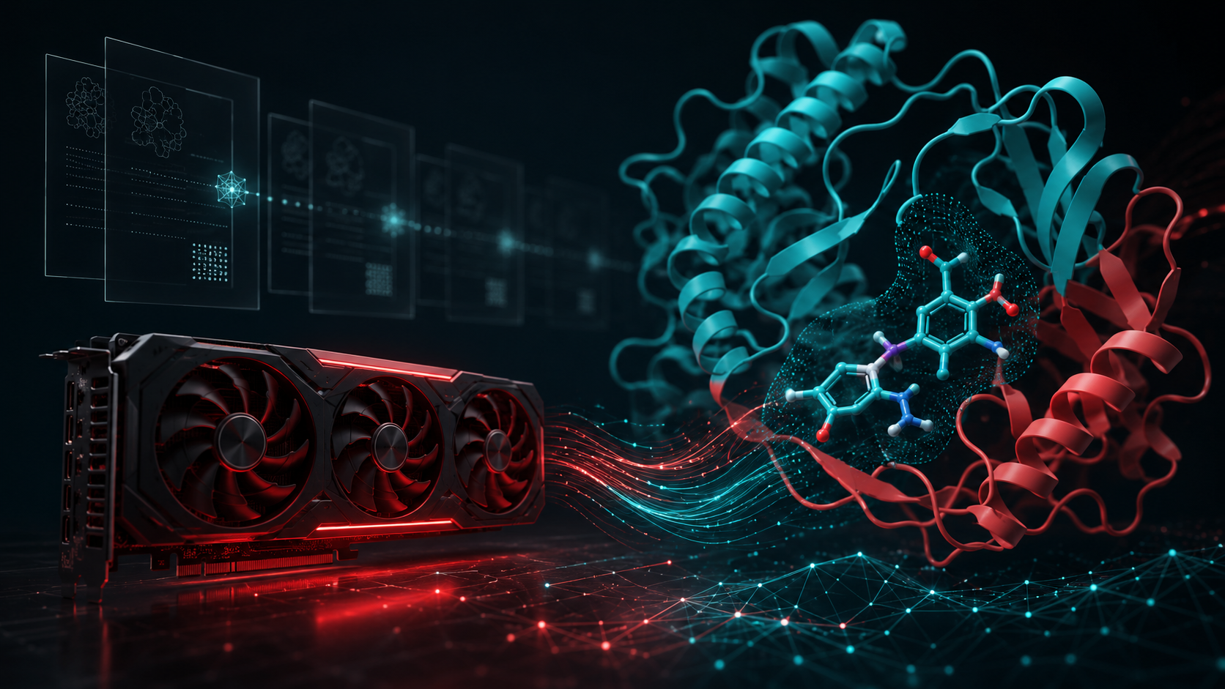
AMD AI DevMaster Hackathon · Track 2
ProtBind
A local-private protein–ligand research Agent on AMD Radeon
Local Qwen inference · ROCm/HIP tools · audited scientific state
Huang Siming — Solo Participant
Closing thesis: private, auditable research collaboration without pretending that a model score is an experiment.
Notes:
Narration: Open with the product thesis, not the toolkit. Emphasize private local inference and evidence-bounded scientific state.

Slide 2

AMD AI DevMaster — Track 2: Agentic AI
The research gap
Small research teams need an auditable workstation workflow, not a persuasive cloud chat wrapper.
Protein–ligand research crosses private compounds, structures, docking, papers and assay measurements. The failure mode is not just wrong text — it is lost provenance.
Private data leaves the workstation
Generated prose becomes false evidence
Long workflows lose state
!
↯
sequences, compounds, assay tables
scores get confused with experiments
artifacts, failures and approvals vanish
Target users
Private biotech or academic labs
Computational chemists using local GPUs
Wet-lab teams that need a reproducible handoff
1
2
3
Design goal: keep reasoning helpful, computation reproducible, data local, and evidence honest.
02
Notes:
Narration: Explain why a local Agent matters: private data, real scientific tools, and receipts. Avoid claiming this replaces experimental validation.

Slide 3
AMD AI DevMaster — Track 2: Agentic AI
Four-layer Agent architecture
The LLM proposes and explains actions; deterministic tools alone change scientific state.
Interaction
OpenCode · local Web UI · CLI · local Qwen model served by HipFire
Control
Typed MCP tools · ShadowPlan previews · one-time approvals · scientific gates
Science
TriPharm · Meeko/Vina · PoseBusters · local retrieval · assay fitting · optional DrutAI
Evidence
Hash-bound manifests · immutable artifacts · stage receipts · bounded reports
Boundary: tool receipts, not LLM prose, advance the run state
03
Notes:
Narration: Walk top to bottom. Stress the core safety split: the model can recommend and summarize, but only auditable tools can mutate artifacts or stage state.

Slide 4
AMD AI DevMaster — Track 2: Agentic AI
End-to-end docking workflow
A stage machine with explicit inputs, evidence, gates and receipts.
Research question + receptor + candidate library
CREATED
INPUT
VALIDATED
RECEPTOR
READY
INDEXED
SCREENED
Every transition
case opened
case, files, privacy, hashes
prepared receptor + fixed site/box
candidate library + TriPharm SQLite
TriPharm high-recall CPU/HIP
PREFLIGHT
fresh continuation token
user approval
one-stage execution
SELECTED
DOCKED
VALIDATED
REPORTED
POSTFLIGHT audit
quick-Vina pruning
production Vina rerun
PoseBusters + geometry
dossier + next wet-lab work
SHA-256 receipt
04
Notes:
Narration: Use this slide as the core demo map. Each later demo screenshot should map back to one state transition.

Slide 5
AMD AI DevMaster — Track 2: Agentic AI
Stage outputs and evidence boundaries
Each stage has a result, but not every result is evidence of binding.
Stage
Inputs checked
Main output
Evidence boundary
INPUT_VALIDATED
Case schema, input files, privacy policy, SHA-256
input-validation receipt
Executable inputs; not binding evidence
RECEPTOR_READY / INDEXED
Receptor preparation, fixed site/box, frozen library/index
prepared receptor + SQLite index receipts
Reproducible candidate space; not affinity
SCREENED / SELECTED / DOCKED
TriPharm high-recall hits, quick-Vina pruning, production Vina poses
ranked hits, selected set, Vina poses/scores
Computational hypotheses; scores are not experiments
VALIDATED / REPORTED
Pose QA, box containment, clashes, geometry, failures and unknowns
per-pose QA + report/dossier
Geometry validity; not biological activity
Report preserves uncertainty: failures and unknowns remain visible
05
Notes:
Narration: This is the anti-overclaiming slide. Name the boundary after each stage so judges see that the system is useful without fabricating evidence.

Slide 6
AMD AI DevMaster — Track 2: Agentic AI
ShadowPlan and stage-gated execution
Preview, approve, execute one stage, audit, then bind the result to a receipt.
PREFLIGHT
TOKEN
APPROVE
EXECUTE
POSTFLIGHT
RECEIPT
validate next transition
run + manifest + policy hash
explicit user decision
one deterministic stage
artifact audit + status
SHA-256 acceptance record
ShadowPlan preview
Fail-closed behavior
READS · receptor, index, manifest
WRITES · next-stage artifacts only
RISKS · unsupported chemistry, worker failure
RECOVER · retry from last accepted receipt
Stale tokens, changed artifacts, invalid geometry, unsupported chemistry, or worker crashes cannot be silently converted into success.
06
Notes:
Narration: Show OpenCode WAITING_APPROVAL if available. Tie ShadowPlan to native one-time approval and the acceptance receipt after execution.

Slide 7
AMD AI DevMaster — Track 2: Agentic AI
Tool responsibility boundaries
Four tools, four roles — and clear claims they are not allowed to make.
1
2
3
4
TriPharm
quick-Vina
Production Vina
PoseBusters + geometry
High-recall pharmacophore prefilter; HIP output must match CPU complete ordering.
Fast coarse ranking to shrink the formal docking set.
Rerun selected candidates in a fixed, hash-bound environment.
Check box containment, atom distances, clashes and pose plausibility.
Hits are hypotheses, not activity.
Not the final docking evidence.
Scores are ranking estimates, not affinity.
Pose QA is not biological validation.
LLM can route, explain and summarize. It cannot fabricate a score, pose, QA result, receipt, or wet-lab conclusion.
07
Notes:
Narration: This slide protects against the “docking wrapper” critique by showing where the Agent adds safety and where deterministic science tools own the state.

Slide 8
AMD AI DevMaster — Track 2: Agentic AI
AMD Radeon / ROCm implementation
Local inference and scientific tools run on a private workstation path.
Local Agent lane
ROCm/HIP science lane
Qwen3.6-27B via HipFire
AMD Radeon Pro W7900 · gfx1100
loopback-only inference endpoint
OpenCode / Web UI / CLI
✓
TriPharm HIP prefilter with CPU reference parity gate
✓
CPU reference finalizer keeps ranking exactness before speed claims
✓
Hash-fixed Vina, Meeko, RDKit, PoseBusters and workers
private data stays local
✓
Separate GPU lanes can isolate inference from scientific compute; single-GPU hosts can time-slice
model does not own state
Safe performance statement: fast exact HIP prefilter demonstrated; no end-to-end screening speedup claim while CPU finalizer dominates.
08
Notes:
Narration: Show rocm-smi/gfx1100 screenshot if available. Mention the exactness gate before any acceleration claim.

Slide 9
AMD AI DevMaster — Track 2: Agentic AI
Measured W7900 evidence
Local Agent benchmark: one warm-up plus three measured runs.
100%
100%
100%
7.271 GB
16.552 s
tool-sequence pass rate
tool-call success rate
artifact-citation pass rate
observed peak Radeon VRAM
p50 end-to-end latency
Inference path
Routing compression
TTFT p50
9.605 s
exposed tools
25 → 2
Model throughput p50
schema bytes
9794 → 454
33.139 tok/s
10406.7 → 4694.3
mean prompt tokens
All values are scoped to the local W7900 Agent benchmark.
Latency ratio is exploratory: prefix-cache and thermal effects were not fully isolated.
09
Notes:
Narration: Lead with reliability metrics, then latency/throughput/VRAM. Be explicit that routing compression is a prompt/schema benefit and the latency ratio is exploratory.

Slide 10
AMD AI DevMaster — Track 2: Agentic AI
Scientific validation without overclaiming
The deck should reward honesty: supported, bounded, and not claimed are separate.
Supported
Bounded
Not claimed
✓
W7900/gfx1100 Agent receipts
!
Controlled redocking revision: 9/10 on same already-observed fixed-ten set
×
Vina score ≠ binding affinity
✓
100% required tool/citation pass
!
Pharmer remains an independent CPU baseline
×
PoseBusters ≠ biological validation
✓
TriPharm HIP complete-order parity with CPU reference
!
Performance depends on target and workflow scope
×
No broad superiority over Pharmer
×
No end-to-end TriPharm speedup while CPU finalizer dominates
×
1S19/MC9 known-site control ≠ blind discovery
Bottom line: computational outputs are hypotheses until wet-lab data are imported and reviewed.
10
Notes:
Narration: Say this explicitly in the pitch. Judges will trust a system that refuses to pretend that docking is an experiment.

Slide 11
AMD AI DevMaster — Track 2: Agentic AI
Wet-lab data closes the loop
ProtBind can carry hypotheses into experiments, then import real assay evidence without changing its evidence rules.
Computational hypotheses
Experiment design
Immutable import
screen · dock · validate
HYPOTHESIS_ONLY
Co-IP · CETSA · SPR/BLI
enzyme · dose response
raw + canonical tables
batch metadata
Report update
Approved learning
Deterministic fits
what changed · what failed
what remains unknown
reuse preferences and failures
not old conclusions
4PL · one-site binding
quality flags
DrutAI is annotation-only; curve-fit quality does not prove direct binding or mechanism.
11
Notes:
Narration: This is the product path beyond a demo. Mention assay import and explicit fits, while preserving the “not proof of mechanism” boundary.

Slide 12
AMD AI DevMaster — Track 2: Agentic AI
Submission story and closing
Use the deck plus a short recording to prove the local, auditable workflow.
Recommended recording / screenshots
What the judges should remember
rocm-smi + W7900/gfx1100 + loopback HipFire endpoint
ProtBind turns a local Radeon GPU into a private, auditable research collaborator without pretending that a model score is an experiment.
1
2
OpenCode WAITING_APPROVAL, ShadowPlan, one-time approval
3
TriPharm CPU/HIP parity receipt and timings
4
DOCKED + VALIDATED acceptance receipts
Public package
5
local /demo, /poses and /dossiers pages
PR #72 · source repository · contest fork · project specification PDF · pitch deck
github.com/AMD-DEV-CONTEST/Radeon-hackathon-2026-07/pull/72
github.com/HUSRCF/hackathon/tree/submission/protbind-amd-devmaster
Thank you
12
Notes:
Narration: End with the closing line exactly. Keep the demo as proof of workflow: local GPU, approvals, receipts, and conservative scientific claims.

