Slide 1
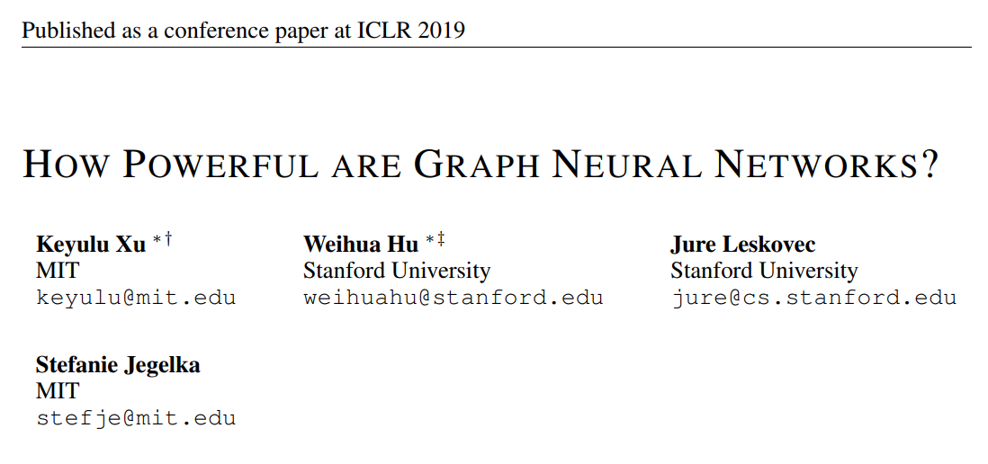

Slide 2
Most common GNN models
Graph Neural Networks:
GraphSAGE
GCN

Slide 3
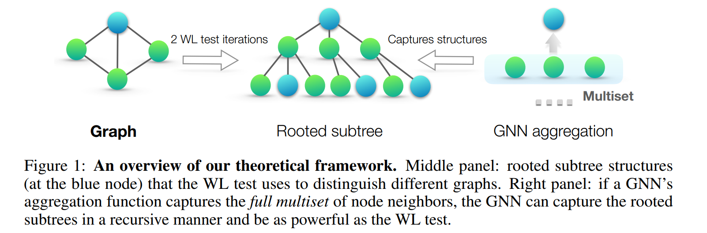
THEORETICAL FRAMEWORK: OVERVIEW
we can assign each feature vector a unique label in {a; b; c...}. Then, feature vectors of
a set of neighboring nodes form a multiset

Slide 4
1. A maximally powerful GNN maps two nodes to the same location only if they have identical subtree structures with identical features on the corresponding nodes.
2. A maximally powerful GNN would never map two different neighborhoods, i.e., multisets of feature vectors, to the same representation.

Slide 5
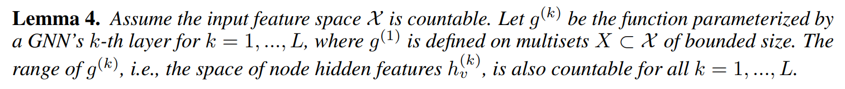
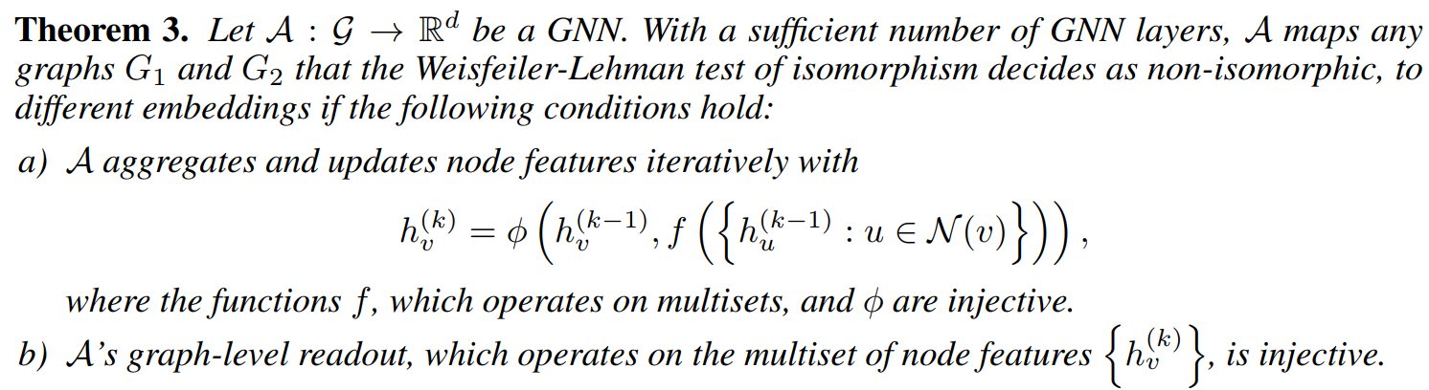

Slide 6
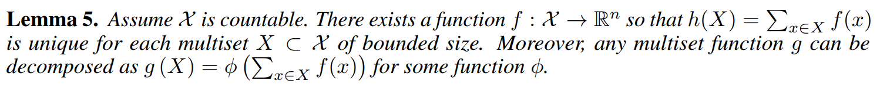
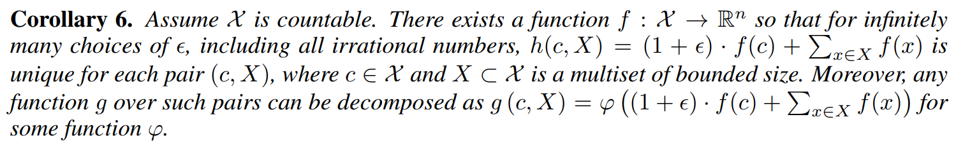
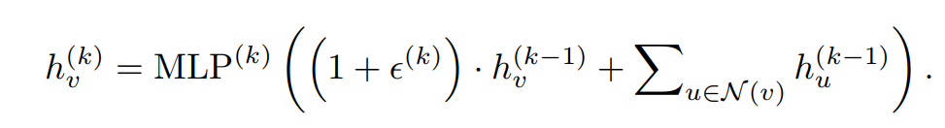
GRAPH ISOMORPHISM NETWORK (GIN)
GIN

Slide 7
1-LAYER PERCEPTRONS ARE NOT SUFFICIENT
1-layer perceptrons can behave much like linear mappings, so the GNN layers degenerate into simply summing over neighborhood features.

Slide 8
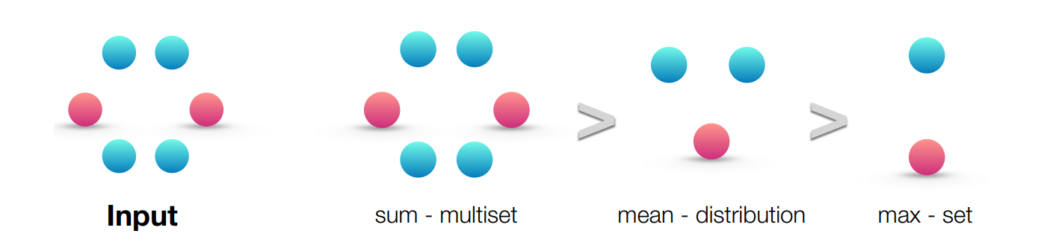
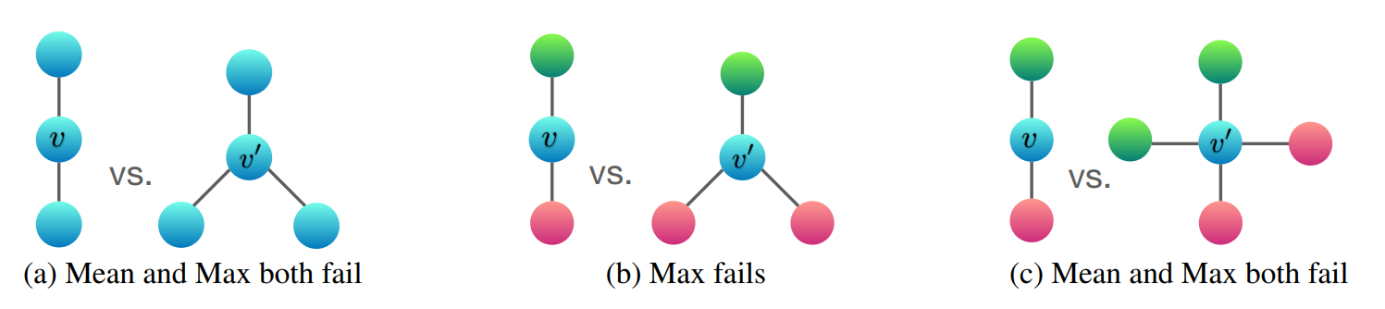
STRUCTURES THAT CONFUSE MEAN AND MAX-POOLING

Slide 9
