Slide 1

Representation Learning on Graphs with Jumping Knowledge Networks
International Conference on Machine Learning, 2018

Slide 2
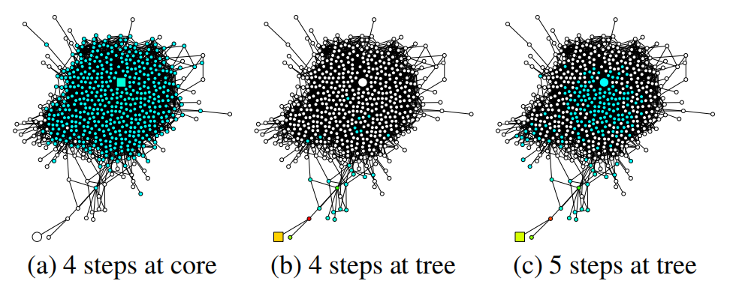
Problem
Notes:
核心节点区分度不高

Slide 3
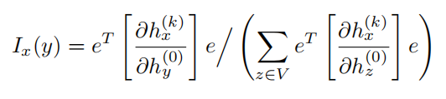
Definition
Influence score:
h⁽⁰⁾x is the input feature and h^{(k)}x is the learned hidden feature of node x ∈ V at the k-th (last) layer of the model, e is the all-ones vector

Slide 4
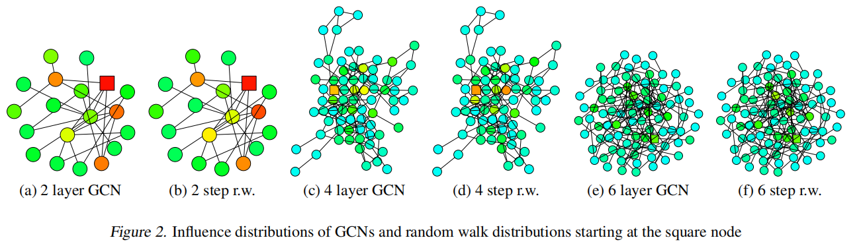
Model Analysis
Influence distribution of GCN ≈ random walks

Slide 5
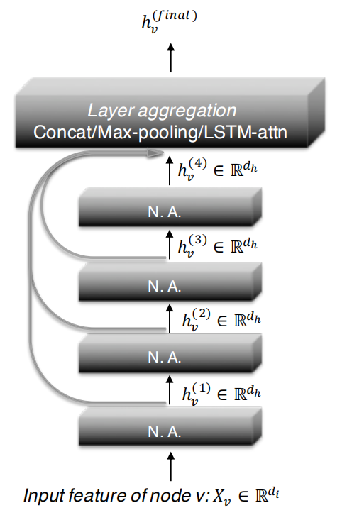
Jumping Knowledge Networks
Concatenation
Max-pooling: selects the most informative layer for each feature coordinate
LSTM-attention: identifies the most useful neighborhood ranges for each node v by computing an attention score for each layer

Slide 6
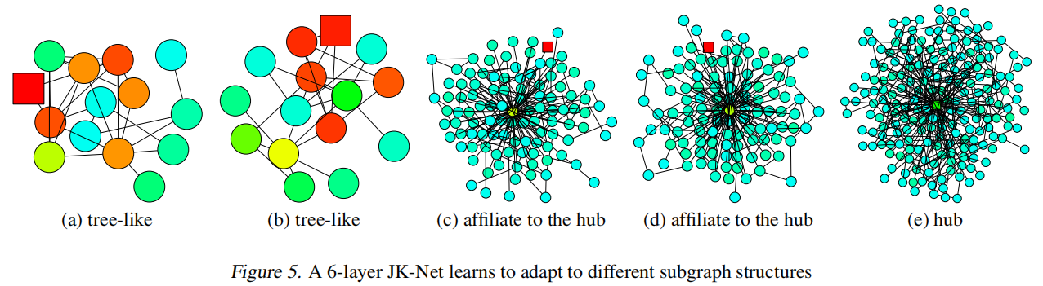
JK-Net Learns to Adapt

Slide 7



Slide 8
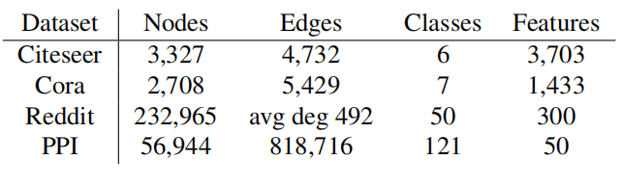
Experiments
Baselines:
Graph Convolutional Networks (GCN)
GraphSAGE
Graph Attention Networks (GAT)

Slide 9
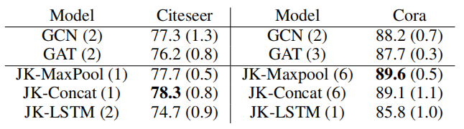
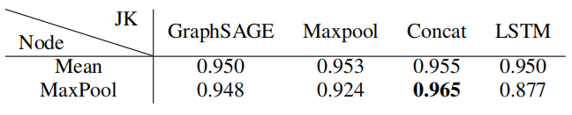

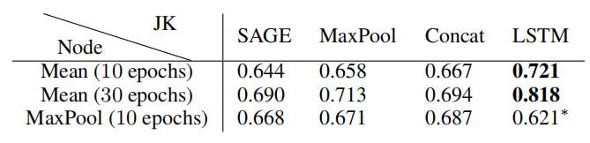
Results
Citeseer & Cora
accuracy
Reddit
Micro-F1 score
PPI
Micro-F1 scores
Notes:
GraphSAGE is sample-based, where neighbors of a node are sampled to be a fixed number, while GAT considers all neighbors.
MLP (Multilayer Perceptron).多层感知器

