Slide 1
Photo-Realistic Single Image Super-Resolution Using a Generative Adversarial Network

Slide 2
The highly challenging task of estimating a high- resolution (HR) image from its low-resolution (LR) counterpart is referred to as super-resolution (SR).
The optimization target of supervised SR algorithms is commonly the minimization of the mean squared error (MSE) between the recovered HR image and the ground truth.
This is convenient as minimizing MSE also maximizes the peak signal-to-noise ratio (PSNR), which is a common measure used to evaluate and compare SR algorithms

Slide 3
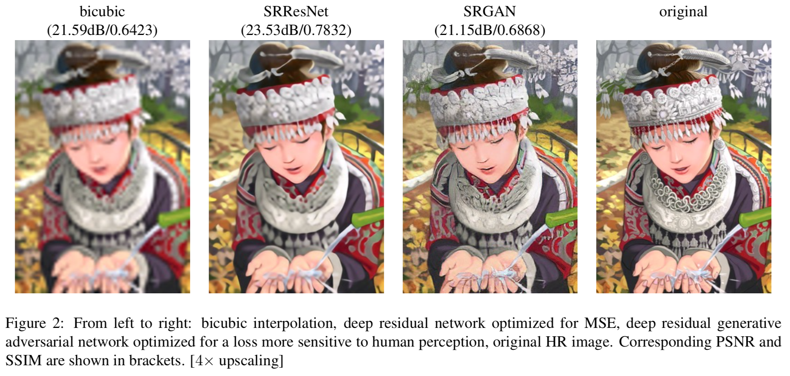
define a novel perceptual loss using high-level feature maps of the VGG network combined with a discriminator that encourages solutions perceptually hard to distinguish from the HR reference images.

Slide 4
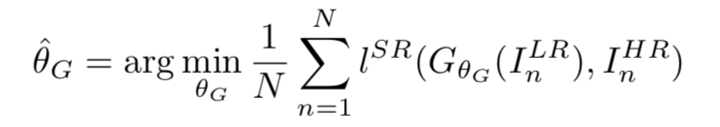
Method
the aim is to estimate a high-resolution
I^{LR} is obtained by applying a Gaussian filter to I^{HR} followed by a downsampling operation with downsampling factor r
ultimate goal is to train a generating function G that estimates for a given LR input image its corresponding HR counterpart.

Slide 5
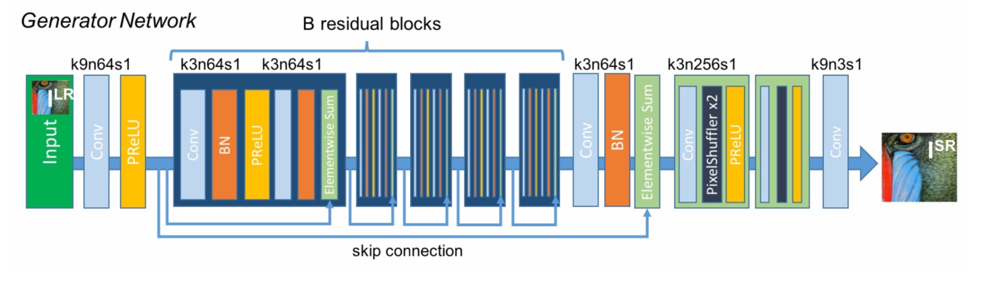
Adversarial network architecture
very deep generator network G, which is illustrated in Figure 4 are B residual blocks with identical layout.
use two convolutional layers with small 3×3 kernels and 64 feature maps followed by batch-normalization layers and ParametricReLU as the activation function.
We increase the resolution of the input image with two trained sub-pixel convolution layers

Slide 6
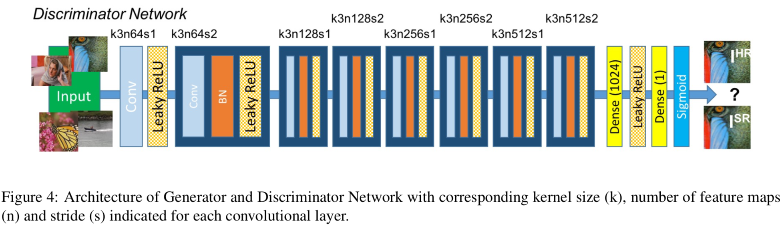
use LeakyReLU activation and avoid max-pooling throughout the network
It contains eight convolutional layers with an increasing number of 3 × 3 filter kernels, increasing by a factor of 2 from 64 to 512 kernels
The resulting 512 feature maps are followed by two dense layers and a final sigmoid activation function to obtain a probability for sample classification.

Slide 7
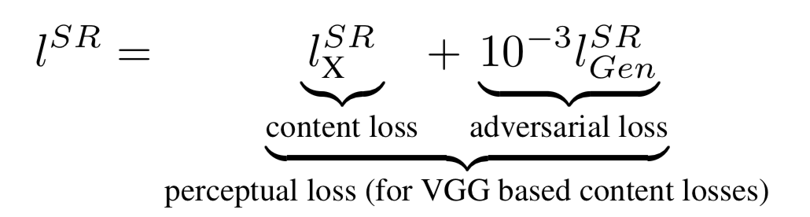
Perceptual loss function
We formulate the perceptual loss as the weighted sum of a content loss and an adversarial loss component

Slide 8
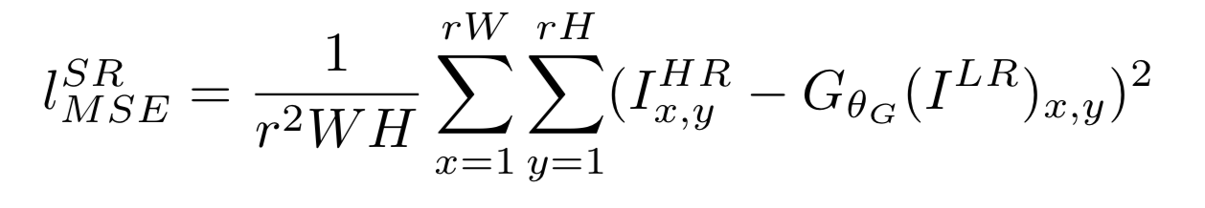
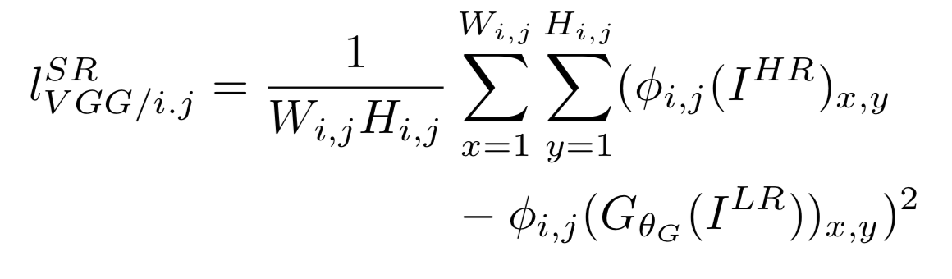
Content loss
define the VGG loss based on the ReLU activation layers of the pre-trained 19 layer VGG network

Slide 9
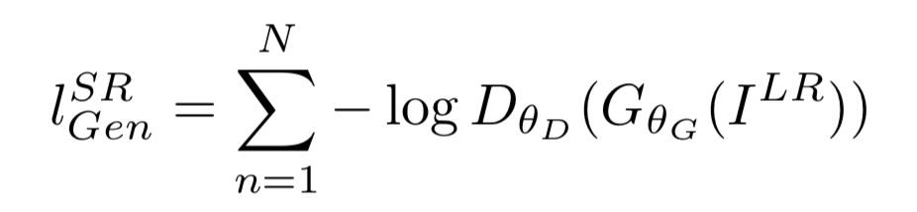
Adversarial loss
add the generative component of our GAN to the perceptual loss

