Slide 1
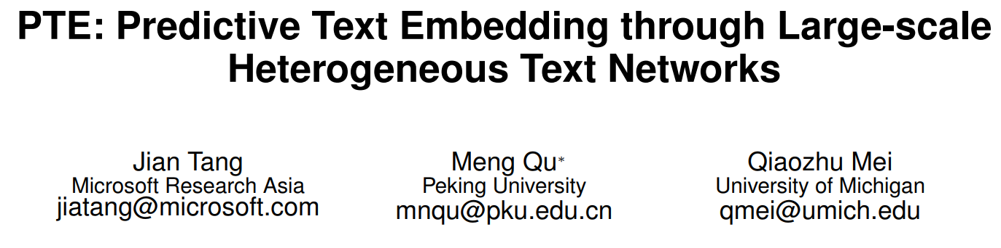

Slide 2
Supervised Embedding: Specific task, not general;
Unpervised Embedding: General; fails in specific task;
In this paper:
PTE : adapts the advantages of unsupervised text embeddings but naturally utilizes labeled information in representation learning.

Slide 3
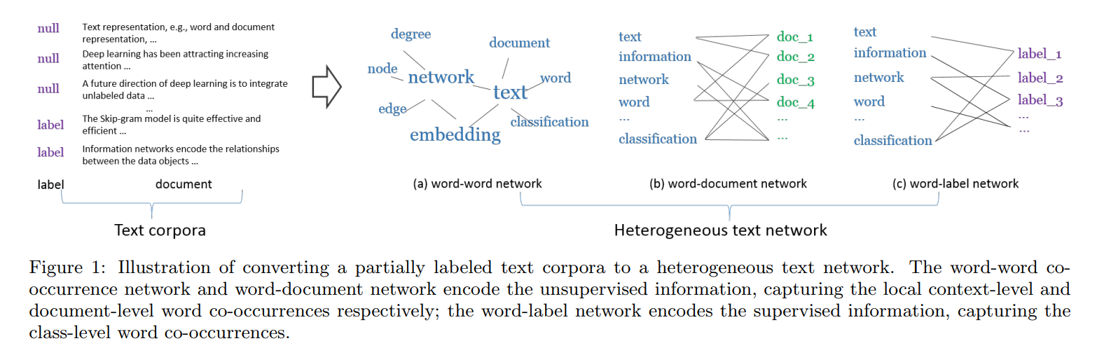
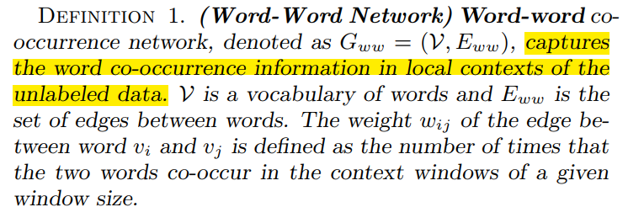
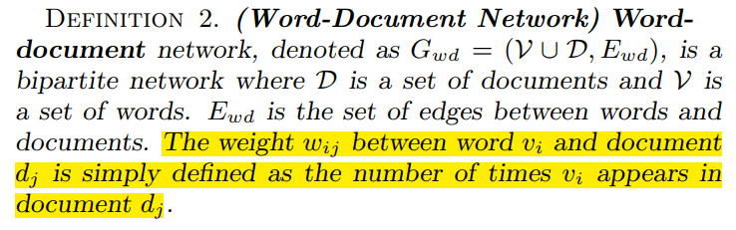

Slide 4
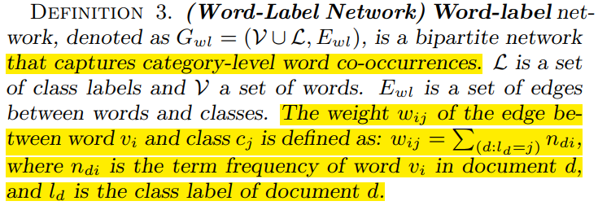
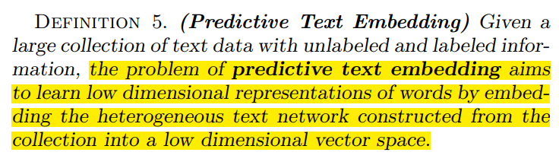
Supervised Information

Slide 5
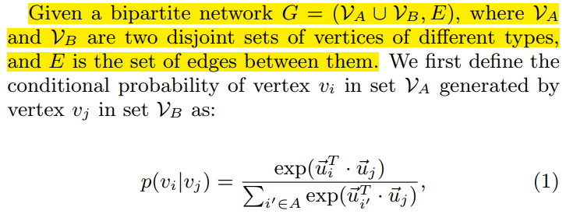
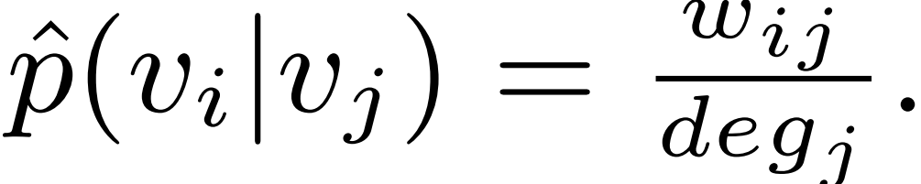
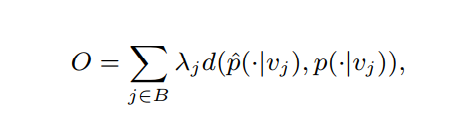
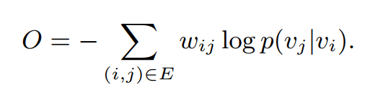
Bipartite Network Embedding
we can make the conditional distribution be close to its empirical distribution:
d is the KL-divergence between two distributions,

Slide 6
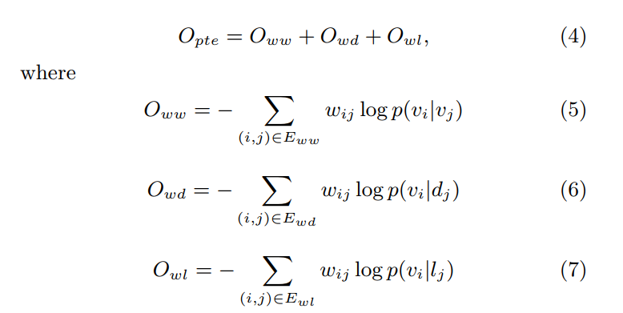
Heterogeneous Text Network Embedding
The heterogeneous text network is composed of three bipartite networks: word-word, word-document and word-label networks, where the word vertices are shared across the three networks.

Slide 7
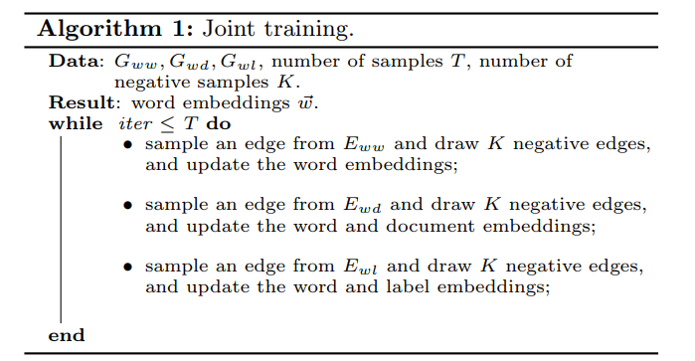
Joint training: train the model with the unlabeled data (the word-word and word-document networks) and the labeled data simultaneously.

Slide 8
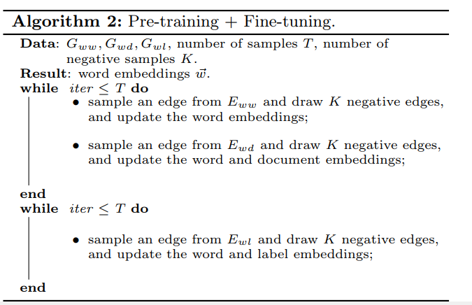
Pre-training and fine-tuning : learn the embeddings with unlabeled data first, and then fine-tune the embeddings with the word-label network.

Slide 9
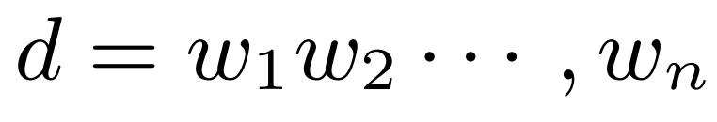
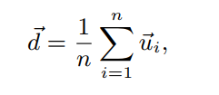
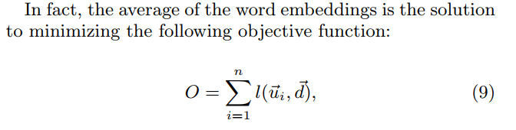
Text Embedding
An arbitrary piece of text can be obtained by simply averaging the vectors of the words in that piece of text.

Slide 10
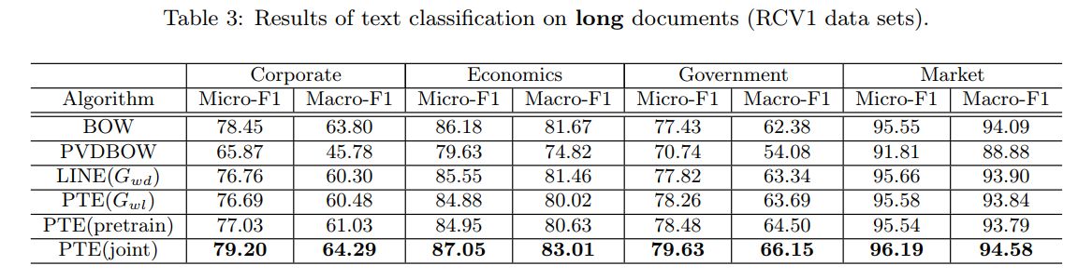
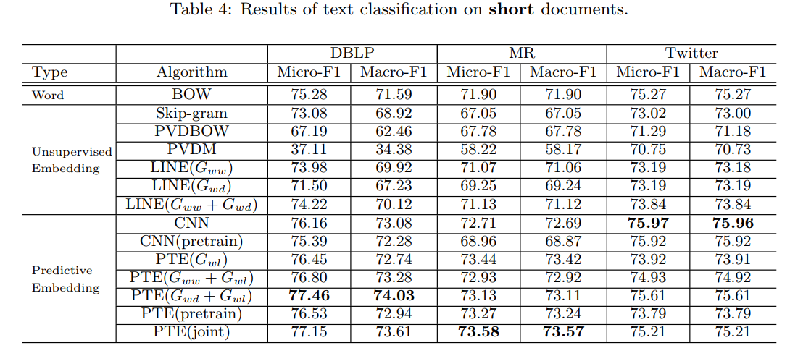
Experiments

Slide 11
