Slide 1

Neural-Brane: Neural Bayesian Personalized Ranking for Attributed Network Embedding

Slide 2
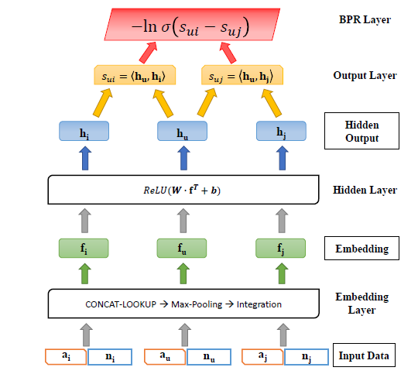
The embedding layer ：learns a unified vector representation of a node from the vector representation of its nodal attributes and neighbors
The hidden layer ：applies nonlinear dimensionality reduction over the embedding vectors of the nodes
The output layer and the BPR layer ：enable model inference through back-propagation.

Slide 3
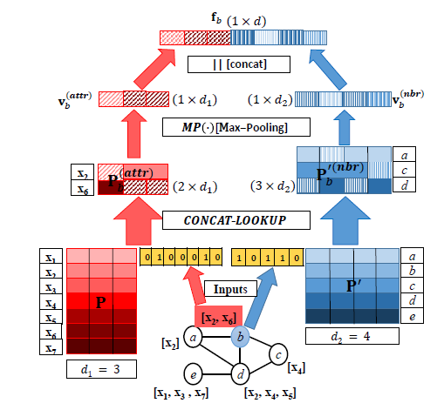

Embedding layer
Hidden layer
for achieving better convergence speed

Slide 4
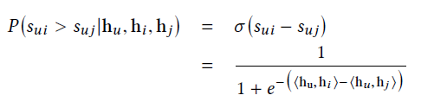


Output and BPR Layers
BPR layer implements the Bayesian personalized ranking objective
For the embedding task, the ranking objective is that the neighboring nodes in the graph should have more similar vector representations in the embedding space than non-neighboring nodes
Model the probability of preserving ranking order sui > suj using the sigmoid function
the larger the difference between sui and suj , the more likely the ranking order sui > suj is preserved
the probability of all the ranking orders being preserved is defined as follows:

Slide 5
Model inference and optimization
employ the back propagation algorithm by utilizing mini-batch gradient descent to optimize the parameters
given an arbitrary node u, we sample one of its neighbors with the probability proportional to the edge weight
sample its non-neighboring node with the probability proportional to the node degree in the graph

Slide 6
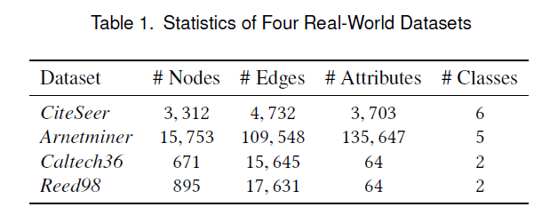
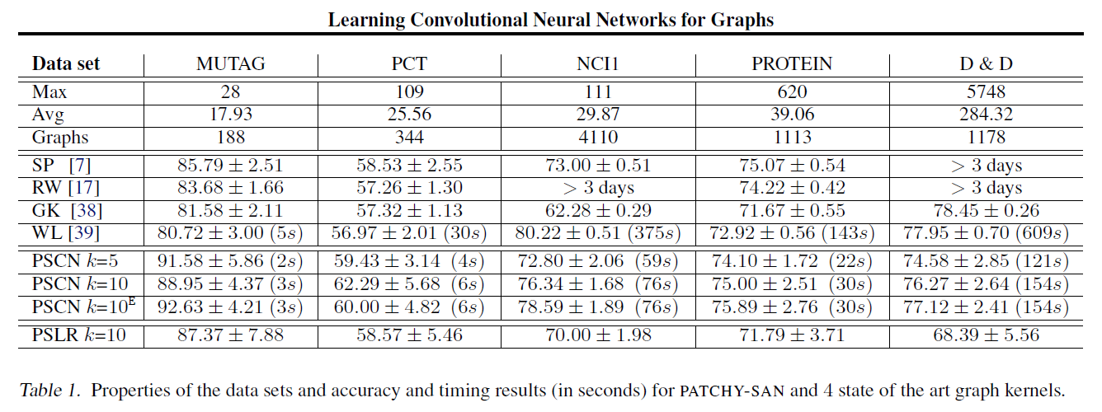

Slide 7
