Slide 1
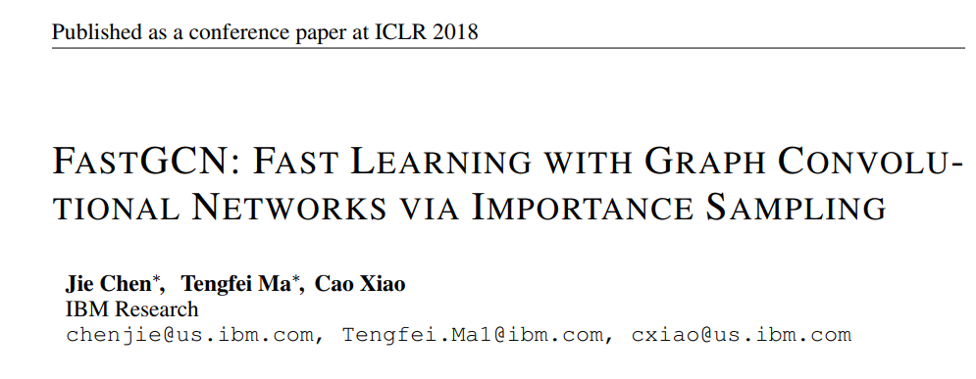

Slide 2
Challenges
1. As with many graph algorithms, the adjacency matrix encodes the pairwise relationship for both training and test data. but the graph may be constantly expanding with new vertices.
2. A more severe challenge for GCN is that the recursive expansion of neighborhoods across layers incurs expensive computations in batched training.

Slide 3

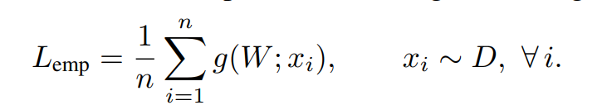
View graph convolutions as integral transforms
1. consider the standard SGD scenario where the loss is the expectation of some function g with respect to a data distribution D:
2. Through Sampling:

Slide 4
For graphs, one may no longer leverage the independence and compute the sample gradient !
An alternative formulation???
let us assume that there is a (possibly infinite) graph G0 with the vertex set V0 associated with a probability space (V0; F; P). For the given graph G, it is an induced subgraph of G0 and its vertices are iid samples of V0 according to the probability measure P.

Slide 5
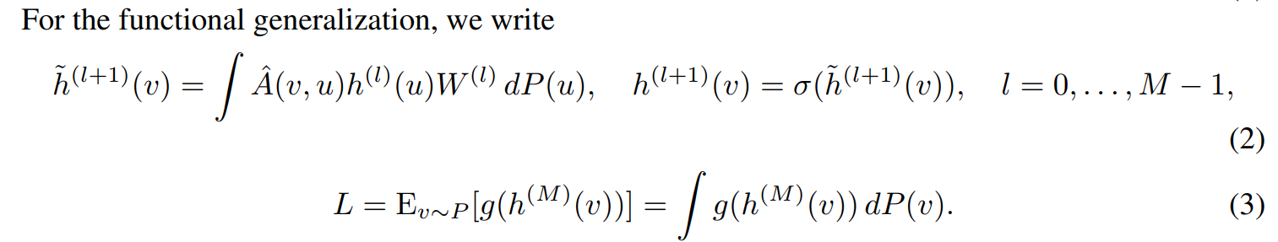
Recall the architecture of GCN

Slide 6
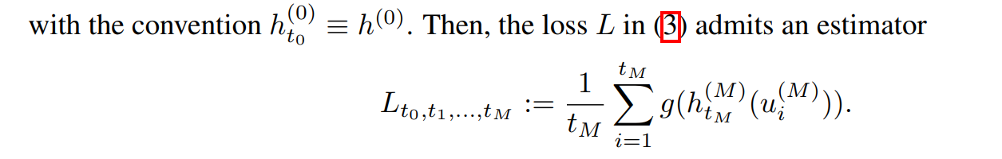
For each layer l, we use iid samples ∼ P to approximately evaluate the integral transform:

Slide 7
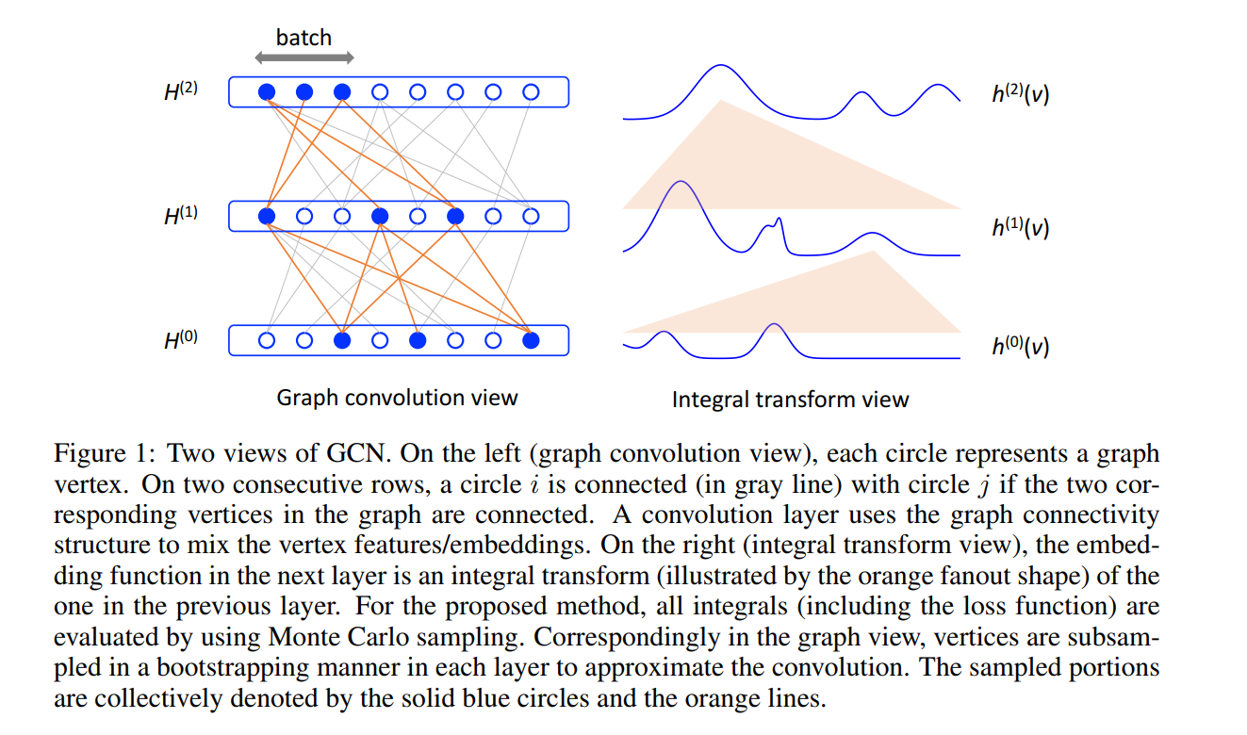

Slide 8
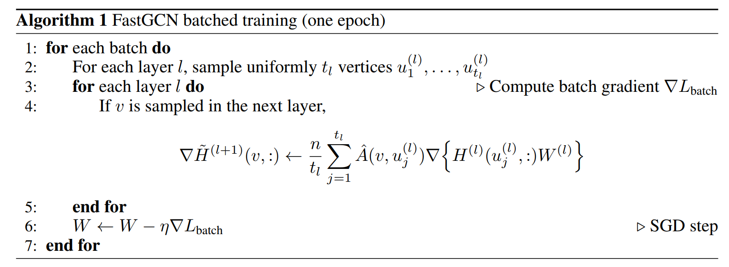
Uniform Sampling

Slide 9
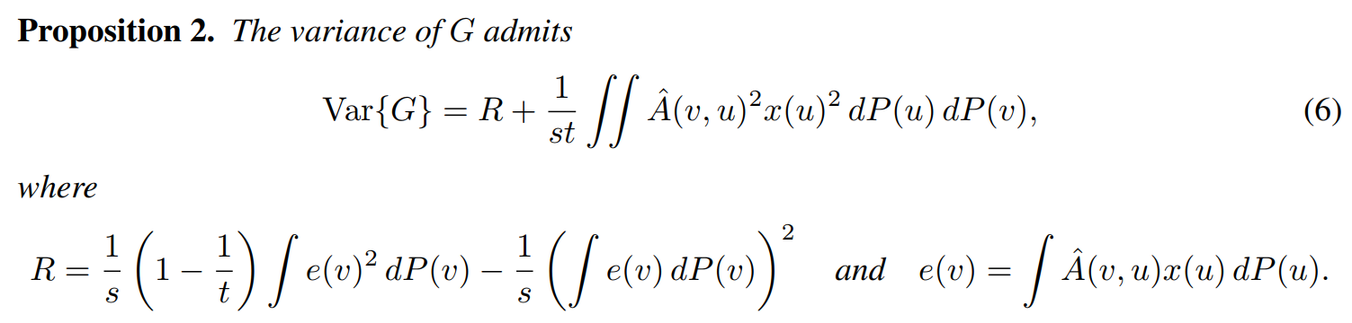
Importance Sampling
The current result (6) is the consequence of sampling uj by using the probability measure P. One may perform importance sampling, altering the sampling distribution to reduce variance.

Slide 10
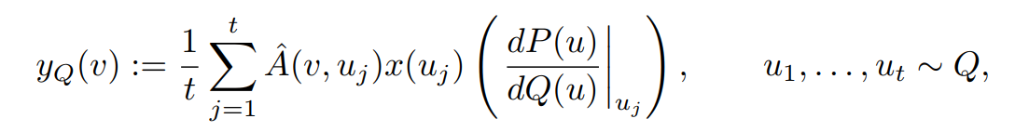
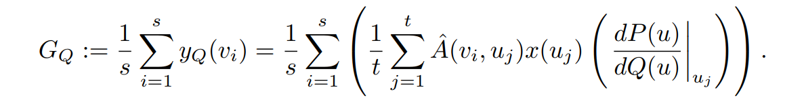
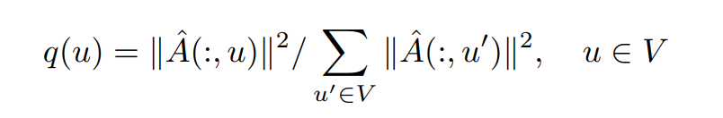
Clearly, the expectation of GQ is the same as that of G, regardless of the new measure Q
In practical use

Slide 11
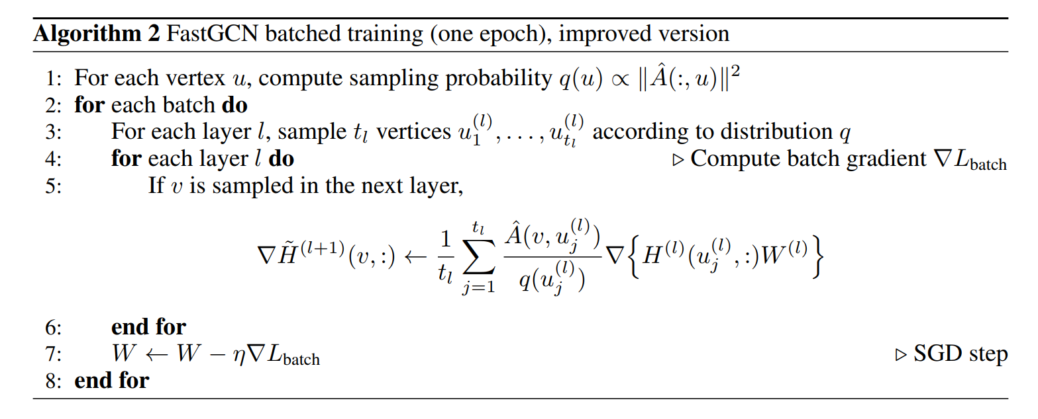

Slide 12
