Slide 1

ATRank:
An Attention-Based User Behavior
Modeling Framework for Recommendation
The Thirty-Second AAAI Conference on Artificial Intelligence (AAAI-18)

Slide 3
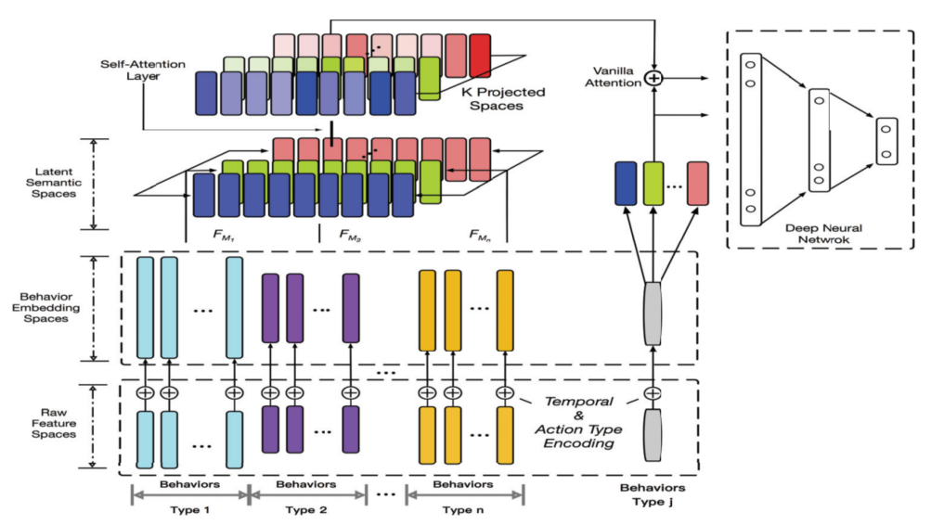

Slide 6
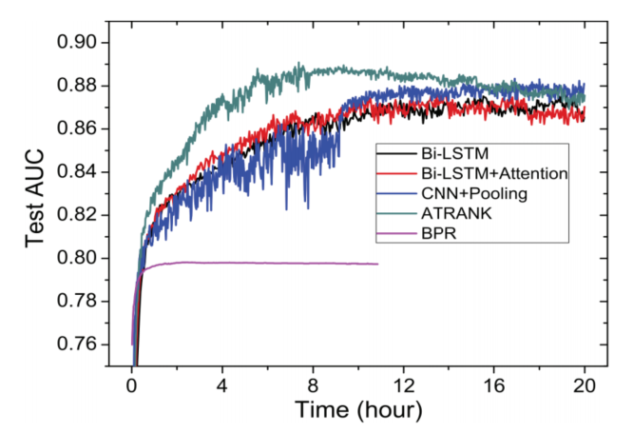
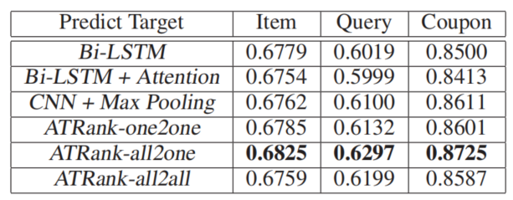

Slide 7
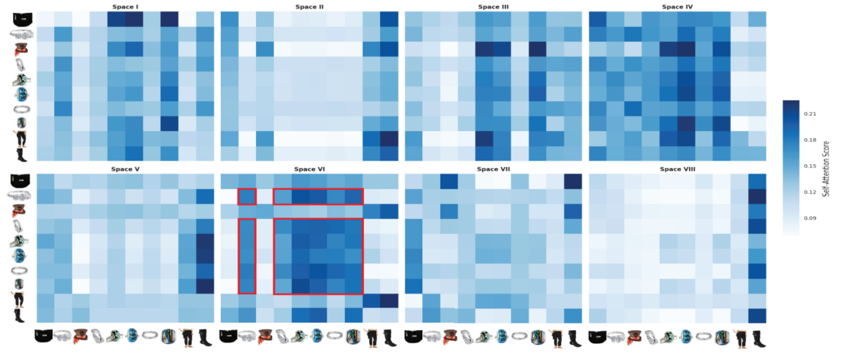

Slide 8
