Slide 1
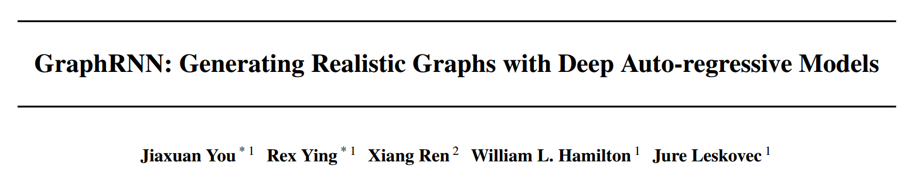
ICML 2018
PanXiang
2019.3.12

Slide 2
WORK
GRAPH-RNN:approximates any distribution of graphs with minimal assumptions about their structure
Benchmark
Scaling to graphs 50× larger than previous deep models

Slide 3
Abstract
Modeling and Generating Graphs
Area: biology, engineering and social sciences
Challenge
efficiently sampling
Large and variable output spaces
Non-unique representations
Complex dependencies
Related-work
GraphVAE
GraphGAN

Slide 4




Notations and Problem Definition

Slide 5
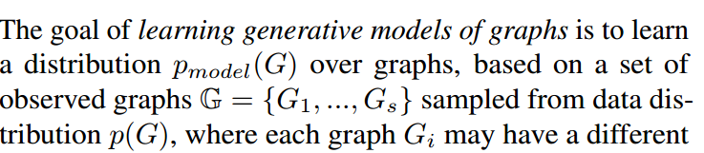
Approach
Vector-representation based models
Graph-Embedding
GAN, VAE
Drawback
Cannot naturally generalize to graphs of varying size
Requires training on all possible node permutations or specifying a canonical permutation, both of which require O(n!) time in general

Slide 6
Approach
Node-embedding based models.
encoding a graph’s structural properties into node embeddings
define a generative model that decodes edge probabilities based on pairwise relationships between learned node embeddings
Drawback
a fixed-set of nodes

Slide 7
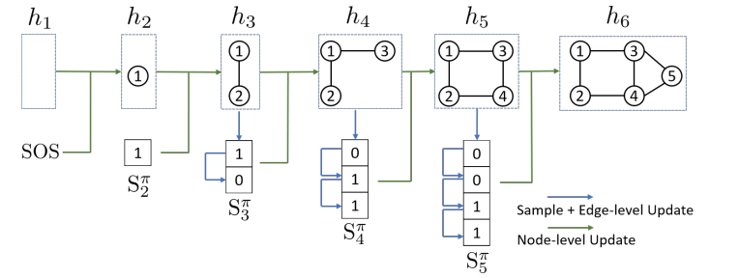





Approach

Slide 8
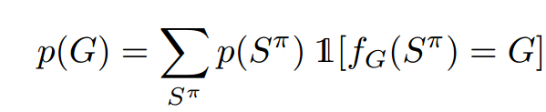
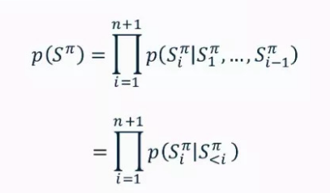
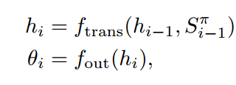
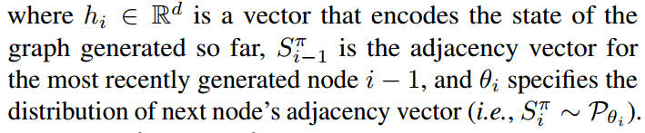
Approach
Notes:
In general, ftrans and fout can be arbitrary neural networks,and Pθi can be an arbitrary distribution over binary vectors.This general framework is summarized in Algorithm 1

Slide 9
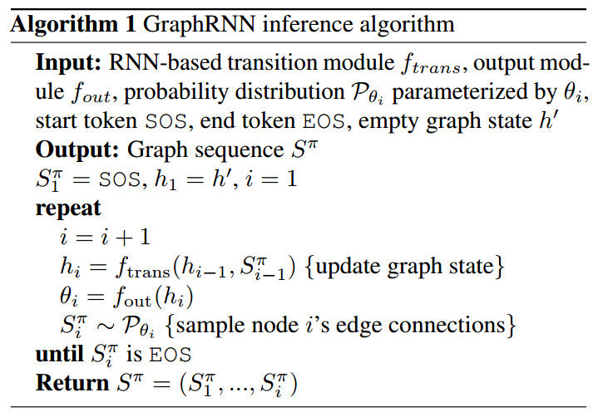
Approach

Slide 10
Approach

Slide 11
Approach

Slide 12
Approach

Slide 13
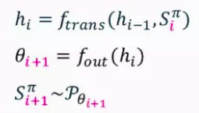
GRAPHRNN VARIANTS
Transition function f_trans as a Gated RecurrentUnit (GRU)
Differ in the implementation of f_out
Multivariate Bernoulli.
single layer multilayer perceptron (MLP) with sigmoid activation function,
We then sample edges in Siπ independently according to a multivariate Bernoulli distribution parametrized by θi.

Slide 14
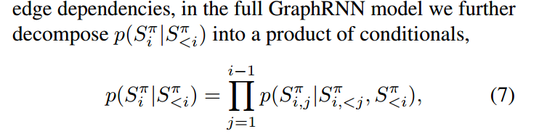
Dependent Bernoulli sequence
Add information: now link state

Slide 15
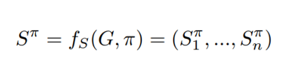

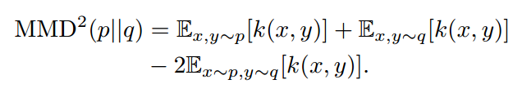
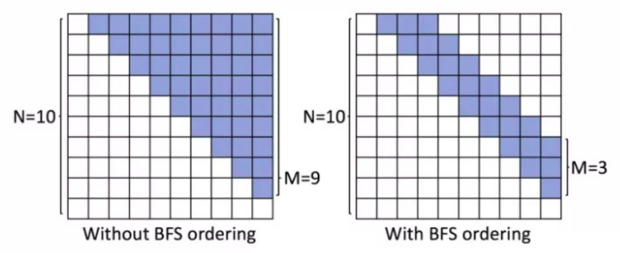
BFS
random permutation π as input
Benefit
all possible BFS orderings, rather than all possiblenode permutations
“LOCAL”:in the “frontier”of the BFS(in BFS)
M

Slide 16
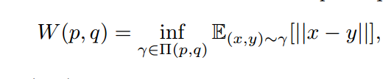
Maximum Mean Discrepancy (MMD) Measures
Wasserstein distance

Slide 17
