Slide 1
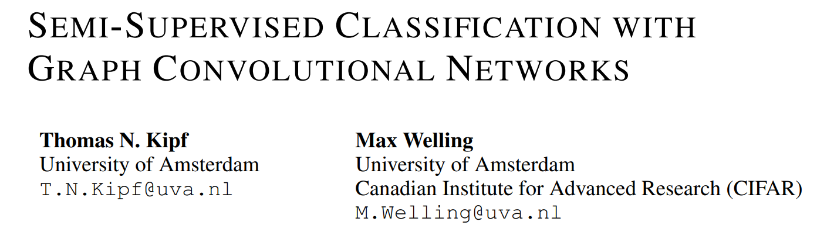

Slide 2
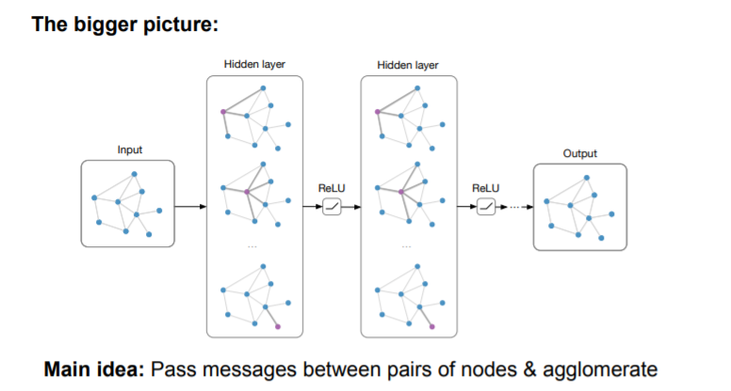

Slide 3
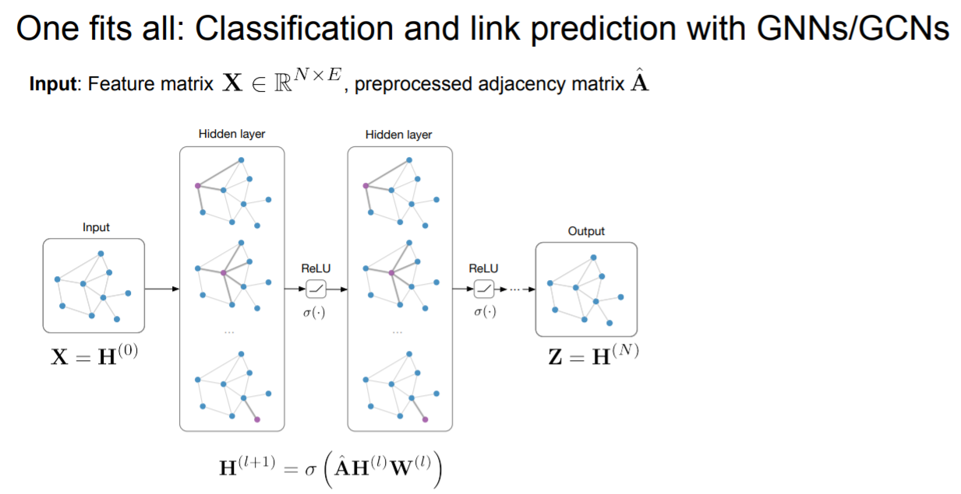
Definitions

Slide 4
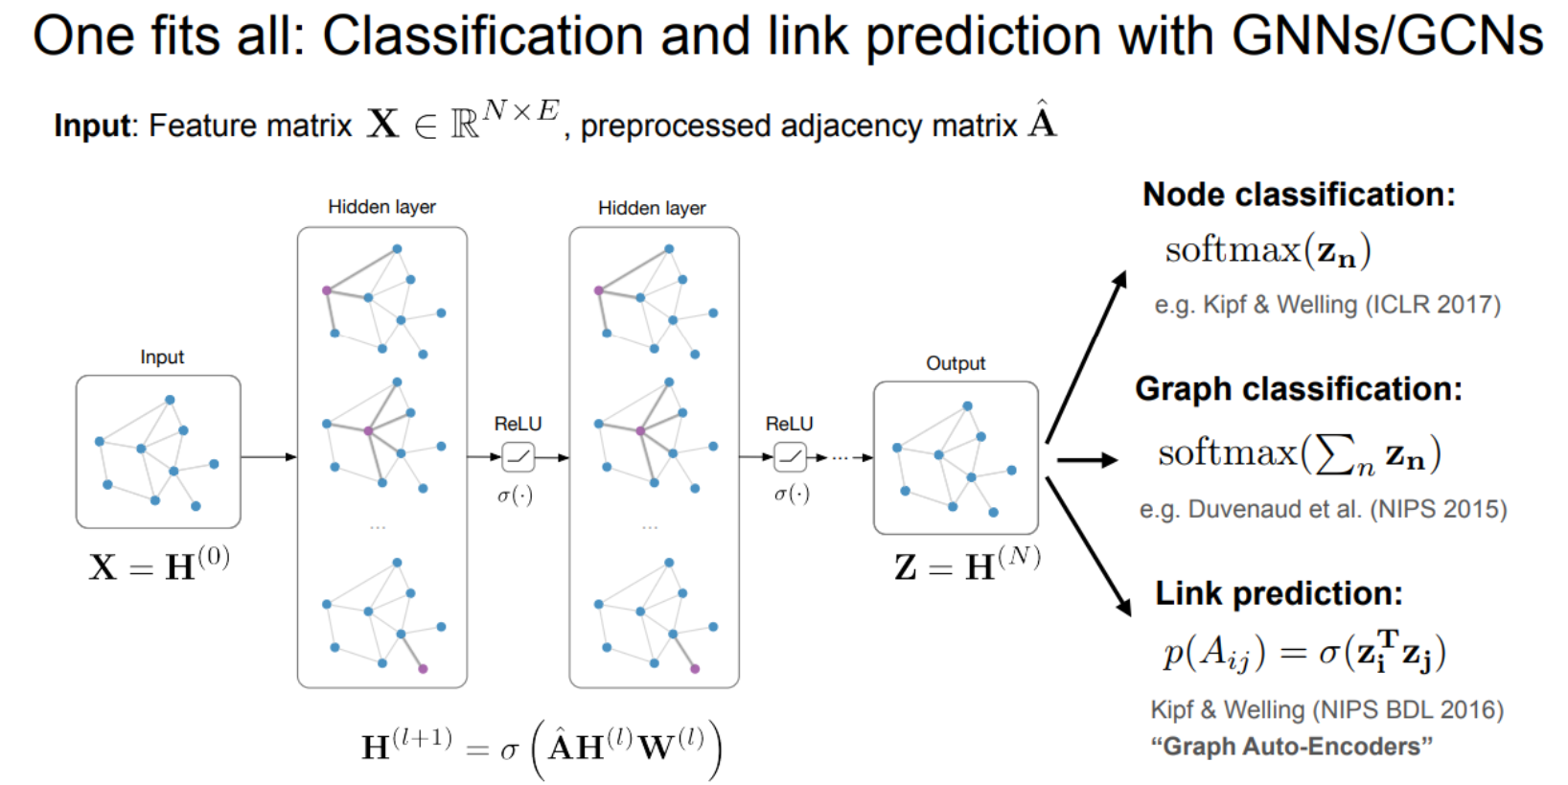

Slide 5

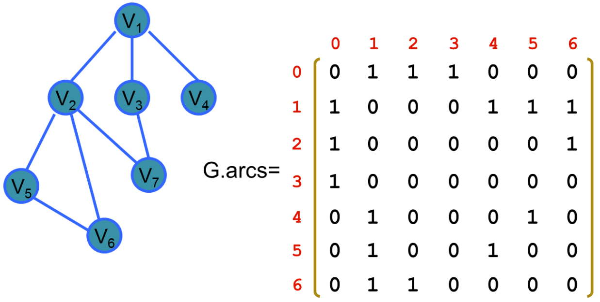
Two limitations
Multiplication with A means that, for every node, we sum up all the feature vectors of all neighboring nodes but not the node itself (unless there are self-loops in the graph).
How to fix that?
with A^=A+I, where I is the identity matrix

Slide 6
Two limitations
A is typically not normalized and therefore the multiplication with A will completely change the scale of the feature vectors
How to fix that?
Normalizing A such that all rows sum to one, i.e. D^-1A
D is the diagonal node degree matrix
use a symmetric normalization, i.e. D^(-1/2)AD^(−1/2)

Slide 7
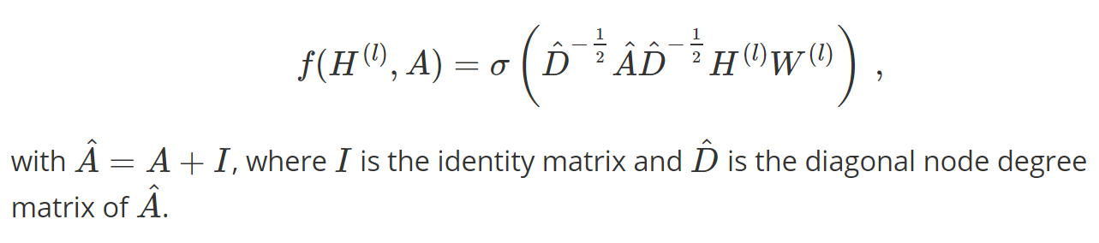
The propagation rule

Slide 8
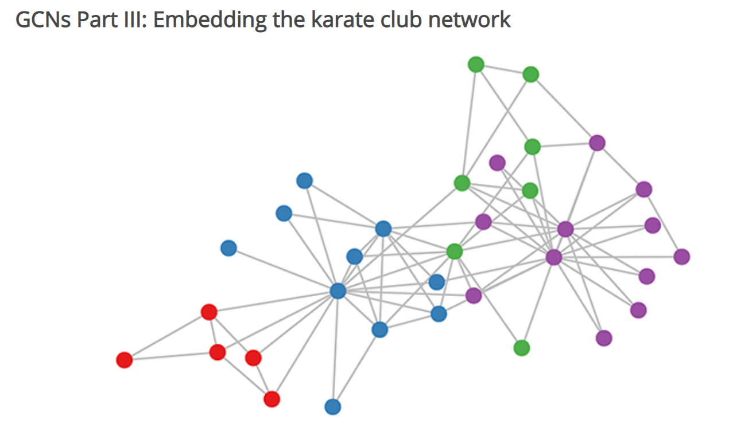
A simple example
A 3-layer GCN with randomly initialized weights.
we simply insert the adjacency matrix of the graph and X=I (i.e. the identity matrix, as we don't have any node features) into the model.

Slide 9
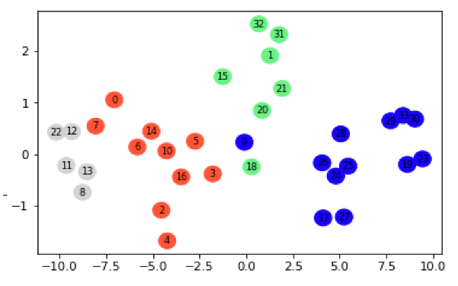
Visualize

Slide 10
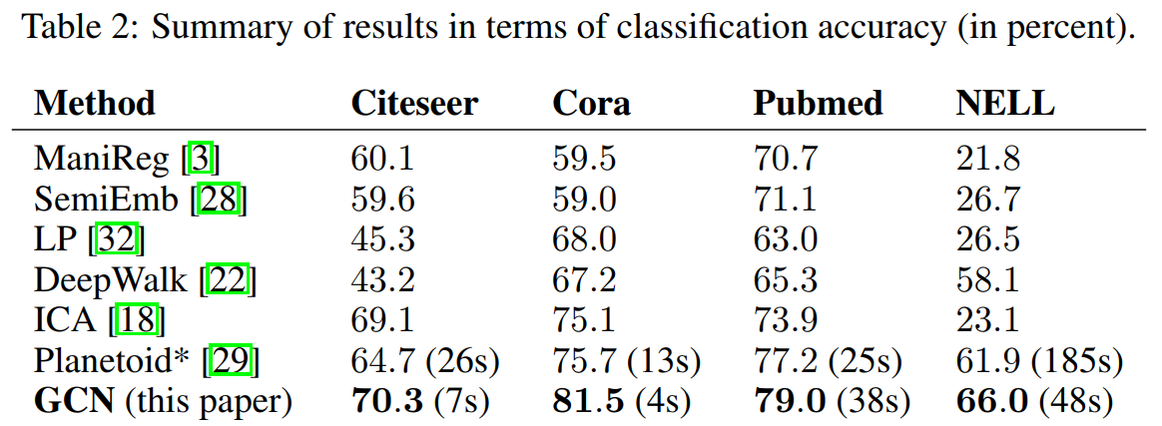
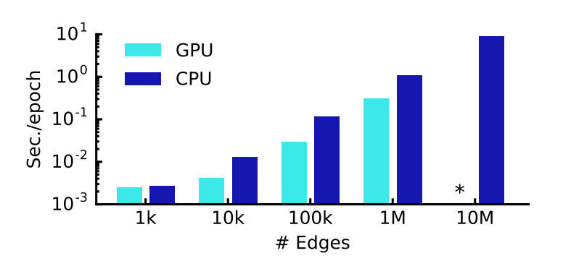

Slide 11

LIMITATIONS AND FUTURE WORK
Memory requirement, full batch training
Directed edges and edge features
Limiting assumption
(1)locality (dependence on the Kth-order neighborhood for a GCN with K layers)
(2)introduce a trade-off parameter λ

