Slide 1
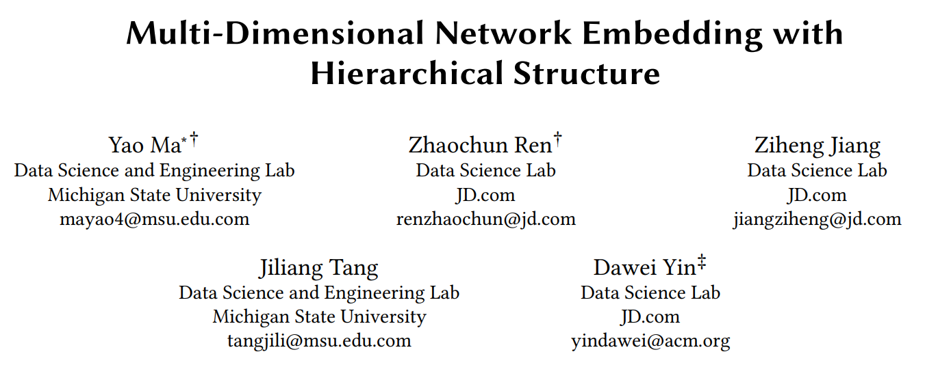
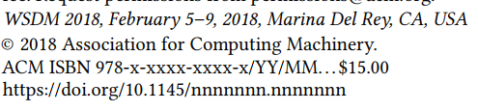

Slide 2
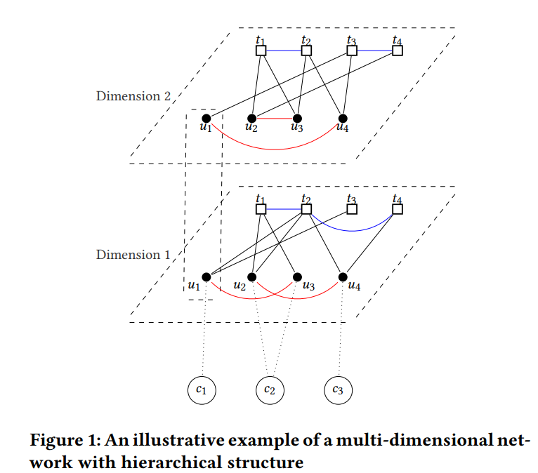
two types of nodes
The relations of nodes in U, nodes in T and nodes between U and T are two-dimensional.
Each node in U is associated to one parent in C

Slide 3
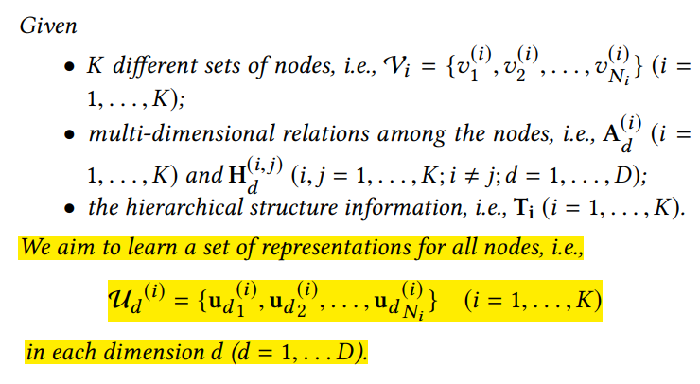
MINES
Mathematically capture multi-dimensional information and hierarchical structure
Incorporate such information simultaneously for embedding.
Assume all the types of nodes have hierarchical structures with a depth of 2

Slide 4
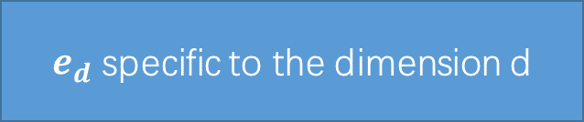
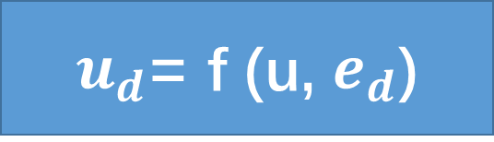
Capturing Multi-Dimensional Relations
perform the network embedding for each dimension separately
ignores information across dimensions
$e_{d}$ specific to the dimension d
independent information individually
u for the information shared across dimensions
dependent information across dimensions
$u_{d}$= f (u, $e_{d}$)
f is a function to combine the shared component u and the specific component $e_{d}$

Slide 5
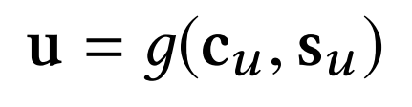
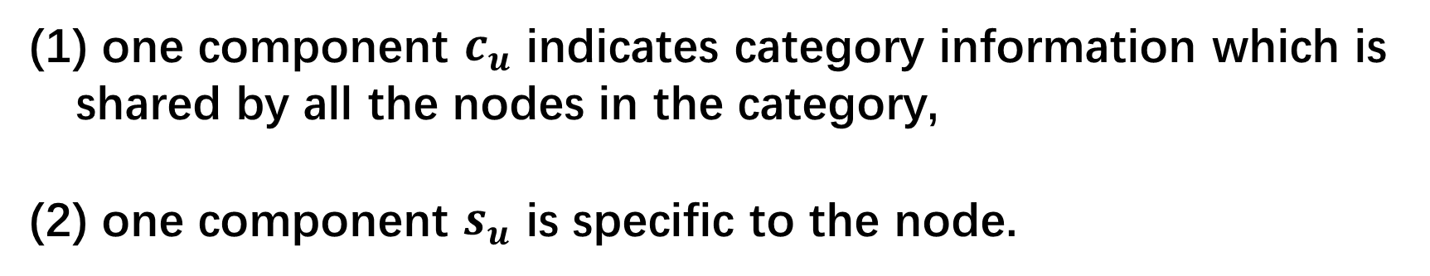
Capturing Hierarchical Structure
model the hierarchical structure
model its category information
one component $c_{u}$ indicates category information which is shared by all the nodes in the category,
(2) one component $s_{u}$ is specific to the node.
Notes:
For the nodes in the same category, they should also share the similar characteristics.

Slide 6

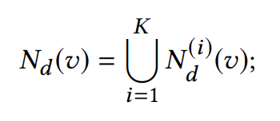
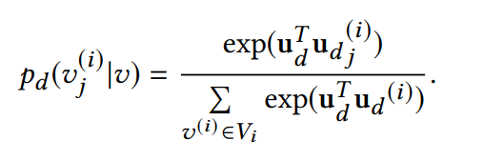
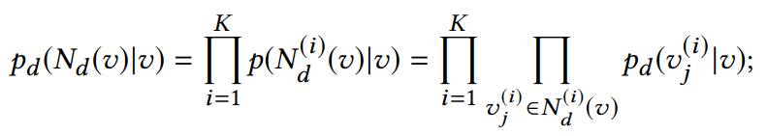
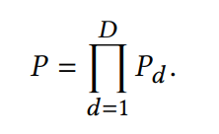

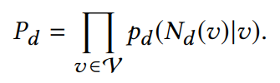
The Proposed Framework
skip-gram model
learn the embeddings for the nodes in each dimension

Slide 7
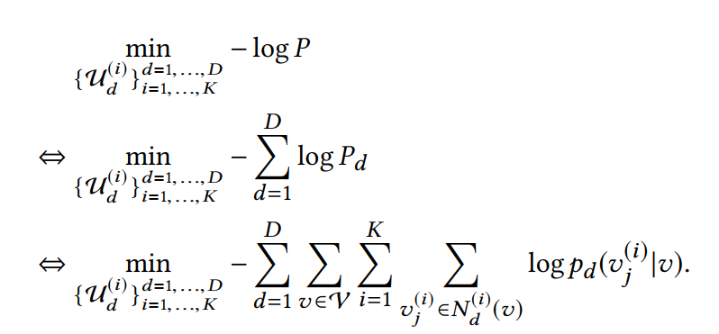
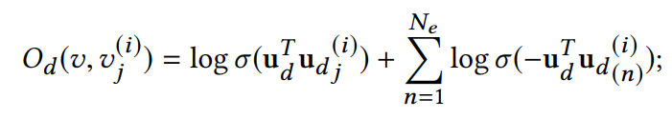


Slide 8
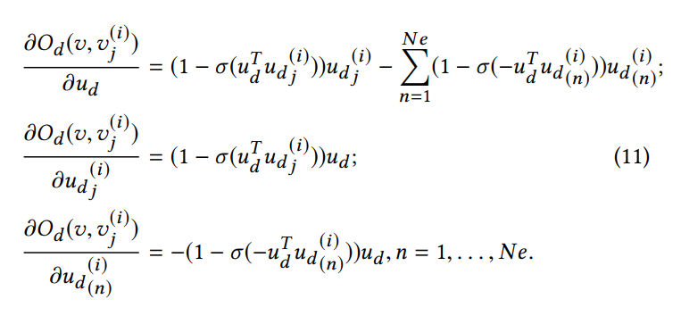

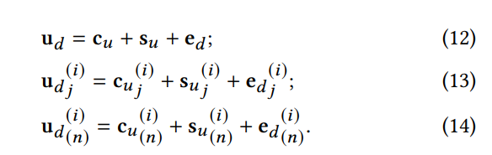
Optimization Method

Slide 9
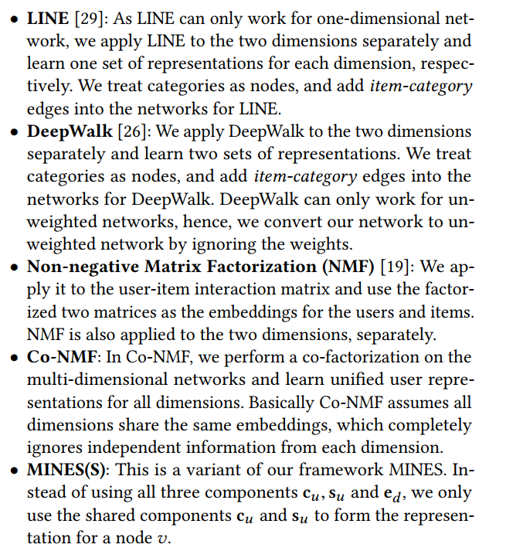

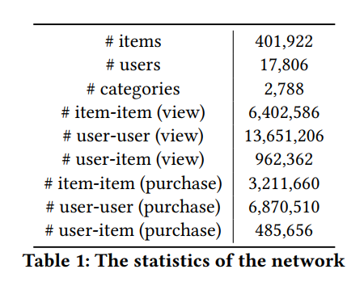
EXPERIMENTS

Slide 10
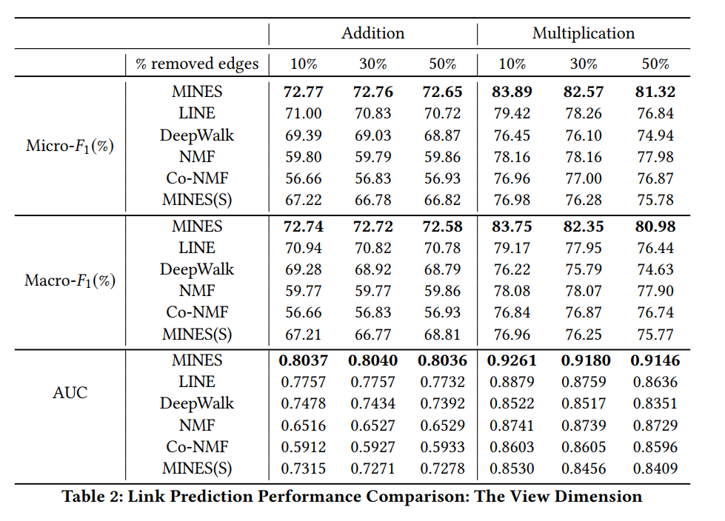
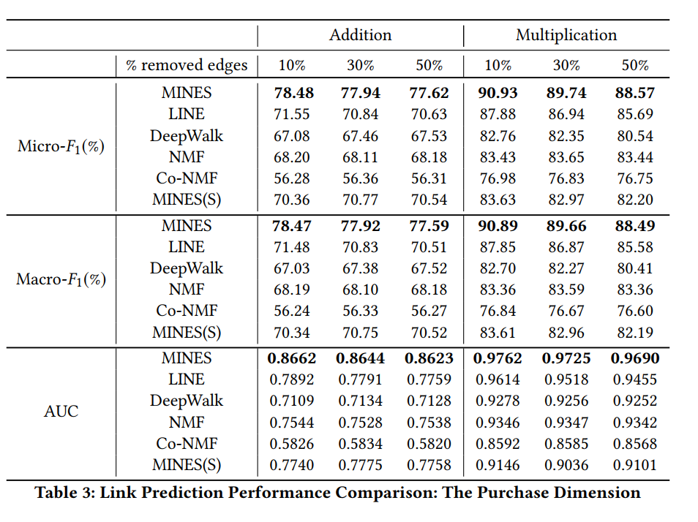
Link Prediction

Slide 11
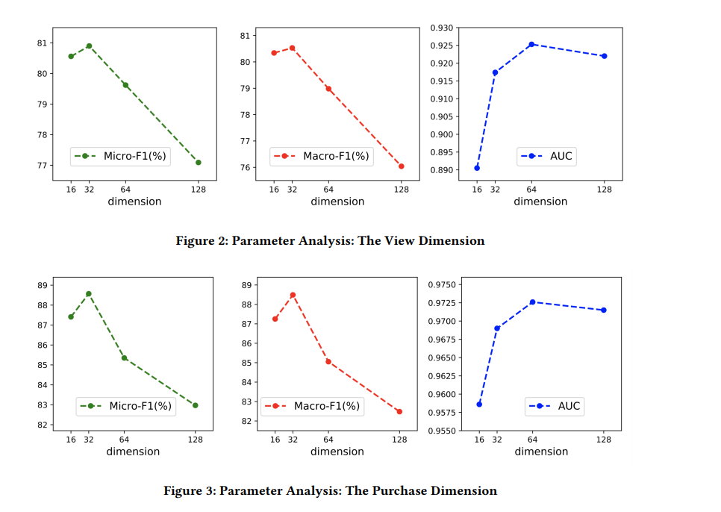
Parameter Analysis
Notes:
问题：1.异质信息？ 节点分类处理可以保留异质信息？
2.实验具有可信度？Baseline太久了

Slide 12
Thanks and QA

