Slide 1
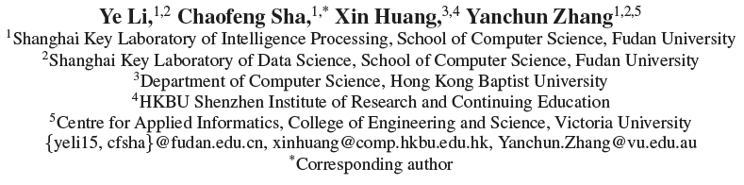
Community Detection in Attributed Graphs: An Embedding Approach
吴尧
2018/9/26

Slide 2
Problems
Numerous studies are proposed to identify communities using network structure, including metric-based algorithms and generative models.
The entities modeled by the network nodes usually have attribute information that is important for making sense of communities.
While nodes in a community are densely-connected, they should also share homogenous node attributes.
Notes:
通常图中节点的属性也经常是社区形成的关键因素，比如citation network 中的文章有关键字这个属性

Slide 3
Problems
Most existing attributed community detection methods directly utilize the original network topology leading to poor results due to ignoring inherent community structures
we propose a novel community structure embedding based model for community detection incorporating community structures and node attributes.

Slide 4
Methods
Propose a embedding method to encode inherent community structures
Leverage the information of node attributes and explore associated attributes
Integrate community structure embedding matrix and node attributes matrix, and formulate the problem as an nonnegative matrix factorization optimization problem.

Slide 5
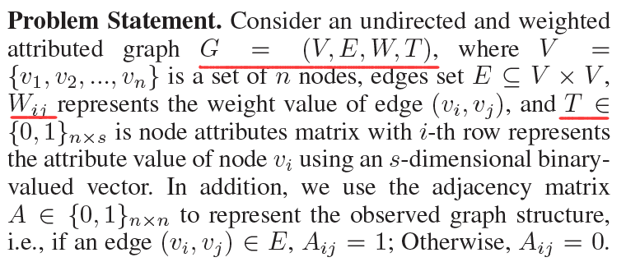
Preliminaries

Slide 6
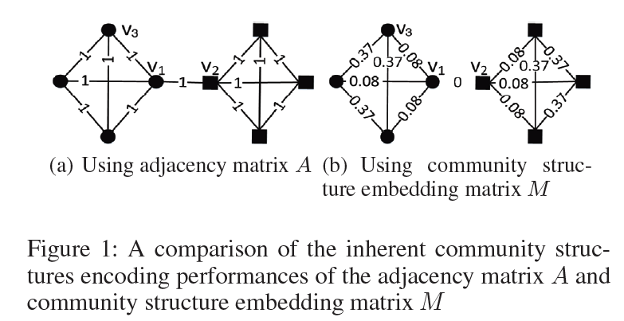
Community Structure Embedding
Obtain a community structure embedding matrix(M) that encodes the inherent community structures.

Slide 7

Community Membership Similarity
Given n nodes and the number of communities K, we define the community membership matrix U_{n×K} where each U_{ij} presents the tendency that i-th node belongs to j-th community for 1 ≤ i ≤ n and 1 ≤ j ≤ K; U_{i}: presents i-th row of U.

Slide 8

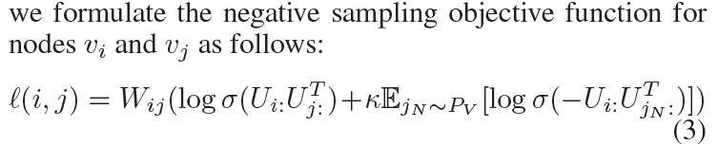
Embedding Matrix (M).
Our community structure embedding method tries to maximize σ(Ui:U for connected nodes v_{i} and v_{j} , meanwhile minimizing σ(Ui:UTj for a pair of randomly selected nodes v_{i} and v_{j} .

Slide 9

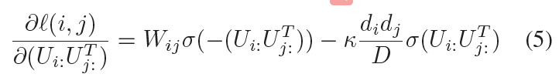
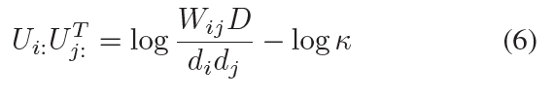
Embedding Matrix (M).

Slide 10
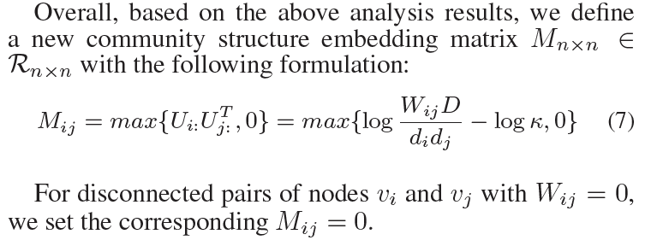
Embedding Matrix (M).

Slide 11
Embedding Matrix (M).
Our community structure embedding method tries to maximize σ(Ui:U for connected nodes v_{i} and v_{j} , meanwhile minimizing σ(Ui:UTj for a pair of randomly selected nodes v_{i} and v_{j} .

Slide 12
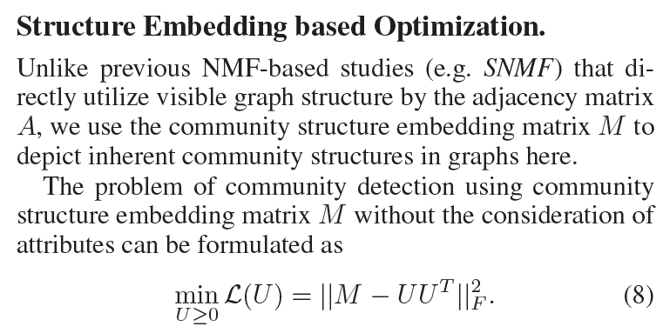
Embedding Matrix (M).

Slide 13
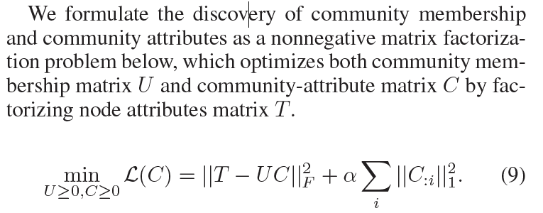
Community Attributes.

Slide 14
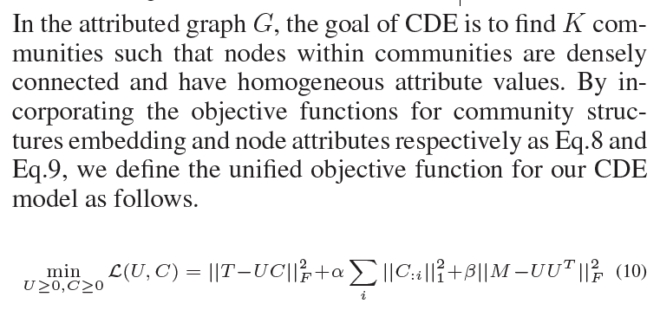
Unified Objective Function for CDE

Slide 15
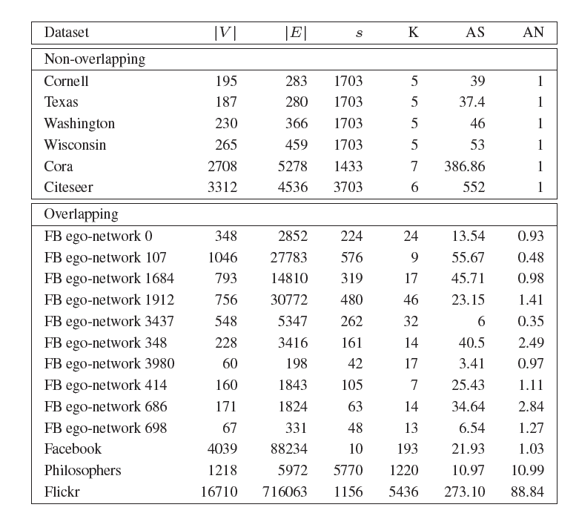
DATASET
Table 1: Dataset Statistics. |V |: number of nodes, |E|: number
of edges, s: number of node attributes, K: number of communities,
AS: average size of communities,
AN: average community memberships, FB: Facebook dataset.
Notes:
1.Citation network : For training, we only use 20 labels per class, but all feature vectors.
2. Nell :The semi-supervised task here considers the extreme case of only a single labeled example per class in the training set

Slide 16
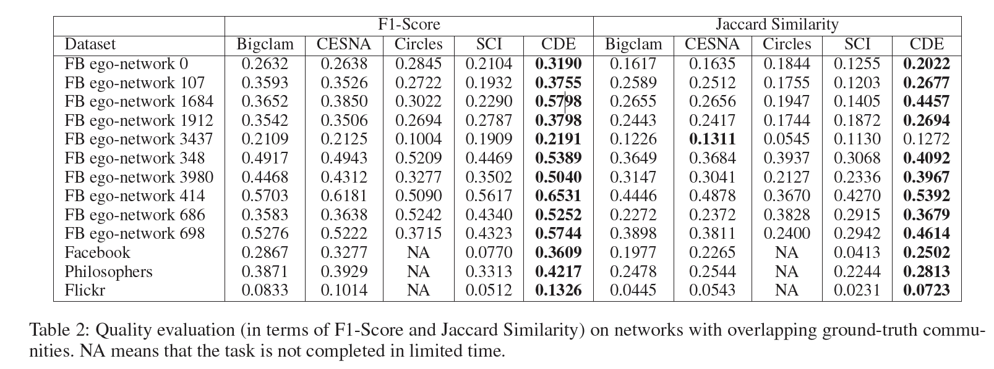
RESULTS

Slide 17
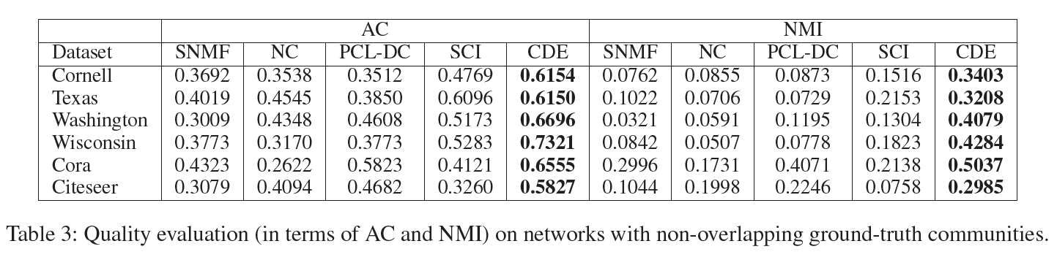
RESULTS
Notes:
归一化互信息是度量两张图片相似度的一种表达方式

Slide 18
Thanks !

