Slide 1
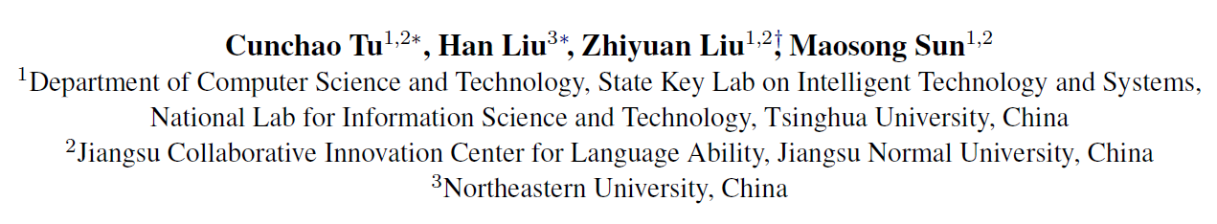
CANE: Context-Aware Network Embedding for Relation Modeling

Slide 2
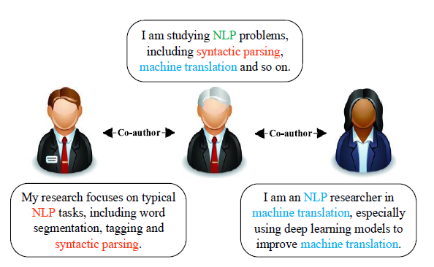
existing NE models aim to learn a fixed context-free embedding for each vertex and neglect the diverse roles when interacting with other vertices.
one vertex usually shows different aspects when interacting with different neighbor vertices, and should own different embeddings respectively

Slide 3
Problem Formulation
Context-free Embeddings: the embedding of a vertex is fixed and won’t change with respect to its context information
Context-aware Embeddings: CANE learns various embeddings for a vertex according to its different contexts. Specifically, for an edge eu;v, CANE learns context-aware embeddings v(u) and u(v).

Slide 4



The Method
Overall Framework：
two types of embeddings for a vertex v ：structure-based embedding $v^{s}$ and text-based embedding $v^{t}$
Concatenate
the text-based embedding $v^{t}$ can be either context-free or context-aware

Slide 5


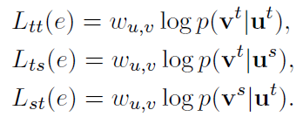
Structure-based Objective
Text-based Objective
map the two types of vertex embeddings into the same representation space
the text-based embeddings can be obtained either in context-free ways or context-aware ones

Slide 6
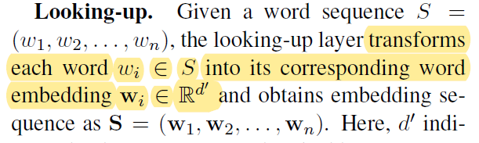


Context-Free Text Embedding
CNN, Bidirectional RNN and GRU
Convolution
Max-pooling
Notes:
capture the local semantic dependency among words

Slide 7
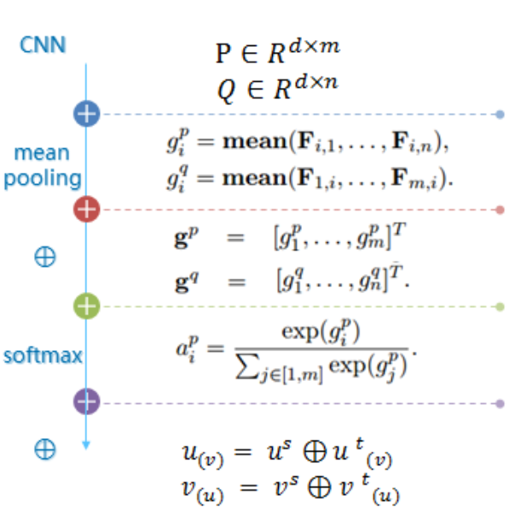
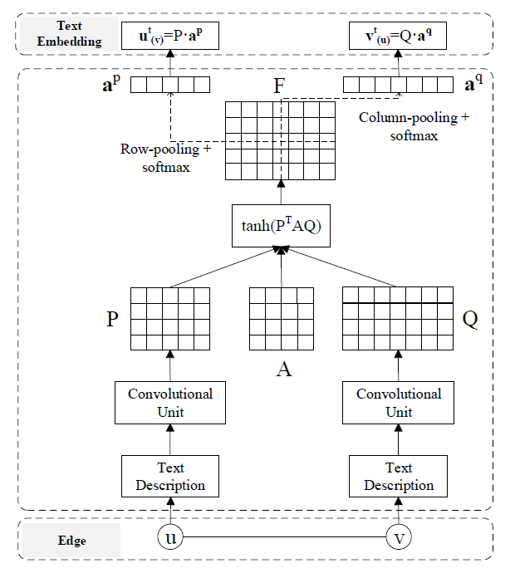
Context-Aware Text Embedding
mutual attention:enables the pooling layer in CNN to be aware of the vertex pair in an edge
Notes:
先经过CNN卷积后，引入关系矩阵A，相乘激活得到F矩阵，对F矩阵行和列分别采用mean-pooling，然后经过softmax激活得到基于上下文的attention权值向量a，在讲向量a与P相乘得到节点u的基于上下文文本的embedding，最终再与先前学习得到的基于网络结构学习得到的embedding进行拼接后，得到最终节点U的目标Embedding。

Slide 8

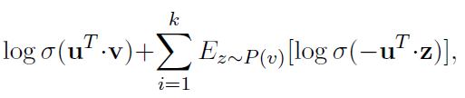
Optimization of CANE
CANE aims to maximize several conditional probabilities between

Slide 9
