Slide 1

Collaborative Similarity Embedding
for Recommender Systems
WWW 19

Slide 2
Motivation
Many existing model-based CF algorithms leverage only the user-item associations available in a given user-item bipartite graph. Thus, when the available user-item associations are sparse, these algorithms may not work well.
The higher-order proximity has been shown useful in graph embedding methods. In general, exploiting additional collaborative relations shows promise in learning better representations of vertexes in an information graph.
There is a lack of a unified and efficient model that generalizes the underlying computation and aims at recommendation problems.

Slide 3
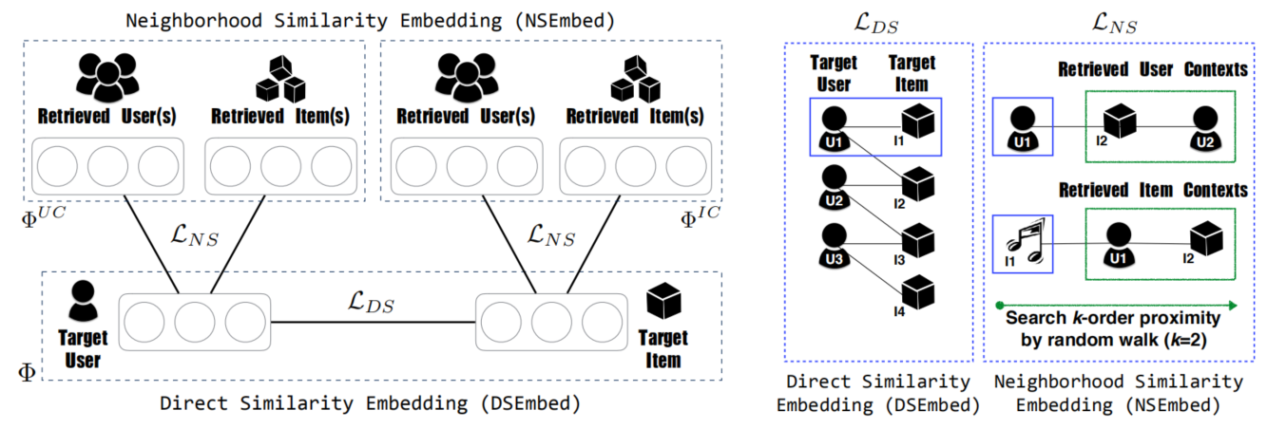

CSE Framework
Notes:
a direct similarity embedding (DSEmbed) module to model user-item associations, and a neighborhood similarity embedding (NSEmbed) module to model user-user and item-item similarities.
The DSEmbed model provides the flexibility to implement two mainstream types of modeling techniques: rating-based and ranking-based models to preserve direct proximity of user-item associations; NSEmbed, in turn, models user-user and item-item relations using the contexts
within a k-step random walk,

Slide 4
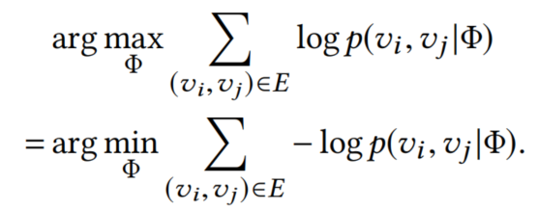
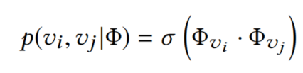
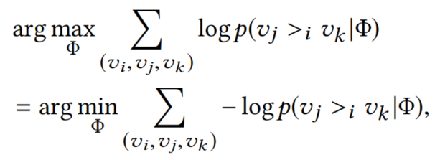

Direct Similarity Embedding (DSEmbed)
A rating-based approach
A ranking-based approach
Notes:
For a ratingbased approach, the objective is to find the embedding matrix Φ that maximizes the log-likelihood function of observed user-item pairs
In contrast, a ranking-based approach cares more about whether we can predict stronger association between a ‘positive’ user-item pair (vi,vj) ∈ E than a ‘negative’ user-item pair (vi,vk) ∈ E¯

Slide 5
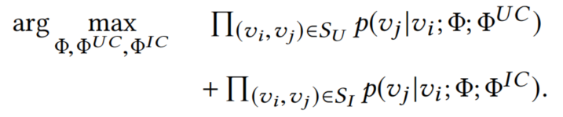
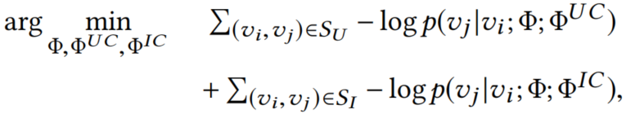
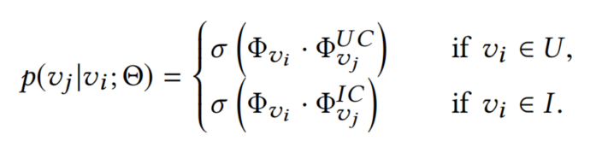
Neighborhood Similarity Embedding(NSEmbed)
the vertex itself Φ
the context of other vertices Φ^{UC}, Φ^{IC}

Slide 6
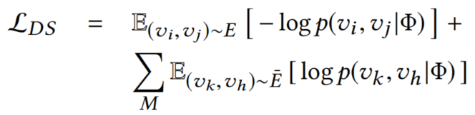

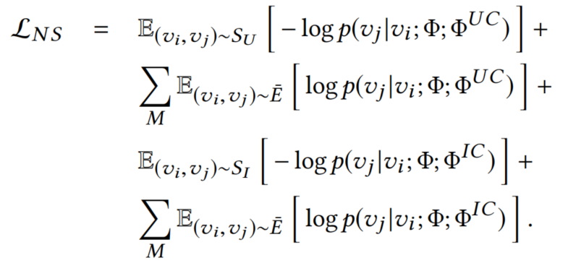
Sampling-based Expectation Loss

Slide 7
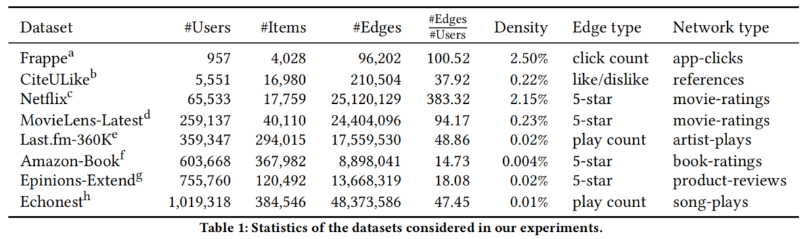
Experiment

Slide 8
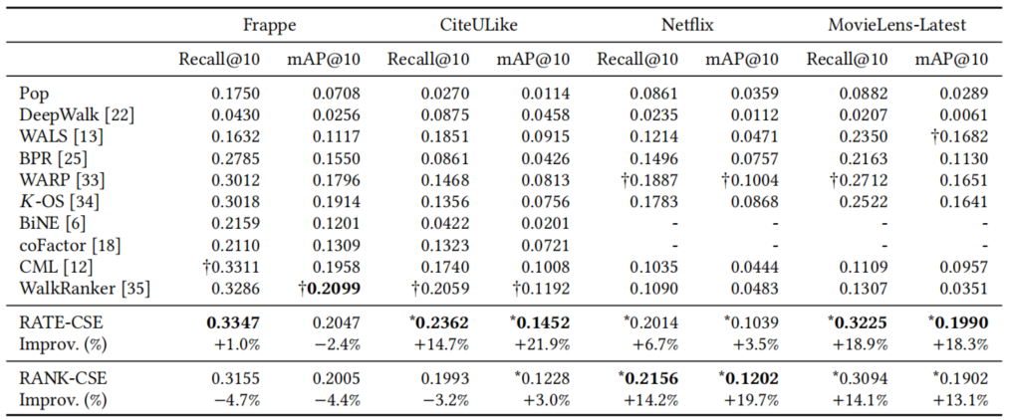

Slide 9
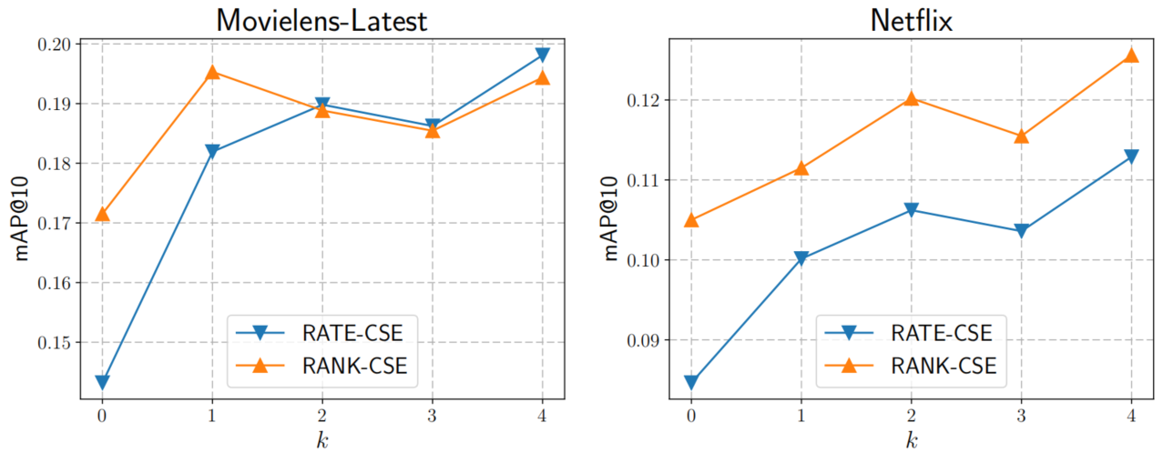
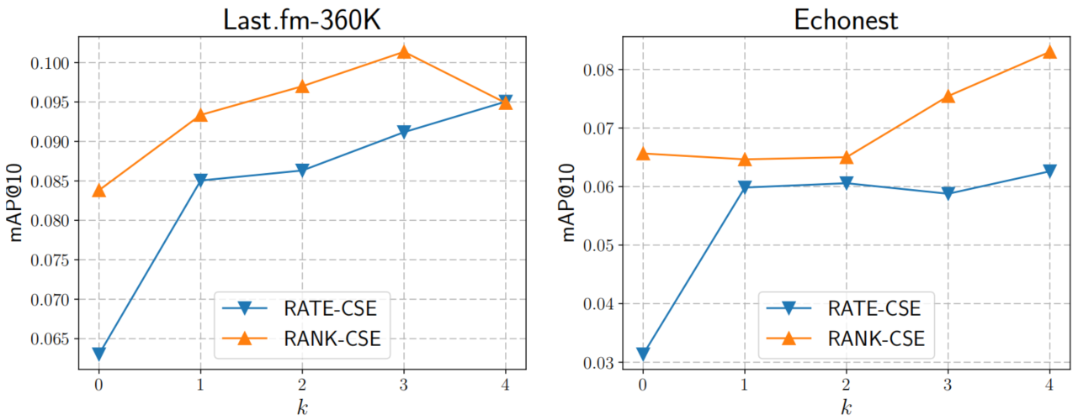
the k-order neighborhood proximity of a pair of users (or items)

Slide 10
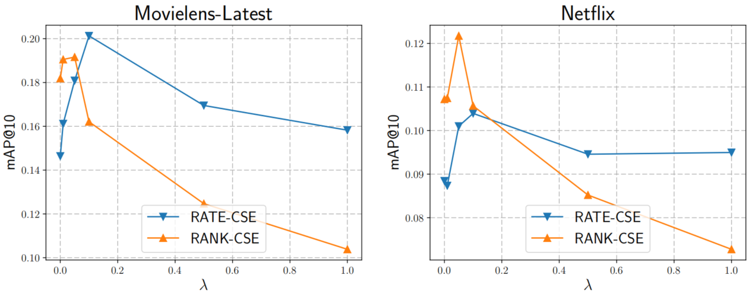
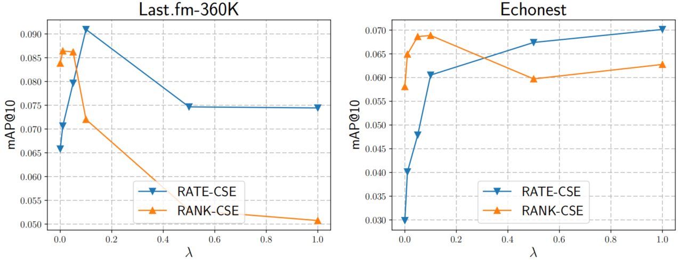

Slide 11
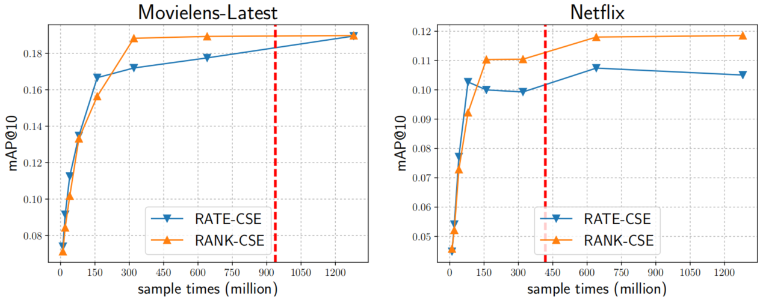
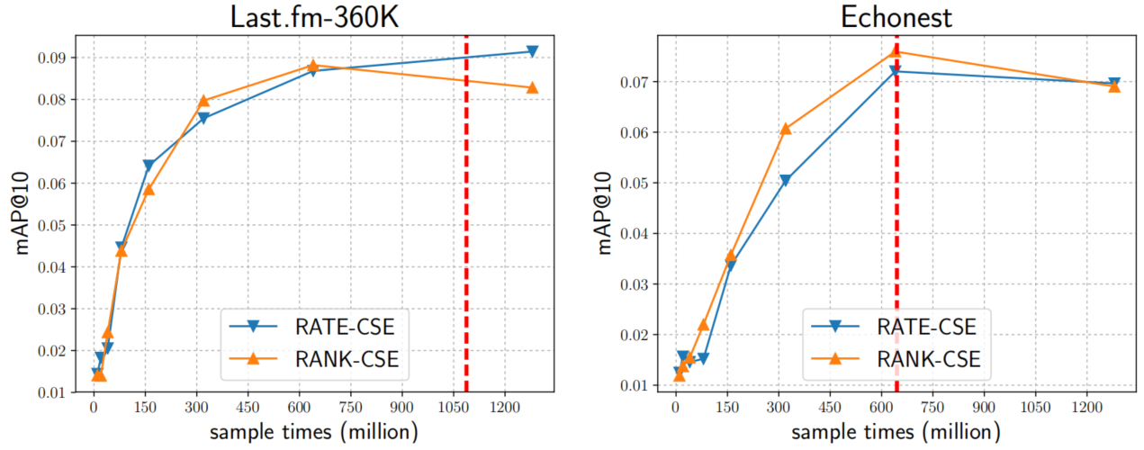
Movielens-Latest
259137 users
24404096 edges
Netflix
65533 users
25120129 edges
Last.fm-360K
359347 users
17559530 edges
Echonest
1019318 users
48373586 edges

