Slide 1
CARL: Content-Aware Representation Learning for Heterogeneous Networks

Slide 2
Challenges
the heterogeneous structural information of the network consisting of multiple types of nodes and relations
the unstructured semantic content associated with nodes
online updates due to incoming new nodes in growing network

Slide 3
CARL Framework
Structural: heterogeneous SkipGram model
Unstructural: deep semantic encoding

Slide 4
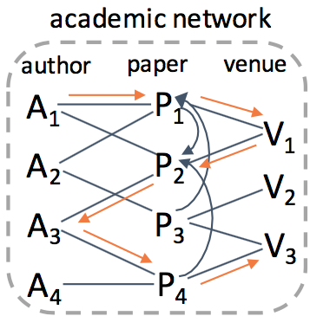

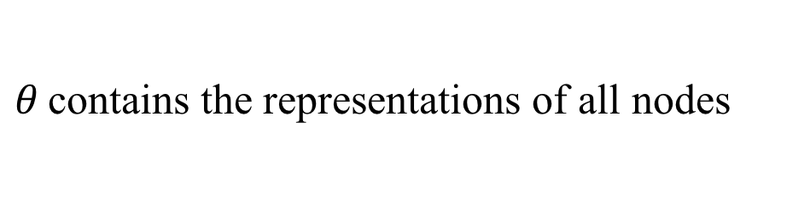
Heterogeneous Network Embedding
maximize the likelihood of each type of context node given the input node :
$θ$contains the representations of all nodes

Slide 5




Incorporating Deep Semantic Encoder
HSG with Unstructured Semantic Regularization (HSG-SR)
tightly join HSG with the conditional probability of semantic constraint , leading to unstructured semantic regularization onto objective o₁

Slide 6



Incorporating Deep Semantic Encoder
Unstructured Semantic Enhanced HSG (SE-HSG)
concatenate the output of deep semantic encoder with the input of HSG, leading to unstructured semantic enhancement onto objective o₁

Slide 7
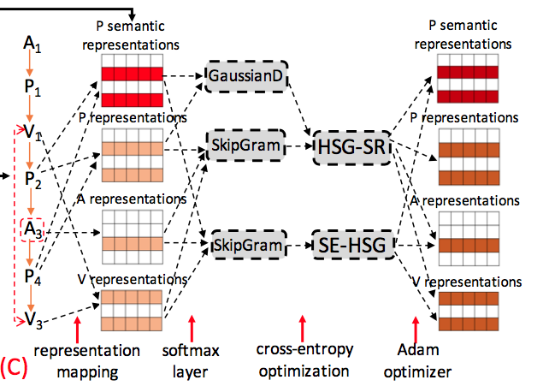
Incorporating Deep Semantic Encoder

Slide 8
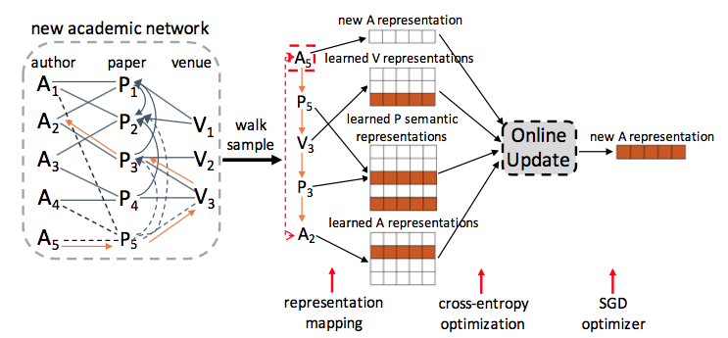
Online Update for New Nodes

Slide 9

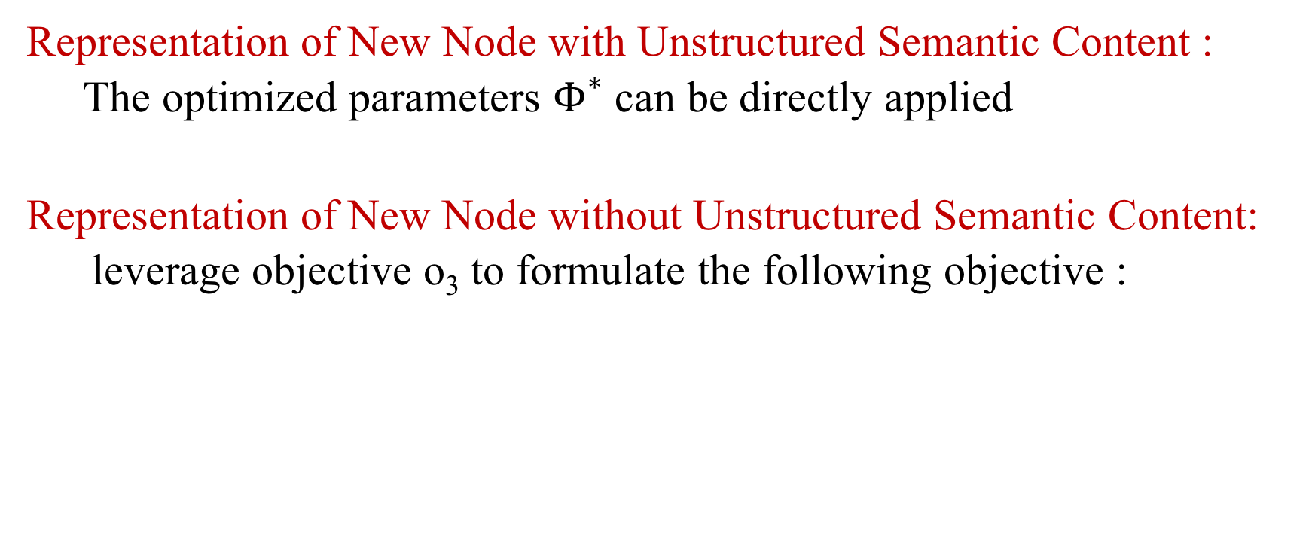
Online Update for New Nodes
Representation of New Node with Unstructured Semantic Content :
The optimized parameters $Φ^{∗}$ can be directly applied
Representation of New Node without Unstructured Semantic Content:
leverage objective o₃ to formulate the following objective :

