Slide 1
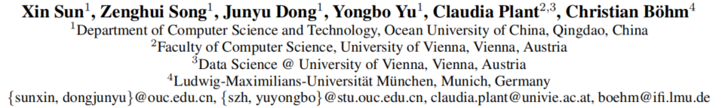
Network Structure and Transfer Behaviors Embedding
via Deep Prediction Model
AAAI-19

Slide 2
Motivation
Natural networks encountered in the real world are sparse and have many undiscovered and noisy links. It is hard to get a full view of the authentic relationship between any two nodes from the network itself.
The networks from the real world exhibit significant dynamic evolution behavior. It is impossible to catch the network evolution process from the structured data itself.
Previous work did not systematically consider local and global structure with its dynamical behaviors.
How to capture the network structure and neighborhood context information from the network structured data
How to embed the complex and non-linear network structural data into low-dimensional vector representations, while preserving the transfer possibilities among the nodes
Challenge

Slide 3
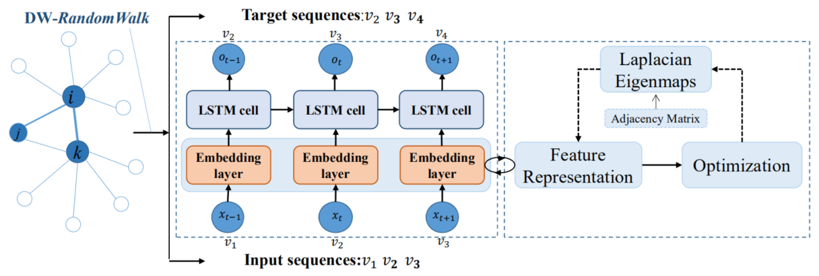
Deep Network Embedding(DNE) framework

Slide 4
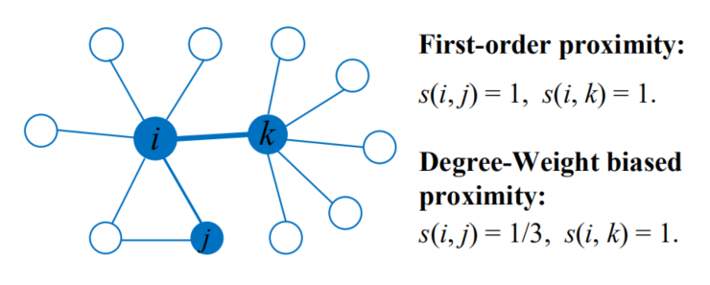
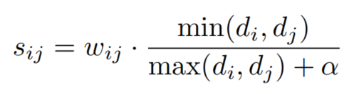
Degree-Weight biased Random Walk
The degree-weight biased proximity has the ability to capture the social role information among nodes.
transition probability

Slide 5

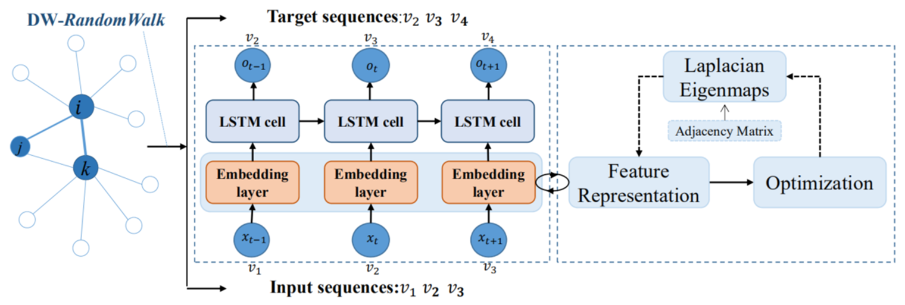


The Embedding Model
maximize the likelihood of predicting the next node
Y is the predicted target node, and O is the output of the softmax layer

Slide 6
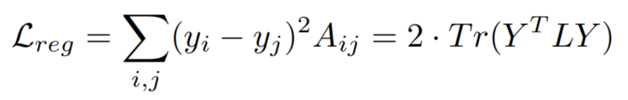
Embedding Space Optimization
use Laplacian supervised Embedding space Optimization (LapEO) to preserve the local network structure
Y ∈ R^{|V |×d} is the node representation, A is the adjacency matrix, L = D - A, D ∈ R^{n×n} is a diagonal matrix, Di,i =∑_{j} Ai,j

Slide 7
Experiments
Datasets
BlogCatalog (Tang and Liu 2009) social network dataset about blogger authors, commonly used as the ground-truth for multi-label classification task
CoRA, CiteSeer and PubMed (Sen et al. 2008) collections of scientific publications from different databases
The 20-Newsgroups (Lang 1995) a collection of 20,000 newsgroup documents, partitioned into 20 different categories
Baseline Methods
DeepWalk (Perozzi, Al-Rfou, and Skiena 2014)
LINE (Tang et al. 2015)
SDNE (Wang, Cui, and Zhu 2016)
Struc2Vec (Ribeiro, Saverese, and Figueiredo 2017)
GraphGAN (Wang et al. 2017)

Slide 8
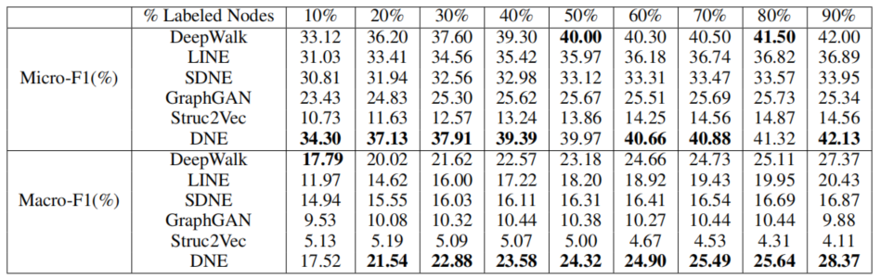
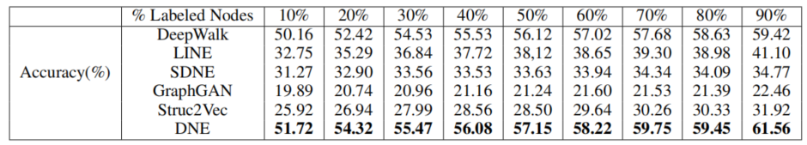
Multilabel classification on BlogCatalog
Node Classification on Citeseer

Slide 9
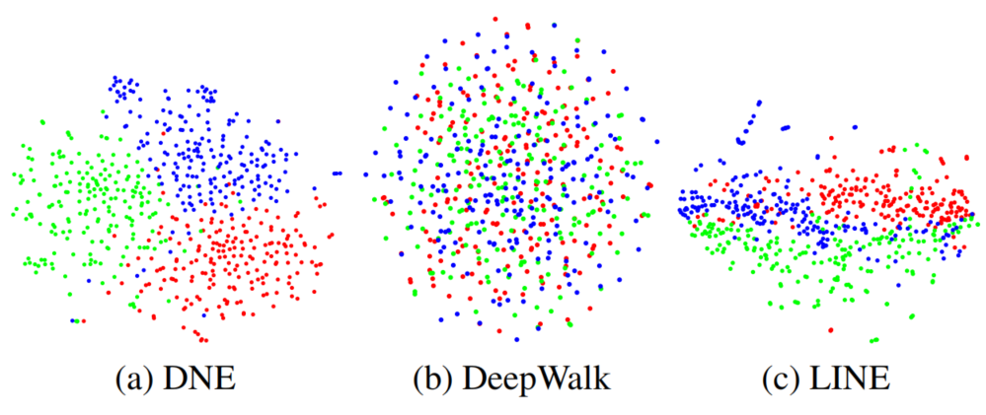
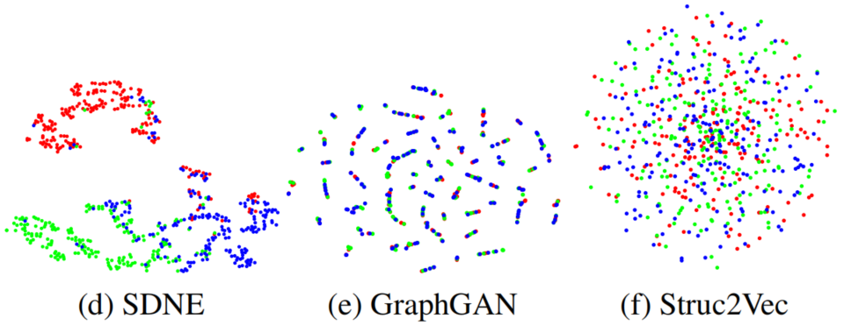
Visualization of 3-NG dataset
Red: comp.graphics
Blue: rec.sport.baseball
Green: talk.politics.guns

