Slide 1
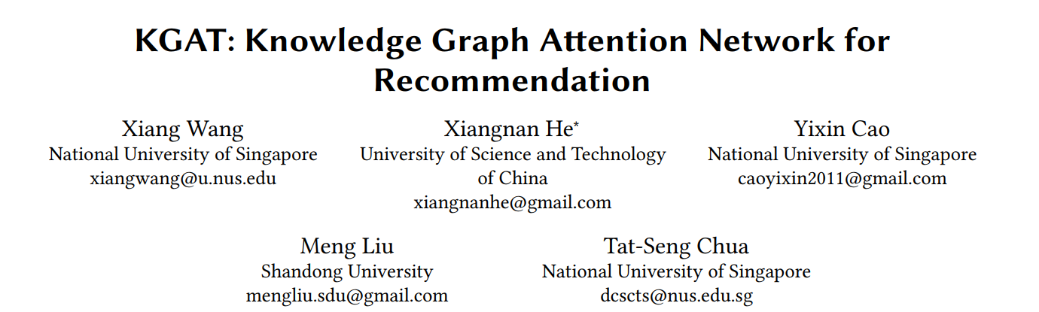
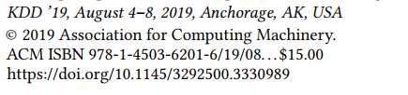

Slide 2
Current Models
1. Collaborative fltering: inability of modeling side information
2. SL paradigm for recommendation(FM,NFM,Wide&Deep): transform Side Infprmation into a generic feature vector, together with user ID and item ID, and feed them into a supervised learning (SL) model
Backs: model each interaction as an independent data instance and do not consider their relations

Slide 3
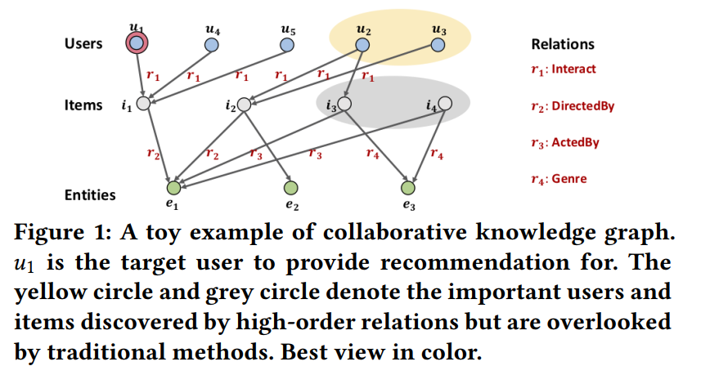

Slide 4
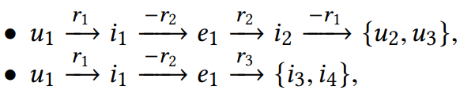
As illustrated in Figure 1, the key to successful recommendation is to fully exploit the high-order relations in CKG, e.g., the long-range connectivities:
Challenges:
1) the nodes that have high-order relations with the target user increase dramatically with the order size, which imposes computational overload to the model,
2) the high-order relations contribute unequally to a prediction, which requires the model to carefully weight (or select) them

Slide 5
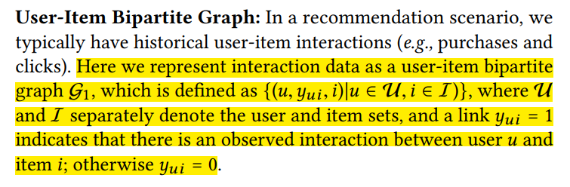
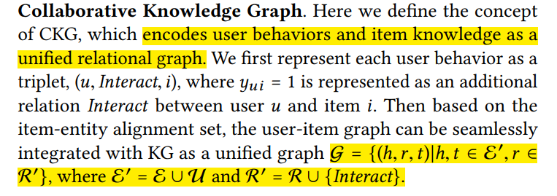
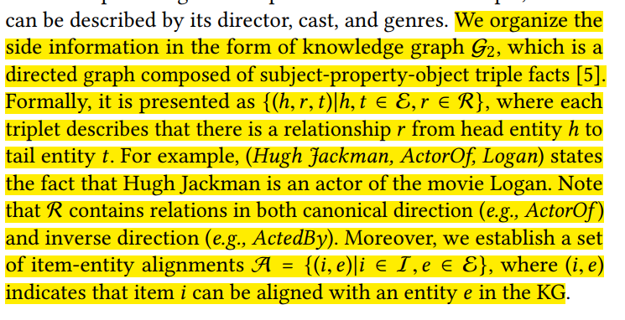
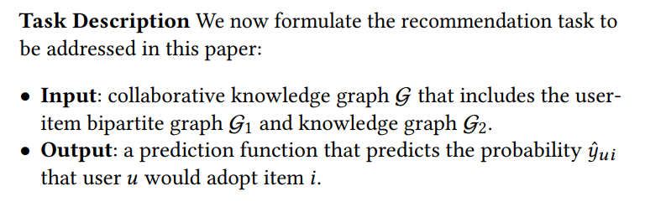
TASK FORMULATION

Slide 6
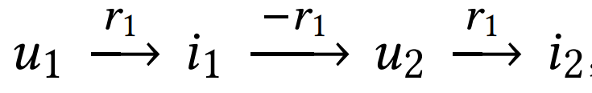


High Order Connectivity
CF models: similarity users would exhibit similar preferences on items
SL models: Users tend to adopt items that share similar properities

Slide 7
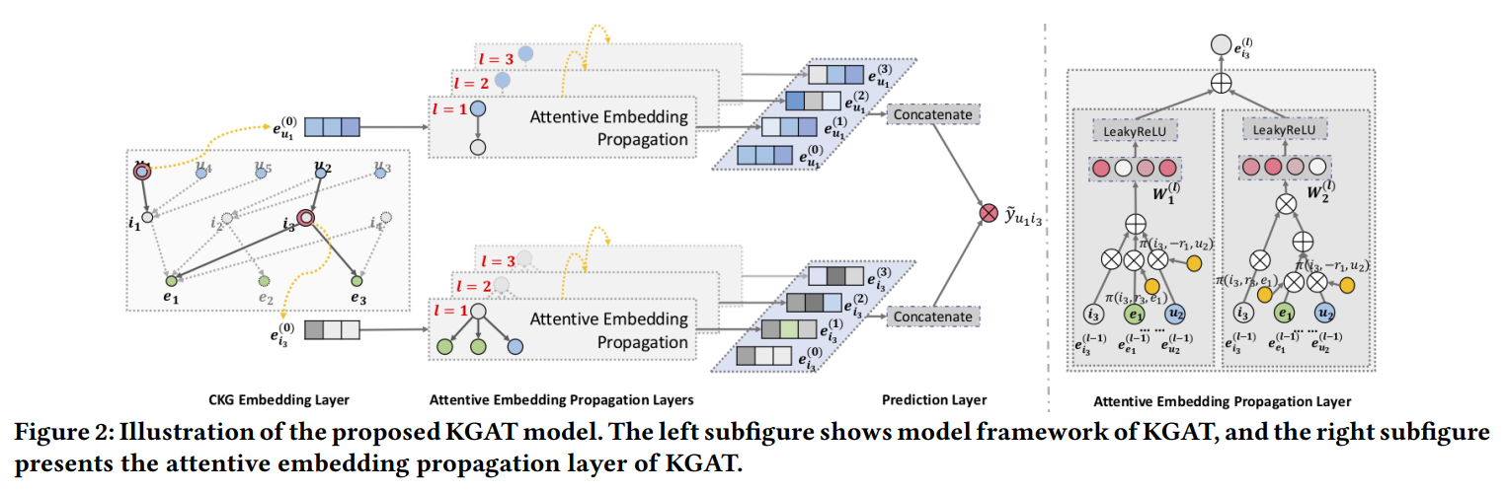

Slide 8

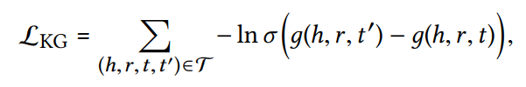
Embedding Layer
TransR: Knowledge graph embedding

Slide 9

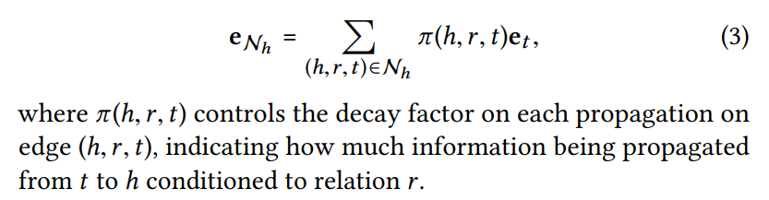
Attentive Embedding Propagation Layers
Information Propagation:

Slide 10

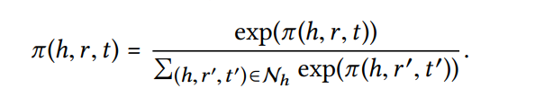
Knowledge-aware Attention
implement π(h,r, t)
Normalize the coefcients across all triplets

Slide 11



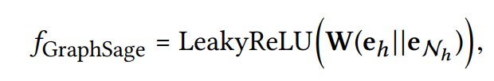
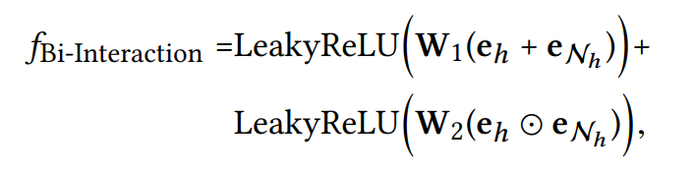
Information Aggregation
GCN Aggregator
GraphSage Aggregator
Bi-Interaction Aggregator

Slide 12

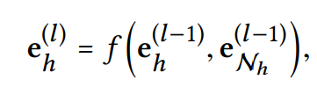
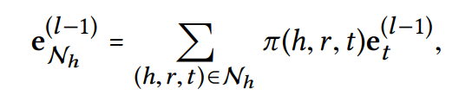
High-order Propagation
Stack more propagation layers to explore the high-order connectivity information

Slide 13
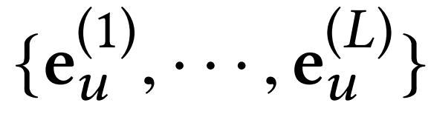
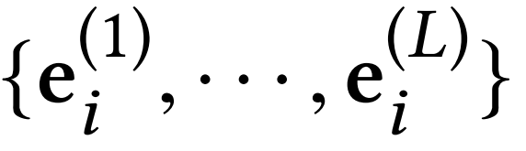
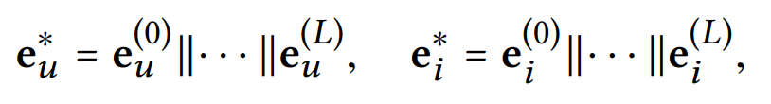

Model Prediction
multiple representations for user node u
predict their matching score

Slide 14
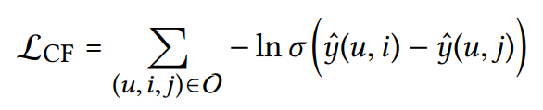

Optimization

Slide 15
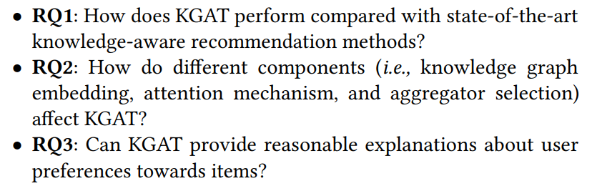
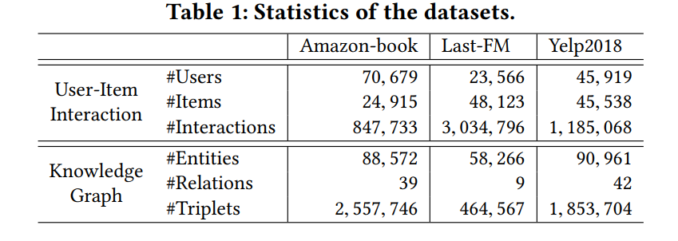
EXPERIMENTS

Slide 16
