Slide 1
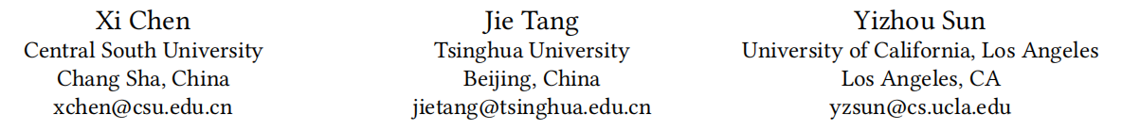
Modeling Personalized Dynamics of Social Network and Opinion at Individual Level

Slide 2
Motivation
previous network models contain two parts:
generating structure as per user property;
changing property as per network structure
They usually treat everyone in an uniform fashion.
PENO is the first attempt to introduce personality impact in network dynamics.
Notes:
解释性不好

Slide 3



Definition
global relationship variation can be described as a time serial of undirected network graph
Opinion represents his or her ideology stand and varies with time as well
four dimensions of personality
agreeableness, leadership, neuroticism, openness
Notes:
G<t> consists of all ties at moment t
Each individual possess a property vectors namely "opinion"

Slide 4




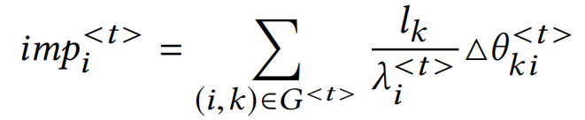
Opinion Propagation
For each entity, weighting and combining his current property and neighbors’property as the property in next moment.
Notes:
where x<t>n is the property average of person n and all his neighbors.

Slide 5
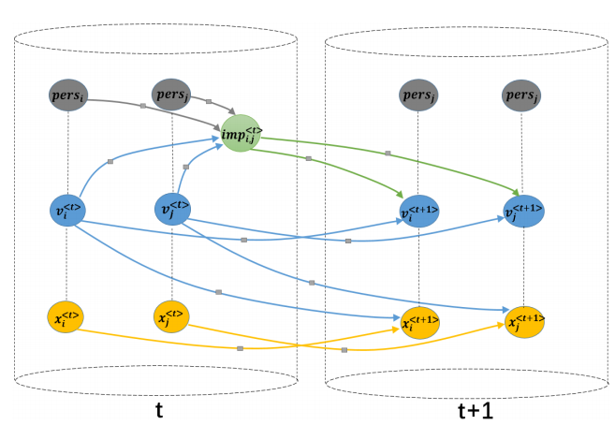

Slide 6
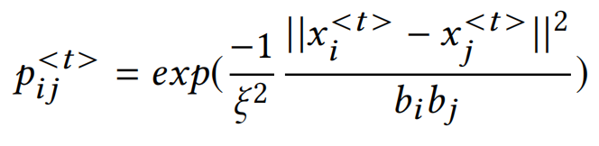
Tie Formation
There is no way someone can keep in touch with all former friends: limited energy and time for consuming. Furthermore, friendship also ends when two no longer share common views.
Notes:
ξ is a system parameter to control the overall tie formation difficulty. openness bn draws ones’ willing in making friends.

Slide 7
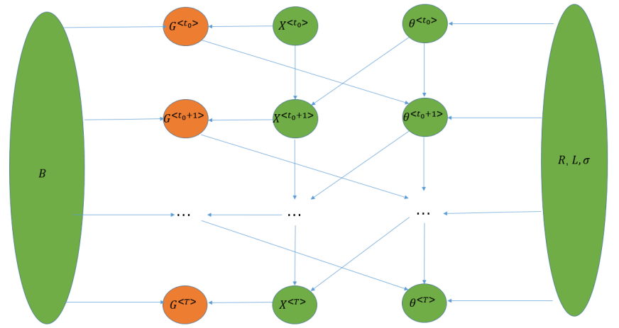
PENO Model
a personalized evolving model for social network and opinion

Slide 8
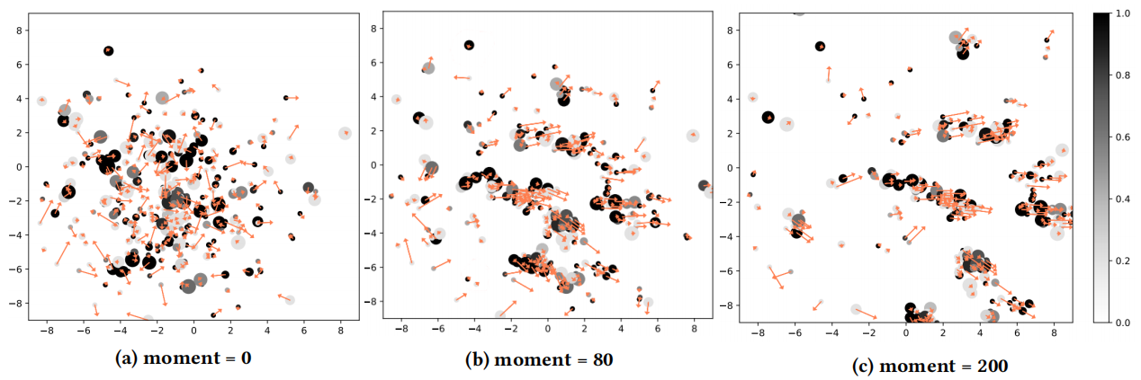
Simulation
node color: openness, node size: agreeableness, arrow length: leadership
Notes:
Opinion velocity is 0.03
node placement refers to opinion, arrow is trend.
Outlier moves merely along his own direction
Entity with high openness (black) are much likely to follow the mainstream opinion
Opinion gathers into different communities and continuously attracts new members.

Slide 9
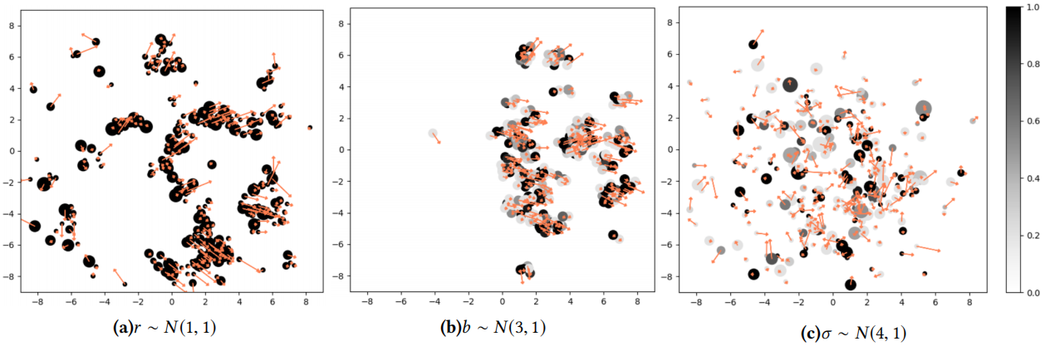

Slide 10
Experiment
Data
Legislative voting. Collected data contain bills from 1983 to 2017. Minimum moment interval is set to one month. Entire evolution contains T = 382 moments, N = 2, 180 legislators, 130, 692 bills and 2.1 million voting records.
Digg friendship. Minimum moment interval is set to three days. In total, T = 209 moments, selected users N = 5, 000, and 71,985 friendship ties are considered.
Baselines
Co-evolve social network model(CoNN)
Dynamic social network with latent space models (DSNL)
Latent feature propagation model(LFP)
Phase transition model(PTM)
Notes:
Digg is a news website where users recommend stories and articles to the public. Friendship on Digg exactly indicates the users sharing similar idealogy.
The basic model where network structure and latent feature affect reciprocally and evolve at the same time.
This model updates properties as per distance-based probability.
Primary idea relies on binary latent feature propagation. It aims to mine connection from finite common behaviors or interests.
An approach to describe molecule behaviors during phase transition.

Slide 11
