Slide 1


Slide 2
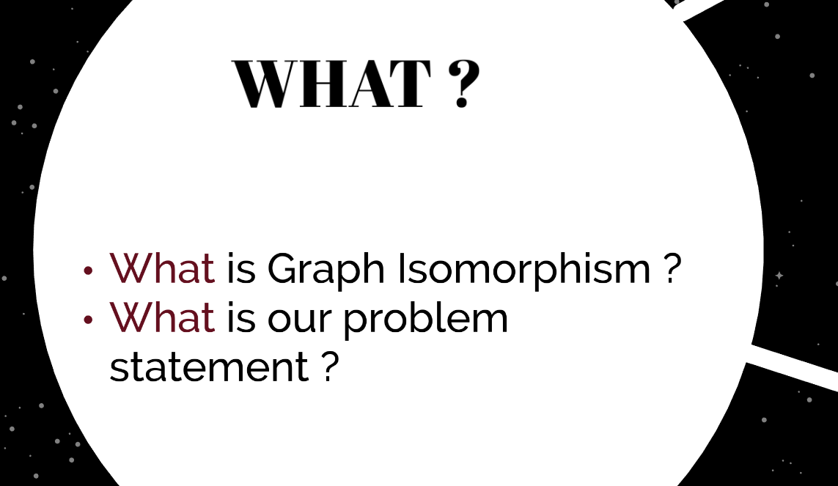

Slide 3
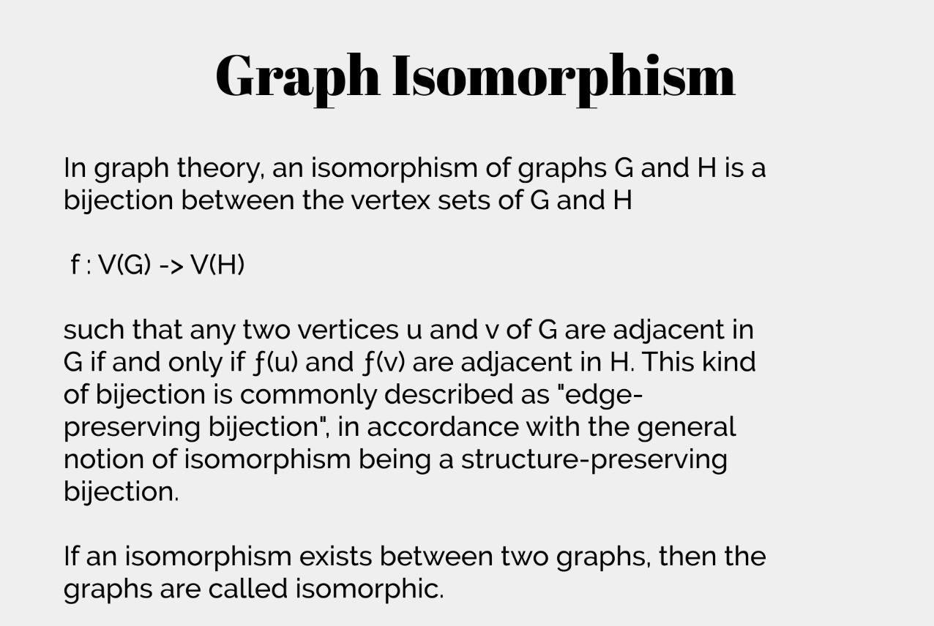

Slide 4
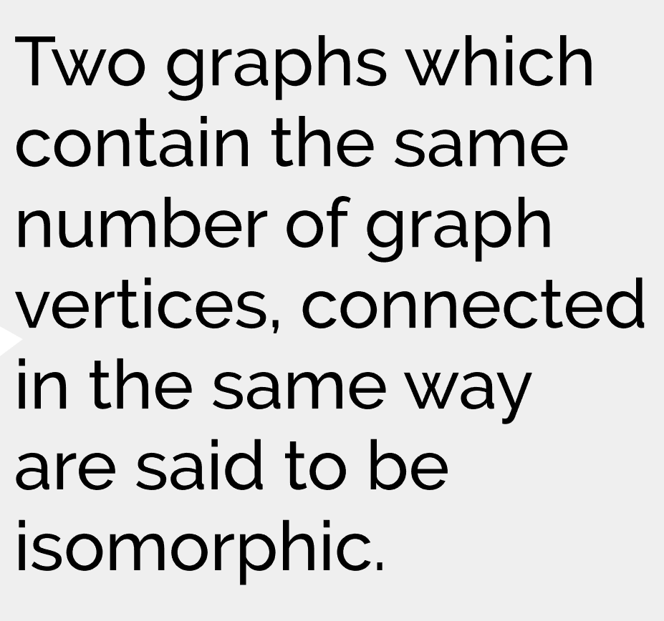

Slide 5
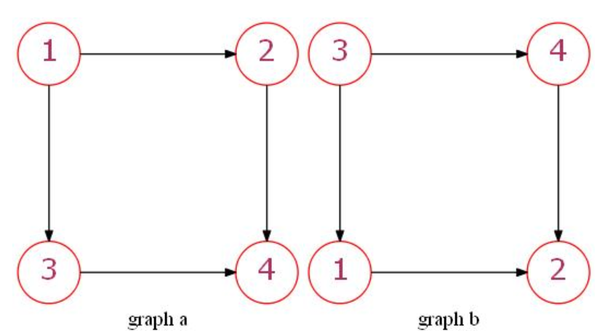
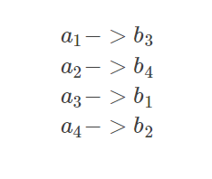

Slide 6
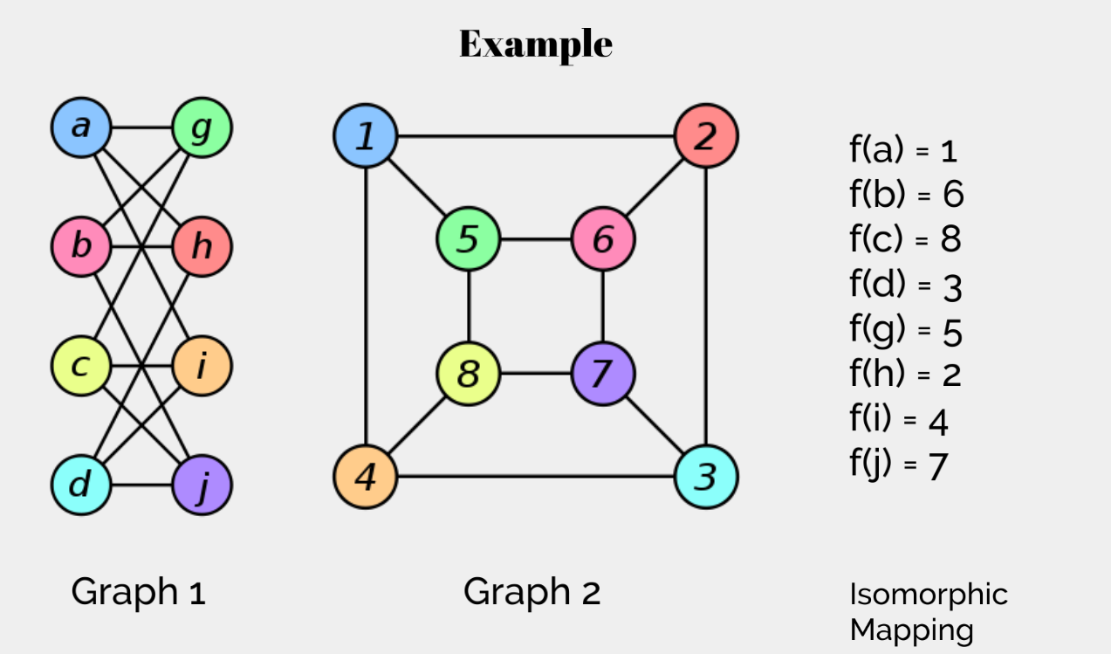

Slide 7
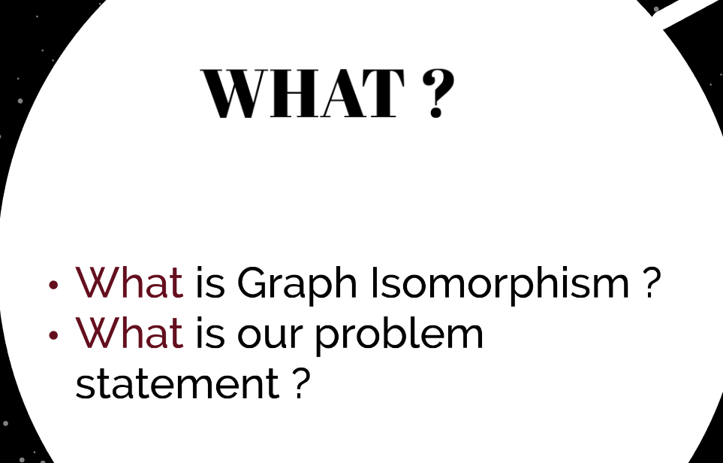

Slide 8
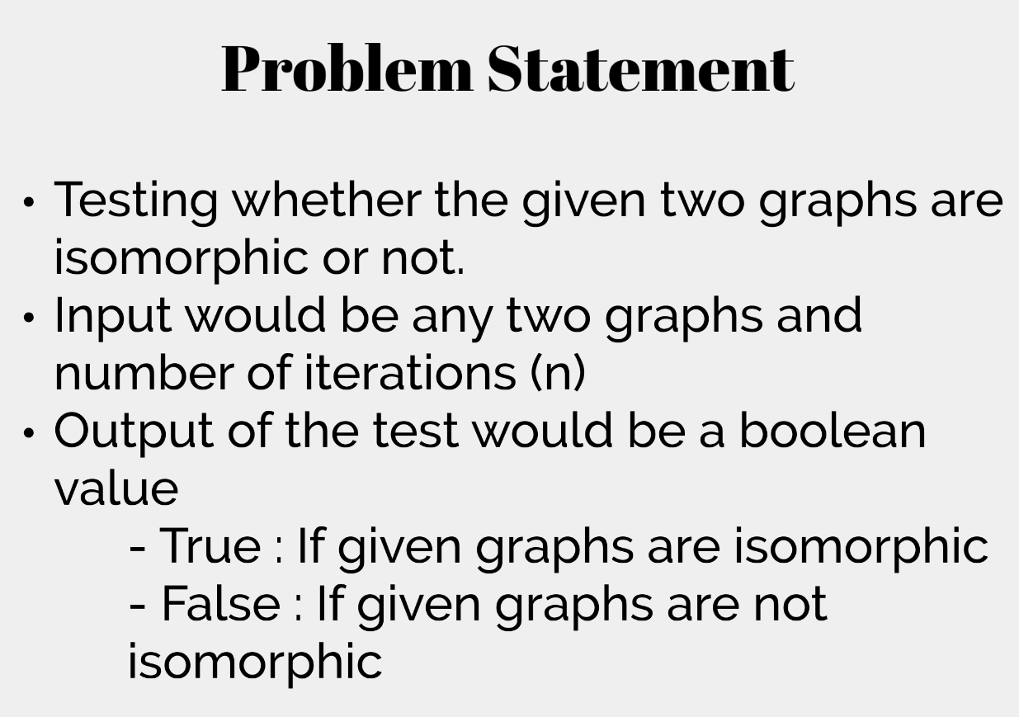

Slide 9
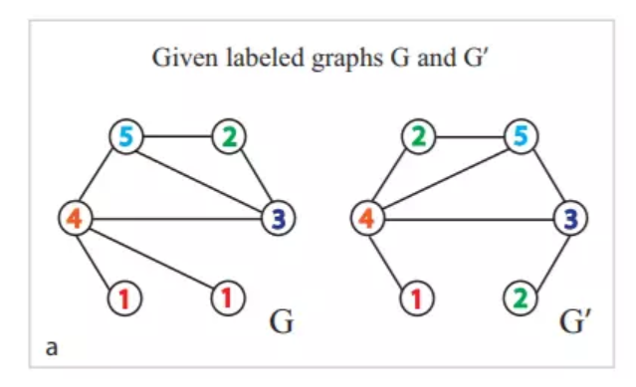
Step 1: Given G and G' are labeled, In practical applications, sometimes we can't get the label of the node. In this case, we can mark the node with the label "1".

Slide 10
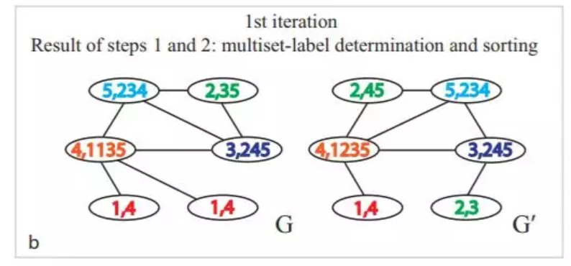
Step2:Aggregate the labels of the neighbor nodes to get a string of labels, and sort the strings in ascending order.

Slide 11
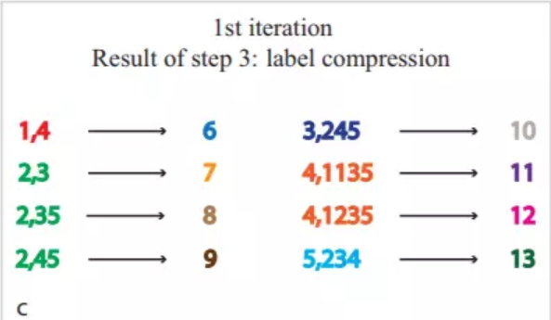
Step3:Hashing the string, here generates a one-to-one mapping dictionary, this step can also use other string hash function, as long as the collision rate is as small as possible.

Slide 12
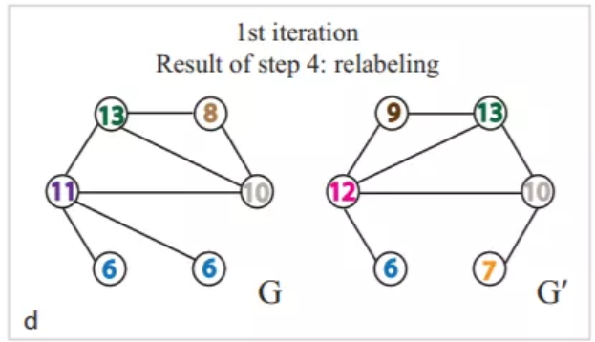

Reassign the hashed value to the corresponding node
G={6、6、8、10、11、13}，G'={6，7，9，10，12，13}
The Jaccard formula can calculate the similarity between G and G`

Slide 13
