Slide 1

SHINE: Signed Heterogeneous Information Network Embedding for Sentiment Link Prediction
吴尧
2018/10/15

Slide 2
Problems
Predicting the sign of sentiment links is a fundamental task in many areas such as personal advertising and public opinion analysis.
Previous works mainly focus on textual sentiment classification
the most are unobserved but implied by other sources of information such as social relation and users’ profile.
Notes:
通常图中节点的属性也经常是社区形成的关键因素，比如citation network 中的文章有关键字这个属性

Slide 3
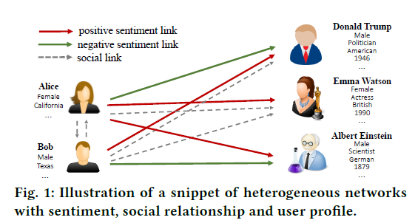
Solution
First, due to the lack of explicit sentiment links in mainstream social networks, we establish a labeled heterogeneous sentiment dataset which consists of users’ sentiment relation, social relation and profile knowledge by entity-level sentiment extraction method.

Slide 4
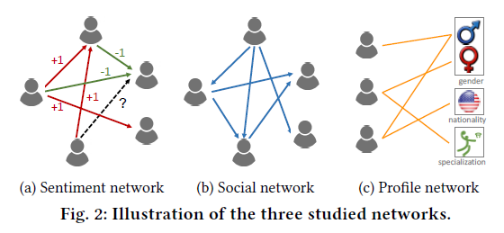
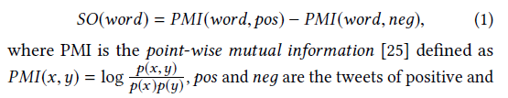

Solution
Calculate sentiment orientation (SO) scores as:

Slide 5
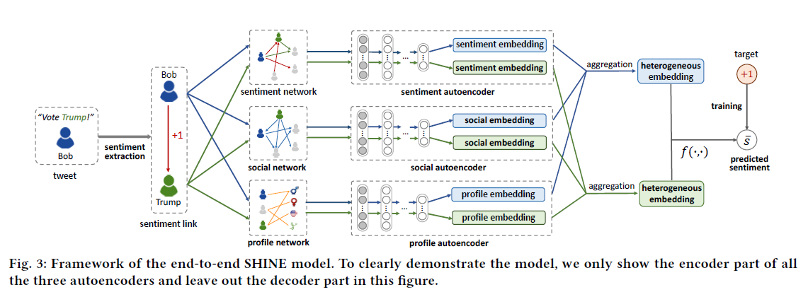
Framework
Then we propose a novel and flexible end-to-end Signed Heterogeneous Information Network Embedding (SHINE) framework to extract users’ latent representations from heterogeneous networks and predict the sign of unobserved sentiment links.

Slide 6

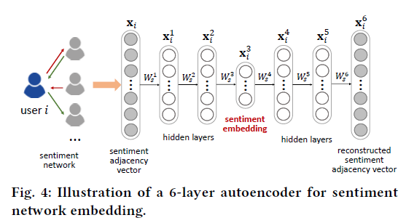


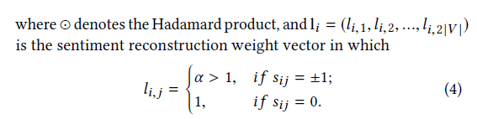

Network Embedding
Given the input x_{i} , the hidden representations for each layer are:
The basic goal of the auto encoder is to minimize the reconstruction loss between input and output representations.

Slide 7
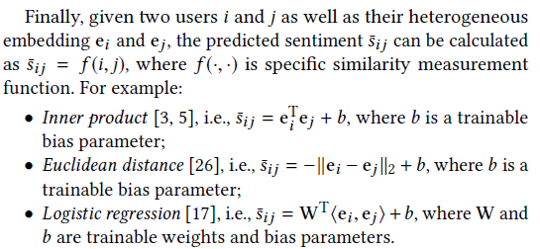
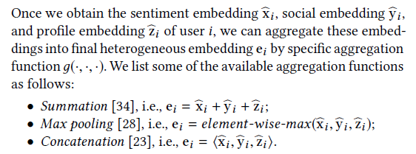
Representation Aggregation
Sentiment Prediction

Slide 8
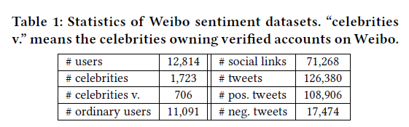
DATASET
Weibo-STC: Our proposed Weibo Sentiment Towards Celebrities dataset consists of three heterogeneous networks
Wiki-RfA: Wikipedia Requests for Adminship is a signed network with 10,835 nodes and 159,388 edges, corresponding to votes cast by Wikipedia uses in election for promoting individuals to the role of administrator. A signed link indicates a positive or negative vote by one user on the promotion of another.
Notes:
1.Citation network : For training, we only use 20 labels per class, but all feature vectors.
2. Nell :The semi-supervised task here considers the extreme case of only a single labeled example per class in the training set

Slide 9
Baselines
• LINE
• Node2vec
• SDNE
• FxG: Fairness and Goodness [12] predicts the weights of edges in weighted signed networks by introducing two measures of node behavior: goodness (i.e., how much the node is liked by other nodes) and fairness (i.e., how fair the node is in rating other nodes’ likeability).
• LIBFM: LIBFM [18] is a state-of-the-art feature based factorization model. In this paper, we use the concatenated one-hot vectors of users in three networks as input to feed LIBFM.
Notes:
1.Citation network : For training, we only use 20 labels per class, but all feature vectors.
2. Nell :The semi-supervised task here considers the extreme case of only a single labeled example per class in the training set

Slide 10
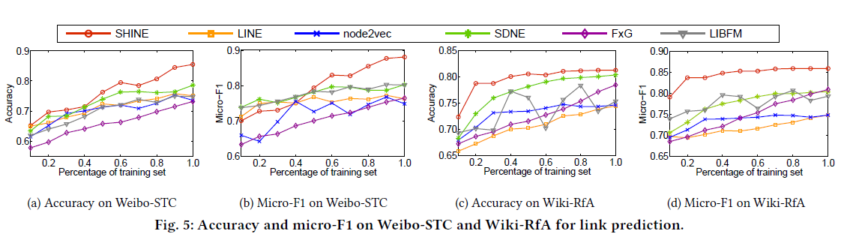
RESULTS

Slide 11
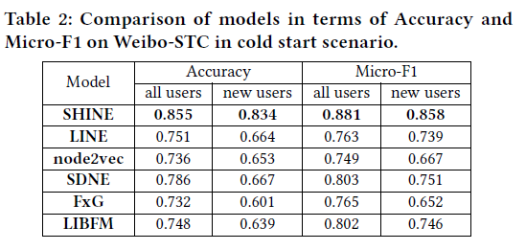
RESULTS
Notes:
归一化互信息是度量两张图片相似度的一种表达方式

Slide 12
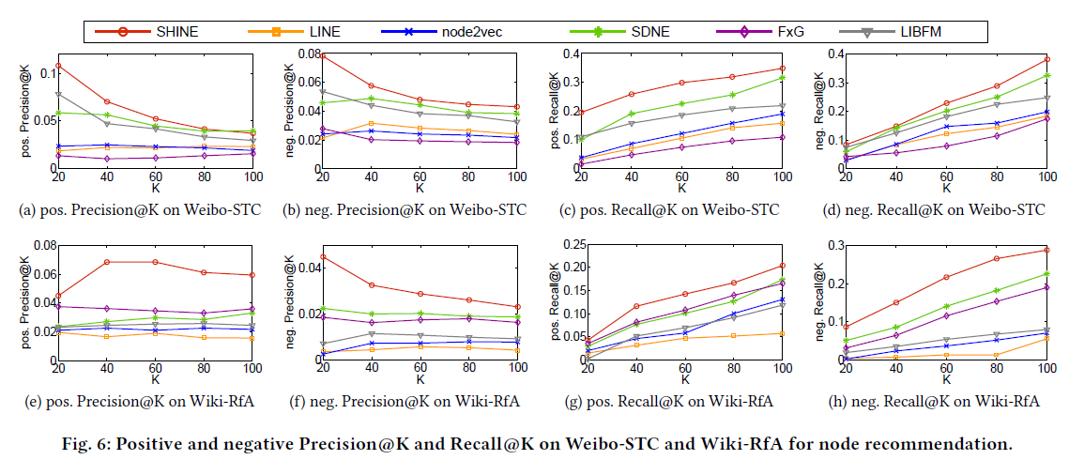
RESULTS
Notes:
归一化互信息是度量两张图片相似度的一种表达方式

Slide 13
Thanks !

