Slide 1
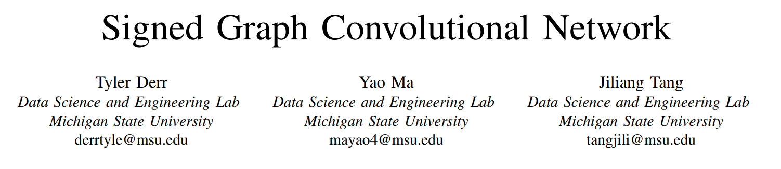

Slide 2
main challenges
1. how to correctly handle negative links, since their properties are inherently different than those of positive links;
2. how to combine the positive and negative links into a single
coherent model to learn effective node representations.

Slide 3
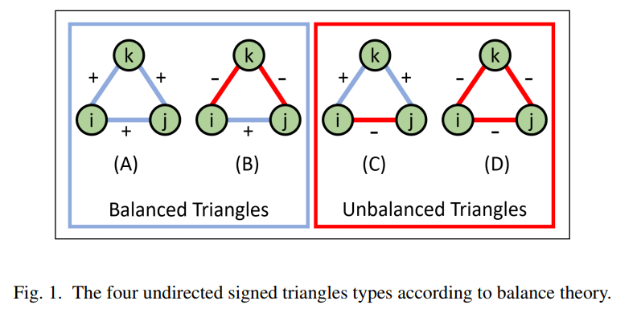
Balanced Path
“the friend of my friend is my friend”
“the enemy of my friend is my enemy”.

Slide 4
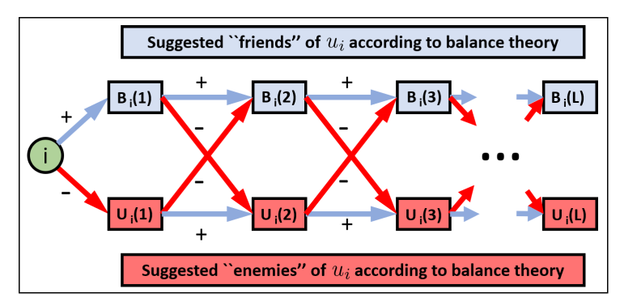
A balanced path as one that consists of an even number of negative links, and similarly an unbalanced path being one that has an odd number of negative links.

Slide 5
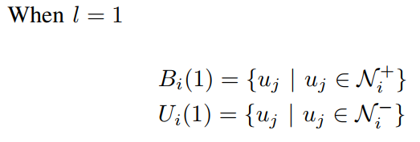
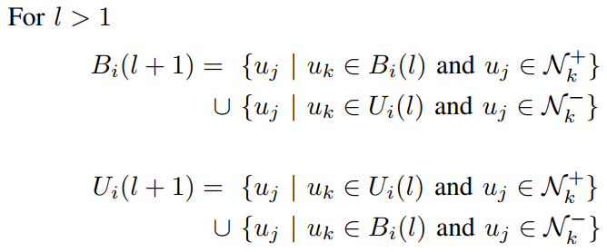
respectively for user ui, from the sets Bi(l) and Ui(l) of length l.

Slide 6
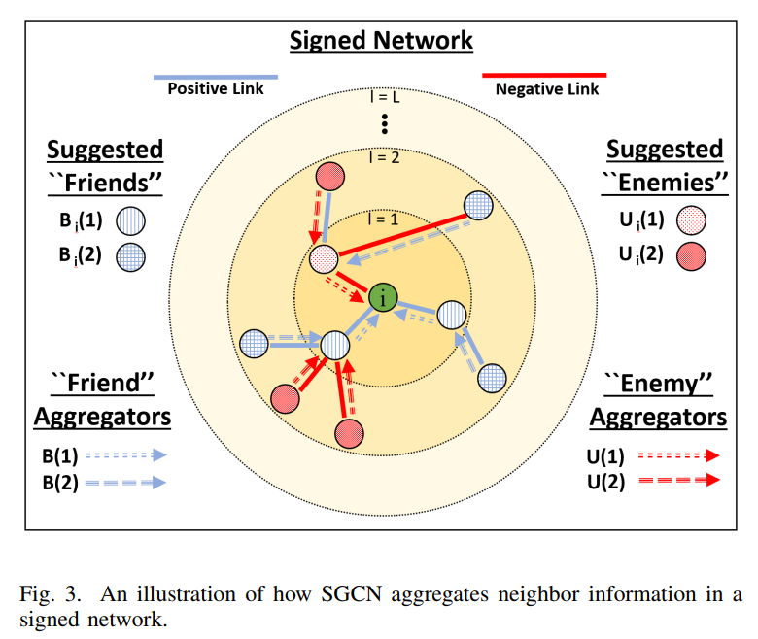
in signed networks, we cannot categorize all users the same
keep a representation of both their 'friends' and 'enemies'

Slide 7
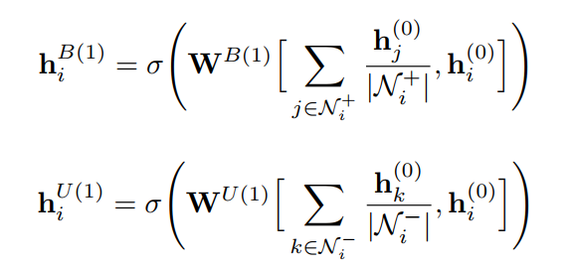

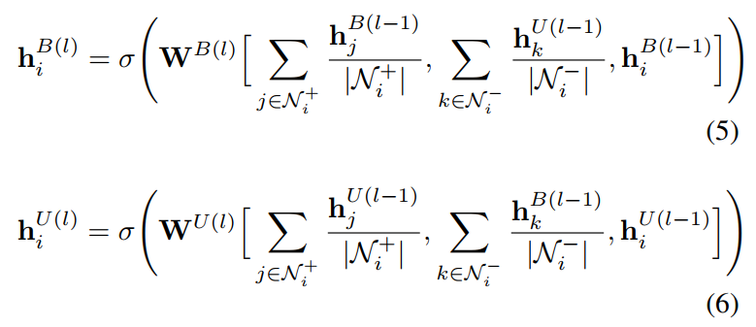


Slide 8
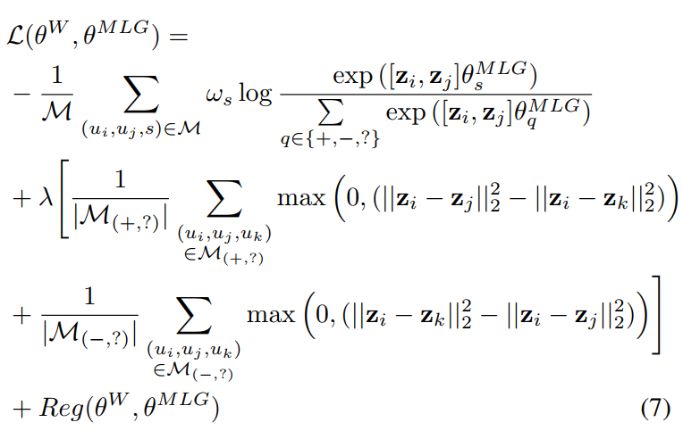
1. classify whether a pair of node embeddings are from users with a positive, negative, or no link between them.
2. to have positively linked users closer in the embedded space than the no link pairs, and the no link paired users should be closer than users having a negative link between them.

Slide 9
