Slide 1
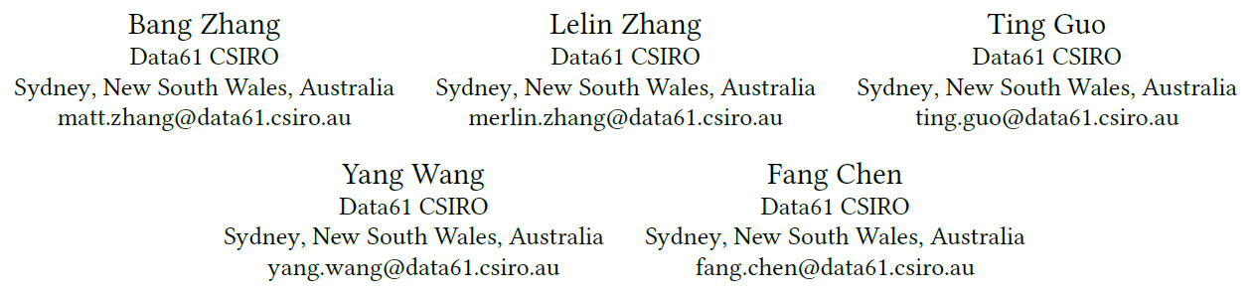
Simultaneous Urban Region Function Discovery and Popularity Estimation via an Infinite Urbanization Process Model

Slide 2
Introduction
makes the contribution via tackling the following three challenges:
(1) How to define and discover underlying urban development patterns hidden in the cross-domain urban data?
(2) How to cluster urban regions based on their urbanization patterns?
(3) How to make predictions for target domains given the discovered cross-domain correlations and patterns.
Main techniques:
Supervised topic modelling and spatial distance dependent Bayesian nonparametric process

Slide 3
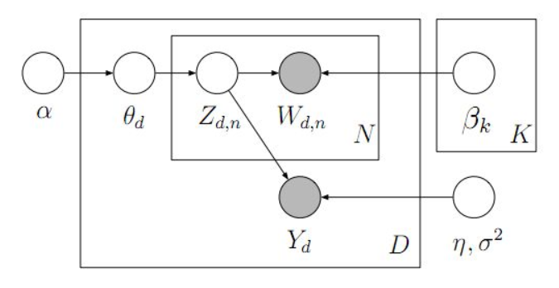
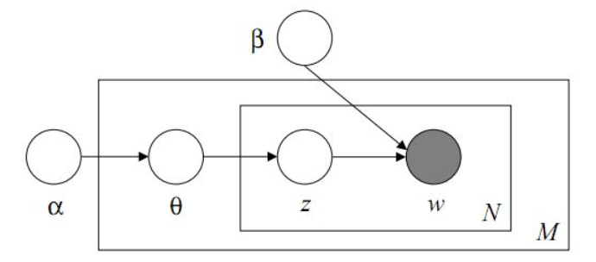
Supervised Topic Model
LDA:
unsupervised, but they can hardly be utilized for predicting documents’ responses.
sLDA:
supervised topic models
Jointly learning topics and their regression coefficients for the document responses
Notes:
document relevance rank, as they express general themes without the ability to take advantage of supervised information.
既然是Supervised，就得有个label。sLDA是把这个label，也就是Y和每个文档document关联起来的。

Slide 4

Distance dependent CRP
Chinese restaurant process (CRP) : a distribution over a probability measure.
it is widely used as a Bayesian nonparametric prior for clustering methods and mixture models.
the CRP generates exchangeable distributions over partitions
The distance dependent CRP (ddCRP) modifies the CRP by determining the table assignment via customer links.
We set the decay function as f (d) = 1(d ≤ a), where 1(・) is the indicator function.
Notes:
CPR生成分区上的可交换分布，就是说聚类结果不受客户顺序的影响，对城市区域聚类不合适，因为邻近的城市区域更有可能具有相似的人口构成和对城市功能的需求。
新客户往往坐在她最亲密朋友坐的桌子上。di j表示预定义的客户对之间的距离度量,α的概率是一个新客户分配给自己。f(·)是一个衰减函数，它调解两个客户之间的距离如何影响彼此链接的概率。整个客户分配间接地决定了桌子分配，桌子分配指定了客户的分区。当且仅当一个客户可以通过客户链接联系到另一个客户时，两个客户位于同一个cluster中。在我们的案例中，我们将SUSAs视为客户

Slide 5
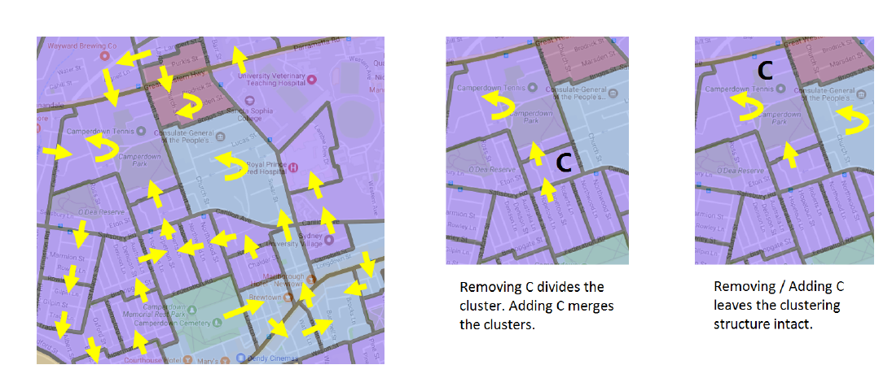
the limit : clustering urban regions with similar functions but far away from each other.
introduce another hierarchy layer (a standard CRP) on top of the ddCRP in which the connected SUSAs generated by the ddCRP are further grouped into clusters.
Notes:
分别考虑空间相似性和功能相似性

Slide 6
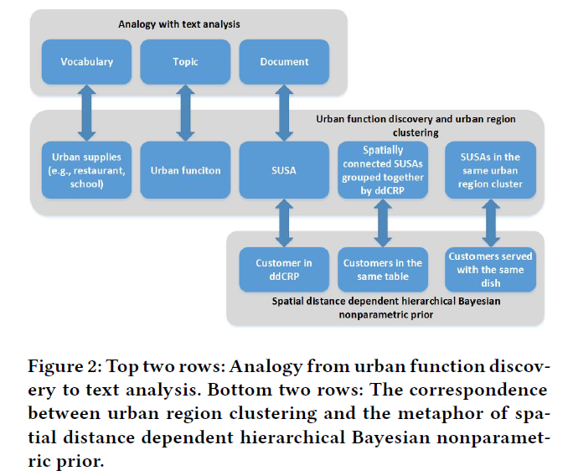
Infinite Urbanization Process Model
A SUSA can only assigned to its adjacent SUSA or itself as we set a = 1 in the decay function f (・).
Because of its nonparametric nature, the IUP model can generate an infinite large number of clusters.

Slide 7

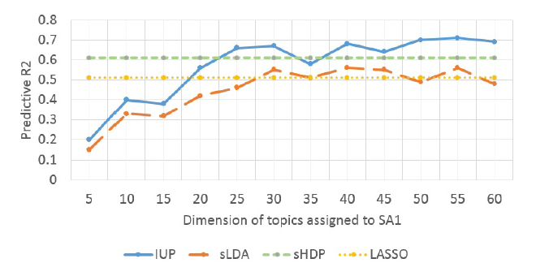
The predictive R2 score is used for measuring the regression performance
Notes:
监督分层LDA L1正则化二乘回归

