Slide 1

Attributed Network Embedding for Learning in a Dynamic Environment

Slide 2
challenge
the inherently correlated network and node attributes could be noisy and incomplete, it necessitates a robust consensus representation to capture their individual properties and correlations
the embedding learning needs to be performed in an online fashion to adapt to the changes accordingly.

Slide 3
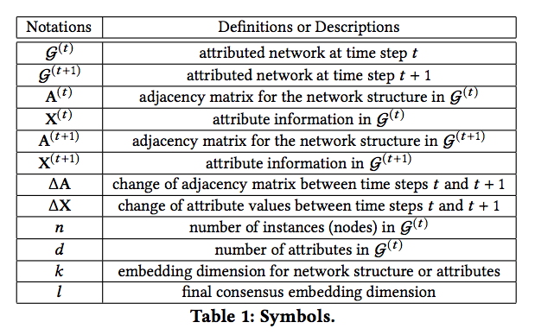
Problem definition

Slide 4


DANE: Offline Model
find a consensus embedding representation

Slide 5
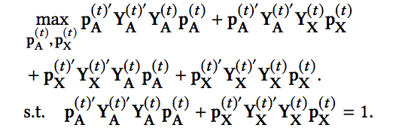
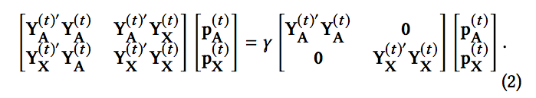

DANE: Offline Model

Slide 6
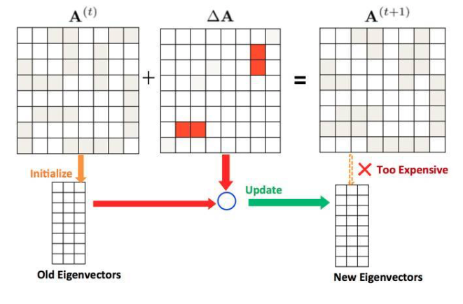
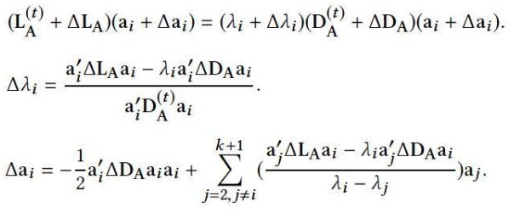
Online Model of DANE

Slide 7
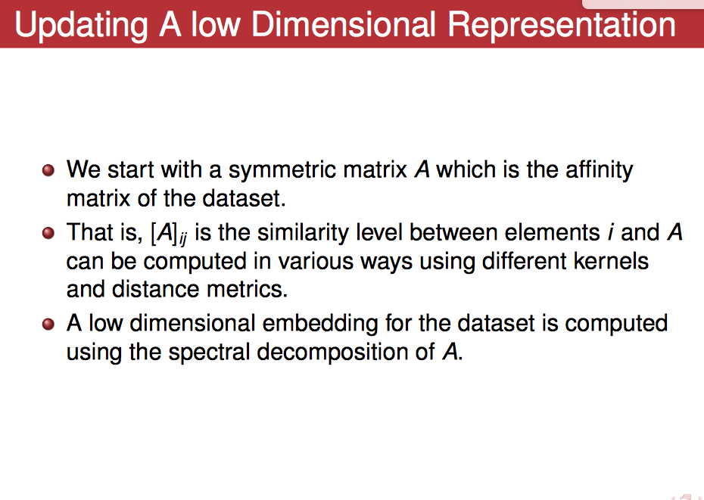

Slide 8
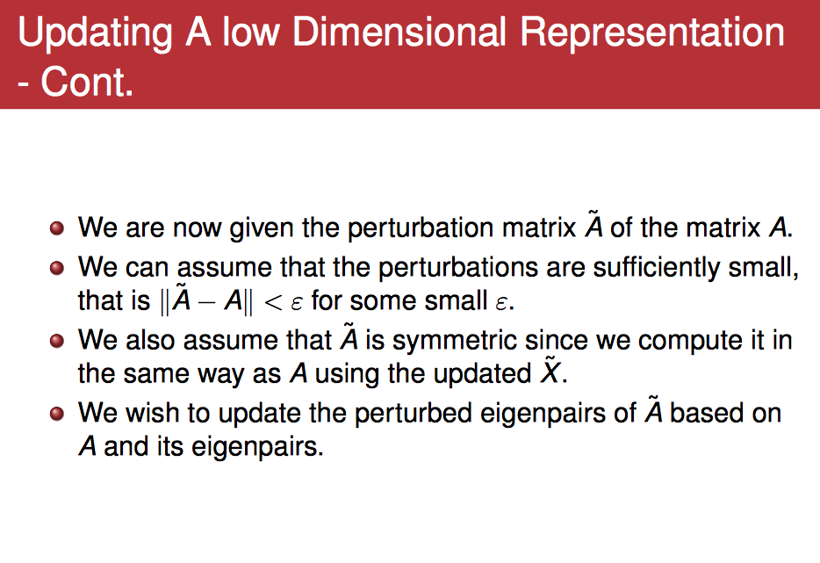

Slide 9
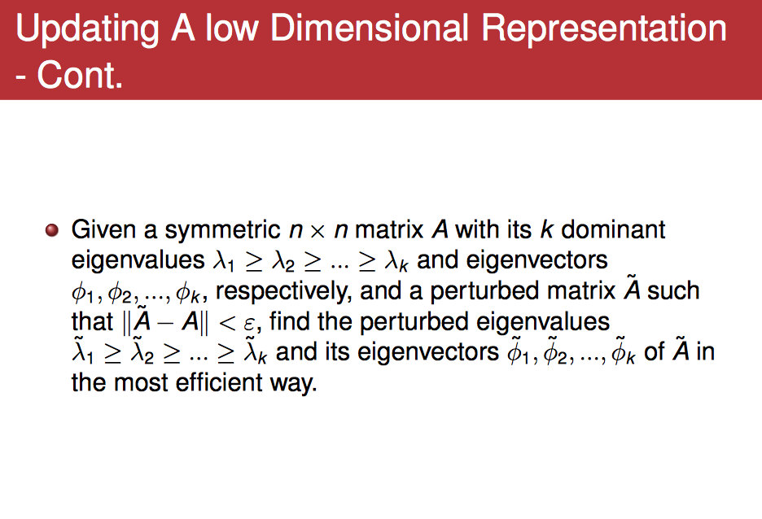

Slide 10
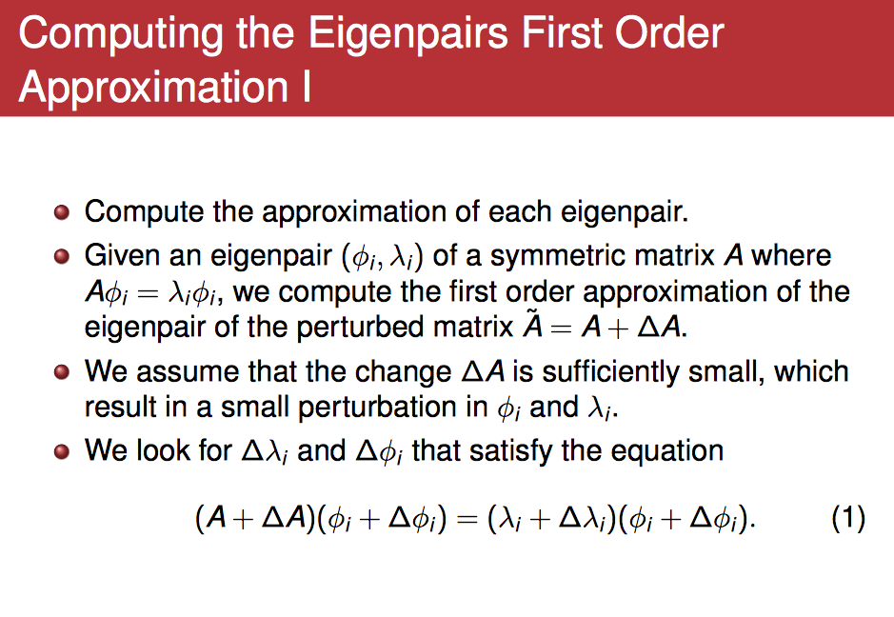

Slide 11
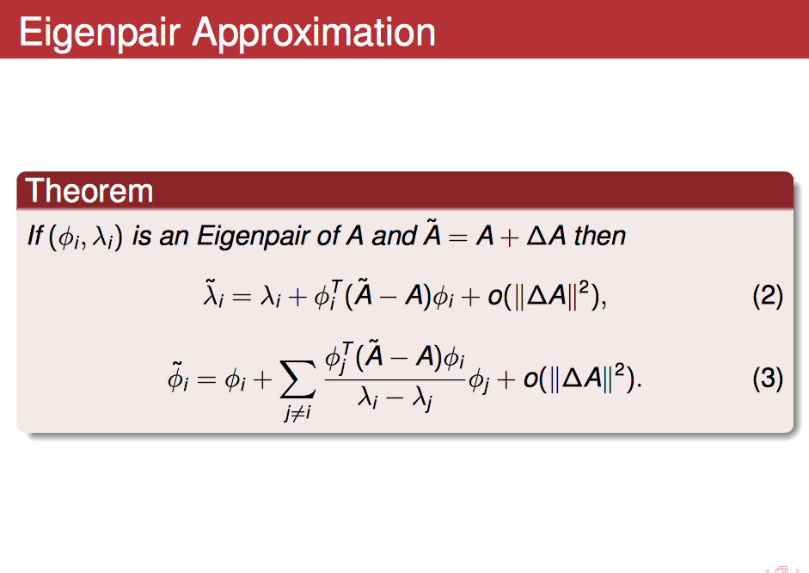

Slide 12
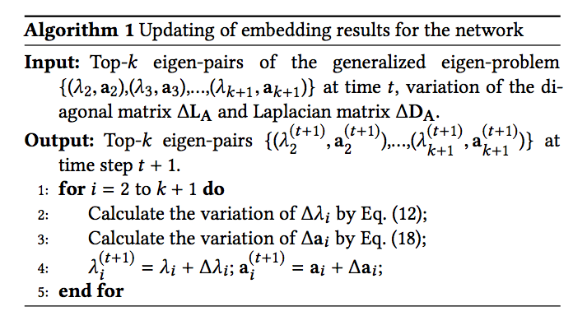
Online Model of DANE

