Slide 1
Lazy Evaluation of Sliding Window Join on Modern Multicores
Shuhao Zhang

Slide 2
Stream Join
GPS signals
Detect Stops
Car stops
Join over the same trip
Accelerometer signals
Join
Potential accident
Detect spikes
Phone shakes
Credit: How Uber Detects on Trip Car Crashes – Nicolas Anderson & Jin Yang, Uber (Flink Forward, Oct, 2019)
Notes:
Nowadays, data are generated fast in the form of streams from multiple places.
Joining multiple data streams is a common task in many applications.
This figure illustrates how Uber detects car accident, presented in Flink Forward, Oct, 2019.
There are several features that strongly correlated to car accident including both the GPS location information and accelerometer sensors.
From the GPS location, we can extract the information where the car stops. But, a car may stop because of red-green-light or simply a dropoff, so a car stop does not directly implies a car accident.
The accelerometer sensor, at the same time, can detect, for example, if there is a sudden shake on your phone.
If we combine both sudden shake of your phone and also car stops, we could infer a potential car accident.
All the aforementioned process have to be conducted in real time, so whenever such a car accident being detected, Uber can immediately send a message to the passenger to query if anything goes wrong and a emergence team will contact the user if something really happens.
In this application, the most critical part is the fast stream joining.

Slide 3
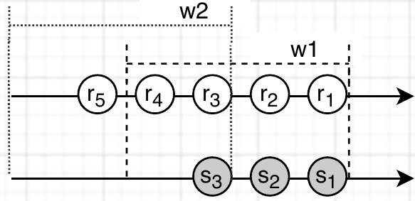
Background: Sliding Window Join
Input Stream R
Input Stream S
Sliding window join: joining over subsets (e.g., w1) of two input stream.
Sliding window join is costly and significant efforts have been spent on accelerating it utilizing hardware parallelism.

Slide 4
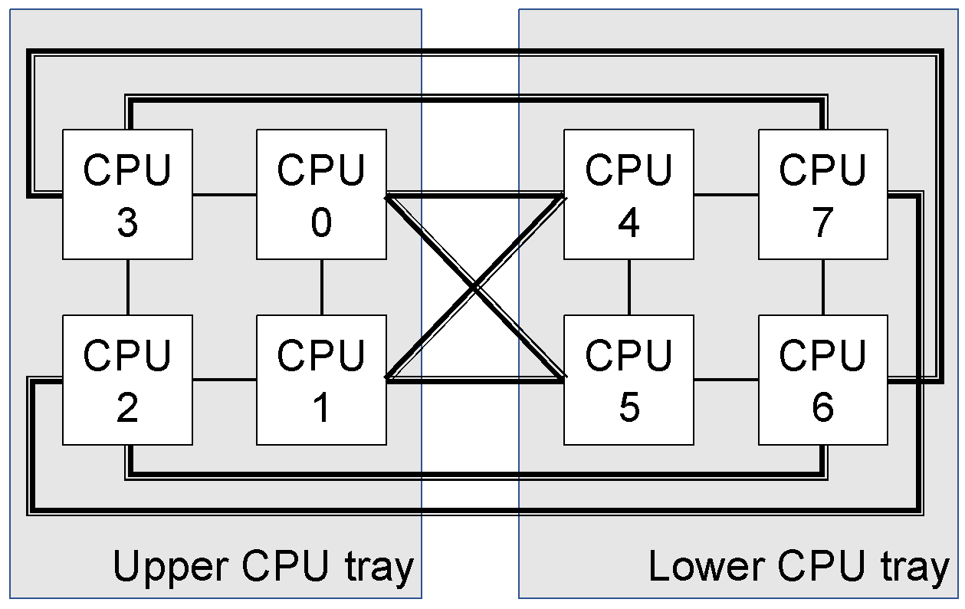
Background: Modern Multicore Processors
HUAWEI KunLun Server;
8 * 18 Cores (w/o HyperThreading)

Slide 5
Research Goal
Goal: achieve ultra-fast sliding-window join processing by better utilizing modern multicore processors
There is a tradeoff between maximizing execution parallelism and maximizing sharing computing among windows

Slide 6
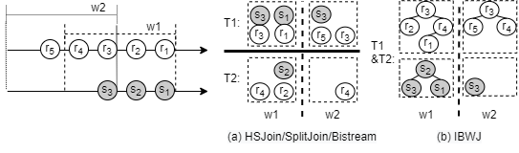
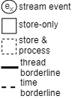
Prior Work
They are all eager incremental Single-Window-based approach:
Frequent state updates involving significant commu./synch. overhead
Eager processing strategy involves severe cache thrashing issues
6
Notes:
Existing sliding window join algorithms such as handshake join, splitjoin, bistream and the recent index-based window join in SIGMOD 2020 are having common features: 1) fine-grained incremental computation and 2) eager distribution and execution.
The fine-grained incremental computation can be costly as we need to constantly update the states.
The eager execution approach is shown to be less effective in our current SIGMOD submission.
6

Slide 7
Existing Solutions Revisited
Significant overhead due to windowing update
Severe cache thrashing issues
A new solution is required!
7
Notes:
7

Slide 8
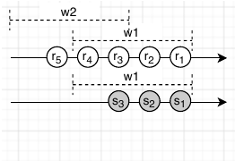
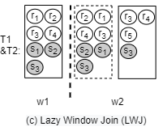
Our Proposal: Lazy Window Join (LWJ)
We adopt lazy incremental Multi-Window-based approach:
Wisely utilize hardware resource for each window with complete set of tuples
Efficiently reuse intermediate results to minimize recomputing overhead
8
Notes:
Motivated by our observations found in our SIGMOD 2021, we should try to leverage on the high execution efficiency of lazy join algorithms, essentially the relational join algorithms to handle sliding window join.
The key spirit is that we should delay the processing of each window so that we can apply data specific optimization before join is applied.
However, naively to do so will end up with high processing latency and potentially many re-computation among overlapping windows.
8

Slide 9
Design Overview
LWJ is achieved by two relatively independent components
Intra-Window Join Processor
Maximize computing efficiency of each window
With a cost-model to guide the parameter configurations
Sliding Window Controller
Minimize overall computing workloads by exploring shared-workloads
With a cost-model to guide number of windows

Slide 10
Intra-Window Join Processor
Key: Applying highly efficient relational join algorithm (e.g., radix parallel join) in processing each window

Slide 11
Sliding Window Controller
Key: Applying efficient lazily update of intermediate states to support subsequent windows’ computing

Slide 12
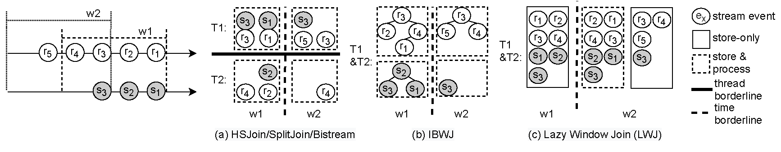
Summary: Lazy Window Join (LWJ)
Algorithm | Incremental Window Execution | Online Distribution Strategy (What) | Data Flow Mechanism (How) | Join Algorithm
HSJoin | Tuple-wise incremental | Eagerly Partition-by-timestamp | Bi-directional flow | Stream Join
SplitJoin/ BiStream | Tuple-wise incremental | Eagerly Partition-by-timestamp | Broadcast | Stream Join
IBWJ | Task-wise incremental | Eagerly Partition-by-key | Shared Index | Stream Join
LWJ | Window-wise incremental | Non-Partition | Shared Input Array | Relational Join (e.g., Parallel Radix Join)
12
Notes:
In this work, we propose a novel algorithm called lazy window join.
The first key feature of it is window-wise incremental computing which minimizes large overhead of maintaining concurrent window updates while still utilizing sharing opportunities between windows.
The second key feature is that we apply lazy join algorithm in handling each window to maximize the execution efficiency on modern multicore processors.
12

Slide 13
Some Remarks
IBWJ is nothing but a parallel-version of SHJ.
Remember to checkout the taxonomy
13
Notes:
13

Slide 14
Plan (6 months)
Based on AlianceDB*, implement HSJoin, SplitJoin and IBWJ. (2 months)
Validate our hypotheses in slide 7. (0.5 month)
Design Intra-Window Join Processor with cost-model to handle each window. (1 month)
Design Sliding Window Controller with cost-model to handle window progress. (1 month)
Put them together and evaluate the LWJ. (1.5 month)
*https://github.com/ShuhaoZhangTony/SlidingWindowJoin

