Slide 1
Dataset Search
Bingsheng He

Slide 2
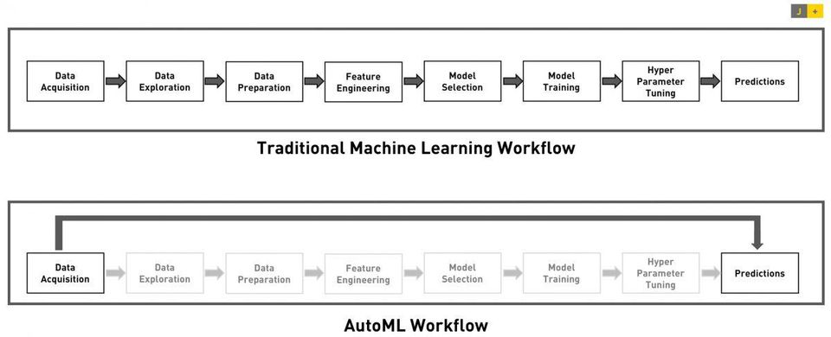
AutoML
Given a dataset and a problem statement (say predicting the fault), AutoML is to automatically search for the model and its hyper parameter settings that generate the best prediction quality.
The search process has two important aspects: The initialization setting and the search algorithm (heuristics).
Initialization setting is very important to a good quality answer in a short time.
Currently, the expert decides the initialization setting.

Slide 3
AutoML
Observation: if two datasets are similar, their AutoML model seems to be similar.
The problem now becomes how to find a similar dataset among a set of datasets?
Chenghui’s work: dataset2vec, and our works vector search.

Slide 4
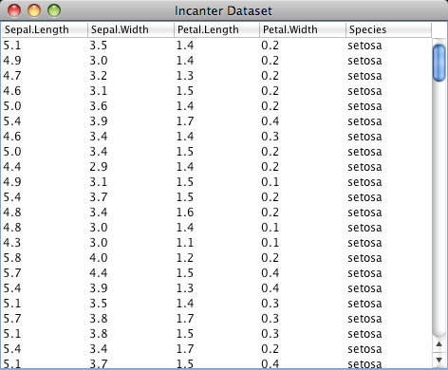
Experimental Studies
We want to verify our models on different datasets
Bigger datasets
Datasets with varying similarities to the local data sets (similar, kind of different, very different etc)

Slide 5
System (Version 1)
Dataset to Vector:
Chenghui’s data meta feature
Dataset2Vec
How to search vector: https://github.com/facebookresearch/faiss

